Slide 1
CSET346 NATURAL LANGUAGE PROCESSING | MILESTONE 1
Detecting Stance in Media on Global Warming for Indic Languages
Favour / Against / None toward one claim, in Hindi and Bengali comments
Sumukh Gupta | S24CSEU0570
B.Tech CSE, Bennett University
Instructor: Dr. Supriya Chanda
Derived from the AISoMe 2026 shared task at FIRE 2026
Notes:
Introduce: project, claim, that the task comes from AISoMe 2026 (English train, Hindi/Bengali test).

Slide 2
1 | PROBLEM IDENTIFICATION
One claim, three labels, Hindi and Bengali comments
“Climate change and global warming is a serious concern.”
Favour
Against
None
Agrees it is a serious concern
Disagrees, minimises, denies
Neutral, off-topic or unclear
Hindi
बहुत ज़रूरी वीडियो। पर्यावरण को बचाना आज की सबसे बड़ी ज़रूरत है।
Hindi
ग्लोबल वार्मिंग सब झूठ है, पहले भी गर्मी पड़ती थी।
Hindi
इसका लिंक कहाँ मिलेगा?
Bengali
খুব দরকারি ভিডিও। পরিবেশ বাঁচানো আজ সবচেয়ে বড় প্রয়োজন।
Bengali
বিশ্ব উষ্ণায়ন সব মিথ্যা, আগেও গরম পড়ত।
Bengali
এর লিংকটা কোথায় পাব?
Examples: team-authored pilot corpus (synthetic, development only). Metric: macro-F1.
Sumukh Gupta | S24CSEU0570 | CSET346 NLP | Milestone 1
2 / 10
Notes:
The claim never appears in the comments. Examples are from our team-authored pilot corpus, not scraped data.

Slide 3
1 | PROBLEM ANALYSIS
Why this is not simple text classification
1 The claim is not in the text
2 Same words, opposite stance
Against, because the claim is about warming:
58.9% of Against vocabulary also appears in Favour (English set).
अगर धरती गरम हो रही है तो इस बार इतनी ठंड क्यों पड़ी? कोई बताएगा? (Against)
वाह भाई, दिसंबर में पंखा चल रहा है, लेकिन जलवायु परिवर्तन तो झूठ है ना? (Favour)
ग्लोबल वार्मिंग सब झूठ है, पहले भी गर्मी पड़ती थी। (Against)
3 Stance is often implicit
4 None is a junk drawer
World knowledge needed; no climate word:
Neutral + off-topic + ambiguous. 215 of 2,300 annotated sentences (9.3%) had no annotator majority.
हमारे गाँव का कुआँ इस साल मई में ही सूख गया, पहले ऐसा कभी नहीं हुआ। (Favour)
भाई आपका माइक बहुत अच्छा है, कौन सा लिया? (None)
Plus: English training data, Hindi/Bengali test data. Examples: pilot corpus (synthetic).
Sumukh Gupta | S24CSEU0570 | CSET346 NLP | Milestone 1
3 / 10
Notes:
Four arguments: external claim, shared vocabulary, implicit stance, heterogeneous None. Stats are measured.

Slide 4
2 | REVIEW OF EXISTING SYSTEMS
What exists, what it reports, why it falls short
Approach | Representative work | Reported result | Limitation for us
Tweet stance, 3 labels | SemEval-2016 Task 6 (Mohammad) | see paper | English; per-target
News-sentence stance | GWSD (Luo et al. 2020) | see paper | English news, not comments
Climate tweets, 6 layers | ClimaConvo (Shiwakoti 2024) | 15,309 rows | IDs only: no text
Multimodal video | MultiClimate (Wang 2024) | acc 0.747, F1 0.749 | English transcripts
Bangla news stance | Dhoroni (Wasi 2024) | acc 0.635, F1 0.308 | News; minority classes weak
Code-mixed Hindi | Swami et al. 2018 | 58.7% accuracy | Target: demonetisation
Same task, translate-train | Squad4, AISoMe 2026 | F1 0.42-0.53 (val 0.65-0.68) | Large val-to-test gap
Squad4: a competing team; only their reported scores are cited. Ours (measured): TF-IDF macro-F1 0.613 on English CV.
Sumukh Gupta | S24CSEU0570 | CSET346 NLP | Milestone 1
4 / 10
Notes:
Numbers are as reported by each source on its own data; not comparable with each other or with ours.

Slide 5
2 | RESEARCH GAP
No resource matches target, language and domain
English labelled data
Resource | Our claim | Hindi / Bengali | Comments
SemEval-2016 climate | Yes | No | Yes
GWSD | Yes | No | No (news)
ClimaConvo | Close | No | Yes, but no text
MultiClimate | Close | No | No (transcripts)
Dhoroni | Close | Bengali | No (news)
Swami 2018 | No (demonetisation) | Romanised Hindi | Yes
AISoMe test (hidden) | Yes | Yes | Yes
GWSD news + SemEval tweets
↓
Hindi / Bengali comments
hidden test: code-mixing, spelling variation, negation, implicit stance
Measured, not assumed: English-trained TF-IDF on the Indic pilot reaches macro-F1 0.341 (floor 0.167) and predicts None for 131 of 150: cross-lingual transfer collapses to majority-class prediction, so in-language data and Indic-specific models are needed. 58.9% of Against vocabulary also appears in Favour: not simple text classification. (Pilot: synthetic, development only.)
Sumukh Gupta | S24CSEU0570 | CSET346 NLP | Milestone 1
5 / 10
Notes:
Headline measured result: English-trained TF-IDF on the Indic pilot gives macro-F1 0.341 and predicts None for 131/150. Gap table: data/DATASET_INVENTORY.md. Pilot is synthetic, development only.

Slide 6
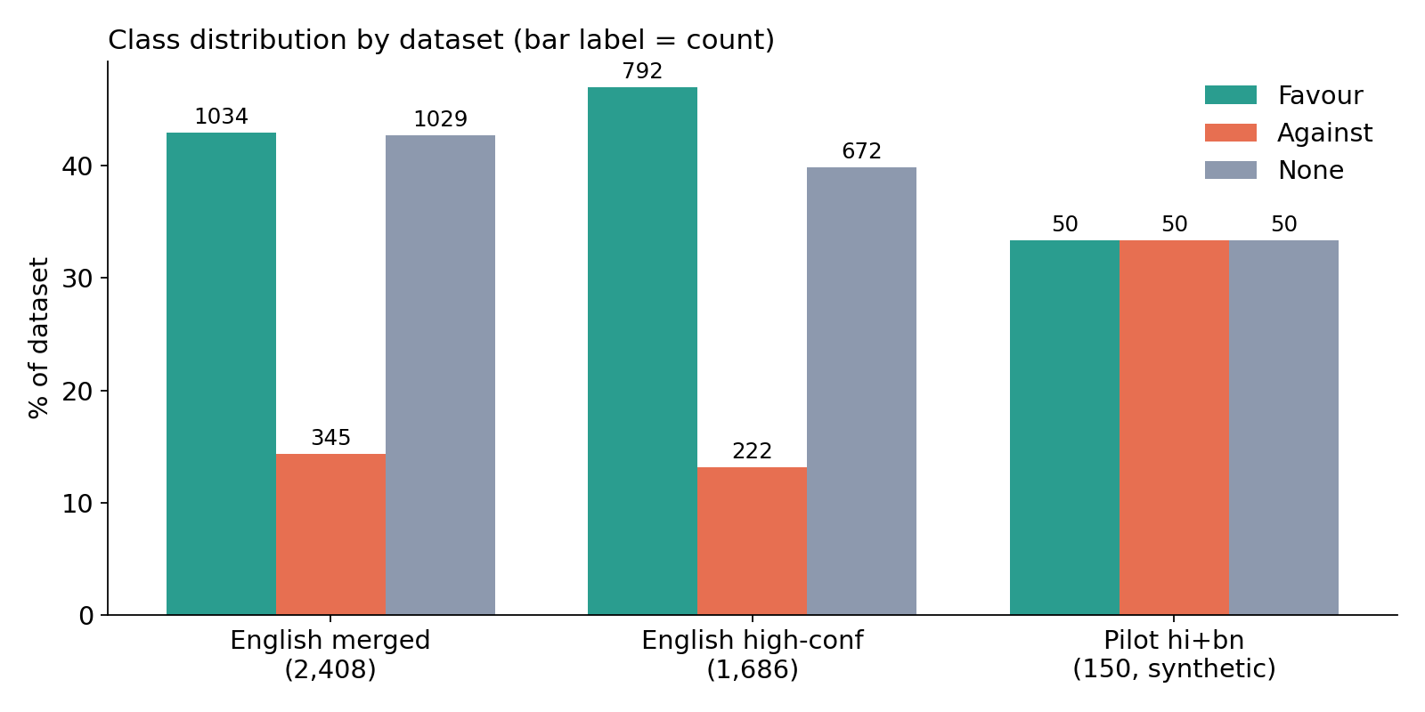
3 | DATASET EXPLORATION AND STATISTICS
What data we actually have
Usable dataset found: PARTIALLY
English merged: 2,408 labelled (GWSD news + SemEval tweets)
Against is rare: 14.3% (SemEval: 26 of 564)
Hapax rate: 54.3% English, 68.4% pilot
Majority floor: macro-F1 0.200
No annotator majority: 215 of 2,300 GWSD (9.3%); 202 remain after dedup, dropped
Median length: 17 words (pilot 10)
Hindi/Bengali: 150 team-authored synthetic comments, development only
Not obtained: official AISoMe data; ClimaConvo text (IDs only). Dhoroni (Bengali news) and Swami (demonetisation) kept out of the training pool.
Sumukh Gupta | S24CSEU0570 | CSET346 NLP | Milestone 1
6 / 10
Notes:
Usable dataset: PARTIALLY. English target-correct data yes; Hindi/Bengali comments only the synthetic pilot.

Slide 7
3 | OBJECTIVES AND METHODOLOGY
Pipeline: clean text to cross-lingual evaluation
1 Understand and measure the task and data honestly
2 Build a reproducible baseline with a floor to beat
3 Design a target-aware multilingual model and a cross-lingual strategy
Preprocess
→
Baselines
→
Target-aware encoder
→
Cross-lingual
→
Evaluate
NFC, noise strip, script ID
TF-IDF word + char, majority floor
MuRIL on claim [SEP] comment
zero-shot vs translate-train
macro-F1, per phenomenon
done
done
written
plan
plan
Models are compared against the floor; the pilot is for development and error analysis only.
Sumukh Gupta | S24CSEU0570 | CSET346 NLP | Milestone 1
7 / 10
Notes:
Green = implemented and run today. Amber = written, not yet run. Grey = planned for Milestone 2.

Slide 8
4 | RELEVANCE OF THE TECHNIQUES
Why each choice, with evidence
Char n-grams (2-5)
MuRIL encoder
Hapax rate 54.3% English, 68.4% pilot: most words seen once. Sub-strings are shared across spellings and Romanised text.
IndicXNLI: MuRIL beats XLM-R, mBERT and IndicBERT on Indic languages; English + Indic training is best. Pretrained with transliterated text.
claim [SEP] comment
Macro-F1 + class weights
Stance is defined relative to the claim, so the model must see both, not just the topic words.
Floor 0.20. Weights: macro-F1 0.56 to 0.61, Against recall 0.25 to 0.54.
Sumukh Gupta | S24CSEU0570 | CSET346 NLP | Milestone 1
8 / 10
Notes:
Char n-grams: hapax rate. MuRIL: IndicXNLI. Pair input: stance is relative to a claim. Macro-F1 + weights: rare Against.

Slide 9
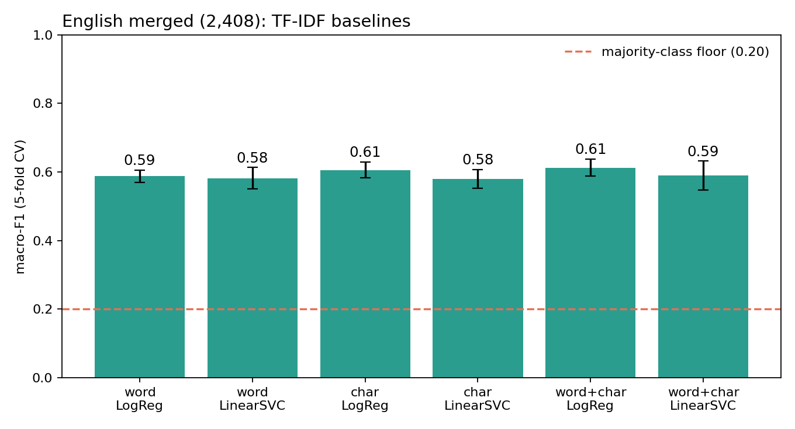
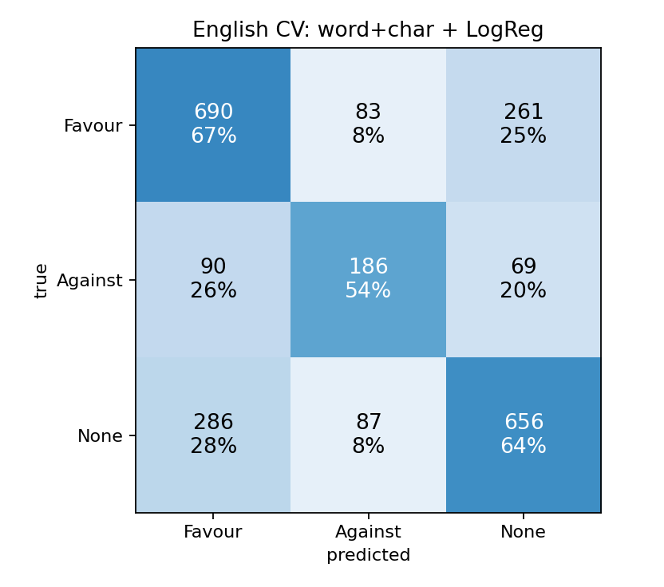
INITIAL IMPLEMENTATION AND PRELIMINARY RESULTS
What runs today
Best (English CV):
word+char LogReg
macro-F1 0.613
floor 0.200
Headline finding: English to Indic zero-shot collapses: macro-F1 0.341 vs floor 0.167, predicting None for 131 of 150 comments. With 58.9% of Against vocabulary also in Favour, this is not simple text classification. (Pilot: synthetic, dev only; not comparable to official results.)
Runs today: loader + validation gate, preprocessing, EDA, TF-IDF baselines, self-checks.
Error analysis: largest confusion is true None predicted Favour (286): factual sentences with no opinion marker. Against recall 0.54.
Sumukh Gupta | S24CSEU0570 | CSET346 NLP | Milestone 1
9 / 10
Notes:
Headline: English-to-Indic zero-shot collapses to majority-class prediction (pilot: synthetic, dev only). English CV numbers are optimistic (no document ids, one hashtag cluster).

Slide 10
2 | FEASIBILITY, RISKS AND NEXT STEPS
Feasible, with known risks
Compute
Risks and mitigation
Milestone 2
Baselines run on a laptop CPU in minutes (done)
Fine-tuning a base-size encoder on short texts: Colab GPU planned
Runtime: not yet measured
Official data not in hand: obtain from the course email; pilot for development only
Against is rare: class weights, macro-F1
Validation-to-test gap: per-phenomenon evaluation
Run MuRIL on claim [SEP] comment (XLM-R as comparison)
Zero-shot vs translate-train vs both
Zero-shot LLM baseline
Swap in official data
Sumukh Gupta | S24CSEU0570 | CSET346 NLP | Milestone 1
10 / 10
Notes:
Biggest risk: validation-to-test gap reported by a peer team (0.65-0.68 to 0.42-0.53).

