Slide 1
Employee Onboarding Summary
  This document summarizes new employee onboarding activity for the current quarter. All departments reported steady intake, with Engineering showing the largest increase in headcount. HR completed compliance training for all new hires within the first two weeks of their start date.
Department Headcount
Department | New Hires | Completed Training | Pending
Engineering | 18 | 16 | 2
Sales | 9 | 9 | 0
Customer Support | 12 | 10 | 2
HR | 3 | 3 | 0
  Two Customer Support hires and two Engineering hires have pending training sessions scheduled for early next month. No onboarding delays have been reported to date.

Slide 2
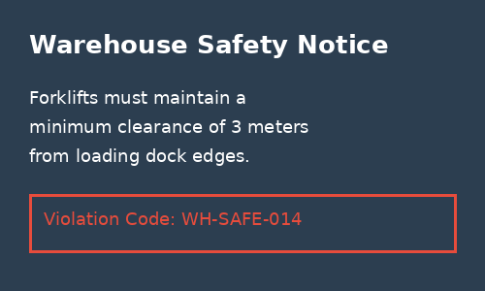
Facility Compliance Notes
  The warehouse safety audit conducted this quarter identified one active violation, shown in the notice below. Facilities management has been notified and corrective signage has been ordered.
Warehouse Safety Notice
  Figure 1: Warehouse safety notice posted at Dock 3
Equipment Inspection Log
Equipment ID | Last Inspected | Status | Next Due
FL-102 | 2026-07-12 | Pass | 2026-10-12
FL-103 | 2026-07-15 | Pass | 2026-10-15
FL-107 | 2026-07-18 | Flagged | 2026-08-01
DK-3-GATE | 2026-08-02 | Pass | 2026-11-02

