Slide 1
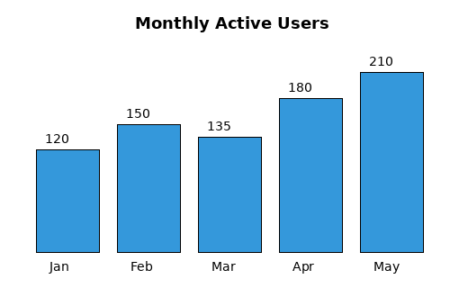
Product Analytics Overview
  This report covers user growth and engagement for the product over the last five months. Monthly active users have grown steadily, with the largest jump occurring between March and April following the release of the mobile app redesign.
Monthly Active Users
  Figure 1: Active users by month, in thousands
  Retention also improved during this period, with week-4 retention rising from 38% in January to 47% in May.

Slide 2
Regional Breakdown
  The table below breaks down active users by region for the most recent month. North America and Europe together account for the majority of the user base.
Region | Active Users | % of Total | MoM Change
North America | 84,200 | 40% | +6%
Europe | 63,500 | 30% | +4%
Asia Pacific | 42,000 | 20% | +9%
Rest of World | 21,000 | 10% | +2%
  Asia Pacific showed the fastest month-over-month growth at 9%, suggesting continued investment in that region is likely to pay off over the next two quarters.

