Slide 1
Quarterly Business Review
Q3 results and Q4 outlook

Slide 2
Highlights
Revenue grew 12% year over year
North region led growth after the August campaign
Customer churn fell to 3.1%
Two new warehouses opened in Pune and Kochi

Slide 3
Regional Sales
Region | Q2 Sales | Q3 Sales | Growth
North | $412,000 | $468,500 | +13.7%
South | $298,000 | $305,200 | +2.4%
West | $355,000 | $389,900 | +9.8%

Slide 4
Sales by Quarter

Slide 5
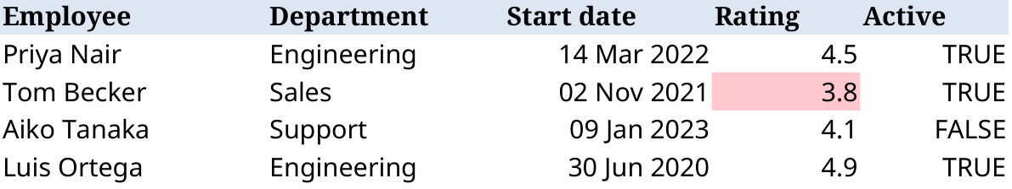
Inventory turnover improved for labels and boxes
Straps and bumpers remain below target and need reorders

Slide 6
Internal notes (hidden)

Slide 7
Next Steps
Hire two analysts before the end of November

