Slide 1
Quarterly Sales Report
  Region totals in USD, all figures unaudited
Region | Q1 | Q2 | Q3 | Q4
North America | $125,000.50 | $134,200.25 | $150,100.00 | $161,500.75
Europe | $98,000.00 | $101,250.50 | $99,000.00 | $120,300.00
Asia Pacific | $76,500.25 | $88,000.00 | $95,250.00 | $110,900.50
Latin America | $31,000.00 | $28,750.75 | $34,500.00 | $39,900.00
Middle East | $22,500.00 | $25,100.00 | $27,800.25 | $30,050.00
Total | $353,000.75 | $377,301.50 | $406,650.25 | $462,651.25
  Note: Q4 includes the holiday campaign.

Slide 2
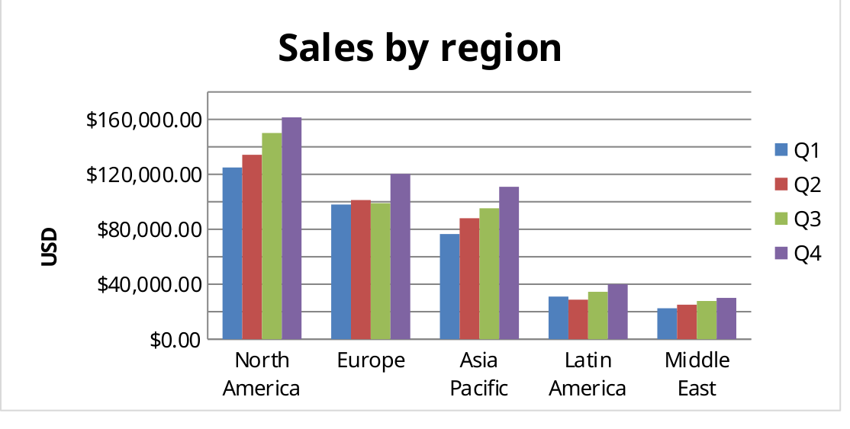
Quarterly Sales Report

Slide 3
Staff
Employee | Department | Start date | Rating | Active
Priya Nair | Engineering | 14 Mar 2022 | 4.5 | TRUE
Tom Becker | Sales | 02 Nov 2021 | 3.8 | TRUE
Aiko Tanaka | Support | 09 Jan 2023 | 4.1 | FALSE
Luis Ortega | Engineering | 30 Jun 2020 | 4.9 | TRUE

