Slide 1
Project Work :
Final ISA(Review 4) / ESA 2020
Project Title Project ID Project Guide Project Team
: Prediction Of Hepatitis and Liver Damage.
: PW20MG02
: Prof. Mahitha G
: 01FB16ECS183 - M Pradeep Kumar
01FB16ECS185 - M Sumukha
01FB16ECS395 - Sreerama Priyanka

Slide 2
Problem Statement
Chronic viral hepatitis is now the second biggest killer after tuberculosis. More than 3600 people die every day in case of the viral hepatitis disease (WHO, 2017). Therefore, this study aims to develop model that can improve the compressiveness of advice provided for the people especially people in remote areas.
Hepatitis B:
prediction of survival of the patient based on clinical report.
Hepatitis C:
predicting the stages of fibrosis.
Liver Damage:
Predicting the liver damage so, they can go for further treatment.

Slide 3
User Profile
To confirm the Hepatitis disease accurately person must undergo liver Biopsy which is invasive procedure, costly, needs expertise and might lead to complications.
Doctor can take actions according to the model result.
Disease can be confirmed without Biopsy.
Dentists are more prone to Hepatitis even they can use this.

Slide 4
Literature Survey
List the papers/references studied
Research Paper:
Title:Adaptive Learning Expert System for Diagnosis and Management of Viral Hepatitis
Link:https://www.researchgate.net/publication/332294787_Adaptive
_Learning_Expert_System_for_Diagnosis_and_Management_of_Viral_
Hepatitis
Authors:Henok Yared Agizew
Dataset –http://archive.ics.uci.edu/ml/datasets/Hepatitis
Methodolgy:This study aims to develop an intelligent expert systems. It is modeled by using decision tree to simulate procedures involved in diagnosis and management of viral hepatitis.

Slide 5
Literature Survey
List the papers/references studied
Research Paper:
Title:Prediction of Liver Fibrosis stages by Machine Learning model.
Link:Authors: Heba Ayeldeen, Olfat Shaker, Ghada Ayeldeen, Khaled.
Dataset:https://archive.ics.uci.edu/ml/datasets/Hepatitis+C+Virus+
%28HCV%29
Methodolgy: Data attributes are classified considering the models
SVM. We have used PCA for feature selection.

Slide 6
List the papers/references studied
Research Paper:
Title: Liver Disease prediction using different Decision tree techniques.
Link:https://aircconline.com/ijdkp/V8N2/8218ijdkp01.pdf
Authors: Nazmun Nahar and Ferdous Ara
Dataset -https://www.kaggle.com/uciml/indian-liver-patient-records
Methodolgy: The study used the dataset from (ILPD) with 583 samples with 10 independent variables and 1 dependent variable and on them classification algorithms are applied.

Slide 7
Proposed Solution
Viral Hepatitis B:
Dataset- UCI- Number of samples: 155
Data Pre-processing – replacing text to number and imputer is
used for missing values
Classification Algorithm: Decision Tree, Gradient Boosting and Random forest.
Hepatitis C:
Dataset: UCI-Number Of samples: 1385
Data Pre-processing:
-> Data attributes are classified by considering the clinical ranges for an attribute.
-> SMOTE Over Sampling Technique is used.
Feature Selection:
-> Dataset: number of features – 30.
-> PCA feature selection and medical research for selection.

Slide 8
Proposed Solution
4. Classification Algorithm
-> Models - Decision Tree, logistic regression, Random forest and SVM.
Liver Damage:
dataset- ILPD- number of samples:583 independent Variables:10, dependent:1
Data Pre-processing
->Imputer is used for missing values
-> SMOTE Over Sampling Technique is used
Classification Algorithm: SVM classifier and Logistic Regression.

Slide 9
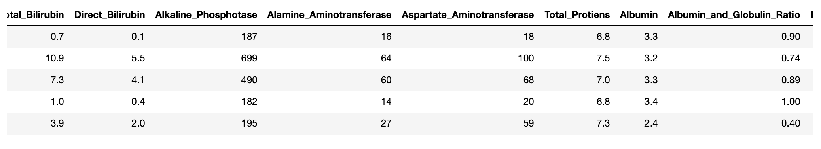
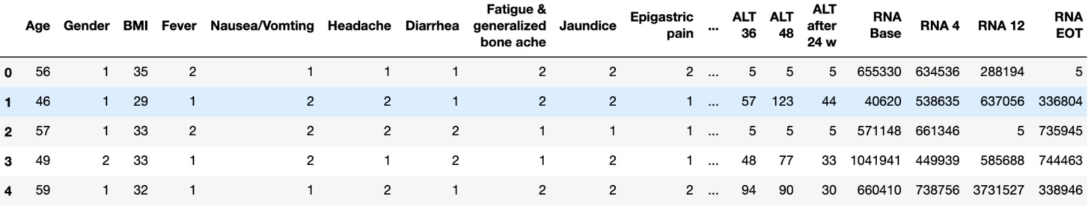
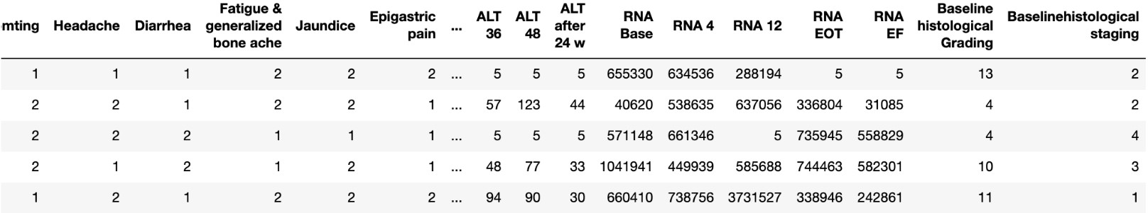
Proposed Solution
Datasets of Liver and Hepatitis C

Slide 10
Proposed Solution
Applying PCA and TruncatedSVD to Hepatitis C
HEPATITIS C – Fibrosis Stages after Pre-processing
Method | Accuracy
SVC ( TruncatedSVD = 15) | 24.18
SVC (PCA=10) | 26.35
Logistic Regression (PCA=10) | 24.18

Slide 11
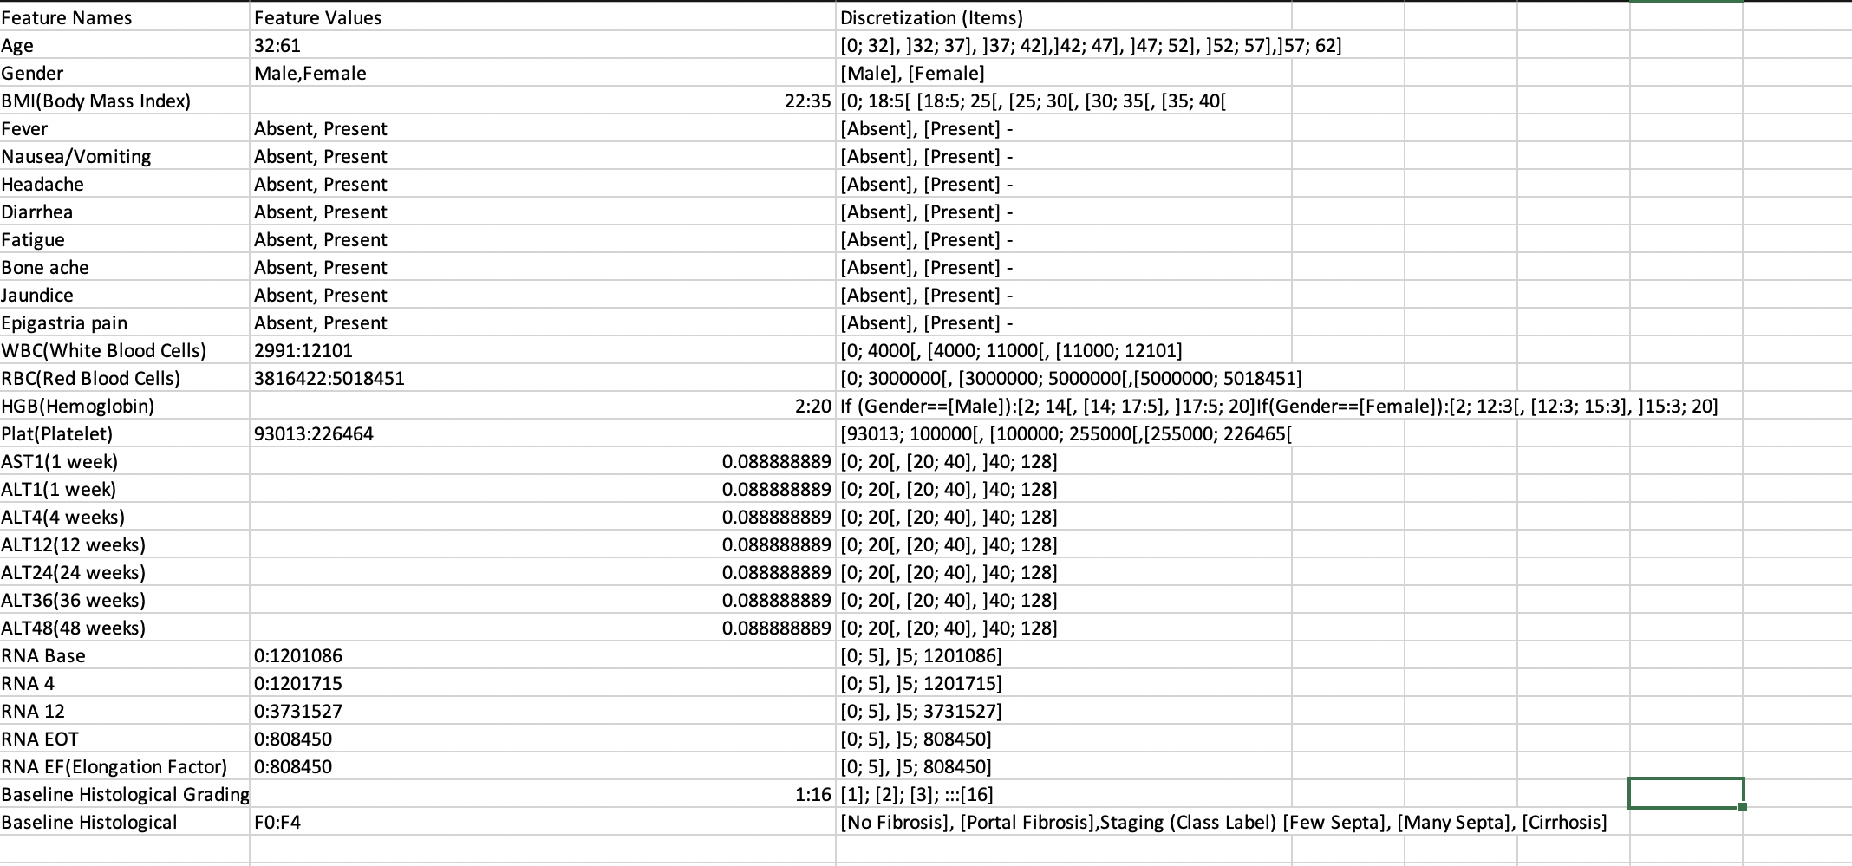
Proposed Solution
Pre-Processing the Hepatitis Data

Slide 12
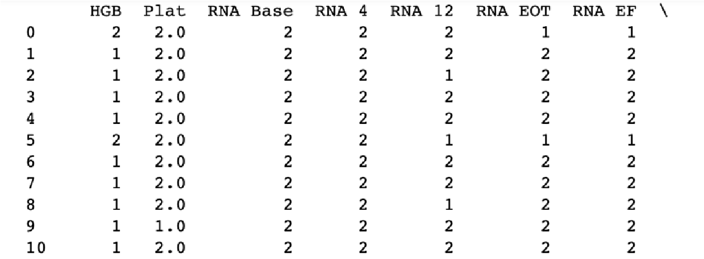
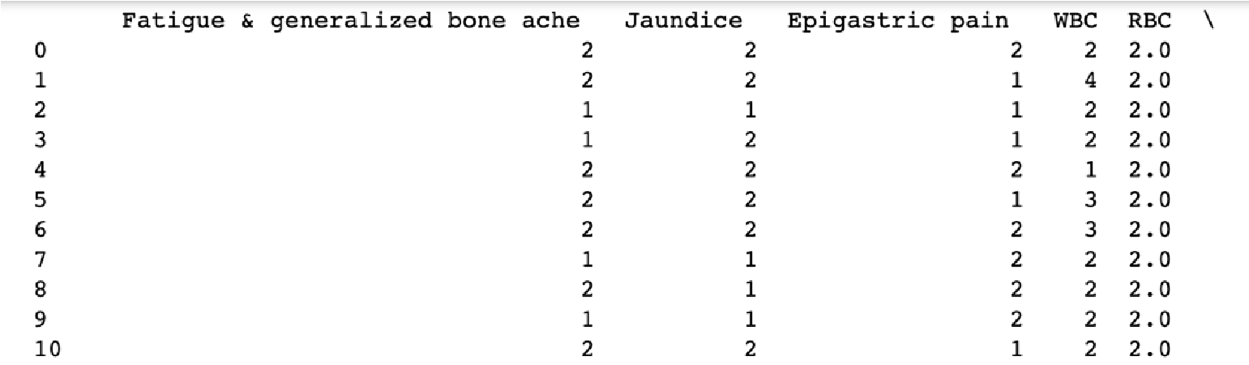
Proposed Solution
After Pre-processing the Hepatitis Data
Decision Tree : 26.21% accuracy

Slide 13
Proposed Solution
By apply SMOTE on Pre-processed Hepatitis Data
Initial no. of samples : 1385
No of samples with each category:
Category one count = 336
Category two count = 332
Category three count = 355
Category four count = 362
By Applying SMOTE : 1448
HEPATITIS C – Fibrosis Stages after Pre-processing
Method | Accuracy
Logistic Regression | 26.89
Random Forest (PCA=15) | 30.00
Decision Treee (RFE=20) | 36.90

Slide 14
Proposed Solution
By apply SMOTE on Pre-processed Hepatitis Data
Initial no. of samples : 1385
No of samples with each category:
Category one count = 336
Category two count = 332
Category three count = 355
Category four count = 362
By Applying SMOTE : 1448
HEPATITIS C – Fibrosis Stages after Pre-processing
Method | Accuracy
Logistic Regression | 26.89
Random Forest (PCA=15) | 30.00
Decision Treee (RFE=20) | 36.90

Slide 15
Proposed Solution
Attributes Like ALT and AST show normal range for Hepatitis C
HEPATITIS C – Fibrosis Stages after Pre-processing
Method | Accuracy
Decision Tree (PCA=14) | 25.63
Random Forest | 28.16
Random Forest (PCA=14) | 28.16

Slide 16
Why Your Solution is Better?
For pre-processing we have not only used machine learning algorithms we have also done medical research for feature selections.
We used real data to test our application.

Slide 17
Technologies / Methodologies
Jupyter Notebook: Analyze Code
Language : Python
HTML/CSS and jQuery: UI visualization
Flask: to run the server in the backend.
AWS EC-2: to Deploy our application.
Software Engineering Approach : Agile Why? : Create goals and distribute work.
Update each team member on the progress and discuss implementation.

Slide 18
Dependencies and Risks
Patient must consult Doctor to know the Diagnosis and further
treatment plan.
Patients must undergo blood tests.
Since our model is probabilistic predictor, doesn’t have 100%
accuracy.

Slide 19
System Architecture
attribute 1
attrib.ute 2
.
.
attribute n
Model
Training set
Testing set
Learning
algorithm
Predictive
model
Predicted outcome

Slide 20

UI/ Use Case
Model
Taking user inputs
<<include>>
Generate
Result
User
Database

Slide 21
Modules
User: User has the lab reports which are sent to the Liver damage predictor.
Database: 583 data samples are trained.
Model: model uses logistic regression and SVM classifier to generate results.

Slide 22
Implementation Details
Data preprocessing: Model cannot understand textual data so replacing missing values using Imputer.
Feature selection: We have applied PCA, SVD, Recursive Feature elimination.
Applying Machine learning models: Random Forest
Decision Tree Gradient Boosting Logistic Regression

Slide 23
Design Approach
What is the design approach followed?
We have followed the Experimental research design approach
Why?
Experimental research design is a powerful design for testing
hypotheses of causal relationship among variables
Benefits of the approach :
The controlled environment in which the study is conducted can yield a greater degree of purity in observation.
Drawbacks of the approach :
It is also difficult to get cooperation from the participants in the
study.

Slide 24
Project Completion
Project Report Status –Ready Project Demo – Fully done
Future work: Currently model predicts based on laboratory test dataset, In future preparing a model which takes both image (Ultrasound scanning of liver) and laboratory test dataset to enhance prediction.

Slide 25
Project Results
LIVER DAMAGE PREDICTION
Method | Accuracy
Logistic Regression | 71.59
SVM | 73.14
Random Forest | 70.29
Smote: Logistic Regression | 73.2
Smote: Radom Forest | 80.4

Slide 26
HEPATITIS B LIVE OR DIE PREDICTION
Method | Accuracy
Random Forest Classifier | 74.19
PCA- 15 attributes, Random Forest | 83.87
Gradient Boosting Classifier | 68
Decision Tree | 61.29
HEPATITIS C – Fibrosis Stages
Method | Accuracy
SVM | 27.8
Random Forest | 32.49
Logistic Regression | 22.18
Decision Tree | 24.18

Slide 27
HEPATITIS C – Fibrosis Stages after Pre-processing
Method | Accuracy
SVM | 27.44
Random Forest | 20.58
Logistic Regression | 22.18
HEPATITIS C – Enzyme and virus count
Method | Accuracy
Logistic Regression (ALT) | 75.45
Logistic Regression (RNA) | 65.34
Decision Tree (ALT) | 66.42
Decision Tree (RNA) | 79.6

Slide 28
Planned Effort Vs Actual Effort
Planned Effort
Topic | Time
Literature Survey and Data Collection | Review 1
Pre processing and feature selection | Review 2
Model development | Review 3
Final Model | Review 4
Actual Effort
Topic | Time
Literature Survey and Data Collection | Review 1
Literature Survey and Pre processing | Review 2
feature selection | Review 3
Final Model Development | Review 4

Slide 29
Lessons Learnt
Learnt things:
-> Working as a team.
->understood importance of domain knowledge to solve a problem.
Challenges faced:
-> Difficulty in acquiring dataset in earlier stage.
-> Algorithms like RFE were time consuming.

Slide 30
Thank You

