Slide 1
echo
by sumukh anand & gagan basandra

Slide 2
elevator pitch
A casual puzzle platformer in which the player uses a combination of strategically placed tiles, dynamic controls, and the ability of cloning to traverse the levels.

Slide 3
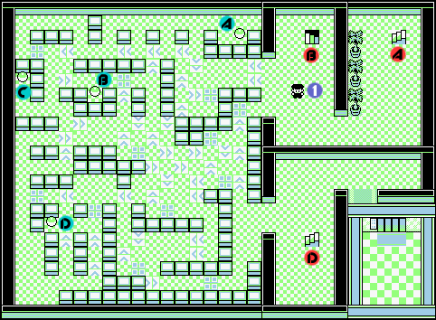
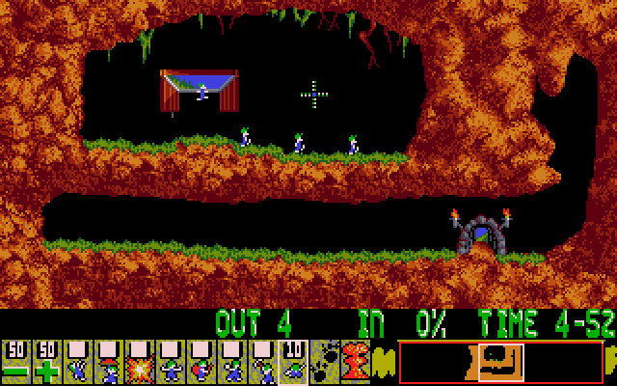
inspiration

Slide 4
mechanics
Directional tiles
Dynamic jumping
Cloning

Slide 5
static objects
Non-movable blocks
Pushable crates
Pressure switches
Destructable barriers
Directional air vents
Etc…

Slide 6
dynamic abilities
Jumping
Cloning
Sliding
Self destruct
Etc…

Slide 7





Slide 8


Slide 11
scoring
Time
Number of clones used
Stars (Angry Birds style)

