Slide 1
Food Ordering Application

Slide 2
Who
Admin
Customers

Slide 3
Where
Booking KIOSK
Admin System
Future Updates
Door-Delivery Service

Slide 4
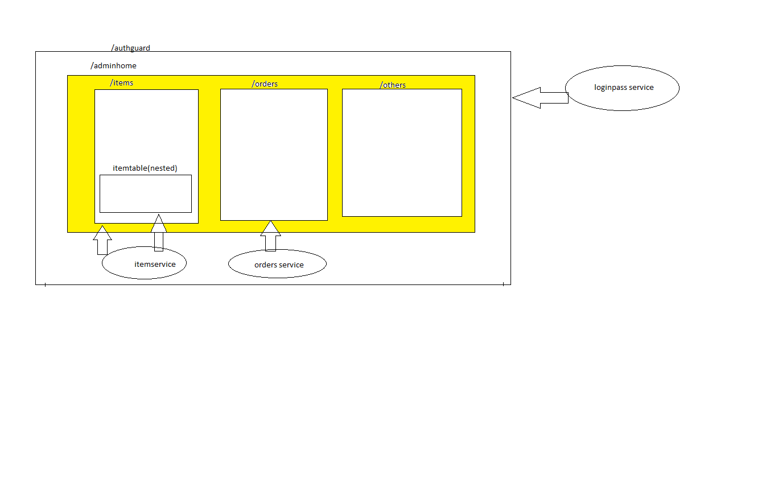
Admin

Slide 5
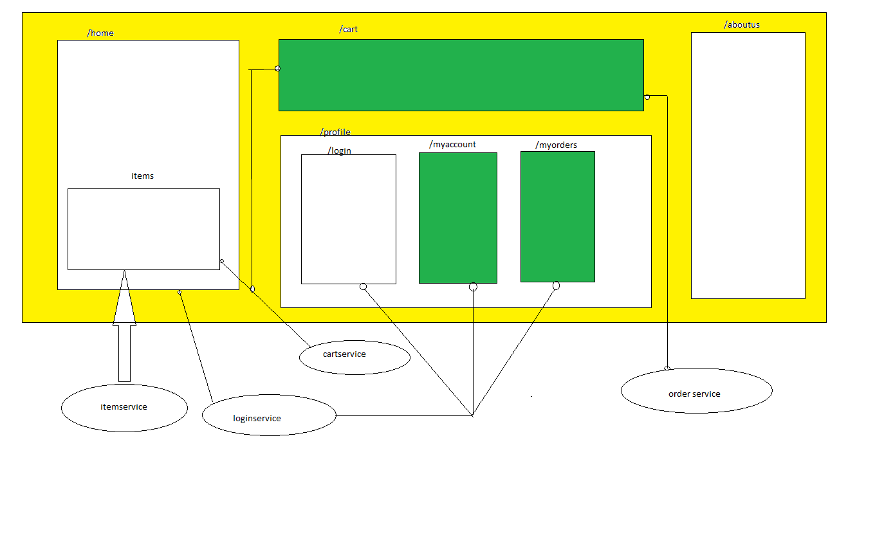
Customer/Regular User

