Slide 1
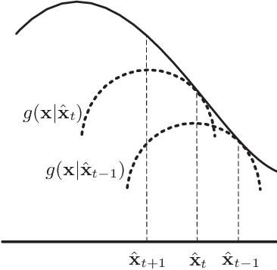

Measure Once, Optimize Twice Trust Regions & Step-Size Restrictions in Policy Gradient Methods
William Ruys

Slide 2
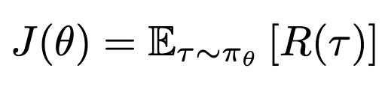
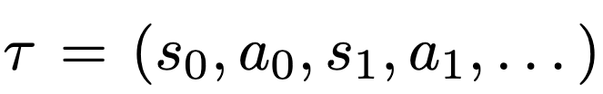
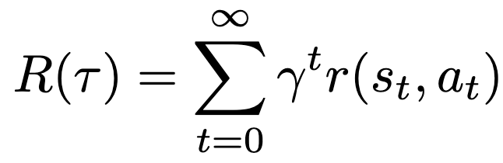
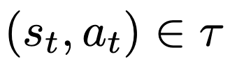

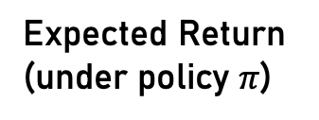


Policy Gradient Methods
Reinforcement learning seeks a policy $π_{θ}$ to maximize the total expected return:
Expected Return (under policy $π$)
Sampled Trajectory (following $π$)
Return of Trajectory
Discounted per-transition reward

Slide 3
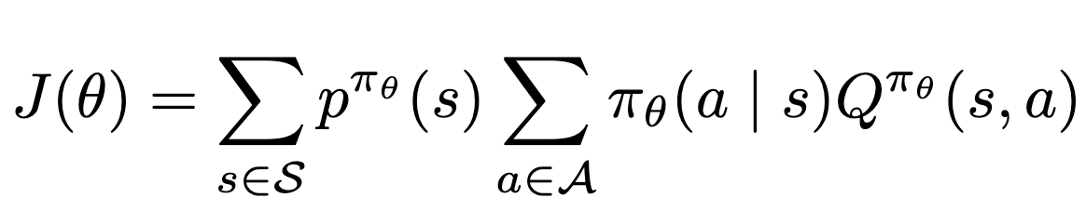




Policy Gradient Methods
Reinforcement learning seeks a policy $π_{θ}$ to maximize the total expected return:
Expected Return (under policy $π$)
State Visitation
Value of Action
Expected Downstream Value (following $π_{θ}$)

Slide 4
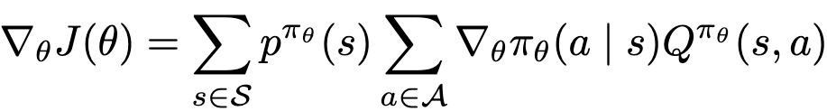

Policy Gradient Methods
Simple approach is to follow the gradient:
Policy Gradient Theorem:
on-policy gradient estimator does not depend on gradient of state-visitation distribution
Notes:
The miracle of the policy gradient theorem is two fold

Slide 5
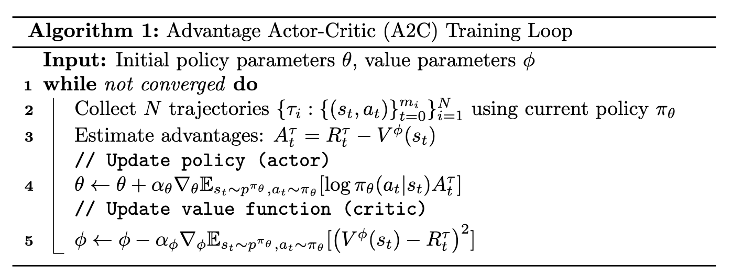

Policy Gradient Methods
Policy Gradient
Predictor of Average Value from
(Baseline / Control Variate)

Slide 6
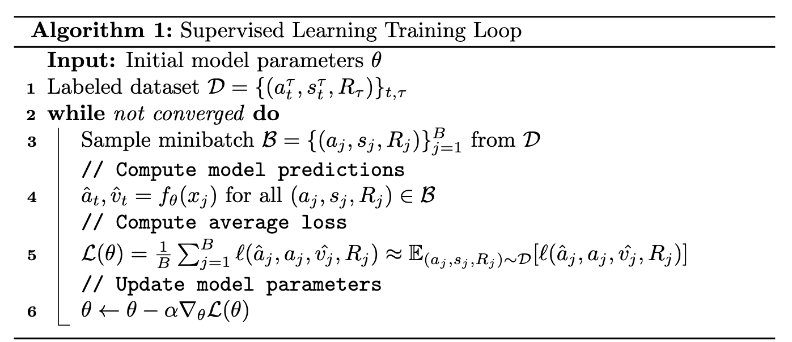
How IS THIS DIFFERENT FROM SUPERVISED LEARNING?

Slide 7

How IS THIS DIFFERENT FROM SUPERVISED LEARNING?
Gradient approximated by minibatches
Full gradient w.r.t $D$ too large/expensive to calculate all at once
Each (state, action, reward) sample is used multiple times
Dataset size “separate” from optimization steps
Dataset does not depend on $θ$
If $π_{θ}$ shifts too much,
some states never resampled
RL has stability concerns

Slide 8
How to ADJUST
Gradient approximated by minibatches
Full gradient w.r.t $D$ too large/expensive to calculate all at once
Each (state, action, reward) sample is used multiple times
Dataset size “separate” from optimization steps
Dataset does not depend on $θ$
If $π_{θ}$ shifts too much,
some states never resampled
RL has stability concerns
Optimize current policy w.r.t samples collected on old policy

Slide 9
How to ADJUST
Gradient approximated by minibatches
Full gradient w.r.t $D$ too large/expensive to calculate all at once
Each (state, action, reward) sample is used multiple times
Dataset size “separate” from optimization steps
Dataset does not depend on $θ$
If $π_{θ}$ shifts too much,
some states never resampled
RL has stability concerns
Optimize current policy w.r.t samples collected on old policy
Requires small policy updates

Slide 10

How to ADJUST
Gradient approximated by minibatches
Full gradient w.r.t $D$ too large/expensive to calculate all at once
Each (state, action, reward) sample is used multiple times
Dataset size “separate” from optimization steps
Dataset does not depend on $θ$
If $π_{θ}$ shifts too much,
some states never resampled
RL has stability concerns
Optimize current policy w.r.t samples collected on old policy
Requires small policy updates
Optimize current policy w.r.t samples collected on external (possibly expert) policy
See: behavioral cloning, offline RL, “An operator view of policy gradient methods” (Ghosh, 2020)

Slide 11
How to ADJUST
Gradient approximated by minibatches
Full gradient w.r.t $D$ too large/expensive to calculate all at once
Each (state, action, reward) sample is used multiple times
Dataset size “separate” from optimization steps
Dataset does not depend on $θ$
If $π_{θ}$ shifts too much,
some states never resampled
RL has stability concerns
Optimize current policy w.r.t samples collected on old policy
Requires small policy updates
Small policy updates help

Slide 12
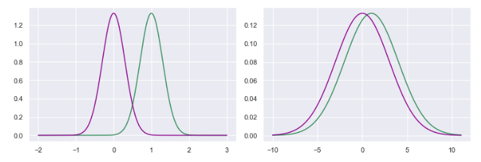


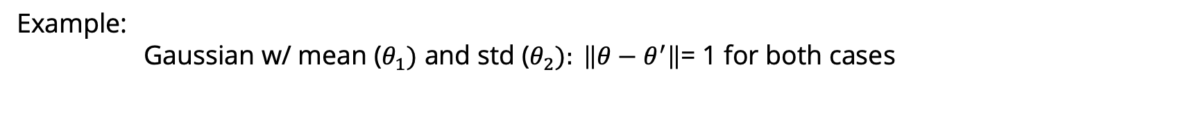
Small parameter steps $!=$small policy updates.
Example: Gaussian w/ mean ($θ_{1})$ and std ($θ_{2}): \left\|θ−θ^{′}\right\|$= 1 for both cases
$$Δμ=1, σ=0.3$$
$$Δμ=1, σ=3$$
Ratio between $π_{θ^{′}}(x)/π_{θ}(x)$ large
Ratio between $π_{θ^{′}}(x)/π_{θ}(x)$ small
Natural Policy Gradients in Reinforcement Learning Explained (Heeswijk, 2022)

Slide 13







What does Sample Reuse mean in RL?
The usual setting:
Samples collected by policy $π_{θ}$, optimize $π_{θ}$toward $π_{θ^{∗}}$:
Optimize:
Gradient expectation w.r.t $π_{θ}$:
Once we step ($θ^{′}=θ+α∇_{θ}J(θ)$), no longer at $π_{θ}$
$$π_{θ^{∗}}$$
Measure & step here
$$π_{θ}$$
$$∇_{θ}J$$
$$π_{θ′}$$

Slide 14


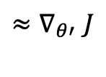


What does Sample Reuse mean in RL?
Old samples collected by policy $π_{θ}$, but we want to keep optimizing $π_{θ′}$:
Optimize:
Gradient:
Requires a change of variable between probability densities
Want to find
$$π_{θ^{∗}}$$
$$π_{θ}$$
$${≈∇}_{θ′}J$$
$$π_{θ′}$$
Measure here
Step from here

Slide 15
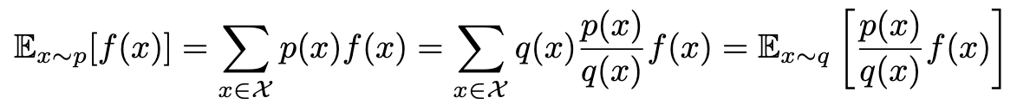

Last Trajectory-Step – Change of Variable
The 1-step return following $π_{θ′}$but sampled from $π_{θ}$:
Given two densities p and q:
r = r(a, s)
…

Slide 16
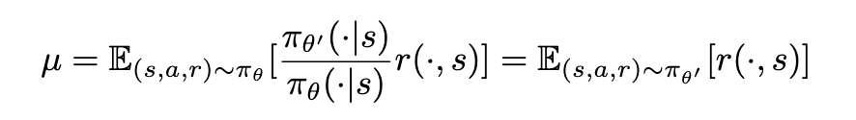
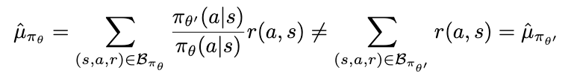
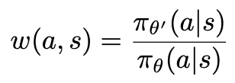
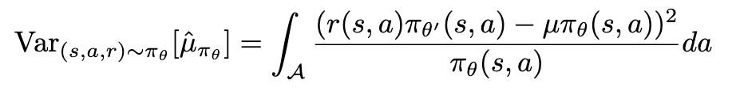


Last Trajectory-Step – Variance
Same population mean, but different estimators
r = r(a, s)
True Mean
…
Sample Mean
Sample batch under $π_{θ}$
Sample batch under $π_{θ′}$
Variance of Sample Mean

Slide 17

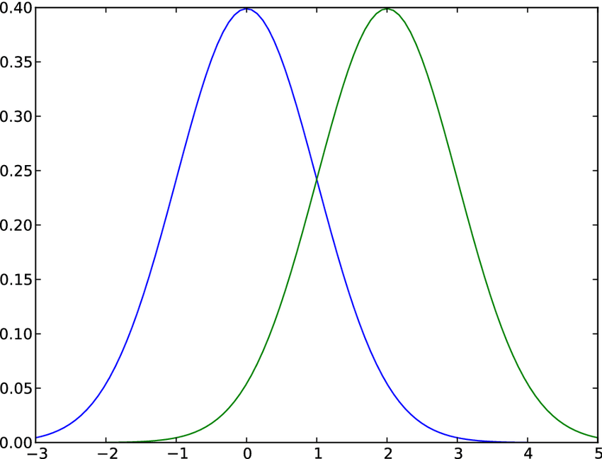


Last Trajectory-Step – Variance
In other applications, change of measure used in variance reduction (importance sampling)
When numerator is small, smaller variance than original mean estimator
But variance explodes when or
$$π_{θ′}$$
$$π_{θ}$$
In our case, not to reduce variance but because we need to.
A policy that shifts too far can lead to terrible approximations

Slide 18

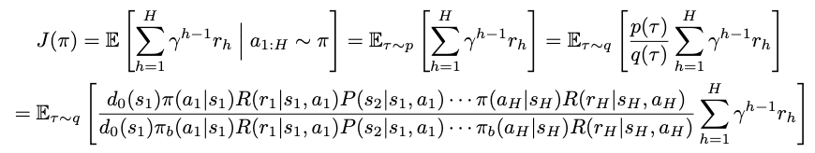

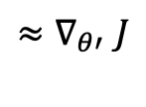
Estimating From Old Trajectories
r = r(a, s)
So far, only 1-step
Measure here
$${≈∇}_{θ′}J$$
$$π_{θ}$$
$$π_{θ′}$$
But we got here from the old policy
Step from here
Change of variable along entire path
Notes on Importance Sampling and Policy Gradient (Jiang, 2023)

Slide 19
Estimating From Old Trajectories
r = r(a, s)
So far, only 1-step
Measure here
$${≈∇}_{θ′}J$$
$$π_{θ}$$
$$π_{θ′}$$
Step from here
But we got here from the old policy
Change of variable along path
Variance can explode (large ratios on path lead to poor estimation)
Notes on Importance Sampling and Policy Gradient (Jiang, 2023)

Slide 20
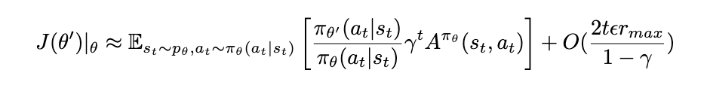


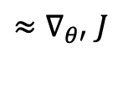



Estimating From Old Trajectories
Measure here
….what if we just ignore that and use a 1-step approximation
Claim: is close to , when is close to
Assume $\left| π_{θ}\left(a_{t}, s_{t}\right)−π_{θ^{′}}\left(a_{t}, s_{t}\right)\right|<ε$,
Different action at each decision chosen with prob at most $ε$
$$\left|p_{θ}\left(s_{t}\right)−p_{θ^{′}}\left(s_{t}\right)\right|=\left(1 −{\left(1−ε\right)}^{t}\right)\left|p_{}\left(s_{t}\right)−p_{θ}\left(s_{t}\right)\right| <2εt$$
The expected return using off-centered measurements at $π_{θ}$
$$π_{θ}$$
$$π_{θ′}$$
$$π_{θ}$$
$${≈∇}_{θ′}J$$
$$π_{θ′}$$
Step from here
Advanced Policy Gradients (Levine, 2020)

Slide 21





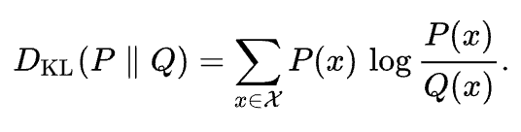

Trust Region Policy Optimization
Measure here
$$π_{θ}$$
$${≈∇}_{θ′}J$$
$$π_{θ′}$$
Step from here
In practice, KL-Divergence is easier to optimize:
Pinsker’s Inequality:
Advanced Policy Gradients (Levine, 2020)

Slide 22




Trust REGION POLICY OPTIMIZATION
Gradient steps can be split by minibatches
Each sample can be used multiple times
If $π_{θ}$ shifts too much, some states never resampled
Optimize current policy w.r.t samples collected on old policy
Require small policy updates
$$π_{θ}$$
$$π_{θ′}$$

Slide 23

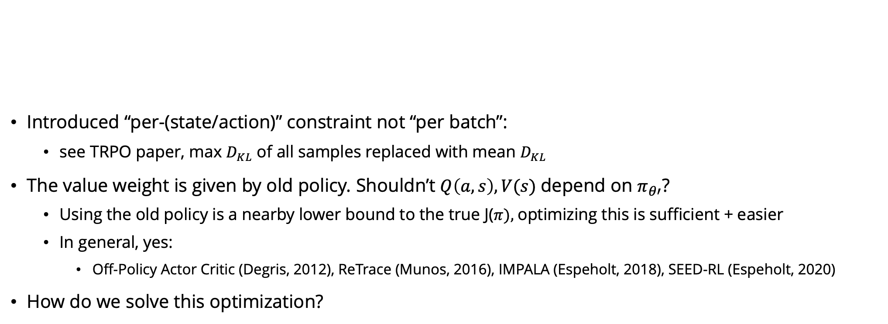
But WAIT…
Introduced “per-(state/action)” constraint not “per batch”:
see TRPO paper, max $D_{KL}$ of all samples replaced with mean $D_{KL}$
The value weight is given by old policy. Shouldn’t $Q\left(a, s\right), V(s)$depend on $π_{θ′}$?
Using the old policy is a nearby lower bound to the true J($π),$optimizing this is sufficient + easier
In general, yes:
Off-Policy Actor Critic (Degris, 2012), ReTrace (Munos, 2016), IMPALA (Espeholt, 2018), SEED-RL (Espeholt, 2020)
How do we solve this optimization?

Slide 24
But WAIT…
Introduced “per-(state/action)” constraint not “per batch”:
see TRPO paper, max $D_{KL}$ of all samples replaced with mean $D_{KL}$
The value weight is given by old policy. Shouldn’t $Q\left(a, s\right), V(s)$depend on $π_{θ′}$?
Using the old policy is a nearby lower bound to the true J($π),$optimizing this is sufficient + easier
In general, yes:
Off-Policy Actor Critic (Degris, 2012), ReTrace (Munos, 2016), IMPALA (Espeholt, 2018), SEED-RL (Espeholt, 2020)
How do we solve this optimization?

Slide 25

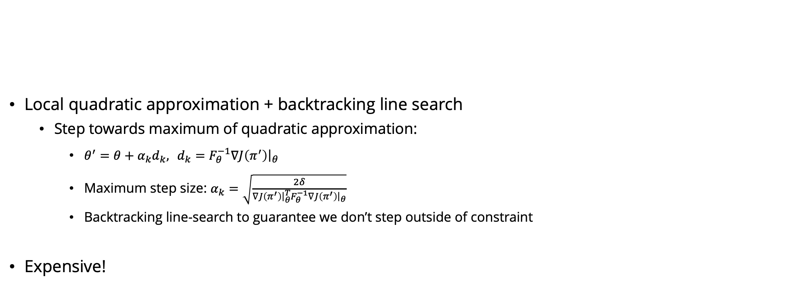
How DO we SOLVE THIS?
Local quadratic approximation + backtracking line search
Step towards maximum of quadratic approximation:
$θ^{′}=θ+α_{k}d_{k}, d_{k}=F_{θ}^{−1}∇J\left(π^{′}\right){\left.​\right|}_{θ}$
Maximum step size: $α_{k}=\sqrt{\frac{2δ}{∇J\left(π^{′}\right){\left.​\right|}_{θ}^{T}F_{θ}^{−1}∇J\left(π^{′}\right){\left.​\right|}_{θ}}}$
Backtracking line-search to guarantee we don’t step outside of constraint
Expensive!
See:
Newton’s Method
Quasi-Newton / CG-Newton
Natural Gradient Methods

Slide 26
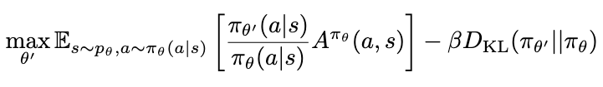
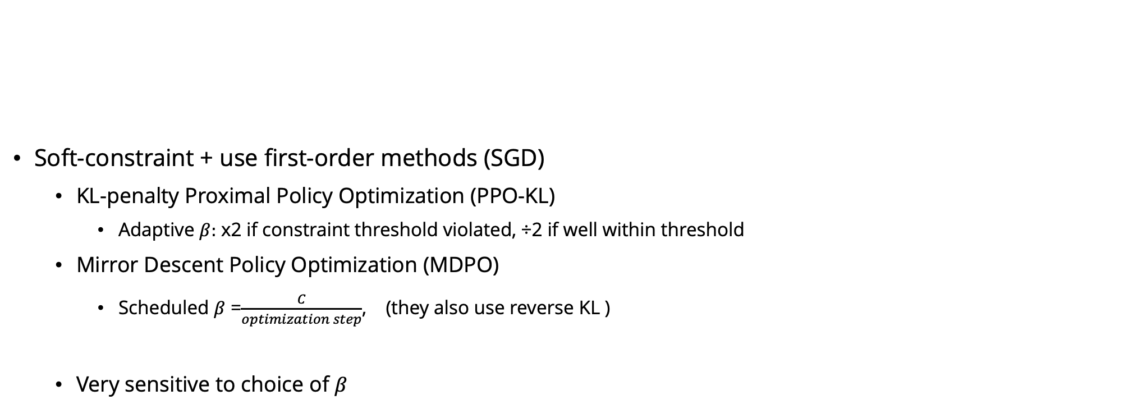
Are there CHEAPER Approximations?
Soft-constraint + use first-order methods (SGD)
KL-penalty Proximal Policy Optimization (PPO-KL)
Adaptive $β:$ x2 if constraint threshold violated, ÷2 if well within threshold
Mirror Descent Policy Optimization (MDPO)
Scheduled $β$ =$\frac{C}{optimization step}$, (they also use reverse KL )
Very sensitive to choice of $β$

Slide 27
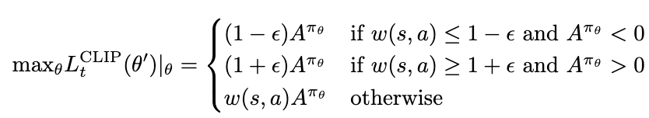

Are there EVEN CHEAPER ROBUST Approximations?
Clipped Proximal Policy Optimization (PPO)
Modify objective function to ”discourage” steps far from trust region

Slide 28







Are there EVEN CHEAPER Approximations?
Clipped Proximal Policy Optimization (PPO)
Per-Sample Gradient:
Direction of Increasing perf
Direction of Increasing perf
$$π_{θ′′}$$
Allows steps that bring policy OUTSIDE of threshold
Restricts steps that can be taken once outside
$$π_{θ′}$$
Nearby ratio = step freely
$$π_{θ′}$$
$$π_{θ}$$
$$π_{θ}$$

Slide 29








When Can Policies outside the THRESHOLD MAKE STEPS
Four cases:
Observed a good action Already have high likelihood
Shouldn’t increase it too much
Observed a bad action Already have low likelihood
Shouldn’t decrease it too much
Direction of Increasing perf
$$π_{θ′}$$
$$π_{θ′}$$
$$π_{θ}$$
$$π_{θ}$$
$$π_{θ′}$$
$$π_{θ′}$$
Observed a good action, have low likelihood Could increase likelihood more
Observed a bad action, have high likelihood Could decrease likelihood more
Steps that:
- Increase w(s, a)
- Increase perf
Steps that:
- Decrease w(s, a)
- Increase perf

Slide 30
When Can Policies outside the THRESHOLD MAKE STEPS
Four cases:
Observed a good action Already have high likelihood
Shouldn’t increase it too much
Observed a bad action Already have low likelihood
Shouldn’t decrease it too much
Direction of Increasing perf
$$π_{θ′}$$
$$π_{θ′}$$
$$π_{θ}$$
$$π_{θ}$$
$$π_{θ′}$$
$$π_{θ′}$$
Observed a good action, have low likelihood Could increase likelihood more
Observed a bad action, have high likelihood Could decrease likelihood more
Steps that:
- Increase w(s, a)
- Increase perf
Steps that:
- Decrease w(s, a)
- Increase perf

Slide 31


PROXIMAL POLICY OPTIMIZATION: HEALTH MONITORING
PPO is not even a “soft constraint” optimization -> important to monitor trust region and stability
Two common metrics:
Clip Fraction -- what percentage of samples fall outside of the trust region after a step
Effective Sample Size (ESS) – IS estimator ratios, error behaves as if “ESS%” less samples were taken
$π_{θ}$ is recentered every 16 batch steps

Slide 32
“Truly Proximal Policy Gradient”
Wang, He (2020)
Allow small backtracking steps outside the trust region
Performs similarly to PPO in practice
Observed a good action Already have high likelihood
Shouldn’t increase it too much
Observed a bad action Already have low likelihood
Shouldn’t decrease it too much
Direction of Increasing perf
$$π_{θ′}$$
$$π_{θ}$$
$$π_{θ}$$
Observed a bad action, have high likelihood Could decrease likelihood more
Observed a good action, have low likelihood Could increase likelihood more
Steps that:
- Increase w(s, a)
- Increase perf
Steps that:
- Decrease w(s, a)
- Increase perf

Slide 33
So FAR
Introduced “old sample” corrections to the policy network update
Requires taking small steps (in “policy space”) to ensure low variance & accurate approximations
What about corrections update to the Value/Critic/Baseline network?
In general, value network is “less sensitive” to using old samples than the policy network
Phasic Policy Gradient (Cobbe, Schulman, 2020) –different number of steps for each / different update frequency
But, yes, it requires a similar correction when samples may be “much” older

Slide 34


IMPALA
“Scalable Distributed Deep-RL with Importance Weighted Actor-Learner Architectures”
Designed for high-throughput in a distributed setting
Samples collected asynchronously from workers, may be several updates out of sync

Slide 35


IMPALA
Samples may be several updates out of sync
Need state distribution correction to N-step Temporal Difference (TD) Target
N-step Temporal Difference (TD) Value Target:
Network Parameter updates in direction of:

Slide 36


state distribution correction
To reduce variance blowup, IMPALA applies truncated IS estimators:
N-step Temporal Difference (TD) Value Target:
(Ionides, 2008) - Original
(Liang, Fu, 2025) – New Bias Bounds

Slide 37


IMPALA: Performance
V-Trace: TD(n) w/ t-IS correction
1-Step: TD(1) w/ t-IS correction
$ε$: TD(1) w/ $\frac{π_{θ}′}{π_{θ}+ε}$IS correction
1-Step correction seems effective

