Slide 1
CYBERFOX SOCIETY · FINAL PROJECT REPORT
CyberFox
AI-Assisted Security Event Detection
A defensive prototype that validates logs, ranks alerts and explains every one.
2,000 events
12 alerts
46 automated tests
Sumyia Butt · CyberFox Society Cybersecurity R&D Internship
October 2026

Slide 2
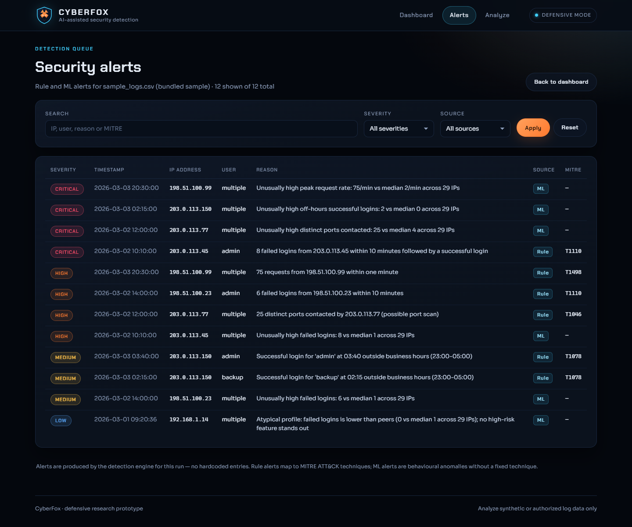
01 · THE PROBLEM
Triage is the bottleneck.
A small team collects more events than it can review by hand, and four behaviours hide inside one flat CSV.
01
Repeated failed logins
5+ failures in 10 min; Critical on success. T1110.
02
Port sweeps and request floods
15+ distinct ports or 60+ requests per minute from one IP. T1046 / T1498.
03
Access outside business hours
Successful login between 23:00 and 05:00 from an unusual context. T1078.
Goal: one ranked queue, every alert explained.
Alerts page · bundled sample · rule and ML alerts in one queue

Slide 3
02 · HOW IT WORKS
One pipeline, two independent detectors.
01
Validate
Well-formed rows only; rejected rows carry line numbers and reasons.
DETECTION LOGIC
Every threshold is visible in code and documented in the README.
02
Detect
Brute force
T1110
Four window rules and an Isolation Forest score the same events.
5+ failures in 10 min; Critical on success.
03
Correlate
Port scan
T1046
Merge alerts, mark events suspicious, assign severity and MITRE.
15+ distinct ports from one source IP.
Request flood
T1498
04
Store
60+ events from one IP in one minute.
SQLite keeps runs, events, alerts and rejected rows.
Off-hours login
T1078
Successful login between 23:00 and 05:00.
05
Present
Isolation Forest
ML SCORE
Flask serves the dashboard, alert queue and upload analysis.
IP features · 200 trees · scores rescaled 0–100.

Slide 4
03 · RESULTS · BUNDLED SYNTHETIC DATASET
Perfect recall, imperfect precision.
2,000
117
12
173
events analysed
malicious rows · 5.9%
alerts raised
events flagged · 8.65%
DETECTOR SCORES VS LABEL
ALERTS BY SEVERITY · 12 TOTAL
Rules
Isolation Forest
PRECISION
RECALL
F1
PRECISION
RECALL
F1
1.000
1.000
1.000
0.676
1.000
0.807
Critical 4
High 4
TP 117 · FP 0 · FN 0
TP 117 · FP 56 · FN 0
Medium 3
Low 1
Combined matches ML: P 0.676 · R 1.000 · F1 0.807
Synthetic caveat: the attacks were generated to match these thresholds, so 1.000 is a sanity check. ML adds 56 false-positive events from one unusual benign host.
6 alerts from rules and 6 from the model. 173 events marked suspicious.
ML severity comes from a 0–100 relative score.

Slide 5
04 · CONCLUSION
Working prototype, honest limits.
DELIVERED
NEXT STEPS
End to end: validation, detection, storage, dashboard and upload analysis.
Live data: connect an authorised log source and replay history.
Real logic: every alert comes from rules and the model, nothing hardcoded.
Tuning: adjust thresholds with analyst feedback.
Real metrics: every number comes from the project's evaluation script.
Workflow: alert acknowledgement and case notes.
Tested: 46 automated tests, 10 MB upload cap, escaped output.
Production: authentication, CSRF protection and hosting.
GITHUB REPOSITORY
Source, README, tests and evaluation script
github.com/your-username/cyberfox

