Slide 1

HR EMPLOYEE
ATTRITION ANALYSIS
Understanding employee attrition trends, patterns and key workforce factors
Portfolio Project

Slide 2
Executive Summary
A concise view of the workforce and attrition picture
Total Employees
Employees Left
Active Employees
Attrition Rate
1,470
237
1,233
16.12%
Key findings from the dashboard
• Research & Development has the highest number of employee exits among the three departments shown.
• The largest visible attrition group is the 26–35 age band.
• Male employees account for 150 of the 237 recorded exits; female employees account for 87.
• Work-Life Balance score 3 has the highest number of exits in the dashboard.
• OverTime, job role and income band are included as interactive dimensions for deeper investigation.
HR Employee Attrition Analysis
2

Slide 3
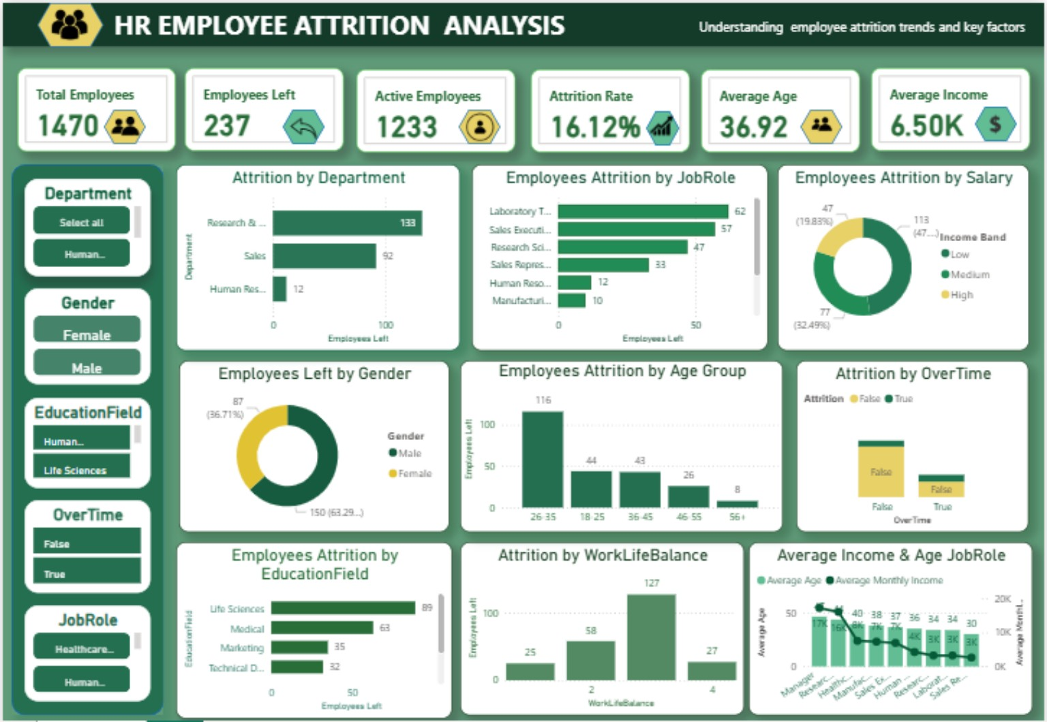
Dashboard Overview
Interactive Power BI dashboard used for exploration and filtering
HR Employee Attrition Analysis
3

Slide 4
Attrition by Department
Employee exits are concentrated in Research & Development and Sales
Research & Development
133
Sales
92
Human Resources
12
Insight: R&D records the highest number of exits, followed by Sales. HR has substantially fewer exits.
HR Employee Attrition Analysis
4

Slide 5
Attrition by Role & Income
Role-level concentration helps identify where retention pressure is highest
Top visible job-role exits
Laboratory Technician
62
Income perspective
Sales Executive
57
Average Monthly Income
Research Scientist
47
6.50K
Sales Representative
33
Income bands are available in the dashboard to compare attrition across Low, Medium and High salary groups.
Human Resources
12
Manufacturing Director
10
HR Employee Attrition Analysis
5

Slide 6
Demographic & Work-Life Patterns
Attrition varies across age, gender and work-life balance groups
Average Age
Male Exits
Female Exits
36.92
150
87
Exits by age group
Exits by work-life balance
127
26–35
116
18–25
44
58
36–45
43
25
27
46–55
26
56+
8
1
2
3
4
Work-Life Balance score 3 is the largest visible exit group.
HR Employee Attrition Analysis
6

Slide 7
Business Questions Answered
The dashboard was designed around practical HR decision-making questions
Workforce size
Attrition
How many employees are in the organization?
How many employees left and what is the attrition rate?
Department
Role
Which department records the most exits?
Which job roles show the highest attrition counts?
Demographics
Compensation
How does attrition vary by gender and age group?
How does attrition differ across income bands?
OverTime
Work-life balance
Is attrition concentrated among employees working overtime?
Which work-life balance group has the most exits?
HR Employee Attrition Analysis
7

Slide 8
Recommendations
Practical actions suggested by the observed attrition patterns
1
Prioritize retention in R&D and Sales
Review workload, manager support, career progression and role-specific turnover patterns in the highest-exit departments.
2
Investigate high-exit job roles
Use role-level analysis to identify positions with unusually high exits and compare tenure, overtime and compensation.
3
Review overtime exposure
Assess whether overtime-heavy employees have higher attrition and consider workload balancing or scheduling interventions.
4
Strengthen career and work-life support
The visible work-life balance distribution suggests a useful area for targeted retention and employee-engagement initiatives.
HR Employee Attrition Analysis
8

Slide 9
Methodology & Tools
End-to-end workflow
01
02
03
04
Data source
SQL Server
Power BI
Insights
IBM HR Analytics Employee Attrition dataset 1,470 employees • 35 columns
Data validation, duplicate checks, missing-value checks and business analysis
DAX measures, interactive slicers, KPIs and dashboard visualizations
Translate patterns into practical HR retention questions and actions
Project outcome: a reusable HR analytics dashboard for workforce monitoring and retention-focused exploration.
Thank you
HR Employee Attrition Analysis

