Slide 1

Consensus Phylogenetic Tree Study
Huangqingbo Sun
02604 Course Project, Fall 2020

Slide 2
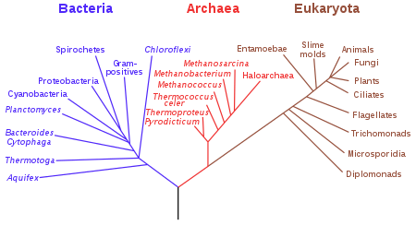
Evolutionary Tree
Evolutionary tree utilizes the tree structure to demonstrate the evolutionary relationships among various biological species.
There are different ways to construct evolutionary trees. In this study, we consider:
1. Maximum Likelihood Tree
2. Maximum Parsimony Tree
3. Minimum Evolution Tree
4. Neighbor-Joining Tree
5. UPGMA Tree
Can we construct a tree that ensemble the information from trees constructed from different ways?
Figure credit: Wikipedia

Slide 3
Consensus Tree
Consensus tree is a summary of the agreement among a set of fundamental trees.
2 Scenarios:
Different data sets same taxa (different sequence segments, different characters of species)
Results from different tree construction algorithms
3 Consensus Methods:
Strict Consensus (Nelson 1979, Sokal & Rohlf 1981)
Consensus n-Trees (Margush & McMorris 1981)
Adam's Consensus (Adams 1972, McMorris et al. 1982)

Slide 4
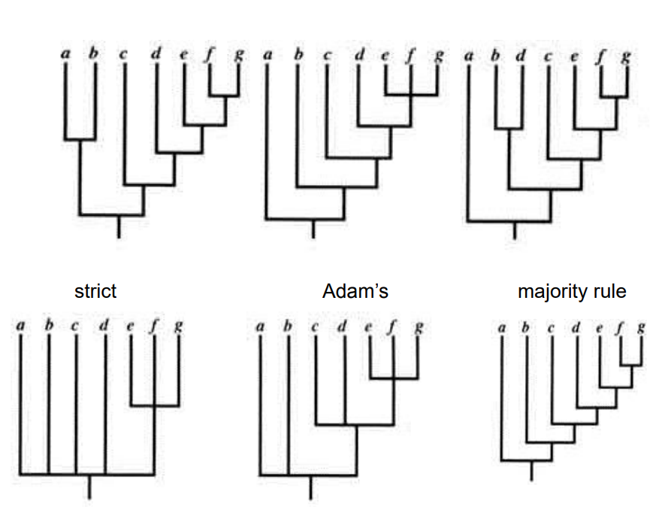
Consensus Tree
The following results are shown with consensus trees constructed by majority rule, since the “strict” and “Adam’s” approach are too conservative in practice.
Credit: Quicke 1993, Principles and Techniques of Contemporary Taxonomy

Slide 5
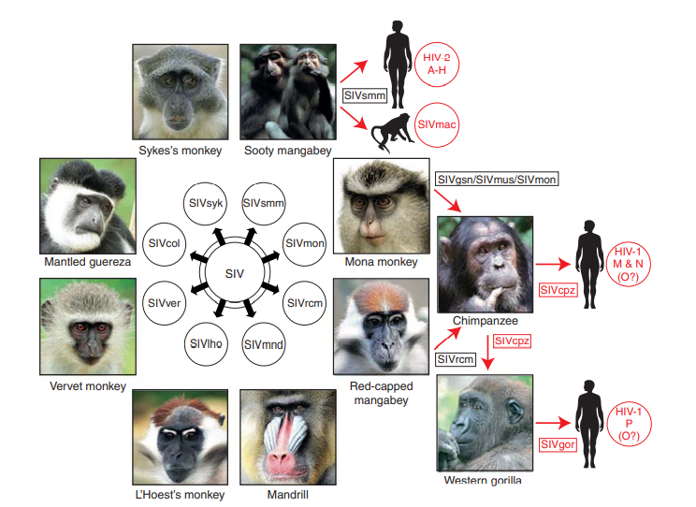
Data-HIV/SIV Part
1. HIV, SIV full sequences
Virus Species
SIVsmm | SIVmon
SIVrcm | SIVmnd
SIVsyk | SIVgor
SIVgsn | SIVagm
SIVdeb | SIVden
SIVwrc | HIV2
SIVagmVer | SIVcpzGAB2
SIVcpzMB897 | SIVagi
HIV1

Slide 6
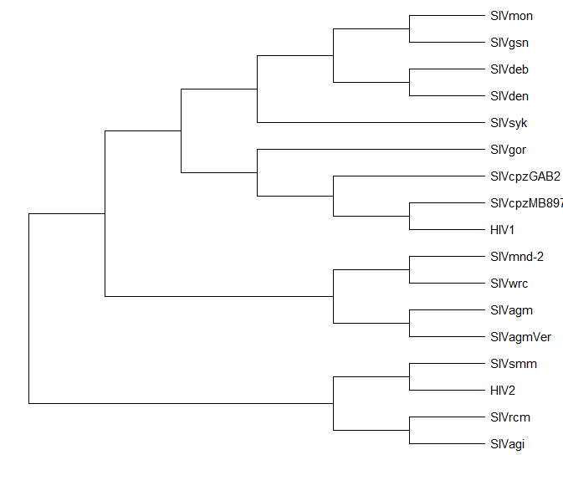
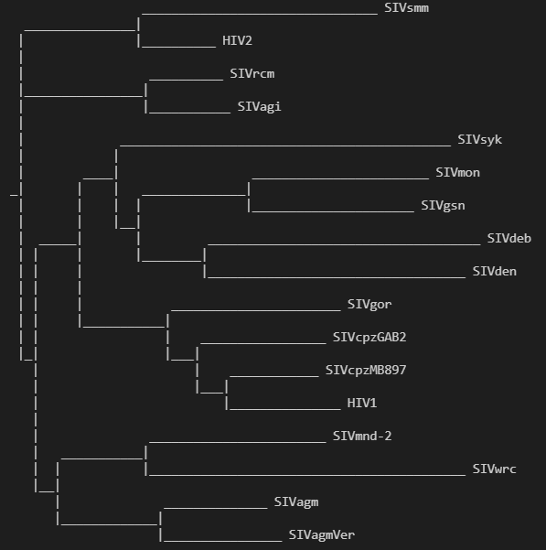
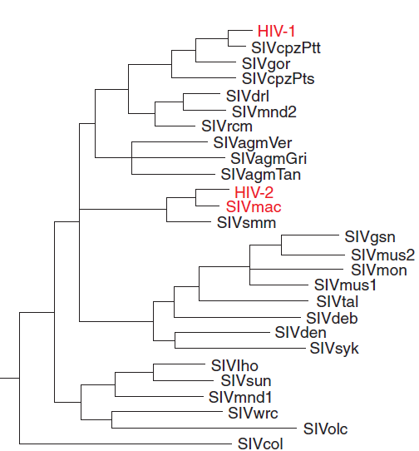
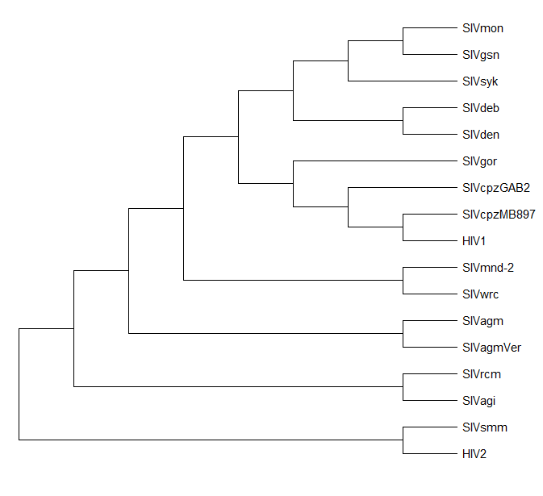
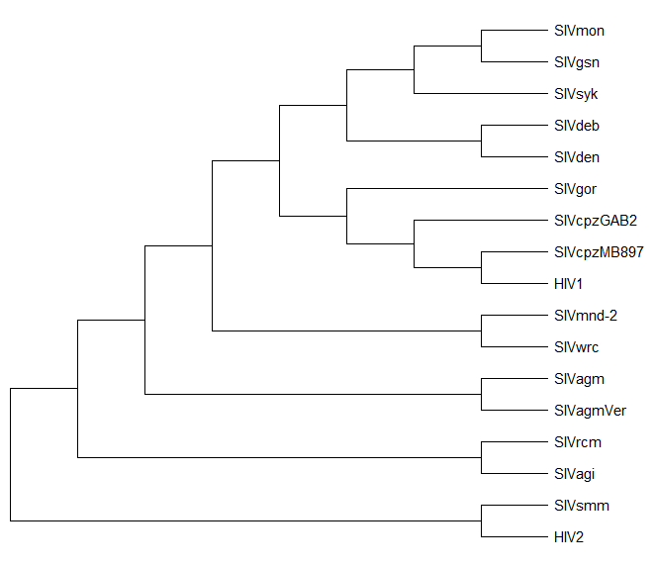
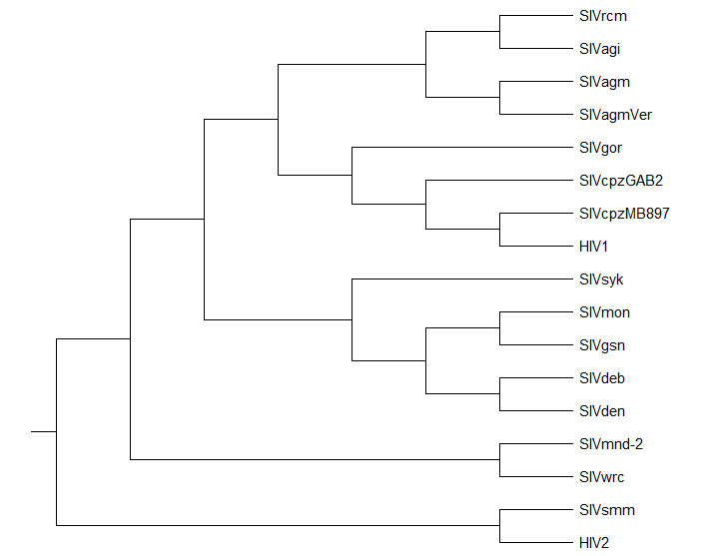
Results-HIV/SIV Part
Majority Consensus Tree (Our Result)
Result from Published Research [1]

Slide 7
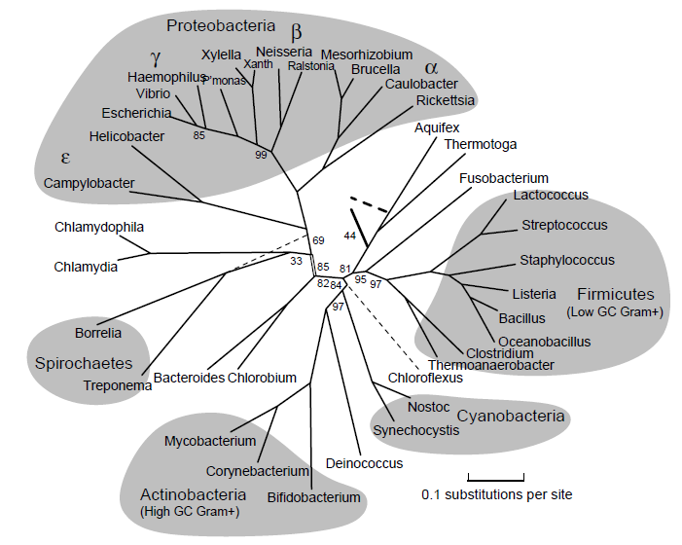
Data-Bacteria rRNA Part
2. Bacteria 5S, 16S and 23S Ribosome RNA sequences
Bacteria Species
Borrelia |  | Caulobacter
Chlamydophila |  | Escherichia
Geobacter |  | Haemophilus
Helicobacter |  | Neisseria
Pasteurella |  | Pseudomonas
Ralstonia |  | Rickettsia
Shewanella |  | Vibrio cholerae
Vibrio parahaemolyticus |  | Xanthomonas
Yersinia
Image credit: [2]

Slide 8
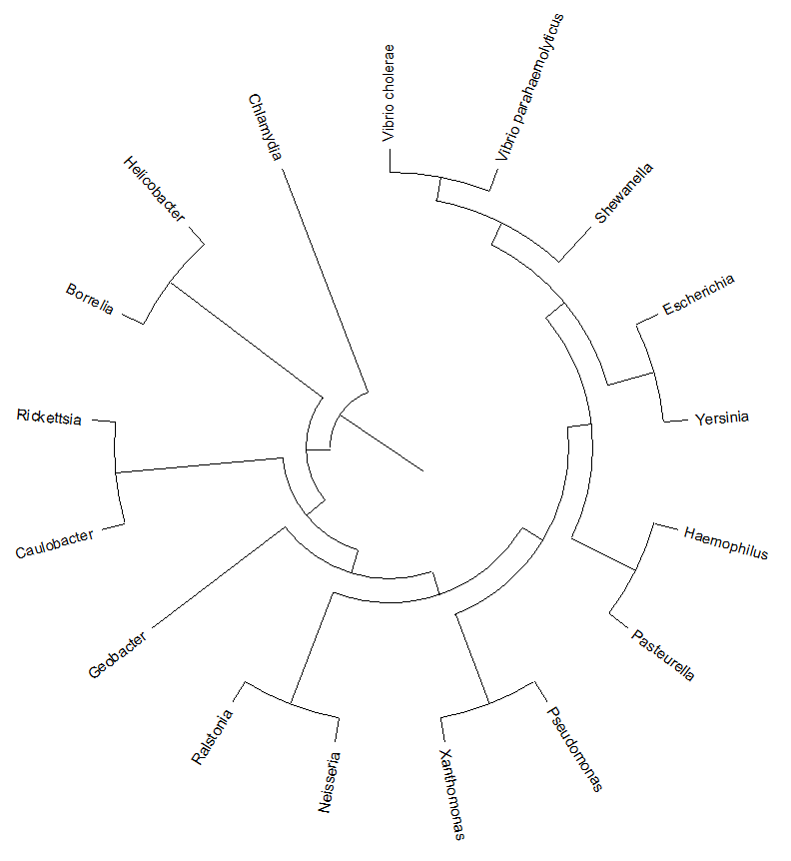
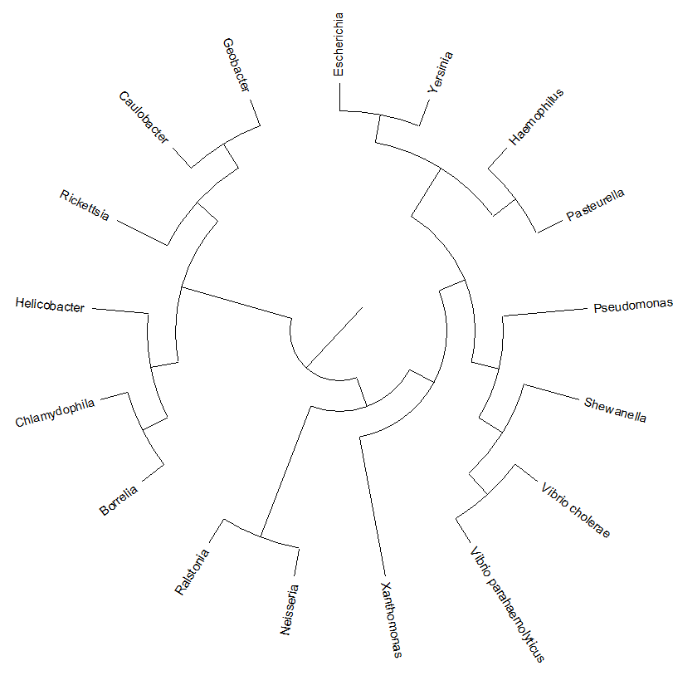
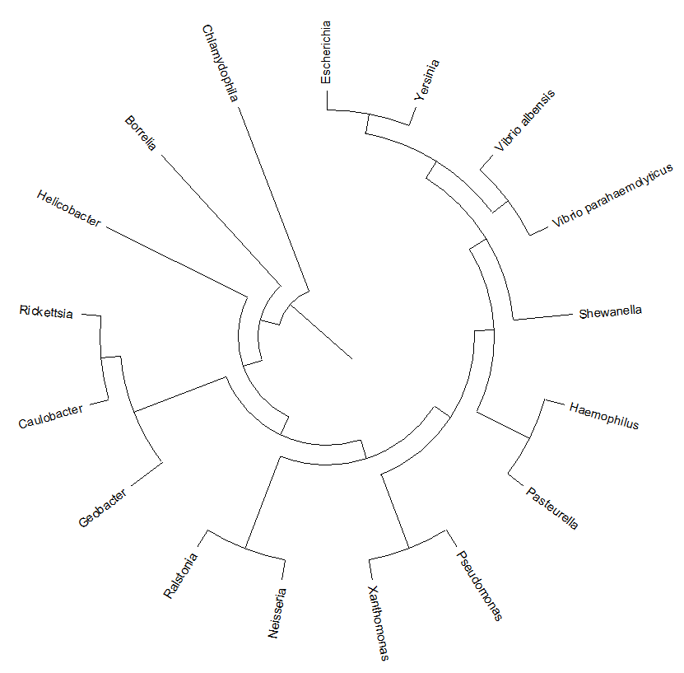
Results-Bacteria rRNA Part
UPGMA Trees (5S, 16S, 23S rRNA sequences)

Slide 9
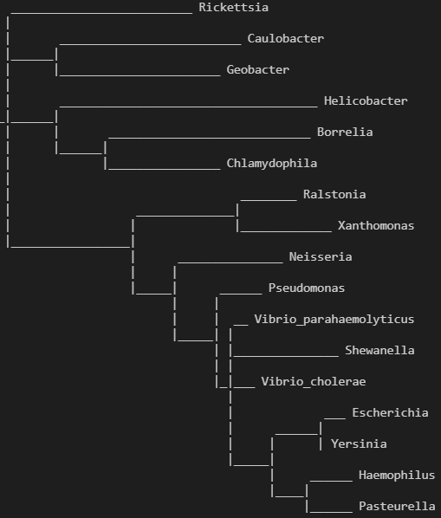
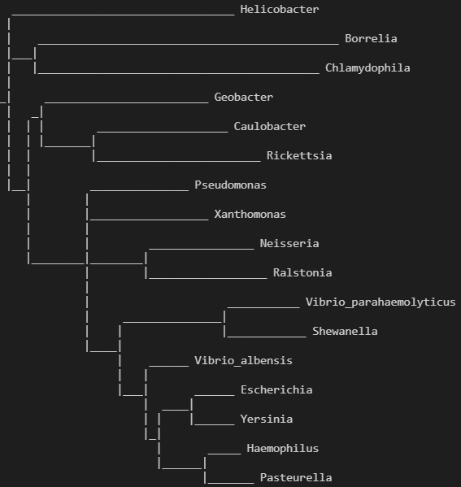
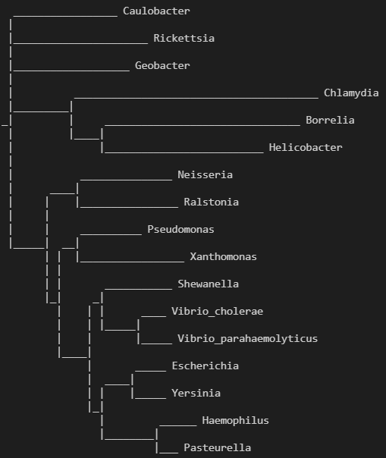
Results-Bacteria rRNA Consensus Tree
Consensus Trees of Trees from Different Algorithms
(5S, 16S, 23S rRNA sequences)

Slide 10
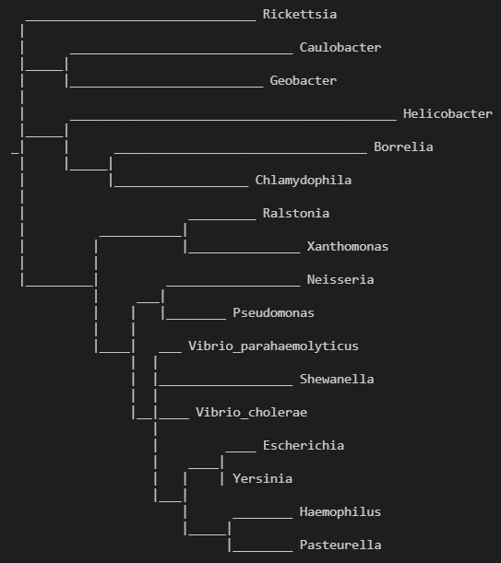
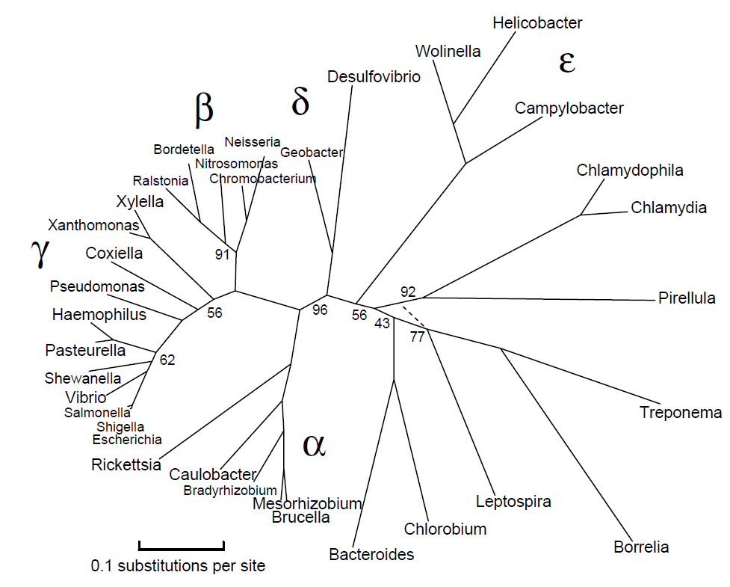
Results-Bacteria rRNA Consensus Tree
α
ε
β
γ
Result from Published Research [2]

Slide 11
Reference
[1] Paul M. Sharp and Beatrice H. Hahn2, “Origins of HIV and the AIDS Pandemic”, Cold Spring Harb Perspect Med. 2011 Sep; 1(1): a006841.
[2] Marshall Berncorresponding and David Goldberg, “Automatic selection of representative proteins for bacterial phylogeny”, BMC Evol Biol. 2005; 5: 34.
[3] “Consensus Trees”, http://hydrodictyon.eeb.uconn.edu/eebedia/images/d/d8/Consensus_2013.pdf.
Thanks!

