Slide 1
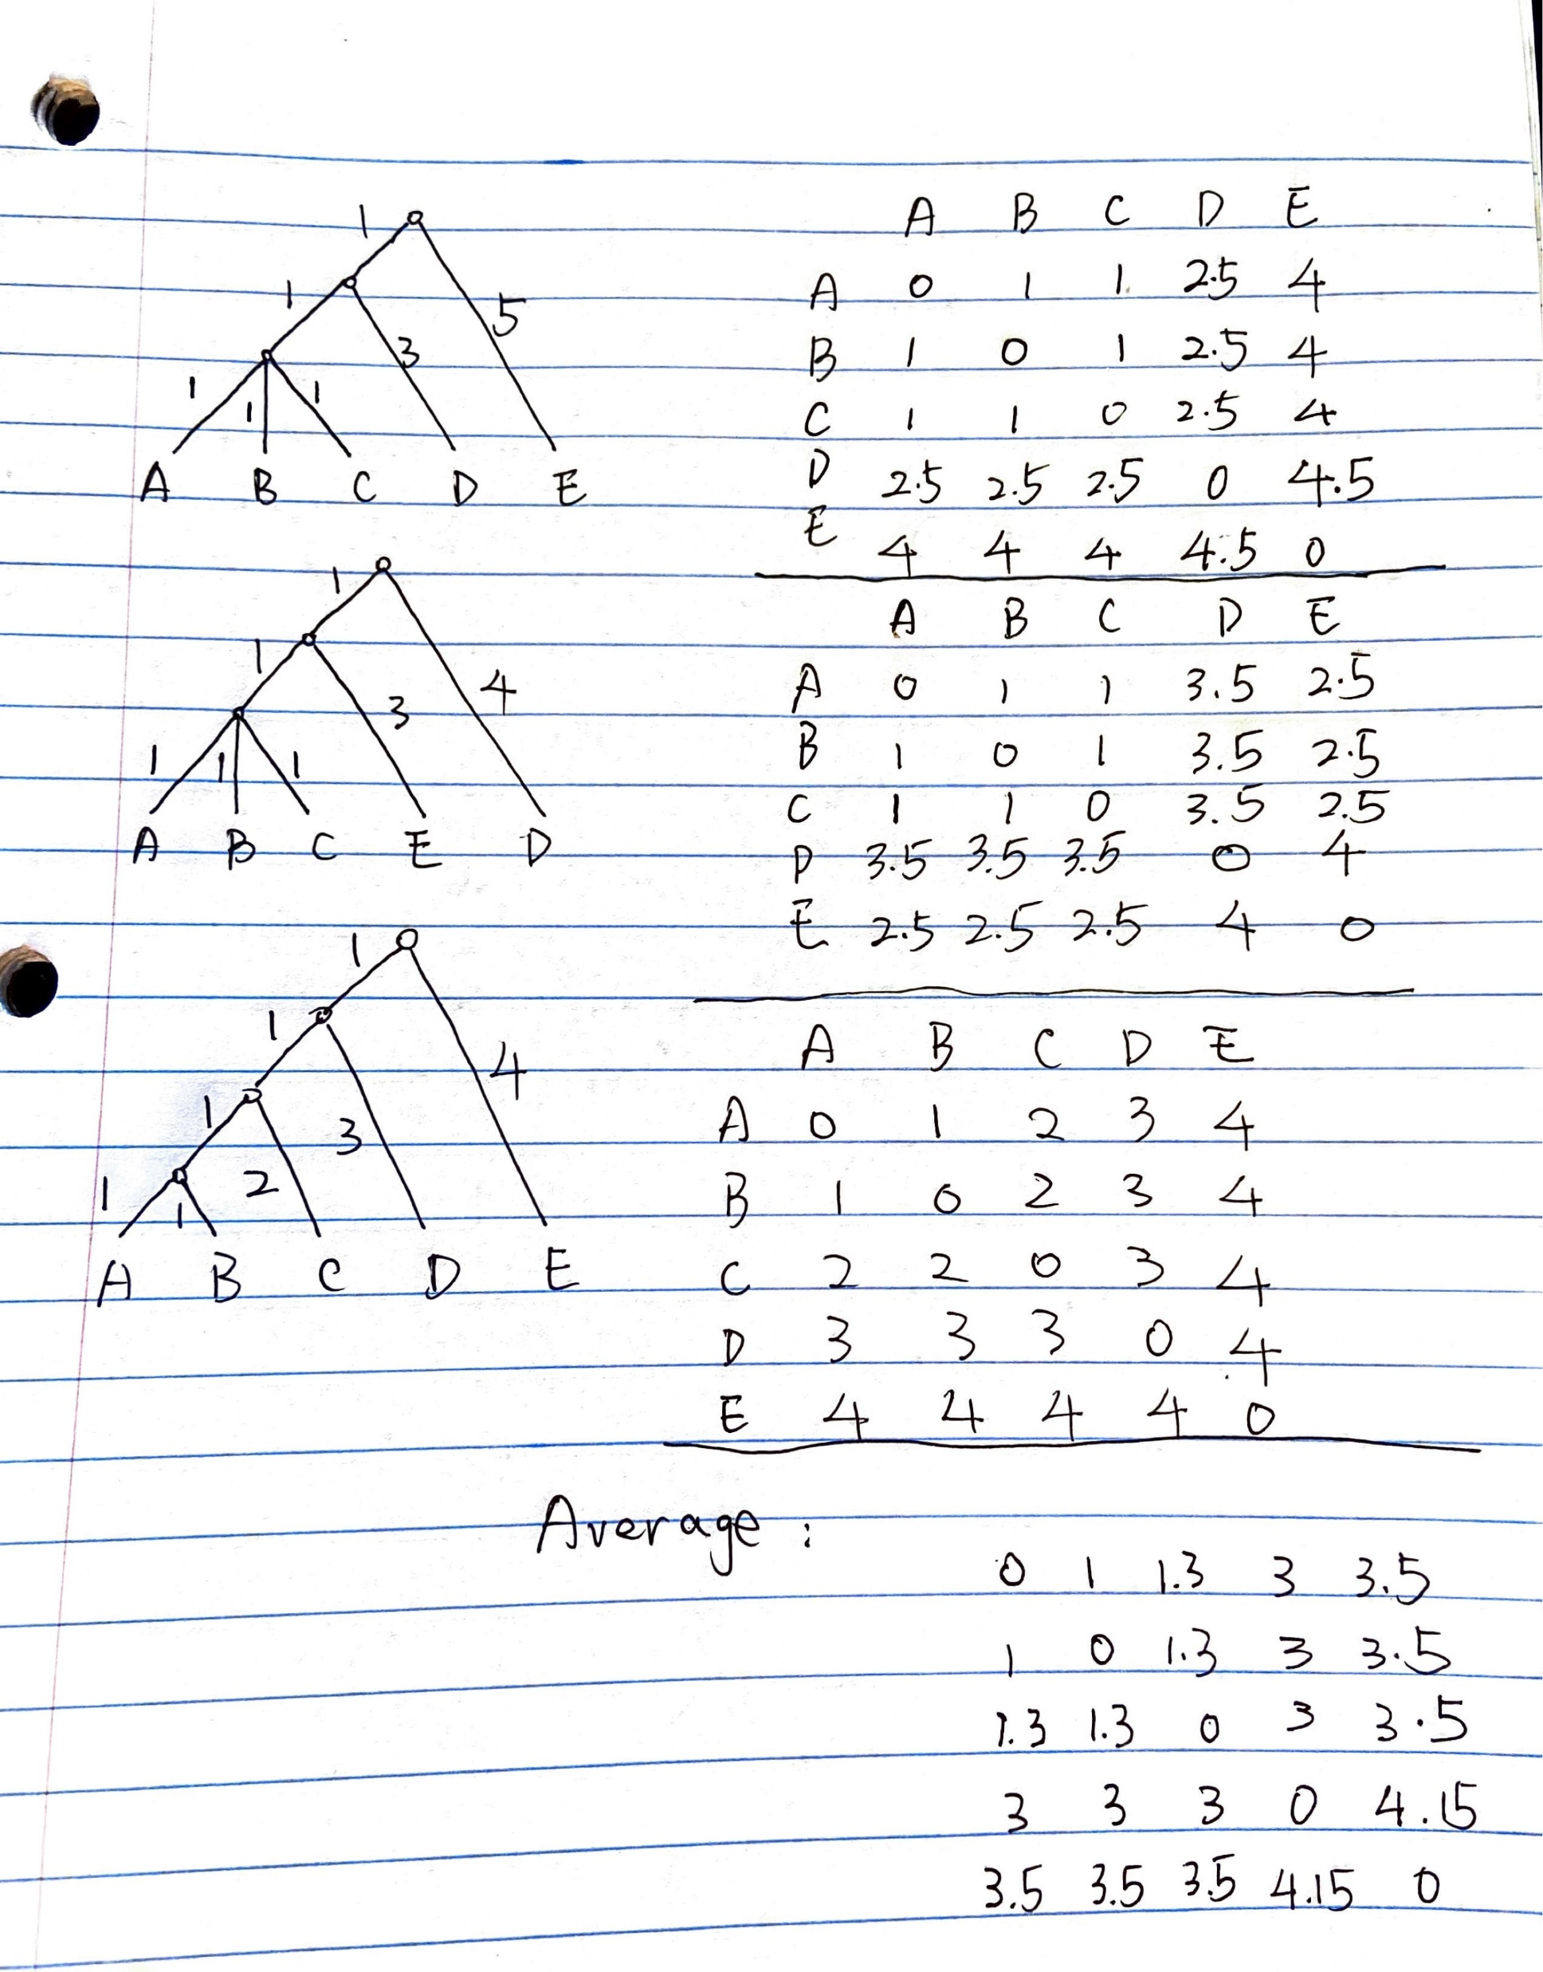
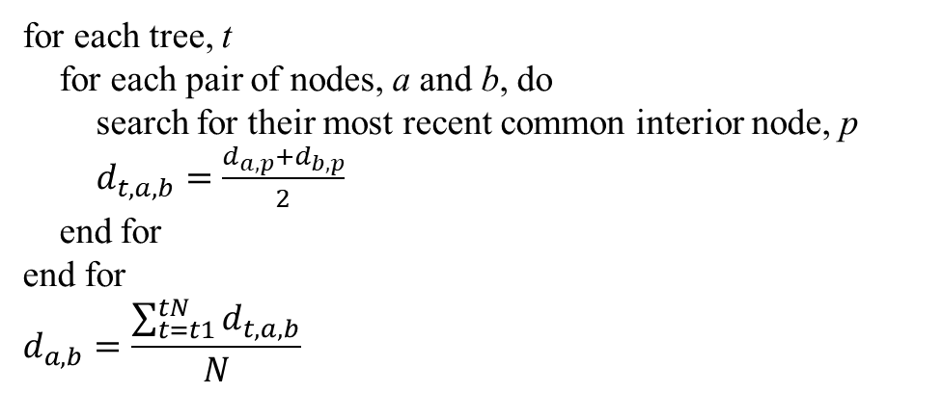
for each tree, t
for each pair of nodes, a and b, do
search for their most recent common interior node, p
$d_{t,a,b}=\frac{d_{a,p}+d_{b,p}}{2}$
end for
end for
$$d_{a,b}=\frac{\sum_{t=t1}^{tN}{d_{t,a,b}}}{N}$$

