Slide 1

Securing Lightweight Authentication Protocol against Quantum Attacks.
By Kare JAI SAI chaitanya - 23MCMT16
Under guidance
Dr. Rajendra prasad lal
Dr. M a saifullah

Slide 2
Context and Motivation
• Emerging networks like SDN-enabled WSNs require secure communication.
• EN-LAKP is effective but vulnerable to quantum threats.
• Goal: Incorporate quantum-safe techniques.

Slide 3
Problem Statement
This project focuses on improving EN-LAKP to make it secure against quantum threats. The goal is to add new, quantum-safe security techniques while keeping the protocol lightweight and efficient so it can still work well on small devices. This will ensure EN-LAKP stays reliable and secure in the future, even in the age of quantum computing.
Notes:
Quantum computers, once fully developed, will be able to break many current security methods, such as those used in Lightweight Authentication and Key Agreement Protocols (LAKPs) like EN-LAKP. This is a serious problem for devices like IoT gadgets and sensors that rely on these protocols to keep data safe. EN-LAKP is designed to work efficiently on small devices with limited power and processing capacity, but it is not strong enough to handle attacks from quantum computers.

Slide 4

Research Objectives
Analyze Existing Vulnerabilities
Incorporate Quantum-Safe Techniques
Optimize Lightweight Operations
Perform Formal Security Analysis
Evaluate Communication Efficiency
Notes:
Identify vulnerabilities in EN-LAKP to quantum attacks.
Integrate quantum-resistant cryptographic techniques while maintaining lightweight efficiency.
Ensure protocol compatibility with resource-constrained environments like SDN-enabled WSNs.
Validate security and performance using tools like Scyther and Wireshark.

Slide 5

RESEARCH
BACKGROUND

Slide 6
Overview of EN-LAKP (Lightweight Authentication and Key Agreement Protocol)
Purpose of EN-LAKP :
  Designed for SDN-enabled Wireless Sensor Networks WSN), EN-LAKP ensures secure communication through lightweight authentication and key agreement.
Key Features:
  Centralized control using an SDN Controller
  Lightweight operations like Hash functions and XOR, ensuring low computational and communication overhead.
  Protects communication in resource-constrained environments.
Limitations :
  Vulnerable to quantum computing attacks (e.g., Shor’s algorithm undermines ECC-based key exchange).

Slide 7

What Is Quantum Computing?
Quantum computing is a new and advanced area of computer science that uses the special properties of quantum mechanics to solve problems that are too hard for even the most powerful regular computers.
Notes:
Quantum computing threats refer to the ability of quantum computers to break traditional cryptographic systems. Unlike classical computers, quantum computers use principles of quantum mechanics, such as superposition and entanglement, to solve complex problems exponentially faster. This poses a significant challenge to widely used cryptographic algorithms that secure digital communications today.

Slide 8
Quantum Computing Threats
Shor's Algorithm :
Breaks asymmetric cryptography (RSA, ECC) by solving factorization and discrete logarithm problems in polynomial time.
Relevance to EN-LAKP:
Although EN-LAKP itself may not use RSA or ECC directly, if it relies on asymmetric key exchanges during key distribution.
Grover's Algorithm:
Speeds up brute-force attacks on symmetric cryptography, effectively halving the key length.
Relevance to EN-LAKP:
EN-LAKP’s relies on hash-based and symmetric key mechanisms makes it vulnerable to Grover’s algorithm as it can reduce the effective strength of a 128-bit key to 64 bits which compromises security.
Notes:
Shor’s Algorithm
Impact: Shor’s algorithm can efficiently solve the integer factorization and discrete logarithm problems, which are the foundation of many public-key cryptographic systems (e.g., RSA, ECC).
Grover’s Algorithm
Impact: Grover’s algorithm provides a quadratic speedup for searching unsorted databases, which can be applied to brute-forcing symmetric keys.

Slide 9
Need for Quantum-Resistant Cryptography
Specific Risks to EN-LAKP :
  Key Agreement Weakness
  Authentication Flaws
  Resource Constrained
Need for Quantum-Safe Enhancements :
  Emerging Solutions :
  Lattice-based, hash-based and multivariate cryptography.
  Challenge
  Integrating quantum-resistant techniques without increasing computational and communication overhead.
Notes:
Session keys generated using classical methods could be intercepted and computed by a quantum adversary.
The use of non-quantum-resistant random number generation and hash functions may fail to ensure mutual authentication in the presence of quantum computing power.
EN-LAKP is designed for environments like SDN-enabled WSNs, where devices have limited computational resources. Adapting to quantum threats without careful redesign could render the protocol inefficient or unusable in such environments.
o counteract these threats, EN-LAKP must incorporate quantum-resistant techniques such as lattice-based cryptography or hash-based digital signatures. These methods are resistant to both Shor's and Grover's algorithms and can be optimized for lightweight operation to maintain the protocol’s suitability for resource-constrained networks.

Slide 10
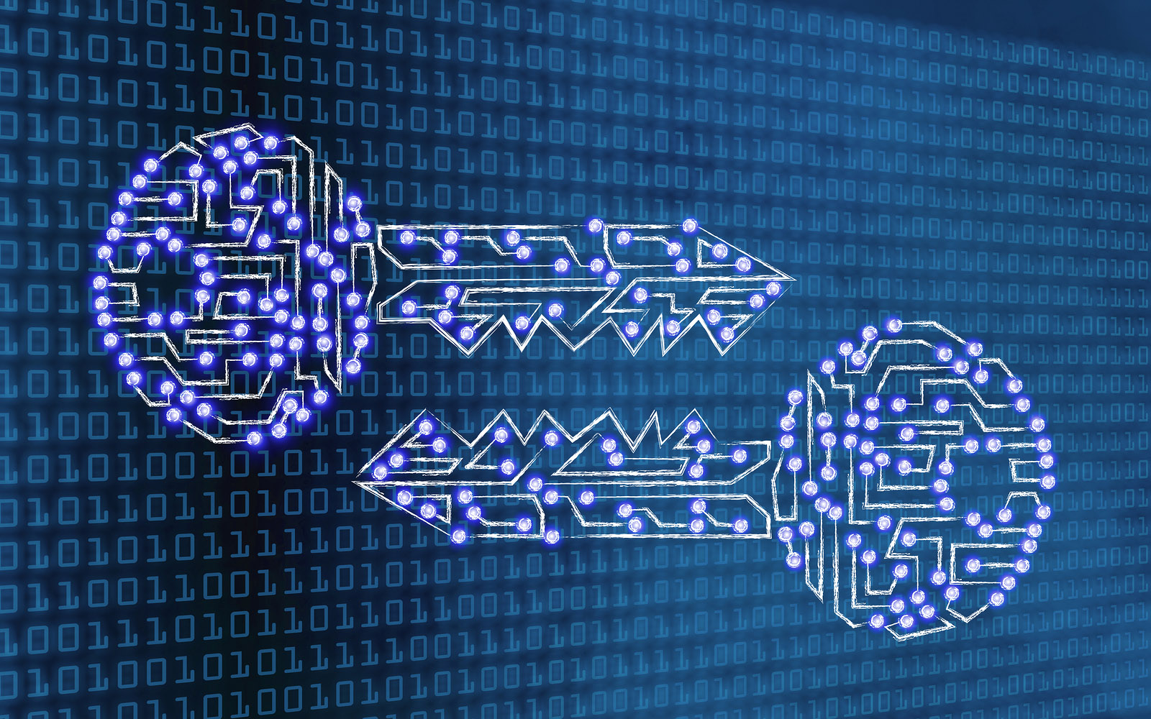
Post Quantum Cryptography
Notes:
Post-Quantum Cryptography develops cryptographic algorithms resistant to attacks from both classical and quantum computers.
Key Features:
Security based on hard mathematical problems, e.g., lattices, codes, or multivariate equations, believed to resist quantum attacks.
Compatibility with existing network infrastructures for a smoother transition to quantum resilience.

Slide 11
PQC Algorithm Families
Hash-Based Cryptography
It is built entirely on hash function, providing strong security but it has larger signature sizes.
Ex : SPHINCS+
Code-Based Cryptography
It is based on error-correcting codes offers excellent security but often suffers from large key sizes.
Ex : Classic McEliece
Lattice-Based Cryptography
It relies on hard mathematical problems. It has high computational efficiency & strong security.
Ex : CRYSTALS-KYBER, SABER
Multivariate Cryptography
Isogeny-Based Cryptography
It utilizes the difficulty of solving multivariate polynomial equations over finite fields.
Ex : Rainbow
It leverages the hardness of finding isogenies between elliptic curves.
Ex : SIKE

Slide 12
Comparison of Algorithms
Focused on Key Agreement
Algorithm | Computational Efficiency | Security Level | Resource Usage
CRYSTALS-KYBER | HIGH | Equivalent to AES-256 | Low
SABER | High | Equivalent to AES-256 | Low
SIKE | Low | Equivalent to AES-256 | High
Classic McEliece | Low | Very High | Very High
NTRU | High | Equivalent to AES-256 | Medium

Slide 13
Comparison of Algorithms
Focused on Digital Signatures
Algorithm | Computational Efficiency | Security Level | Resource Usage
SPHINCS+ | Moderate | Equivalent to AES-256 | Low-Medium
CRYSTAL-DILITHIUM | High | Equivalent to AES-256 | Low
FALCON | Moderate | Equivalent to AES-256 | Low

Slide 14
Selected Algorithms
CRYSTALS-KYBER
Purpose: Key Encapsulation Mechanism (KEM).
Features: High security with minimal latency; supports scalable security levels.
Justification: Proven efficiency for lightweight applications, compatible with EN-LAKP requirements.
SPHINCS+
Purpose: Secure Hash-Based Digital Signatures.
Features: Quantum-safe, stateless, and strong resistance to attacks.
Justification: Lightweight signature scheme suitable for authentication within EN-LAKP.
Notes:
Both algorithms meet the need for lightweight, quantum-resistant cryptography.
Their performance and security have been validated by NIST PQC standardization efforts.

Slide 15
CRYSTAL-KYBER Working
Purpose: Public-key encryption and key encapsulation (used for secure key exchange).
Steps:
Key Generation:
  A user generates a public-private key pair.
  The public key is shared, while the private key is kept secret.
Encryption:
  A sender uses the recipient’s public key to encrypt a message or generate a shared secret.
  This involves adding "errors" to the ciphertext, making it difficult for an attacker to recover the original data.
Decryption:
  The recipient uses their private key to decrypt the message or retrieve the shared secret.
  The private key allows them to efficiently remove the added "errors."

Slide 16
SPHINCS+ Working
Purpose: Digital signatures (used for authentication and data integrity).
Steps:
Key Generation:
  A user generates a public-private key pair.
  The private key is used to create signatures, and the public key is used to verify them.
Signature Generation:
  To sign a message, SPHINCS+ uses a hierarchical structure of hashes.
  The signer selects a specific path within this hash tree, derives a signature, and attaches it to the message.
Verification:
  The verifier uses the public key to confirm the signature.
  They check whether the signature corresponds to the correct path in the hash tree, ensuring the message hasn't been tampered with.

Slide 17
Integration into EN-LAKP
Notes:
Criteria for Selection
Lightweight Nature: Ensures low computational and communication overhead to suit resource-constrained environments like SDN-enabled WSNs.
Quantum Resistance: Must withstand attacks from quantum algorithms like Shor's and Grover's.
Efficiency: Balances security with performance to maintain EN-LAKP’s usability.

Slide 18
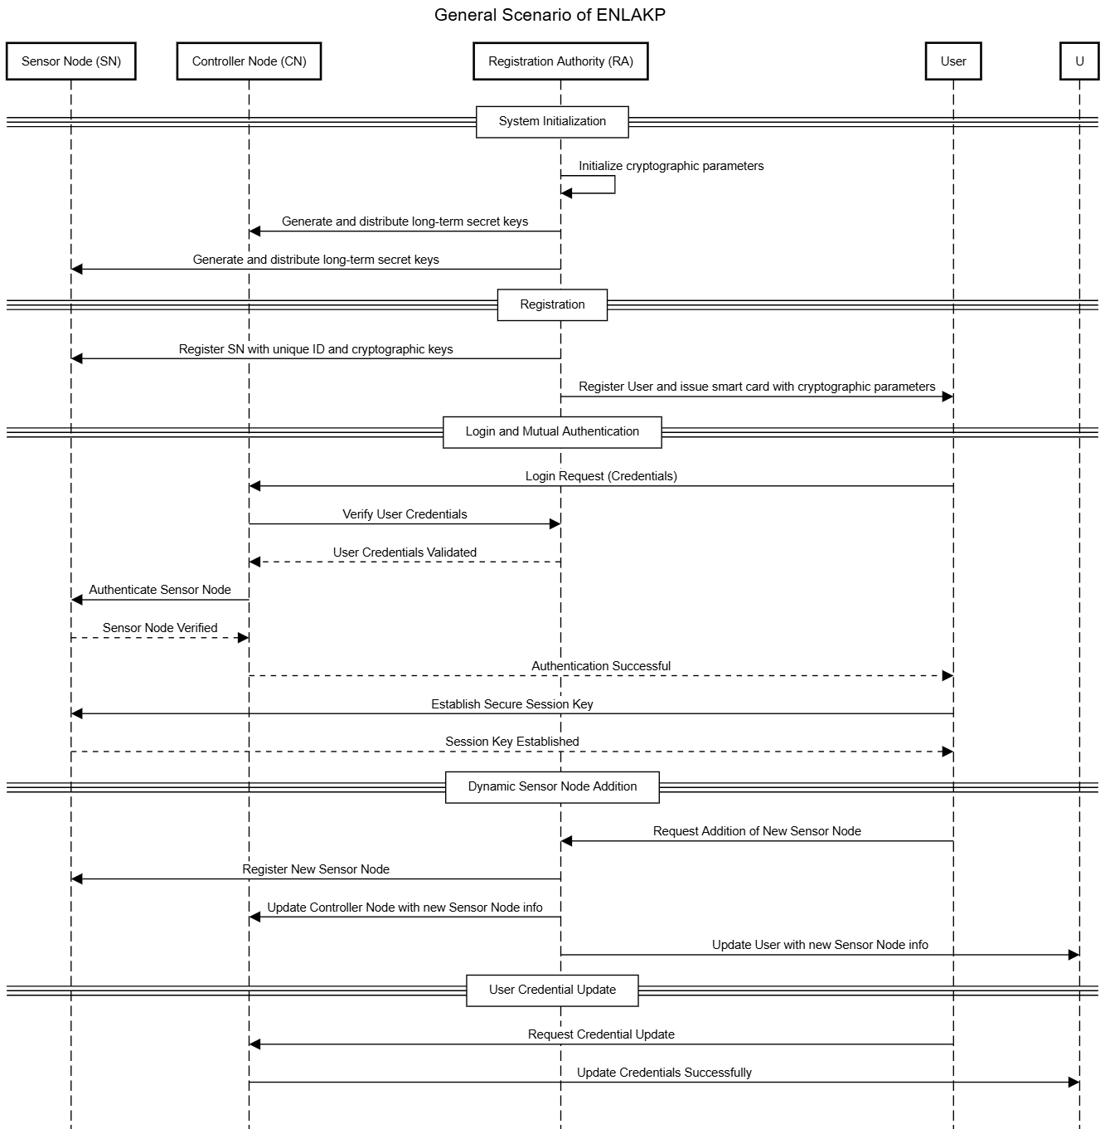
This scenario emphasizes the lightweight and efficient nature of EN-LAKP for resource-constrained environments like WSNs.

Slide 19
Design Modifications
Replacement of ECC with Lattice-Based Cryptography
  > Substituted ECC with CRYSTAL-KYBER
  > Ensures secure and quantum-resistant session key agreements while maintaining lightweight characteristics.
Incorporation of Hash-Based Digital Signatures
  > Integrated SPHINCS+, to provide quantum resilient authentication.
  > Eliminates dependency on asymmetric key signatures vulnerable to quantum attacks.
Lightweight Enhancements
> Optimized cryptographic operations to minimize computational and communication overhead in resource-constrained environments.

Slide 20
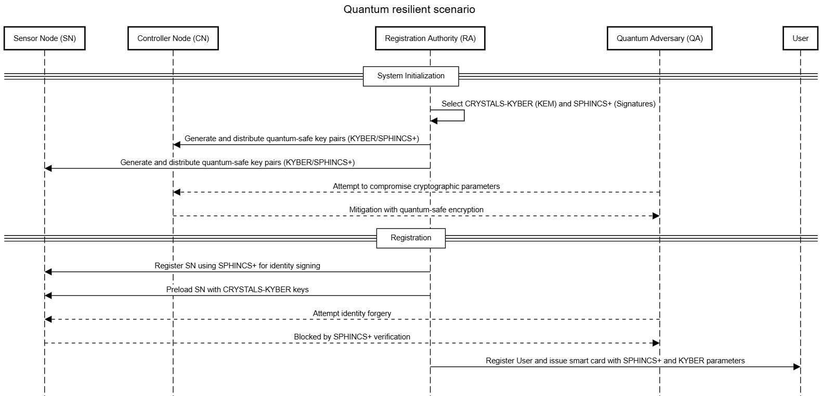
This scenario emphasizes the System Initialization and User Registration.

Slide 21
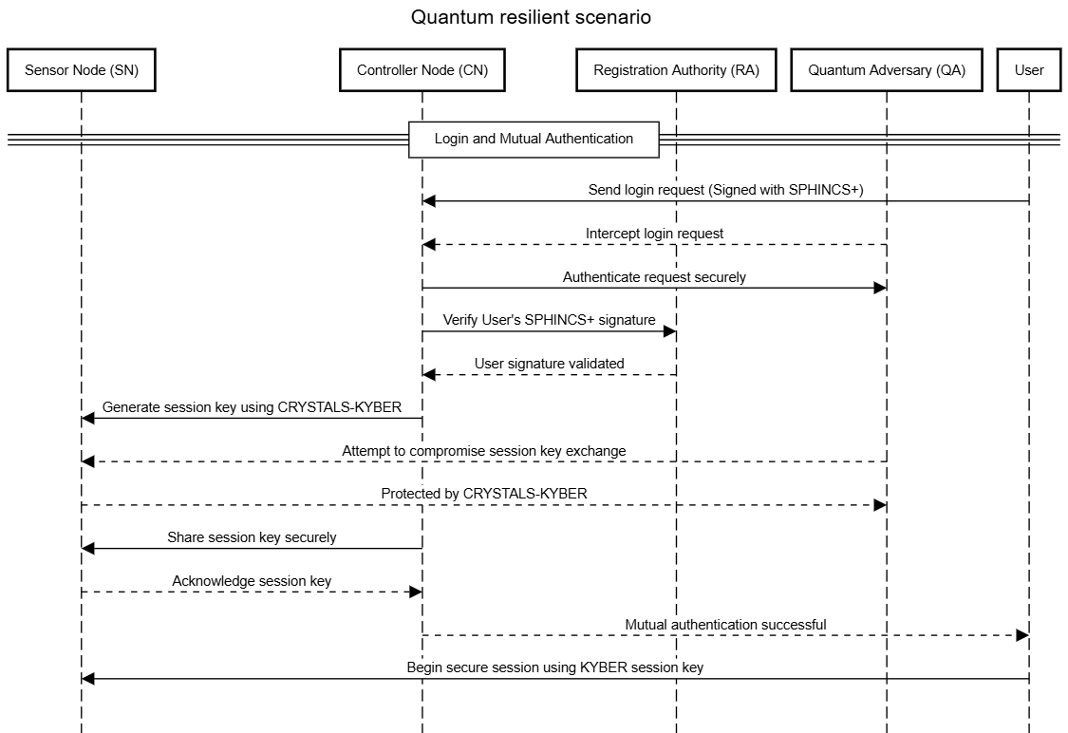
This scenario emphasizes the Login Authentication.

Slide 22
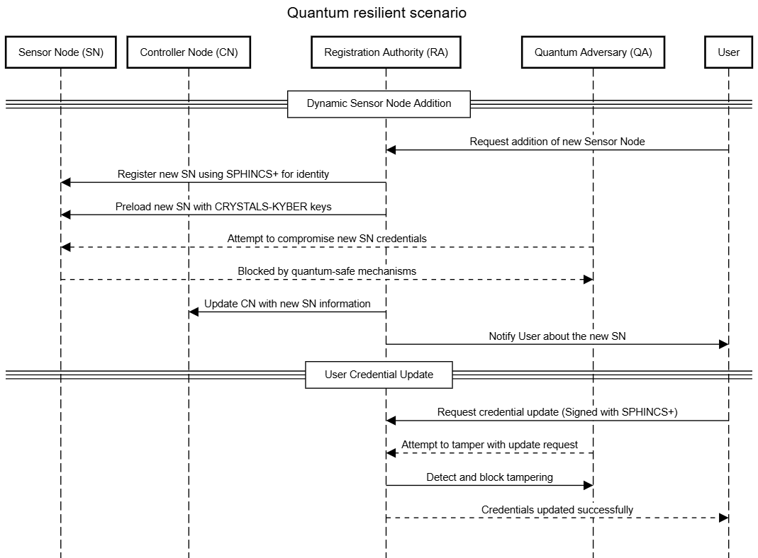
This scenario emphasizes the adding Sensor node and Updating of User Credentials.

Slide 23
Expected Benefits
Quantum Resilience:
  Enhanced protocol will be resistant to both classical and quantum cryptanalytic attacks.
Efficiency in Resource-Constrained Environments:
  It Maintains lightweight properties suitable for WSNs and similar networks.
Secure Communication Framework:
  Strengthened authentication and key agreement mechanisms, critical for future network architectures.

Slide 24
Preliminary Results and Next Steps

Slide 25
Current Progress
Vulnerability Analysis:
Identified quantum threats to EN-LAKP, including key exchange and authentication mechanisms vulnerable to Shor's and Grover's algorithms.
Integration Design:
1. Incorporated CRYSTALS-KYBER for quantum-safe key exchange.
2. Integrating SPHINCS+ for lightweight, hash-based digital signatures.
3. Ensured minimal impact on computational and communication efficiency.

Slide 26
Future Work
Phase 1: Simulation and Implementation (1-2 Months)
  Step 1: Add post-quantum cryptographic methods (CRYSTALS-KYBER and SPHINCS+) to the EN-LAKP protocol.
  Step 2: Create a simulation environment for SDN-enabled WSN using NS3 or OMNeT++.
Phase 2: Security Validation (1 Month)
  Step 3: Perform a detailed security check using the Scyther tool.
  Step 4: Test the protocol against both traditional and quantum-based attacks.
Phase 3: Performance Evaluation (1-2 Months)
  Step 5: Measure communication and processing efficiency using tools like Wireshark.
  Step 6: Compare the improved protocol's performance under different conditions and attacks.

Slide 27
Future Work
Phase 4: Scalability and Adaptability Testing (1 Month)
  Step 7: Test the protocol in large-scale networks with heavy traffic.
  Step 8: Simulate real-world IoT scenarios to check practicality.
Phase 5: Documentation and Sharing (1 Month)
  Step 9: Summarize all work into a comprehensive research report.
  Step 10: Share the findings in journals or conferences.

Slide 28
Conclusion
• EN-LAKP enhancements focus on quantum resilience.
• CRYSTALS-KYBER and SPHINCS+ ensure security against quantum threats.
• Maintains lightweight properties for resource-constrained networks.

Slide 29
References
1. N. Anand and M. A. Saifulla, ”EN-LAKP: Lightweight Authentication and Key Agree ment Protocol for Emerging Networks,” in IEEE Access, vol. 11, pp. 28645-28657, 2023, doi: 10.1109/ACCESS.2023.3255646.
2. R. Bavdekar, E. Jayant Chopde, A. Agrawal, A. Bhatia and K. Tiwari, ”Post Quantum Cryptography: A Review of Techniques, Challenges and Standardizations,” 2023 International Conference on Information Networking (ICOIN), Bangkok, Thailand, 2023, pp. 146-151, doi: 10.1109/ICOIN56518.2023.10048976.
3. M. Heigl, M. Schramm and D. Fiala, "A Lightweight Quantum-Safe Security Concept for Wireless Sensor Network Communication," in 2019 IEEE International Conference on Pervasive Computing and Communications Workshops (PerCom Workshops), Kyoto, Japan, 2019, pp. 906-911, doi: 10.1109/PERCOMW.2019.8730749.
4. Singh, M., Mishra, D. Post-quantum secure authenticated key agreement protocol for wireless sensor networks. Telecommun Syst 84, 101–113 (2023).

Slide 30
Thank You

