Slide 1
Who is Who in Myanmar

Slide 2
Supervisor - Dr. Lwin Mar Thin
Presented By
San Thorl
Zin Mar Kyaw
Hnin Yamone Nwae
Aye Thiri Kyaw
Lwin Me Me Khaing
Ei Ei Linn

Slide 3
Words From Heart
I would like to deeply thank my supervisor, Dr. Lwin Mar Thin, Associate Professor, Hardware Technology Department, University of Computer Studies (Mandalay), for her helpful advices and close guidance throughout this project.
Then respectfully thanks to U Ravi Chhabra, CEO of Geo Mandalar IT Co.Ltd, for his invaluable suggestions, patient comments and detailed technical contribution.
I also thank all my teachers from University of Computer Studies (Mandalay), especially, our rector U Kyaw Zwa Soe, our pro-rector Dr. San San Tin and our teacher Dr. Aye Aye Chaw. I would like to gratefully thank my friends and my dearest parents who have always given great help and support through my life.

Slide 4
Roll No Name Category
7 Ma San Thorl Team Lead+Lead Dev+DevOps
Ma Zin Mar Kyaw Developer
Ma Hnin Yamone Nwae Testing+Documentation
8 Ma Aye Thiri Kyaw UI/UX Lead
Ma Lwin Me Me Khaing UI/UX Lead
12 Ma Ei Ei Linn Developer

Slide 5
Roles and Responsibilities
Team Lead+Lead Dev+DevOps
Developer
UI/UX Lead
Testing and Documentation
Team Leader has the overall responsibility for the successful initiation, planning, design, execution, controlling, monitoring, reporting and closure of the project. Strongest programming and system administration skills in the group. Specific skill in at least one role is a good communication and combination skills to ask penetrating questions, resolve conflicts, as well as more general management skills.
Good logical thinking skills. Comfortable with writing and rewriting code and reading and learning from other developers code.
Responsible for the set-up and maintenance of the content management system, HTML, CSS, JavaScript, MySQL, or other programming languages. And also learn a few frameworks such as BootStrap, Material Design, Angular and so on. Use of graphics tools and mockup tools.
Have clear and concise writing skills. Responsible for controlling the documentation produced by teams in a accurate timely. Focused on testing, analyzing, reporting results and also making recommendations to admins.

Slide 6
Abstract
The country of Myanmar is also known as Burma, and the two names are often confused. It consists of 14 provinces: 7 states representing the areas of 7 main ethnic races and 7 divisions. The purpose of project is to know readily and inexpensively about Myanmar’s people such as Parliament, Writers, Directors, Actors and Singers.
On our websites, you can read the information contained on the page, and if there are any interesting hyperlinks, you can follow those links to find more information or to perform a task.
This could lead to save times and costs for the people who interested about Myanmar’s people.
In this project, Admin can control data records and view reports. The project will be implemented using Flask with Python and deploy on Heroku(CLI).

Slide 7
Objectives
To help for searching people who is who in Myanmar more efficient than ever
To convey helpful information to specific users
To provide the ability for making changes to the site’s information easily for the operator
To replace uncomfortable paper system by modern webpage
To save times and costs

Slide 8
Introduction
The project provides us the complete and accurate information about the Parliament, Writers, Directors, Actors and Singers who are in Myanmar by the webpages.
The project named “Who is Who in Myanmar” is aimed to widely useful for people who want to know about Myanmar and officially known as the Republic of the Union of Myanmar.
Our project is implemented with Flask framework. So it is developed in Flask with Python and also used database with Flask_sqlalchemy. Our project is very useful for those who want to save their times in self-accesssing or experimenting about Myanmar people.

Slide 9
FlowChart Diagram for Who is Who in Myanmar
choose choose choose choose choose choose
Home
Choice Page
Political
Writer
Director
Actor
Singer
Help
Send Message
More Detail Data
Exit

Slide 10
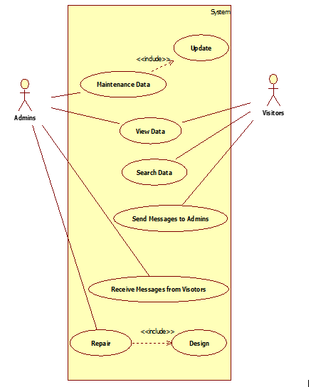
Usecase Diagram for Who is Who in Myanmar

Slide 11
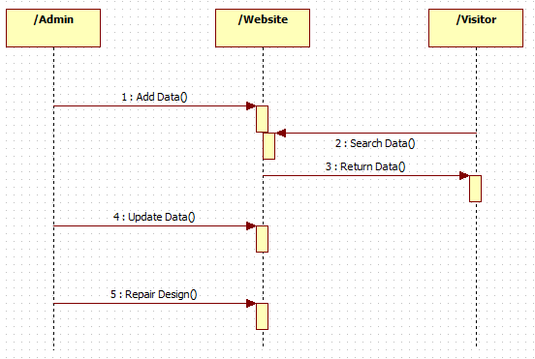
Sequence Diagram for Who is Who in Myanmar

Slide 12
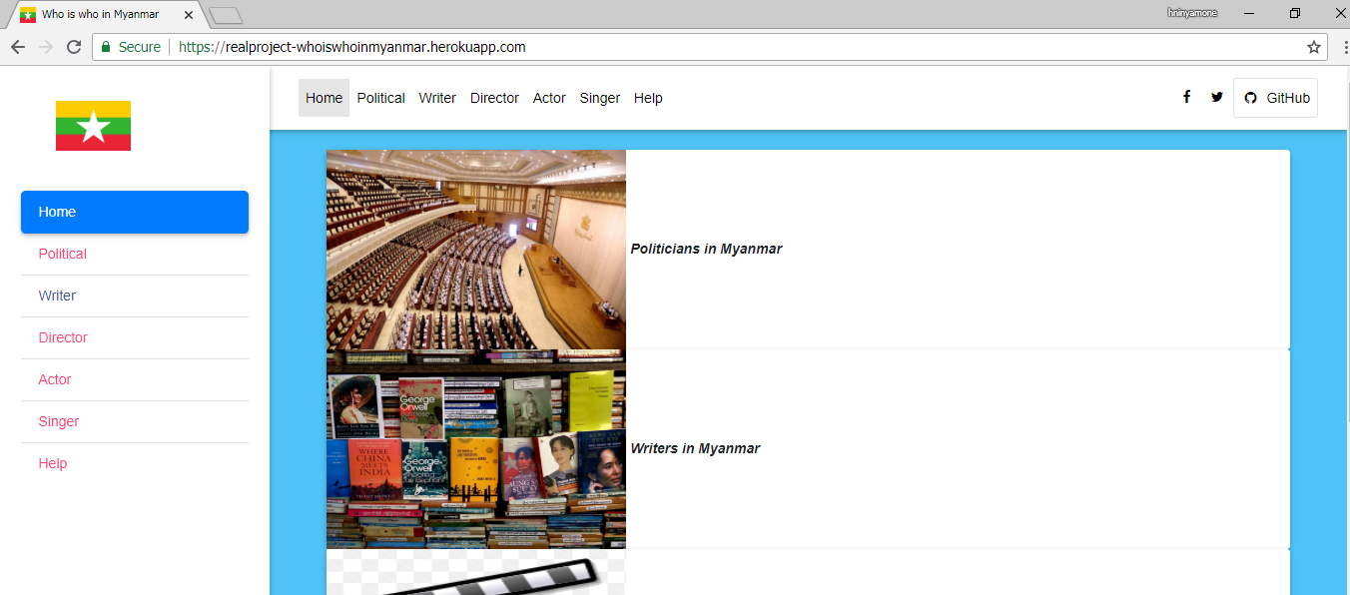

Slide 13
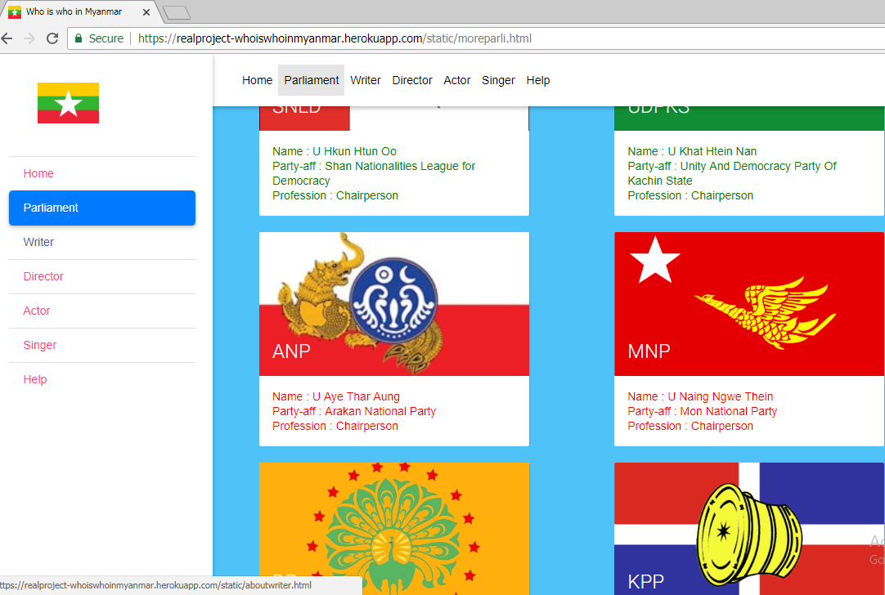

Slide 14
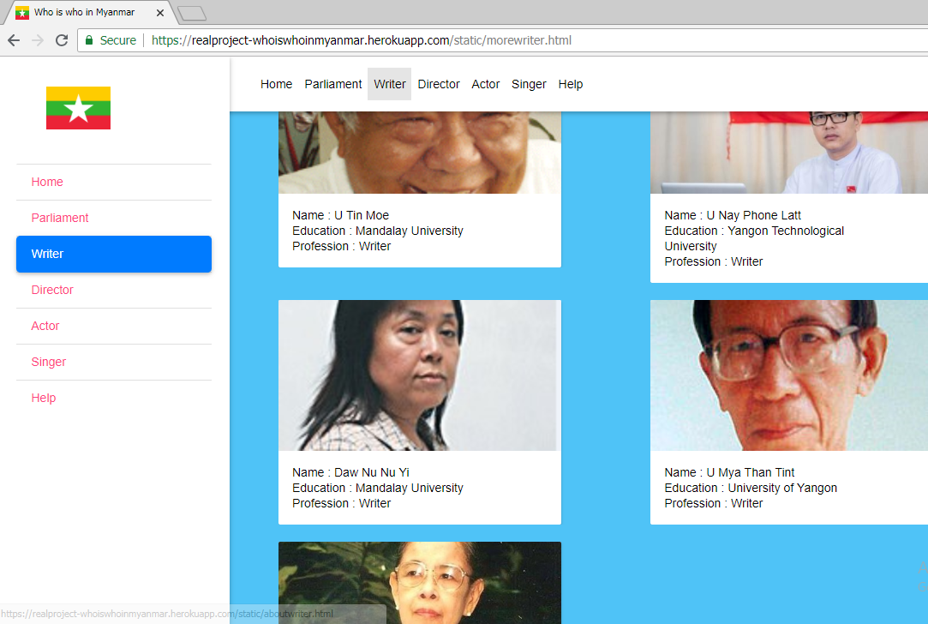

Slide 15
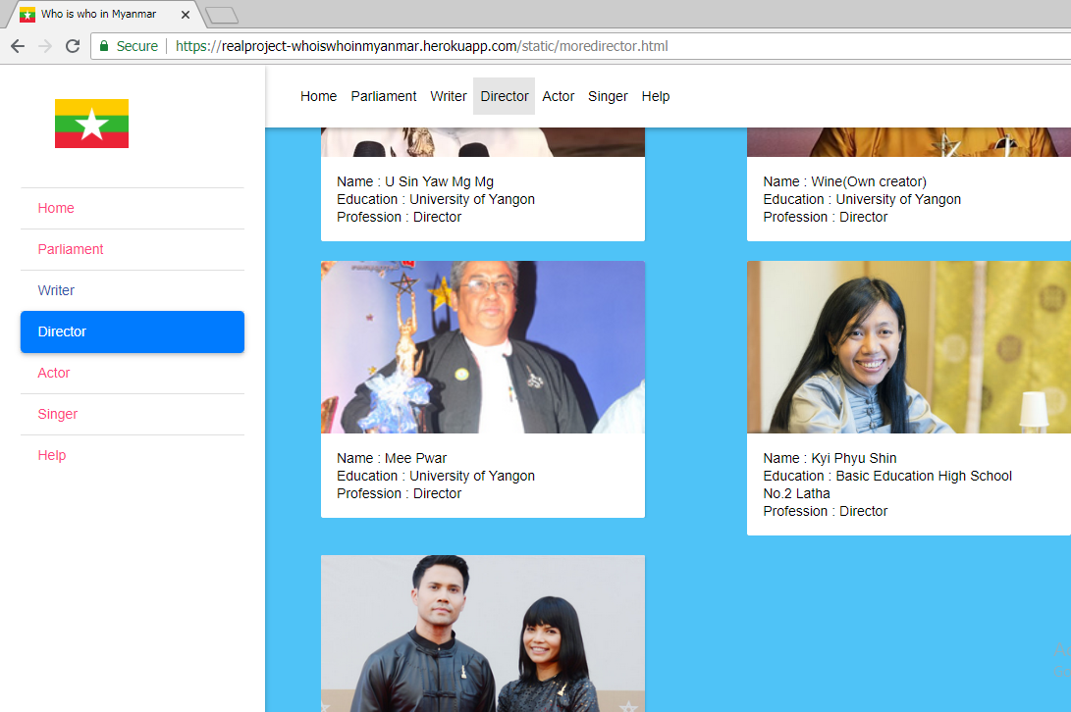

Slide 16
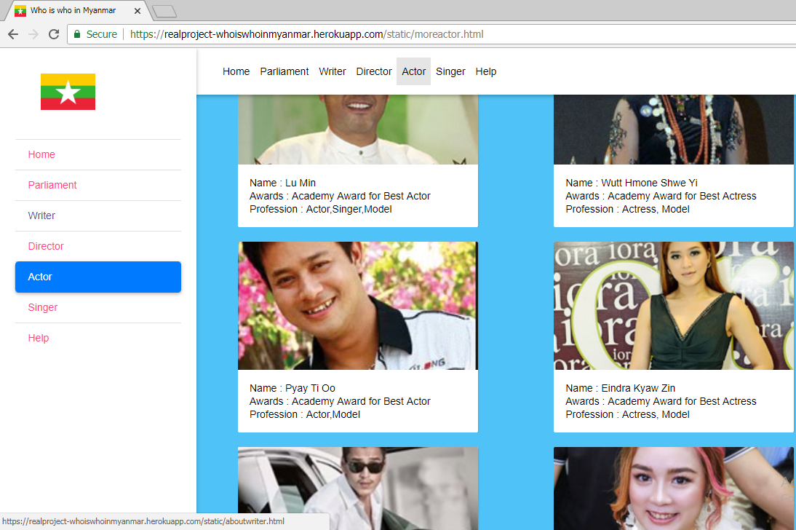

Slide 17
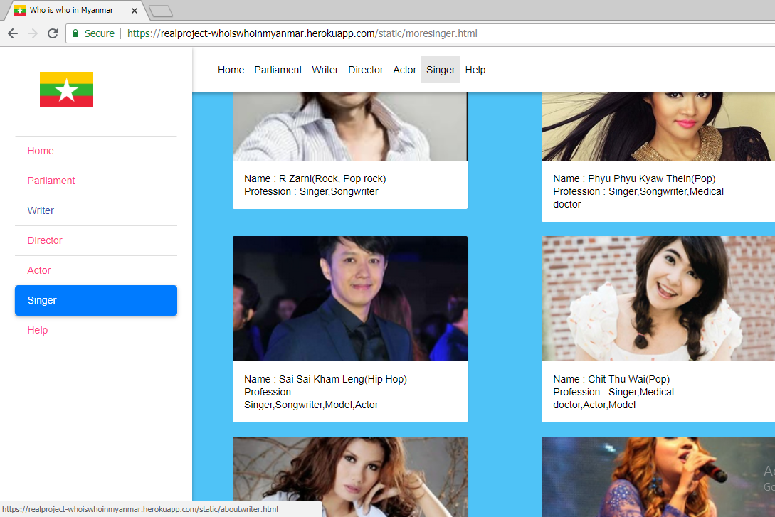

Slide 18
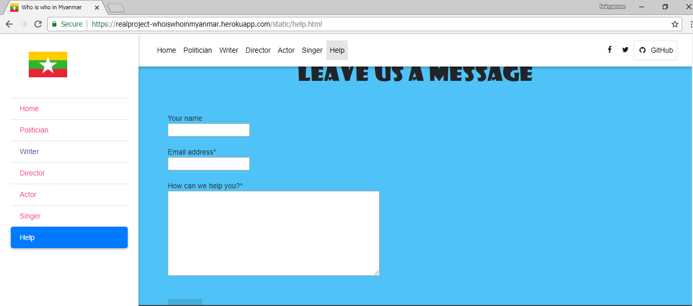

Slide 19
Milestones and Job Distributions
Development Phase | 1-7 Day | 8-14 Day | 15-21 Day | 22-28 Day | 29-35 Day | 36-45 Day | Duration
Analysis |  |  |  |  |  |  | 5
Documentation |  |  |  |  |  |  | 9
Design |  |  |  |  |  |  | 21
Coding |  |  |  |  |  |  | 26
Testing |  |  |  |  |  |  | 6
Total Time |  |  |  |  |  |  | 45

Slide 20
Conclusion
The app provide a great convenience for all users. Users could get all information that they are interested in at once without moving from site to site.
All people who are famous in Myanmar are collected and presented in the app. In which app including common facts about celebrities, writers, business men and also even politicians.
The app’s contents are human readable form and navigate you to the information store you want to know. It can be accessed from both mobile phones and computers with internet access. Moreover, up to date people’s news are provided for users at any given time.

Slide 21
Thanks For Your Attention!

