Slide 1

ADDITIVE PUBLIC OPINION SHAPING
Exact Quantum Encoding and Observable Estimation
Actors
Mixed Narratives
Observable Payoff
This deck isolates the additive mainline, the exact strategic encoding result, and the observable-estimation benchmark.
Core message
In the additive setting, quantum does not define a different game. It exactly encodes the classical ground truth and gives a cleaner route to observable-payoff estimation.
Technical scope: additive GT, exact quantum encoding, residual MLP surrogate, and AE benchmark.

Slide 2
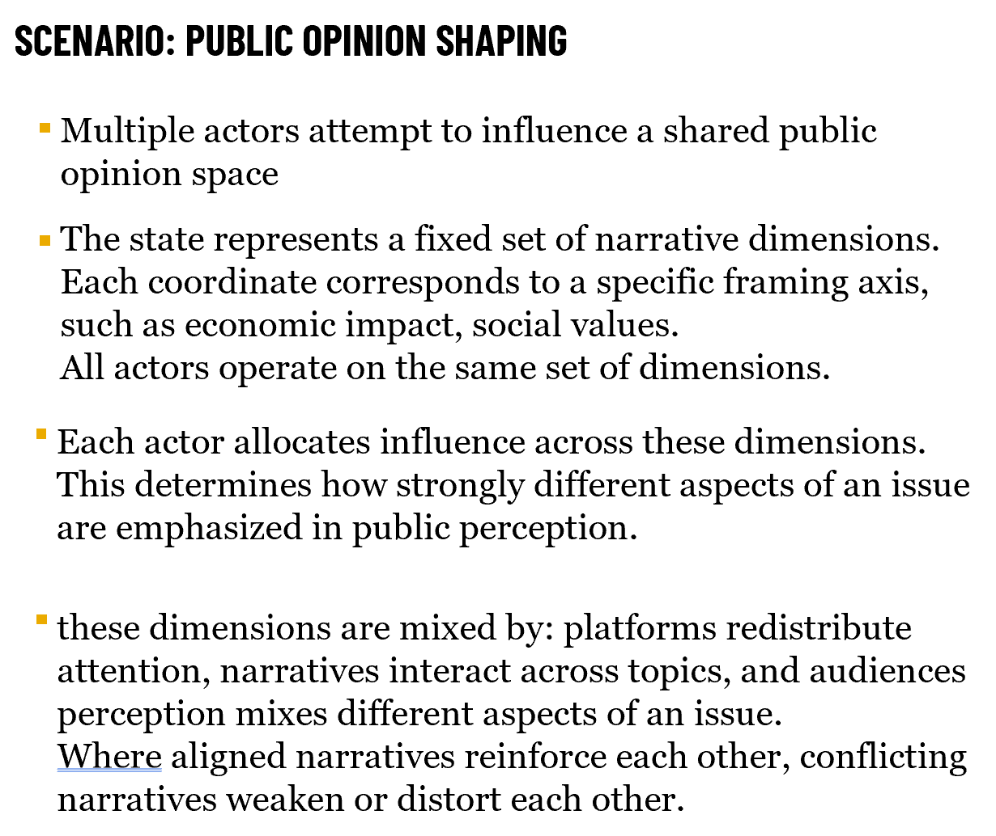
PROBLEM BACKGROUND
Why additive public-opinion shaping is the right reduction.
Multiple actors intervene in one shared opinion space rather than in isolated channels.
Each coordinate represents a narrative axis such as economic framing, identity, or social value.
Actors allocate influence across those coordinates, so strategy is a distributional decision, not a single move.
Platform redistribution and audience cognition mix narratives across coordinates, which creates strategic coupling.
Additive modeling makes this problem explicit: it turns shared narrative shaping into a state update plus a measurable strategic payoff.
Additive Public Opinion Shaping
PAGE 2

Slide 3


ADDITIVE MAINLINE FORMULATION
Three models share one distribution-based scoring interface.
ClassicalGroundTruthGame
Additive ground-truth dynamics
Reference additive dynamics with explicit mixing matrix M and agent-specific maps Bᵢ.
QuantumEncodedGame
Observable-based payoff
Exact encoding of the same additive game in a quantum-style latent state.
ResidualMLPSurrogate
Learned classical surrogate from joint actions to terminal influence distributions.
entmax-1.5 is sharper than softmax, permits sparse attention patterns, and avoids an overly smooth surrogate target.
Additive Public Opinion Shaping
PAGE 3

Slide 4

RIGOROUS STATEMENT
What exact quantum encoding does and does not claim.
Exact statement
For every feasible joint action a, the additive QuantumEncodedGame induces the same terminal influence distribution as the ClassicalGroundTruthGame. Therefore, best responses, regret, and epsilon-equilibrium properties coincide, up to amplitude-estimation discretization error when utilities are evaluated via observable expectations.
pₜ
Exact additive update preserved
Observable payoff from encoded state
This is an exact strategic encoding result. It shows model equivalence at the distribution level. It does not, by itself, establish end-to-end wall-clock quantum speedup.
Additive Public Opinion Shaping
PAGE 4

Slide 5
EXPERIMENTAL SETUP
All headline metrics are judged against the additive classical ground truth.
Scenarios
Headline metrics
Estimation benchmark
Three additive scenarios: shallow, medium, and deep conflict.
Accuracy, Regret, and Epsilon are all checked against additive GT.
AE is compared to Monte Carlo on observable-payoff estimation at equal query budgets.
Ground Truth
Quantum Encoded
Residual MLP
Evaluate under GT reference
Accuracy: whether the approximate model selects the same best-response candidate as the ground truth.
Regret: exact improvement still available in the ground-truth game after following the candidate recommendation.
Epsilon: epsilon-Nash slack of the candidate equilibrium when it is checked in the ground-truth game.
Additive Public Opinion Shaping
PAGE 5

Slide 6
STRATEGY AND REGRET RESULTS
Native PowerPoint charts rebuilt from additive report summaries.
Accuracy numbers
Regret numbers
Quantum: 1.000 / 1.000 / 0.984. MLP: 0.859 / 0.906 / 0.953.
Quantum: 8.9e-06 / 0 / 1.0e-04. MLP: 1.04e-02 / 2.72e-03 / 3.66e-03.
Exact quantum encoding preserves strategy structure, while the learned surrogate remains approximate.
Additive Public Opinion Shaping
PAGE 6

Slide 7
EPSILON RESULT AND INTERPRETATION
Epsilon is a structural consistency check, not the only ranking criterion.
Scenario
Ground Truth
Quantum
Residual MLP
Reading the table
Shallow Low Conflict
0.0713
0.0713
0.0000
Quantum matches GT because the additive encoding preserves the same terminal distribution.
Medium Conflict
0.0000
0.0000
0.0000
MLP caveat
Deep High Conflict
0.0126
0.0126
0.0126
MLP is learned, not exact. A low epsilon in one scenario does not certify equivalence.
Epsilon is reported here to check structural consistency. It should be read together with Accuracy and Regret rather than as a standalone ranking metric.
Quantum and ground truth coincide because they induce the same terminal influence distribution in the additive construction.
Residual MLP remains useful as a modeling baseline, but it should be interpreted as a learned surrogate rather than as a solver or an exact reformulation.
Additive Public Opinion Shaping
PAGE 7

Slide 8
OBSERVABLE ESTIMATION BENCHMARK
Amplitude Estimation vs Monte Carlo under matched query budgets.
Budget 8
AE 0.0190 vs MC 0.0266
Budget 64
AE 0.00255 vs MC 0.00919
Budget 256
AE 0.000579 vs MC 0.00475
For this observable-estimation task, amplitude estimation achieves lower estimation error than classical sampling at every tested query budget.
Additive Public Opinion Shaping
PAGE 8

Slide 9
WHAT THE RESULTS SUPPORT
A strict claim boundary is part of the contribution.
Supported
Not Supported
1. Exact quantum encoding preserves additive strategic structure.
2. Best responses, regret, and epsilon agree with GT up to AE discretization.
3. AE beats Monte Carlo on observable-payoff error at equal query budgets.
1. Universal quantum dominance over classical methods.
2. Hardware-level wall-clock speedup claims.
3. Claims beyond the additive estimation benchmark.
This boundary makes the additive story defensible: exact encoding is a structural statement, while AE provides the measurable performance advantage on a specific observable-estimation task.
Additive Public Opinion Shaping
PAGE 9

Slide 10
CONCLUSION
Final takeaways for the additive-only report.
Takeaway 1
Takeaway 2
Takeaway 3
Additive ground truth makes public-opinion shaping explicit and strategically testable.
Quantum encoding is exact at the strategic level in this additive construction.
Amplitude estimation gives the clean performance advantage in measurable observable-payoff estimation.
Oral closing statement
In the additive setting, the quantum contribution is an exact strategic encoding plus a cleaner route to observable-payoff estimation.
This additive deck is intentionally narrower than the full route-2 report and avoids legacy-baseline claims in its main conclusion.
The rigorous claim is about preserved strategic structure and benchmarked observable estimation, not about universal quantum advantage.
Additive Public Opinion Shaping
PAGE 10

