Slide 1
Learning Relation-Aware Facial Expression Representations with Transformers: A Performance Comparison with CNNs
A20521362
Young Sun Lee
Notes:
Hello, my name is Young Sun Lee.

Slide 2
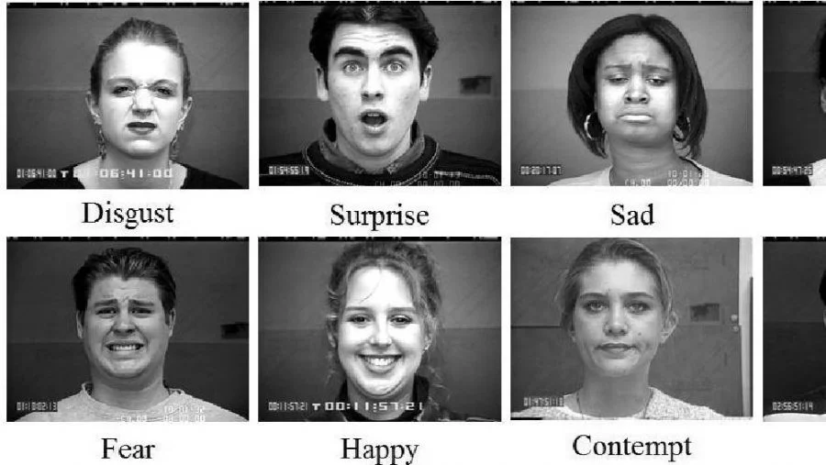
What is Emotion Recognition?
Notes:
Emotion Recognition is a technology that analyzes facial expressions to identify human emotions such as disgust, sur prise sad, fear, happy, etc.

Slide 3
What is Emotion Recognition?
Definition: A technology that analyzes facial expressions to identify human emotions such as happiness, sadness, surprise, etc.
Importance: This can contribute to human-computer interaction and the empathic abilities of future robots.
Applications: Digital advertising, online gaming, customer feedback analysis, healthcare.
Examples:
UAE: Assessing the emotional atmosphere of the population in public spaces.
Skyscanner: Measuring and improving customer satisfaction.
Challenges:
The rigorous definition of the relationship between expressions and emotions.
Ethical issues such as bias promotion, as well as privacy concerns.
The problem of fraud due to misuse.
Notes:
The application areas of Emotion Recognition include Digital advertising, online gaming, customer feedback analysis, healthcare, and more.
Furthermore, this technology has the potential to become the foundation of true interaction between humans and computers in the future.
The challenges include the lack of a strict academic definition between expressions and emotions, and issues such as bias and privacy,
but ethical usage standards are currently being established.

Slide 4
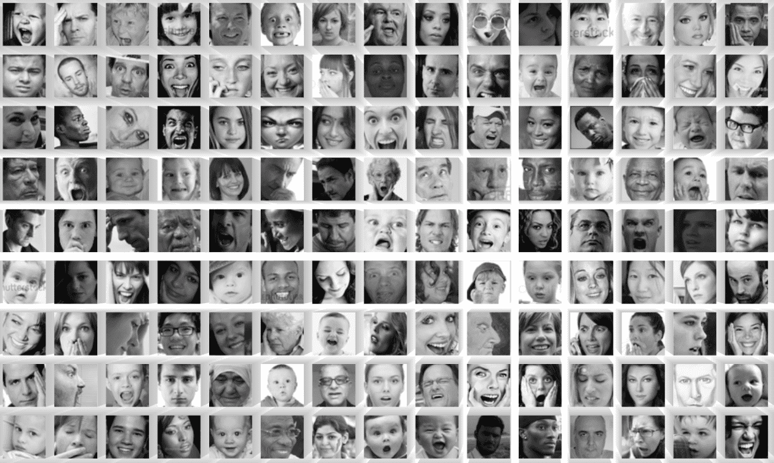
Introduction to the FER-2013 Dataset
Angry, Disgust, Fear, Happy, Neutral, Sad, and Surprise.
Notes:
FER-2013 dataset is an open-source dataset originally created by Pierre-Luc Carrier and Aaron Courville for their ongoing project
and was publicly shared in preparation for a competition on Kaggle just before ICML-2013.
The dataset is categorized into seven emotions: Angry, Disgust, Fear, Happy, Neutral, Sad, and Surprise.
The dataset includes off-frontal poses and various lighting conditions, making the pictures relatively natural.
Natural photos are more difficult to distinguish.
Human performance on this dataset is known to be around 65.5%.

Slide 5
Introduction to the FER-2013 Dataset
Release: The FER-2013 dataset is an open-source dataset originally created by Pierre-Luc Carrier and Aaron Courville for their ongoing project and was publicly shared in preparation for a competition on Kaggle just before ICML-2013.
Classes: The dataset is categorized into seven emotions: Angry, Disgust, Fear, Happy, Neutral, Sad, and Surprise.
Image Size: The images are 48x48 pixels.
Color: black and white
Number of Data: There are 28,709 training images and 3,589 test images.
Features: The dataset includes off-frontal poses and various lighting conditions, making the pictures relatively natural. The number of images is not the same across different emotions.
Human performance on this dataset is known to be around 65.5%.
Notes:
The images are black and white and 48x48 pixels.
There are 28,709 training images and 3,589 test images.
The number of images is not the same across different emotions.

Slide 6
Data Transformation, Augmentation, and Data Loader Configuration
Resizing: Resize images to 230x230 dimensions.
Data Augmentation:
Random Rotation (±15°)
Random Crop (224x224 with padding)
Random Horizontal Flip
Tensor Transformation: Convert images to PyTorch tensors.
Batch Size: 32
Shuffling: Training data is shuffled, test data is not shuffled.
Notes:
The data was augmented by applying Random Rotation, Random Crop, and Random Horizontal Flip, as described in the paper.
Random erasing was also mentioned in the paper, but it was not applied.
The final size of the images was set to 224x224.
The batch size was initially 128, but due to memory issues, it was reduced to 32.
Training data was shuffled, test data was not shuffled.

Slide 7
Models compared in this project
AlexNet
VGGNet
ResNet-50
TransFER
DACL
Notes:
The models compared in this project are as follows:
Initially, I was going to focus only on AlexNet and TransFER,
But because it was not possible to implement TransFER exactly as in the paper, other models were also compared.
The first three are well-known models, and the last two are the models from the paper.

Slide 8
AlexNet
1st place in 2012 ILSVRC (performance difference of more than 10% over the second place)
Five convolutional layers followed by three fully-connected layers
Activation function: ReLU
overlapping pooling, parallel use of two GPUs, local response normalization
Notes:
AlexNet is a well-known historical model that was the winning model of the 2012 ILSVRC.
In this project, AlexNet was included as a benchmark.

Slide 9
AlexNet – this project
3 channel color photo of 256x256x3 → 224x224x1 (FER-2013 consists of grayscale images)
Notes:
The accuracy of AlexNet was about 50% when using Adam and around 40% with SGD.
Several other learning rates were tested, but 0.001 was the best.
Without data augmentation, there was no improvement in learning.

Slide 10
VGGNet
Second in the 2014 ILSVRC (GoogleNet won the first place)
Increased depth to enhance performance. (simple structure)
'Very Deep Convolutional Networks For Large-Scale Image Recognition’ (compared six different architectures)
Used only 3x3 size filters.
The basic architecture: Conv layer - max-pooling to reduce resolution
Started with 64 channels and doubled them each time the resolution was reduced by max-pooling.
Three FC (Fully Connected) layers followed by a softmax layer.
Notes:
VGGNet is the 2014 ILSVRC second-place model, known for its simplicity and deep architecture.

Slide 11
VGGNet – this project
Adjusted version of VGGNet-16 to fit the current input
Composed of four convolutional stages
Each stage consists of two convolutional layers followed by max pooling
After each convolution, batch normalization and ReLU activation are used
The convolutional layers are followed by three fully connected layers before reaching the final classification layer
Notes:
There are various versions of VGGNet, but I used VGGNet-16.
The results showed that both SGD and Adam achieved an accuracy of 66%.

Slide 12
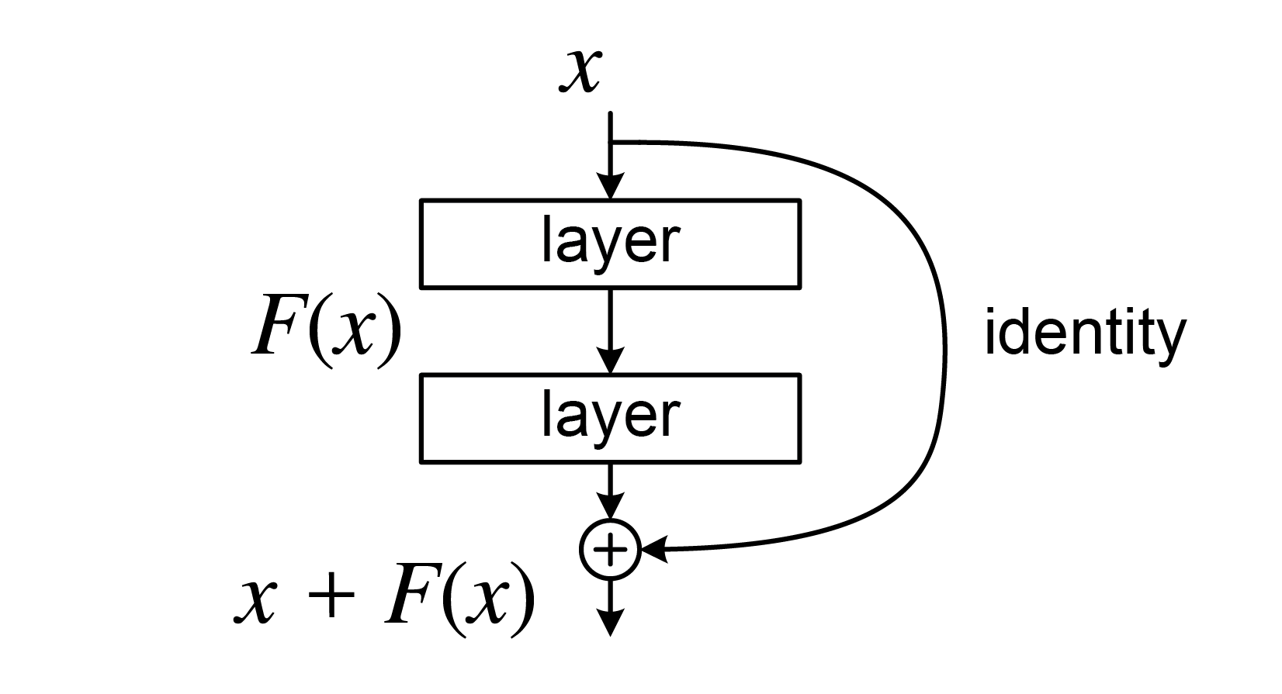
ResNet-50 (Residual neural network)
Won the 2015 ILSVRC
Top-5 error rate in the competition was 3.57% (first neural network that surpassed humans(5%))
Very deep neural network (mitigate the problems of vanishing gradient or exploding gradient)
ResNet allowed connections between the i-th and (i+r)-th layers (shortcut connection)
By using shortcut connection, gradient can be easily propagated to the previous layer during backpropagation
Notes:
ResNet is the 2015 ILSVRC winning model and is historic for being the first to surpass human-level distinction capabilities.
ResNet is characterized by its shortcut connections that skip layers, as you can see in the diagram.
ResNet is very deep neural network,
but by using shortcut connections, it can mitigate the problems of vanishing gradient or exploding gradient,
and the gradient can be easily propagated to the previous layer during backpropagation.

Slide 13
ResNet-50 – this project
ResNet comes in various versions like 18, 34, 50, 101, and 152, and for this project, I utilized ResNet-50, which was modified to accept an input of 224x224x1.
Notes:
There are several versions of ResNet, and we used ResNet-50.
It showed an accuracy of 67% when using Adam.
The performance was somewhat reduced when using SGD.

Slide 14
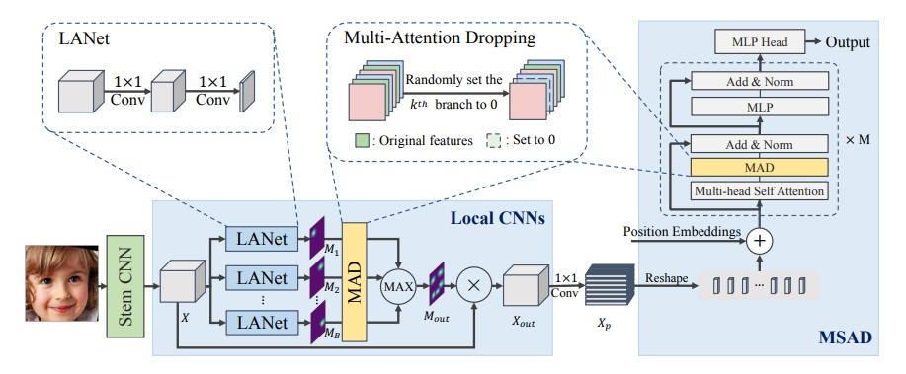
TransFER
Notes:
This model is based on the one from the referenced paper and utilizes both CNN and Transformer architectures.
Firstly, facial images are fed into a stem CNN to extract feature maps.
Feature maps are then passed through the local CNNs to locate diverse useful feature areas.
1 × 1 convolution and reshape operations are used to project feature maps to a sequence of feature vectors which can be directly input into MSAD (MAD in a Transformer encoder).
MSAD (MAD in a Transformer encoder) pushes multi-head self-attention to explore rich relations among different local patches.
MAD stands for Multi-Attention Dropping It is proposed to prevent neural networks from overfitting.
In contrast with the standard Dropout, MAD adopts a group of feature maps (or vectors) as input and treats every feature map as a whole.
This means that one feature map is selected from a uniform distribution and is entirely set to zeroes.
Optimizer is SGD.

Slide 15
TransFER
Facial images are first fed into a stem CNN to extract feature maps (IR-50)
Feature maps are then passed through the local CNNs to locate diverse useful feature areas.
1 × 1 convolution and reshape operations are used to project feature maps to a sequence of feature vectors which can be directly input into MSAD (MAD in a Transformer encoder)
MSAD (MAD in a Transformer encoder) pushes multi-head self-attention to explore rich relations among different local patches.
Optimizer: SGD
MAD(Multi-Attention Dropping): proposed to prevent neural networks from overfitting. In contrast with the standard Dropout, MAD adopts a group of feature maps (or vectors) as input and treats every feature map as a whole. This means that one feature map is selected from a uniform distribution and is entirely set to zeroes.

Slide 16
TransFER – this project (ResNet-18 with Transformer and Dropouts)
def forward(self, x):
x = self.stem_cnn(x)
x1 = self.local_cnn1(x)
x2 = self.local_cnn2(x)
x1 = self.mad(x1)
x2 = self.mad(x2)
x = torch.cat((x1, x2), dim=2)
x = x.permute(0, 2, 3, 1).flatten(1, 2)
x = self.transformer_encoder(x)
x = self.classifier(x.mean(dim=1))
return x
Stem CNN: ResNet-18 (ResNet-50 exceeded memory capacity of the Colab A100)
Local CNNs : CNN1, CNN2
MAD: Standard dropout
Transformer:
The encoder is transformer which doesn’t have a MAD layer
Notes:
In the paper, the Stem CNN is named IR-50, which is a model similar to ResNet-50.
However, when ResNet-50 was used, it exceeded the memory capacity on Google Colab, causing the training to stop.
As a result, I had to use ResNet-18.
Furthermore, it was impossible to implement MAD accurately, so standard dropout was used instead.
The transformer in this project also did not have the MAD layers. It is a regular transformer.
The performance was about 68% with SGD.
Training did not occur with Adam.

Slide 17
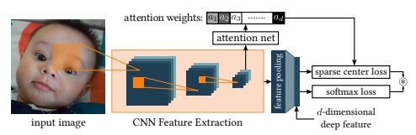
DACL
Notes:
This model is from another paper,
And as you can see, it features a hybrid form combining CNN and Attention mechanisms.

Slide 18
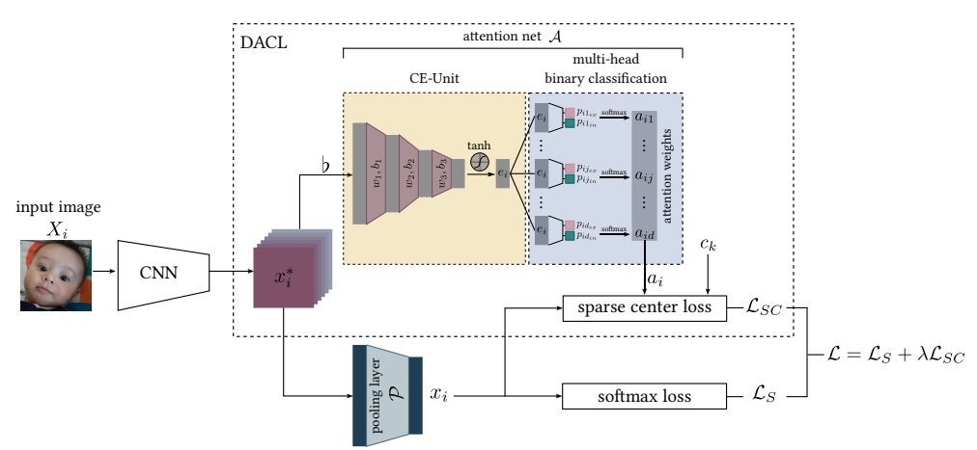
DACL
Notes:
The CNN is Pre-trained ResNet18. This yiels the convolutional spatial feature map x_i.
The CE-Unit takes the spatial feature map as a context and yields an encoded latent feature vector to eliminate noise and irrelevant information.
The multi-head binary classification module then calculates the attention weight.
The final loss is a combination of softmax loss $L_{s}$ and sparse center loss $L_{sc}$
The optimizer is SGD.

Slide 19
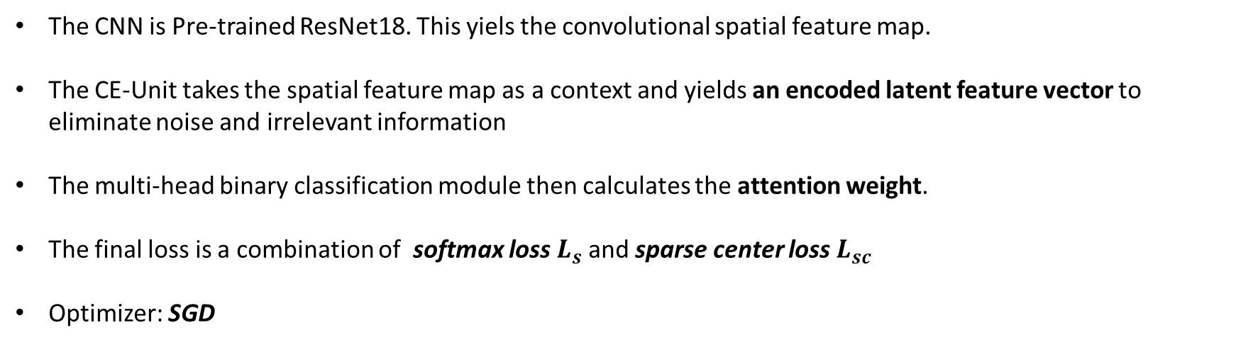
DACL
The CNN is Pre-trained ResNet18. This yiels the convolutional spatial feature map.
The CE-Unit takes the spatial feature map as a context and yields an encoded latent feature vector to eliminate noise and irrelevant information
The multi-head binary classification module then calculates the attention weight.
The final loss is a combination of softmax loss $L_{s}$ and sparse center loss $L_{sc}$
Optimizer: SGD

Slide 20

DACL – this project (ResNet-18 with Attention)
The input is transformed into significant features in the base model (ResNet-18)
The dimensions of the feature map are altered before passing it to the attention module
The attention module enables focusing on the most important features, enhancing the model's predictive capability
The tensor is flattened and then passed through a fully connected layer
the part where the loss is combined, as in the paper, was not implemented.
def forward(self, x):
x = self.base_model(x)
x = x.view(x.size(0), 512, 1, 1)
x = self.attention(x)
x = x.view(x.size(0), -1)
x = self.fc(x)
return x
Notes:
Attention was utilized, but the part where the loss is combined, as in the paper, was not implemented.
The accuracy reached 69%, which was the highest performance observed.
For this model, although SGD was used in the paper, the results were better when using Adam.

Slide 21
Accuracy Ranking
Notes:
Here is the overall ranking.
The two models from the paper had the best results, followed by ResNet, VGGNet, and AlexNet, in that order.
I tried to train a self-made CNN and transformer combination model, but it did not learn.
Thank you.

