Slide 1
TELEMEDICINE SECURITY USING VISUAL CRYPTOGRAPHY
Presented by:
group no.-19

Slide 2
CONTENTS
Introduction
Visual Cryptography
How it works?
Disadvantages of Traditional Visual Cryptography
Proposed algorithm
Basis matrices used for (k, k) and (k, n) VCS
Conclusion

Slide 3
INTRODUCTION
Telemedicine- a strongly capable technology providing cheap and effective healthcare.
Ideal for remote patient monitoring.
Exchange of medical images over the network for remote diagnosis.
Data is vulnerable to hackers’ attack and possible security breaches.
Need to protect the data being transmitted over network.
Our project provides the solution for this problem using Visual Cryptography technique.

Slide 4
VISUAL CRYPTOGRAPHY
Encrypts the information so that decryption can be performed by Human Visual System (HVS).
Category of a secret sharing scheme.
Proposed by Moni Naor and Adi Shamir in 1994.
No cryptographic computation needed while decoding concealed images.

Slide 5
VISUAL SECRET SHARING (VSS)
k-out-of-n VSS scheme
Secret image encoded into n shares.
Each share is random binary pattern, printed onto transparencies and distributed among n participants.
Secret image is decoded by superimposing any k or more transparencies of shares without computation.
Even if one has infinite computational power but has insufficient number of shares, one cannot retrieve the secret information.

Slide 6
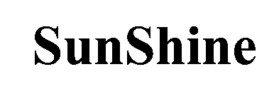

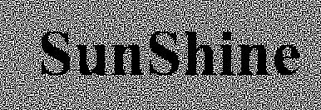


AN EXAMPLE OF (2$,$2) VCS
Secret Image
Share 1
Decrypted secret
Share 2

Slide 7

HOW IT WORKS?
White block
Block 1
Block 2
Black block

Slide 8
DISADVANTAGES OF TRADITIONAL VCS
Pixel expansion- waste of storage space and transmission time
Random pattern of shares
difficult to track mishandled shares
confusion in share identification
Predefined codebook causing excessive memory requirements
Restriction on number of participants

Slide 9
PROPOSED WORK
Construction of 2-out-of-2 visual cryptography scheme
Construction of k-out-of-k visual cryptography scheme ( (3, 3) and (4, 4) VCS)
Construction of k-out-of-n visual cryptography scheme ( (2, 3), (2, 4) and (3, 4) VCS)
Solution for the problem of pixel expansion for binary images.
Stable recovery contrast as 50 %

Slide 10
BASIS MATRICES
n × m Boolean matrices S₀ and S₁ describing sub pixels in shares.
S₀- when pixel in original secret image is white; S₁- when pixel is black.
C₀- obtained by permuting columns of S₀, C₁- obtained by permuting columns of S₁ .
Use of basis matrices can have small memory requirements and it is efficient because it only generates a permutation of the columns of S₀ or S₁.
Chosen matrix defines the color of the m sub pixels in each one of the n transparencies.

Slide 11
CONSTRUCTION OF (2, 2) VCS : PROPOSED ALGORITHM
ALGORITHM: Algorithm to solve the problem of pixel expansion in (2, 2) VCS for binary image.
INPUT: Image Matrix M.
OUTPUT: Two shares, share₁ and share₂ of same size as that of M.

Slide 12






PROPOSED ALGORITHM WORKING
0 Black
1 Black
2 Black
Binary Image
3 Black
4 Black

Slide 13
DEALING WITH 0,1,3,4 BLACK PIXEL BLOCKS
Distribute values of black and white pixels in block so that a visual perception of white occurs on stacking of block.
or
White
0 Black
1 Black
Distribute values of black and white pixels in block so that a visual perception of black occurs on stacking of block.
or
Black
3 Black
4 Black

Slide 14

DEALING WITH 2 BLACK PIXEL BLOCKS
There are two possible type of such blocks:
For diagonally black blocks, count the number of black pixels in neighborhood of black pixels in the block and if count is greater than 8 then treat this block like black block otherwise treat it as white block.
For non-diagonally black blocks, count the number of black pixels in immediate neighborhood of block b and if count is greater than four treat it like black block otherwise treat it as white block.
Diagonally black
Non-diagonally black

Slide 15


BASIS MATRICES USED FOR (2, 2) VCS
S₀ =
S₁ =
White
Black

Slide 16


BASIS MATRICES USED FOR (3, 3) VCS
S₀ =
S₁ =
White
Black

Slide 17
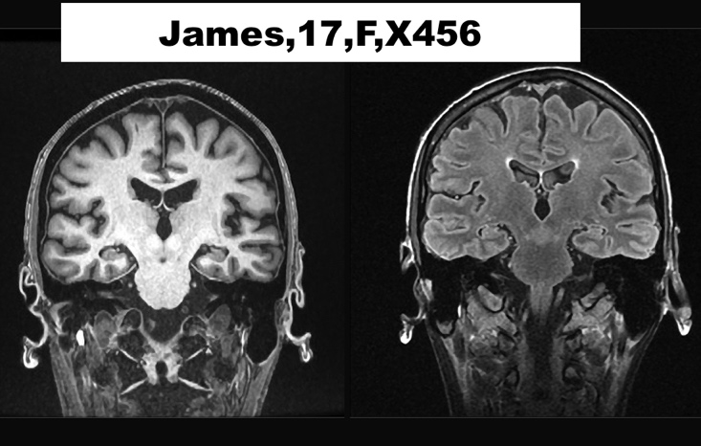
Example of (3,3) VCS
Image with Secret data

Slide 18
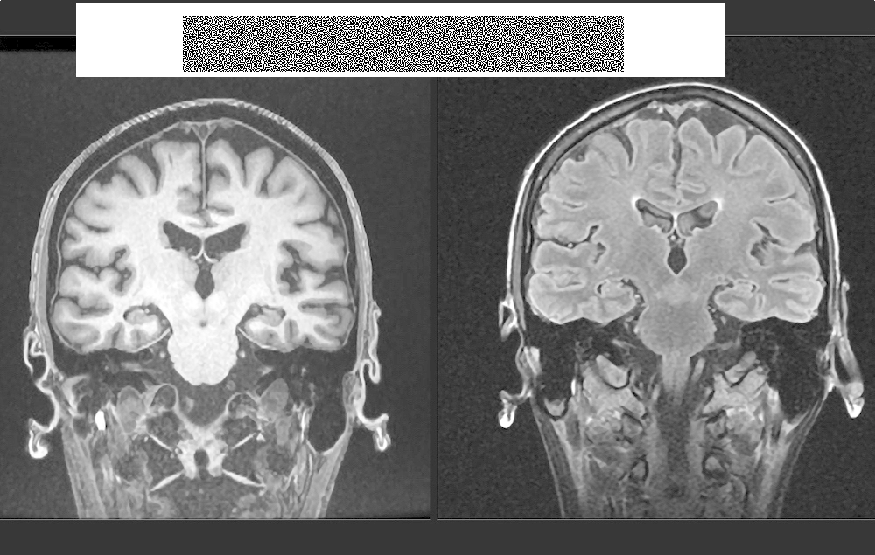
Example of (3,3) VCS
Share 1

Slide 19


Example of (3,3) VCS
Share 2
Share 3

Slide 20

Example of (3,3) VCS
Decrypted Output

Slide 21


BASIS MATRICES USED FOR (2, 3) VCS
S₀ =
S₁ =
White
Black

Slide 22


BASIS MATRICES USED FOR (2, 4) VCS
S₀ =
S₁ =
White
Black

Slide 23
PREPROCESSING ALGORITHM FOR (4, 4) AND (3, 4) VCS
ALGORITHM: Algorithm for pre-processing the input image to solve problem of pixel expansion in (3, 4) or (4, 4) VCS for binary image.
INPUT: Image Matrix M.
OUTPUT: Pre processed image Matrix M.

Slide 24
PROPOSED ALGORITHM FOR (4, 4) AND (3, 4) VCS
ALGORITHM: Algorithm to solve the problem of pixel expansion in (3, 4) VCS and (4, 4) for binary image.
INPUT: Image Matrix M
OUTPUT: Four shares will be generated.
The block size is 2 x 3.

Slide 25





PROPOSED ALGORITHM WORKING
For every block of six pixel(2$×$3) after preprocessing only 4 type of block are possible:
All blocks with 0 or 2 white pixels are treated as black block (In shares use black basis matrix for the block representation) and the block with number of white pixel 4 or 6 are treated as white block (In shares use white basis matrix for the block representation) .
6 White Pixel
4 White Pixel
2 White Pixel
0 White Pixel

Slide 26










BASIS MATRICES USED FOR (4, 4) VCS
S₀ =
S₁ =
White
Black

Slide 27


BASIS MATRICES USED FOR (3, 4) VCS
S₀ =
S₁ =
White
Black

Slide 28
CONCLUSION
Our project contains three fundamental algorithms based on visual cryptography technique.
Solving the problem of data confidentiality within medical images.
Probability of the appearance of black pixels and white pixels in the decoded image is 1 and 0.5 respectively, which guarantees the value of contrast to be 50%.
All the experimental results show the effectiveness of the proposed method and all the output images produced after stacking of the shares provide good visual perception.

Slide 29
THANK YOU

