Slide 1
Final
Sam

Slide 2
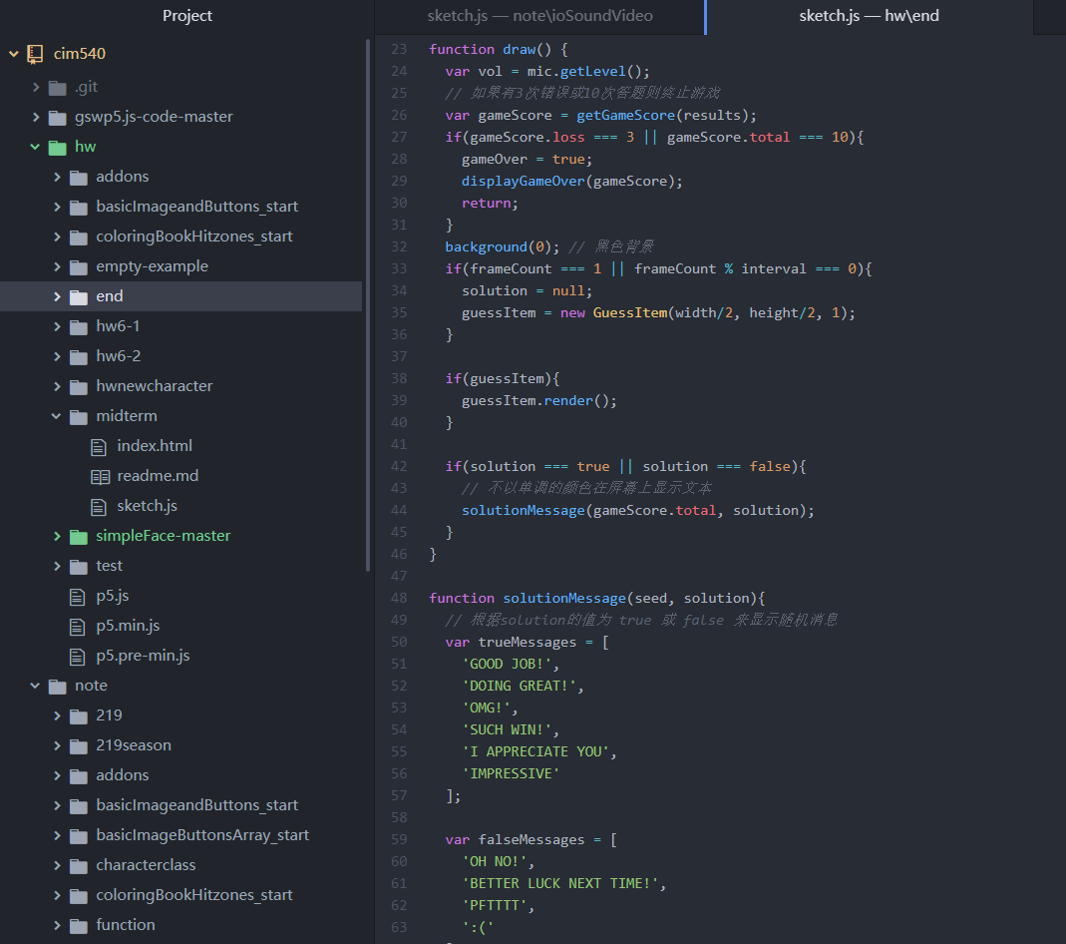
Clock to get up
Stop alatm only u satisfy requirement

Slide 3
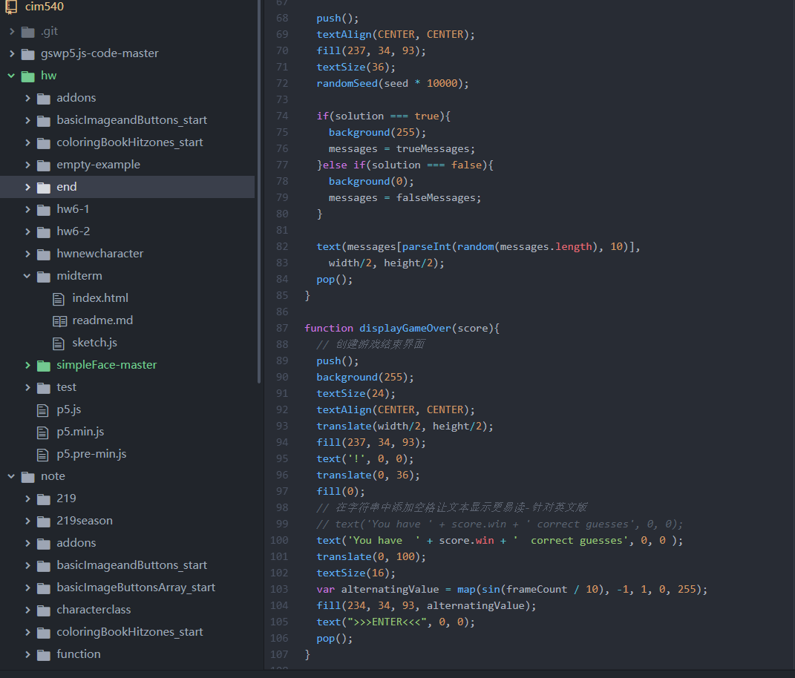
Sound library
Clock
Interface

Slide 4
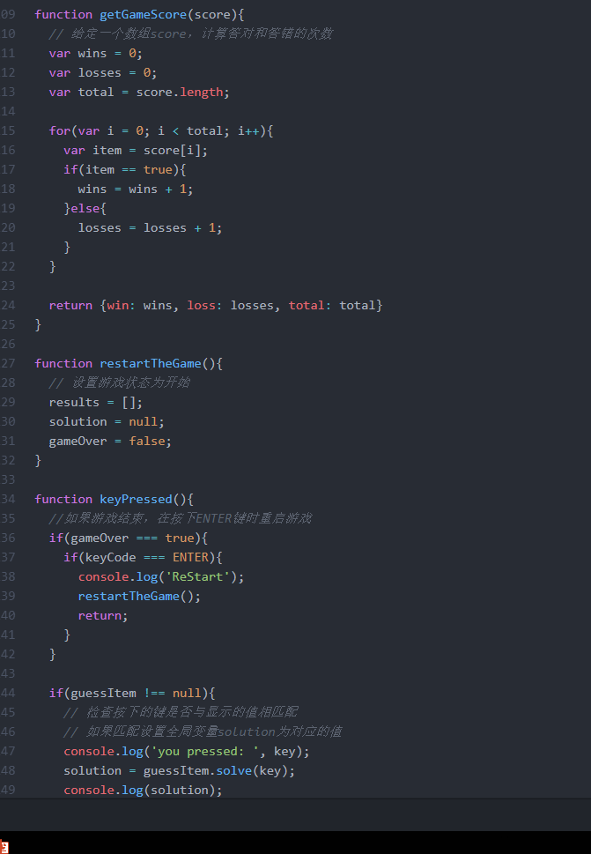
Workflow
Start alarm
show question
Use your sound
R/W
3r stop alarm

