Slide 1
VERJava: Vulnerable Version Identification for Java OSS with a Two-Stage Analysis
Qing Sun，Lili Xu，Yang Xiao，Feng Li，He Su，Yiming Liu，Wei Huo
Institute of Information Engineering, Chinese Academy of Sciences, China
School of Cyber Security,University of Chinese Academy of Sciences, China
Notes:
good afternoon ，im sun qing from School of Cyber Security, University of Chinese Academy of Sciences in China
it is very glad to be here for this presentation，today im going to show my work VERJava：Vulnerable Version Identification for Java OSS with a Two-Stage Analysis

Slide 2
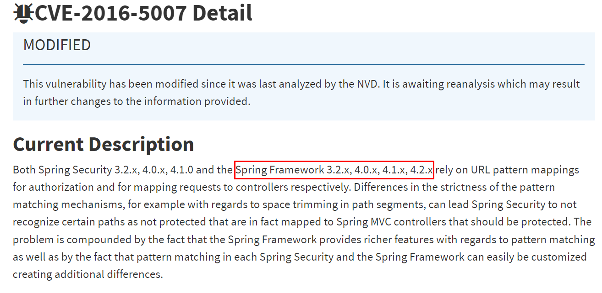

Motivation
The accurate version information are
3.2.1-15，4.0.0-9，4.1.0-9，4.2.0-9
Notes:
To patch the vulnerabilities in OSS , software maintainers often go to check the vulnerable versions of CVEs
However, studies show that CVE's vulnerable version information in NVD is generally inaccurate.
Taking CVE-2016-5007 as an example, the version information provided by NVD is inaccurate.

Slide 3







Motivation
Wrong Messages
Security Analyst
Security
Companies
Researcher
Users
Notes:
Incorrect vulnerable version information will have potential security risks.
This could seriously mislead the repair for software maintainers, and greatly hinder the work of security researchers.
Therefore, it is of great importance to accurately identify the exact vulnerable versions affected by CVEs.
错误的漏洞信息都会存在安全隐患，对于研究者漏洞分析者，其他安全维护者，软件使用者来说，都会存在一定的潜在安全风险

Slide 4
Challenge-I: Code Evolution Processing
// commit 2235894210c75f624a3d0cd60bfb0434a20a18bf
// fix in version 2.9.4
-- /src/.../impl/SubTypeValidator.java
@@ -0,0 +1,98 @@
...
+ if (full.startsWith(PREFIX_STRING)) {
+ for (Class<?> cls = raw; cls != Object.class;
cls = cls.getSuperclass()) {
+ String name = cls.getSimpleName();
+ if ("AbstractPointcutAdvisor".equals(name)||
"AbstractApplicationContext.equals".equals(name)){
+ break;
+ }
+ }
+ }
...
// SubTypeValidator.java in version 2.9.10
if (raw.isInterface()) {
...;
} else if (full.startsWith(PREFIX_SPRING)) {
for (Class<?> cls = raw; (cls != null) && (cls != Object.class); cls =cls.getSuperclass()){
String name = cls.getSimpleName();
if ("AbstractPointcutAdvisor".equals(name)||
"AbstractApplicationContext".equals(name)){
break main_check;
}
}
} else if (full.startsWith(PREFIX_C3P0)) {
if (full.endsWith("DataSource")) {
break main_check;
}
}
1
2
3
4
5
6
7
8
9
10
11
12
13
14
1
2
3
4
5
6
7
8
unmatch
Patch in Jackson-databind v2.9.4
CVE-2017-17485 in Jackson-databind v2.9.10
Notes:
but doing the Vulnerable Version Identification has some challenges
the first one：With the version evolution, the code may change.
Take the code of CVE-2017-17485 in version 2.9.10 as an example.
The conditional and loop statement has been modified， and a new conditional statement has been added, which is different from the patch code.
Simply using added lines to consider the existence of the vulnerability will only match two lines in the patch code,, thus would misjudge version 2.9.10 as vulnerable.
It is challenging to consider the difference between target code and post-patch accurately (marked it as Challenge-I: code evolution processing).

Slide 5
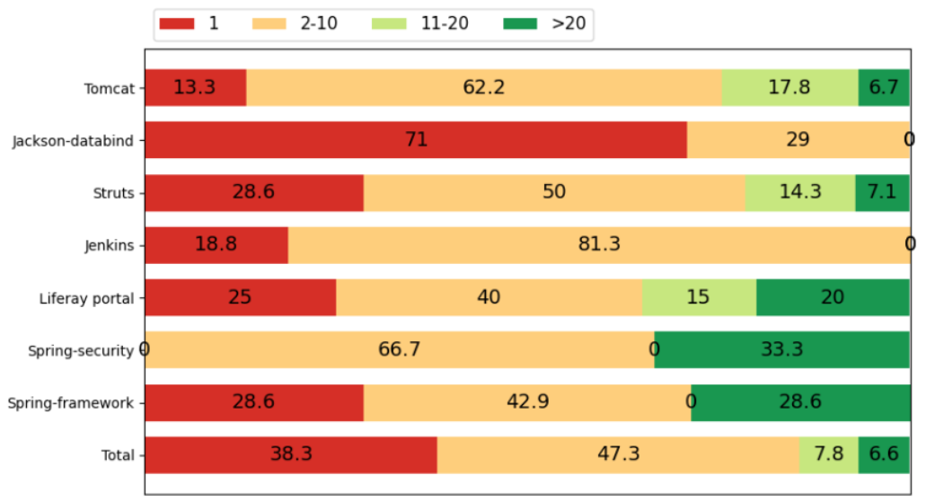
Challenge-II: Multi-Location Fix Handling
Patch for CVE-2011-0013 (Tomcat)
--- 6.0.x/.../manager/HTMLManagerServlet.java (revision 1057269)
@@ -407,10 +407,11 @@
args = new Object[7];
args[0] = URL_ENCODER.encode(displayPath);
- args[1] = displayPath;
- args[2] = context.getDisplayName();
- if (args[2] == null) {
+ args[1] = RequestUtil.filter(displayPath);
+ if (context.getDisplayName() == null) {
args[2] = "&nbsp;";
+ } else {
+ args[2] = RequestUtil.filter(context.getDisplayName());
}
--- 6.0.x/.../manager/StatusTransformer.java (revision 1057269)
@@ -575,7 +575,7 @@
- writer.print(webModuleName);
+ writer.print(filter(webModuleName));
@@ -650,7 +650,7 @@
- writer.print(name);
+ writer.print(filter(name));
@@ -778,11 +778,11 @@
- writer.print(servletName);
+ writer.print(filter(servletName));
for (int i = 0; i < mappings.length; i++) {
- writer.print(mappings[i]);
+ writer.print(filter(mappings[i]));
Over 60%！
Notes:
the second challenge
the patch FOR CVE-2011-0013 involves modifications not only in one function but also in four other functions.
After analyzing an extensive number of patches, we found that Java patches generally involve multiple function locations.
How do we comprehensively estimate the version range of a vulnerability when it exists in multiple functions in multiple files
(marked THIS as Challenge-II: multi-location fix handling)

Slide 6
VERJava
VERJava： A two-stage novel approach to accurately identify the range of vulnerable versions
Vulnerable Versions Range detection in Java
Information Collection
Function-level Vulnerable Version Calculation
Patch-level Vulnerable Version Calculation
Patch
Split patch in functions
Multi-location fix handling
Versions’
source code
Similarity Analysis
Multi-branch handling
Notes:
For such cases ， we have proposed and implemented a novel approach named VERJava to accurately identify the range of vulnerable versions.
V for vulnerable， e for the versions, and r for the range
VERJava is mainly composed of three parts.
The information collection takes a target project's name and a CVE ID as input, uses a customized crawler to fetch the CVE's patch and collect multiple versions' source code for the target project.
then the Function-level Vulnerable Version Calculation calculates vulnerability versions by similarity analysis，
and next the Patch-level Vulnerable Version Calculation considering multi-location repair and multi-branch processing ，generates the vulnerable version list for the entire patch,.
针对这类问题我们提供了VERJava，一个可以准确识别漏洞版本范围的工具
VERJava主要由三个部分组成，首先收集漏洞的补丁以及多版本源代码，然后进行函数等级的漏洞版本计算，最后进行补丁级别的漏洞版本计算，考虑多位置修复与多分支情况的处理。

Slide 7

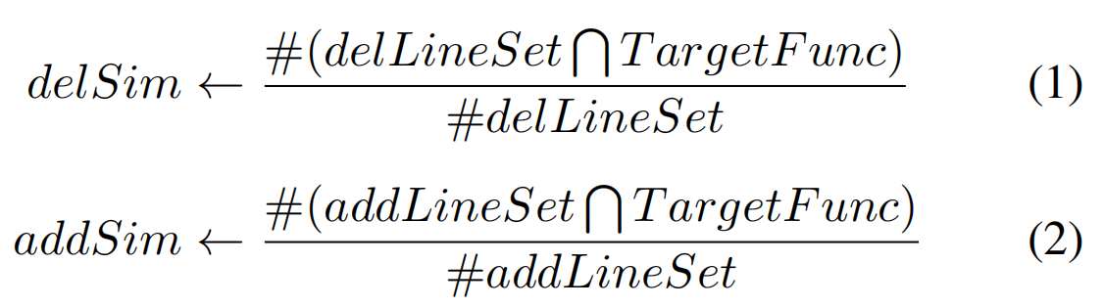

Function-level Vulnerable Version Calculation
Solve Challenge-I: Code Evolution Processing
FuncA Patch
Split in functions
Patch
FuncB Patch
Function-level
Range Result
Similarity between the target function and the post-patch and pre-patch functions
FuncC Patch
...
Notes:
First, split the patch by the function of the source code as a unit, then calculate the similarity between the target version and the pre-patch and post-patch functions, and finally get the vulnerability version range of each function
首先将补丁以源代码的函数作为单位进行拆分，然后计算目标版本和补丁前后代码的相似度，最后得到漏洞每个函数的漏洞版本范围

Slide 8
Patch-level Vulnerable Version Calculation
Vulnerability
Notes:
Next, we found that Java project is usually multi-branch management.
the multiple lines represent different branches of Java project management (1.X, 2.X, etc.), and as time goes by, multiple branches advance update and management at the same time
The red line indicates vulnerability disclosures , it occurs on multiple branches, so the Vulnerable Version should also be multi-branched.
接下来我们通过展示Java项目管理的一般过程来说明Java的管理通常是多分支管理的现象
多条线表示Java项目管理的不同分支（1.X、2.X等等），随着时间的推移是多个分支同时推进更新与管理的
红色部分表示在某一时间点出现漏洞披露，漏洞发生在多个分支上，因此漏洞涉及的版本也应该是多分支的

Slide 9
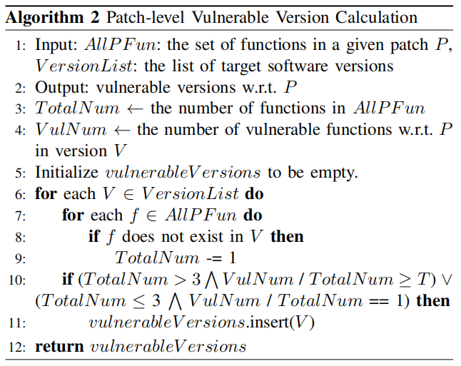
Patch-level Vulnerable Version Calculation
BranchA
Split in branches
Function-level
Range Result
BranchB
Patch-level Vulnerable Version Calculation
Solve Challenge-II: Multi-Location Fix Handling
Notes:
Thus we separately analyze the vulnerable versions with respect to each patch from different branches, merge the results of all patches and obtain a final list of versions vulnerable to the CVE.

Slide 10
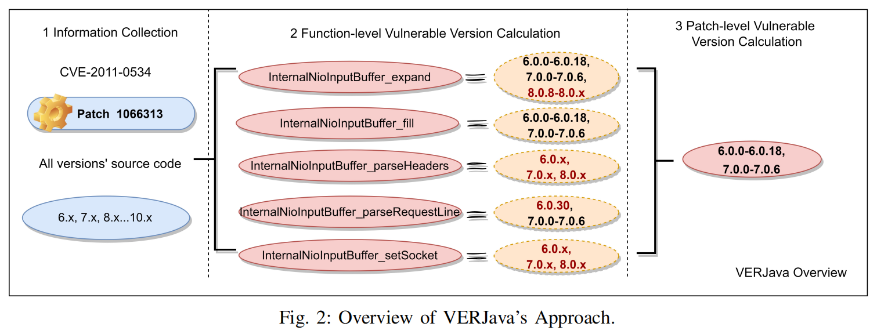
VERJava Overview
Notes:
we show the overview of VERJava’s approach by this
we illustrate the workflow of VERJava by using Tomcat’s CVE-2011-0534 as an example. This CVE has a fixing patch with an issue management ID , containing five patch functions.
At the information collection step, the patch functions and all versions’ source code are collected.
At the function-level stage, a list of versions where each involved function is not patched are calculated respectively.
At the patch-level stage, basically, since almost all the five functions are un-patched in these versions , these versions are considered vulnerable to this CVE.

Slide 11
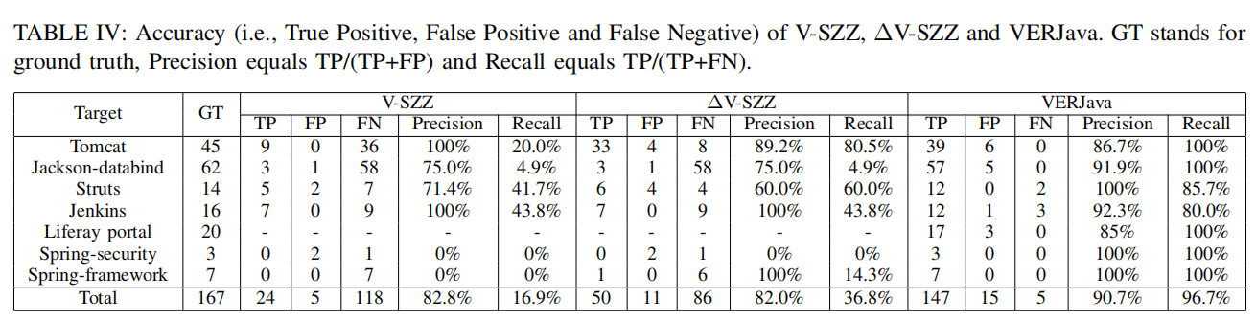
Evaluation
Our dataset contains 7 real-world open-source Java projects, including 167 CVEs, and extracts 344 patches from them
Improve V-SZZ (as∆V-SZZ) to remove 5-line limit.
Notes:
Then, the experimental effect of VERJava is introduced.
Our dataset contains seven real-world open-source Java projects, including 167 CVEs, and extracts 344 patches from them
Experiments show that our VERJava has higher precision and recall compared to existing state-of-the-art work
我们收集的数据
然后实验显示和现有的最新的工作相比，我们的VERJava的准确率和召回率更高

Slide 12
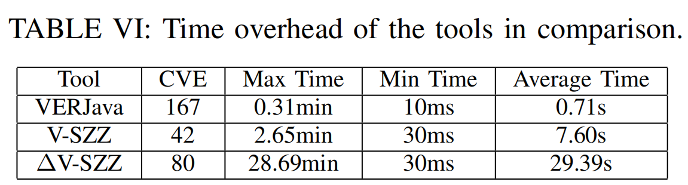
Evaluation
Our dataset contains seven real-world open-source Java projects, including 167 CVEs, and extracts 344 patches from them
Improve V-SZZ (as∆V-SZZ) to remove 5-line limit.
Notes:
In terms of time efficiency, the effect of VERJava is also better
时间效率上比对，也是VERJava的效果更好

Slide 13
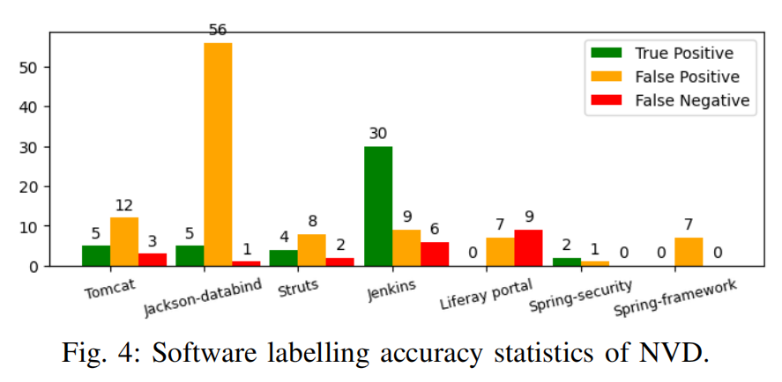


Findings
Sibling classes and interface class fixes.
Notes:
We manually annotated 167 CVEs. The annotation results show that NVD has incorrect version annotations for 121 CVEs (72%).
The NVD ranges seem overly conservative
During the manual analysis of the patch, we found repairs to sibling classes and interface classes.
We think this observation would give some clues in better recurring vulnerability detection for OO language. Specifically, by giving higher weights
to similar code snippets in sibling or interface classes, more recurring vulnerabilities may hopefully be found.

Slide 14

Conclusion
We collected 167 CVEs，and through manual analysis, we found that nearly 70% CVEs of NVD were inaccurate.
https://github.com/sunSUNQ/VERJava_Dataset
Java patches have the characteristics of multi-function repair, multi-line repair and multi-branch management.
VERJava, which can accurately identify the range of vulnerable versions.
VERJava can significantly outperform the state-of-the-art approach V-SZZ.
Notes:
we make this dataset open in this link
we observed that
proposed an approach

Slide 15
THANKS Q&A
sunqing@iie.ac.cn

Slide 16
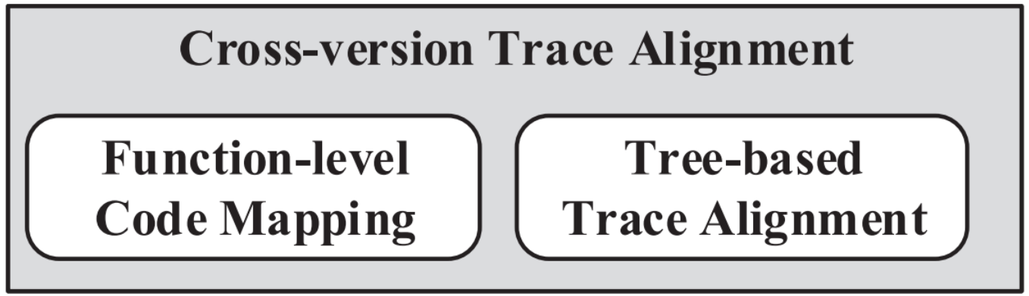
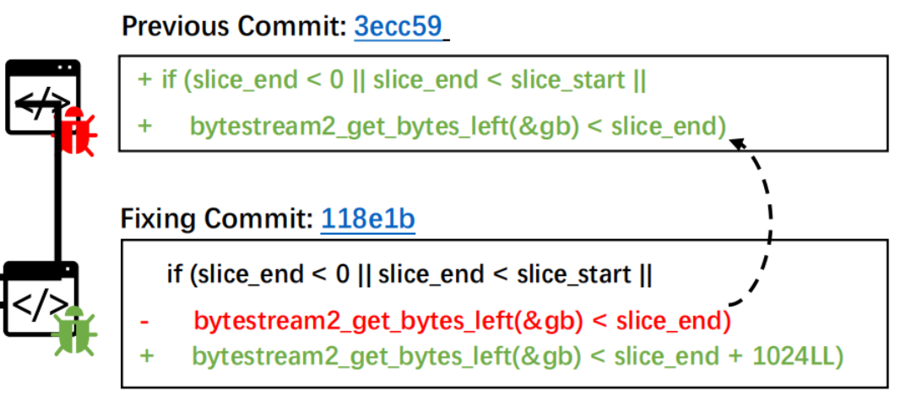
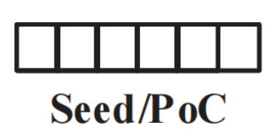

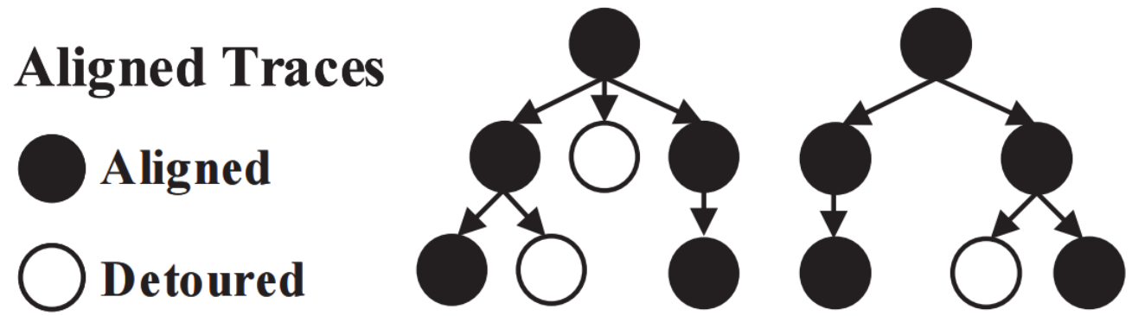
State-of-the-art Approach
Dynamic Analysis Approach
Static Analysis Approach
VULSCOPE(CCS 2021)：
V-SZZ(ICSE 2022)：
Notes:
Dynamic analysis approach use fuzzing-based method for triggering. They first need a public PoC of CVE's reference version, and trys to generate triggerable PoCs for more versions.
Dynamical approach introduces no false positives, however, it cannot ensure the vulnerability existence for the versions that are failed to construct a mutated PoC, which means that it may have false negatives.
To address this problem in a light-weight way, static analysis approach based on the blame feature of version-control systems also leads an active line of research.
Essentially, V-SZZ uses the git blame command for the deleted lines in the patch to locate the earliest commit that introduce the deleted lines. The versions between the inducing commit and the fixing commit are considered to be the range of vulnerable versions.
Such methods cannot handle the patches where the vulnerabilities are fixed by adding checks, namely, no deletion exists

Slide 17
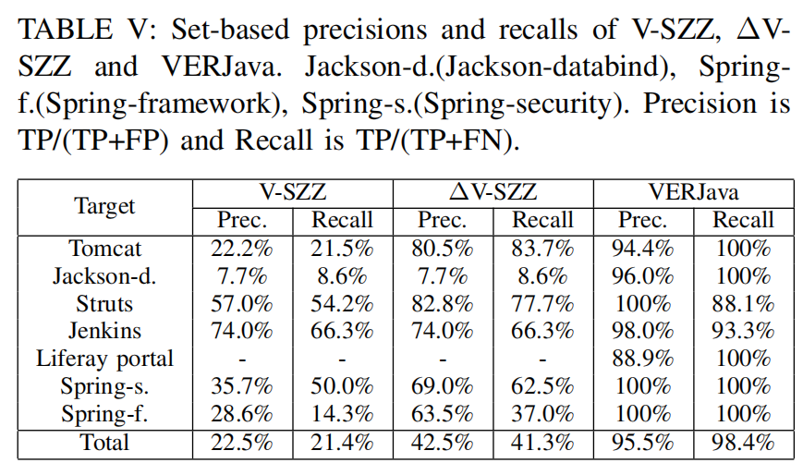
Evaluation
Our dataset contains seven real-world open-source Java projects, including 167 CVEs, and extracts 344 patches from them
Improve V-SZZ (as∆V-SZZ) to remove 5-line limit.
Notes:
我们收集的数据
然后实验显示和现有的最新的工作相比，我们的VERJava的准确率和召回率更高

