Slide 1
RRB / CLIP RELATION STUDY
Research: Relational Residual Bottlenecking for CLIP
A bounded residual route to relation-sensitive retrieval
frozen CLIP path
bounded residual
guardrail audit
Zixuan Sun, Dehao Wu, Tianyi Wang, Yifei Wang
CS510, May 2026
https://textdata.org/submissions/69cc3194dc0c4f1963eab7ab
1/10
Notes:
Open by framing the talk as a technical pattern: preserve the frozen CLIP interface, add a small residual correction, and audit relation gains against retrieval guardrails.

Slide 2
PROBLEM
CLIP can keep the objects and miss the relation
Counterfactual captions keep surface vocabulary close.
Image
The target change is relation, role, order, object, or attribute binding.
"dog left of bicycle"
A high similarity score is not enough if the binding is wrong.
small edit, different relation
"dog right of bicycle"
2/10
Notes:
Use the dog-left versus dog-right example to explain why relation edits are a useful diagnostic. The failure is not that CLIP knows nothing; it often recognizes objects while underweighting the binding relation.

Slide 3
RELATED WORK I
Existing relation fixes often change the retrieval interface
CLIP compositional probes
ARO, SugarCrepe, Winoground
Show bag-of-words behavior under relation, attribute, and order edits.
Structured matching
scene graphs, semantic graphs, graph reasoning
Expose relation structure, but often add parsers, graphs, or pairwise matching modules.
Spatial / knowledge cues
spatial supervision, 3D graphs, knowledge graphs
Improve explicit structure, but move away from plain dual-encoder retrieval.
RRB keeps independent image/text embeddings and dot-product retrieval.
3/10
Notes:
This slide expands the related-work positioning from paper section 2. The key distinction is not that structure is unhelpful; it is that many structured methods change the deployed interface that makes CLIP attractive.

Slide 4
RELATED WORK II
The closest prior art motivates a narrower claim
Reasoning benchmarks
scene-graph prompting, MIRB, causal diagnostics
Motivate relation-sensitive evaluation, but mainly test broader multimodal reasoning settings.
Relation-aware CLIP adaptation
local RACA-CLIP manuscript
Conceptual prior art for relation sensitivity; RRB emphasizes residual preservation tradeoffs.
Preservation-oriented PEFT
LoRA, null-space, projection, residual adapters
Provides adaptation tools; RRB does not claim residual adaptation itself is novel.
Supported contribution: structured counterfactual training through a bounded residual interface, evaluated as a tradeoff.
4/10
Notes:
Make the claim boundary explicit. The paper does not claim to invent residual adapters or preservation constraints. It claims a particular bounded residual recipe and an analysis of where that recipe succeeds and fails.

Slide 5
METHOD SETUP
The method is constrained to the CLIP dual-encoder pattern
Frozen image encoder f_v and text encoder f_t produce normalized z0.
z_v = f_v(I)
Image and text embeddings remain computable independently.
No detector, parser, cross-attention reranker, scene graph, or candidate-pair module is added.
z_t = f_t(T)
Final retrieval remains one dot product between normalized vectors.
sim(I,T) = dot(z_v, z_t)
Design consequence: relation correction must fit inside the embedding path.
5/10
Notes:
This is the setup from method section 3. RRB deliberately rules out stronger reasoning machinery so the evaluation is about correcting the frozen embedding rather than replacing CLIP with a new matcher.

Slide 6
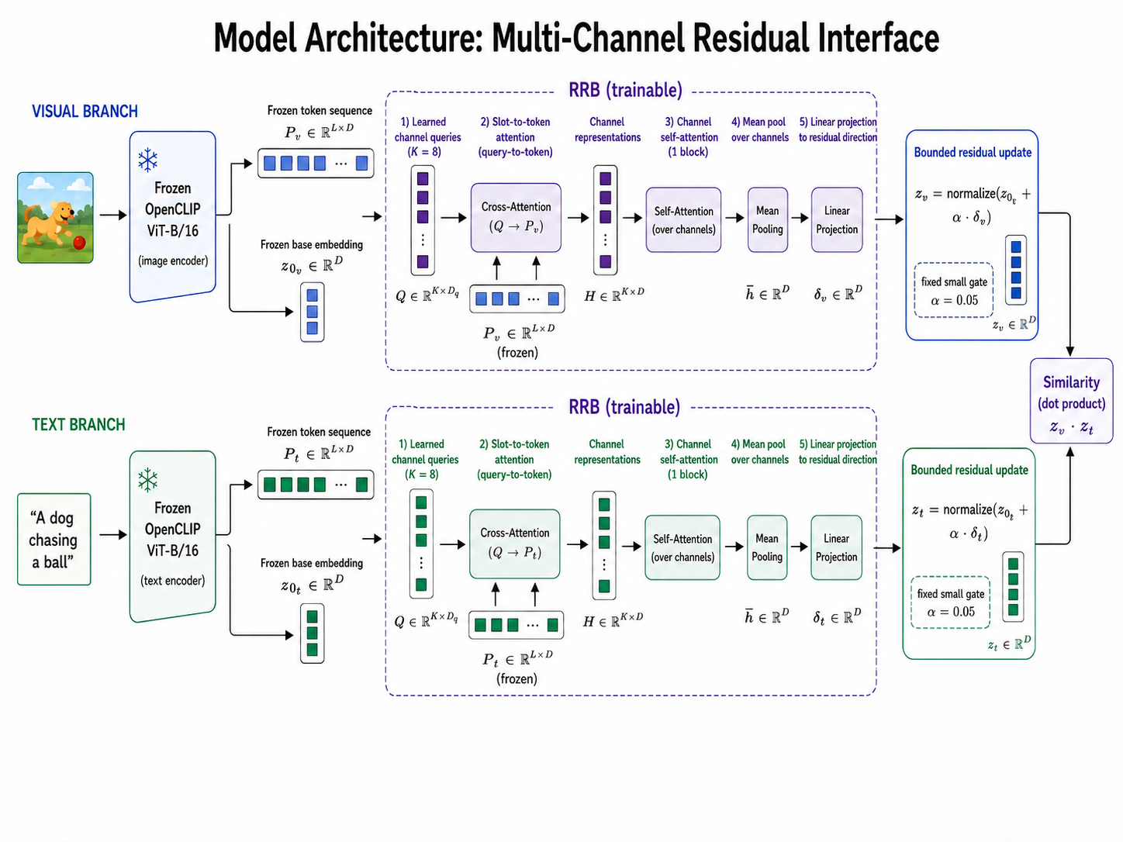
METHOD DETAIL
RRB adds a small residual path, not a replacement embedding
K = 8 learned channel queries
channel self-attention + pooling
z_out = normalize(z0 + alpha Delta)
fixed alpha = 0.05
The bottleneck constrains where the relation objective can move CLIP.
6/10
Notes:
Walk through the architecture figure. Frozen token features feed a parser-free bottleneck. The residual direction is bounded by alpha, and the frozen representation stays dominant.

Slide 7
METHOD DETAIL
The objective separates relation signal from preservation pressure
L = lambda_rel L_intervene + lambda_anchor L_anchor + lambda_delta L_delta
L_intervene
margin ranking over structured counterfactual captions
forces positive caption above edited relation negative
L_anchor
feature mimicry on anchor examples
keeps output embeddings close to frozen OpenCLIP
L_delta
residual magnitude penalty
keeps Delta small before the fixed gate
Selected R028 uses lambda_anchor = 10, lambda_delta = 0.01, anchor ratio = 0.75, and no targeted relational loss.
7/10
Notes:
Explain the training signal from section 3. Structured counterfactuals are not generic hard negatives: the edited caption is close in vocabulary but wrong in binding. Anchor and residual penalties are the guardrail pressure.

Slide 8
EXPERIMENT RESULTS
The run families isolate signal, stability, and claim boundaries
Selection logic
Training signal
Stability and limits
R003 / R005
R023
R019 / R025 / R027
frozen OpenCLIP and plain-adapter baselines
no-targeted weak-anchor RRB
full-RRB seed family
reference relation/guardrail tradeoff before RRB
shows targeted slot loss is unnecessary but weak anchoring misses COCO
relation stable, but COCO gate passes only 1/3
R011 / R014
R028 / R031 / R032
hard-token replacement bottlenecks
R024
anchor-10 no-targeted family
stress test: relation can rise while COCO/ImageNet collapse
generic hard-negative control
selected recipe repeats relation gain; COCO passes 2/3
rules out generic hard negatives; relation falls below the plain adapter
R028
R035-R039
selected no-targeted stronger-anchor RRB
anchor-20 no-targeted sweep
chosen because it passes relation, COCO, and ImageNet gates
R029
lower residual drift, but COCO pass rate remains 3/5
matched targeted stronger-anchor control
R033 / R040
adds targeted loss back; no tradeoff advantage over R028
R030 / R034 / R041 / R043 / R045
no-channel residual controls
diagnostics, Winoground, channel probe, ROP, Flickr30k
test whether a simpler residual path preserves CLIP; it does not
bound the claim: no broad binding, no semantic slots, retrieval tax remains
8/10
Notes:
This consolidated experiment slide replaces the separate design, ablation, stability, and boundary slides. Explain the run families as evidence logic: the selected checkpoint is not a single lucky number, but a point supported and bounded by controls, ablations, seed families, and external checks.

Slide 9
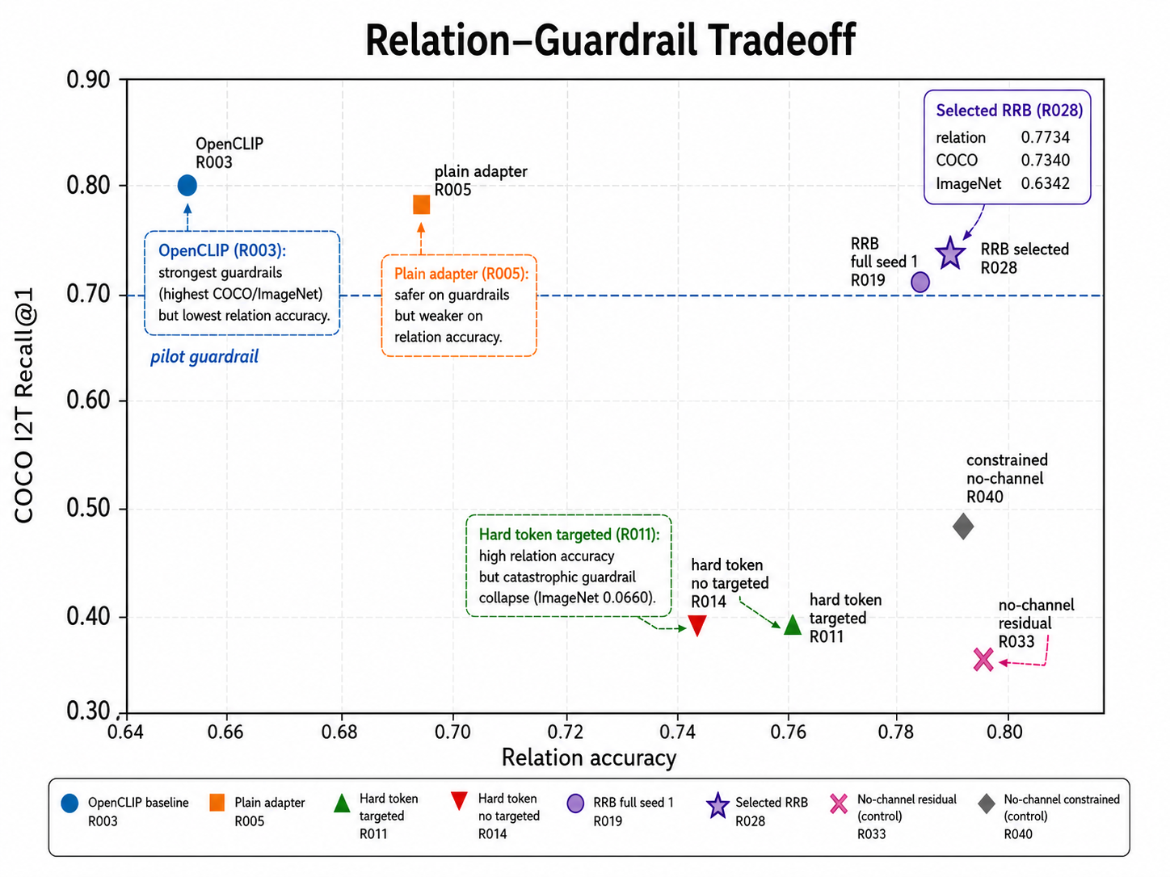
MAIN EVIDENCE
Selected R028 improves relation while staying above guardrails
R005 plain adapter
relation 0.6956
safe but weaker relation baseline
R028 selected RRB
relation 0.7734
passes COCO 0.7340 and ImageNet 0.6342
R033 no-channel control
relation 0.7825
higher relation but COCO collapses to 0.3740
9/10
Notes:
This is the main quantitative claim. R028 is not lossless; it is a better relation-versus-preservation point than hard-token or no-channel controls.

Slide 10
TAKEAWAY
Best claim: a bounded relation-preservation tradeoff
RRB keeps CLIP's deployed dual-encoder interface intact.
Structured relation counterfactuals are the useful signal.
Preservation must be measured directly across seeds and external checks.
relation gains are useful only when preservation is audited
Questions?
10/10
Notes:
Close with the claim that the evidence actually supports: RRB can find a useful bounded residual direction, but the current recipe is not a full solution to compositional binding or robust preservation.

