Slide 1
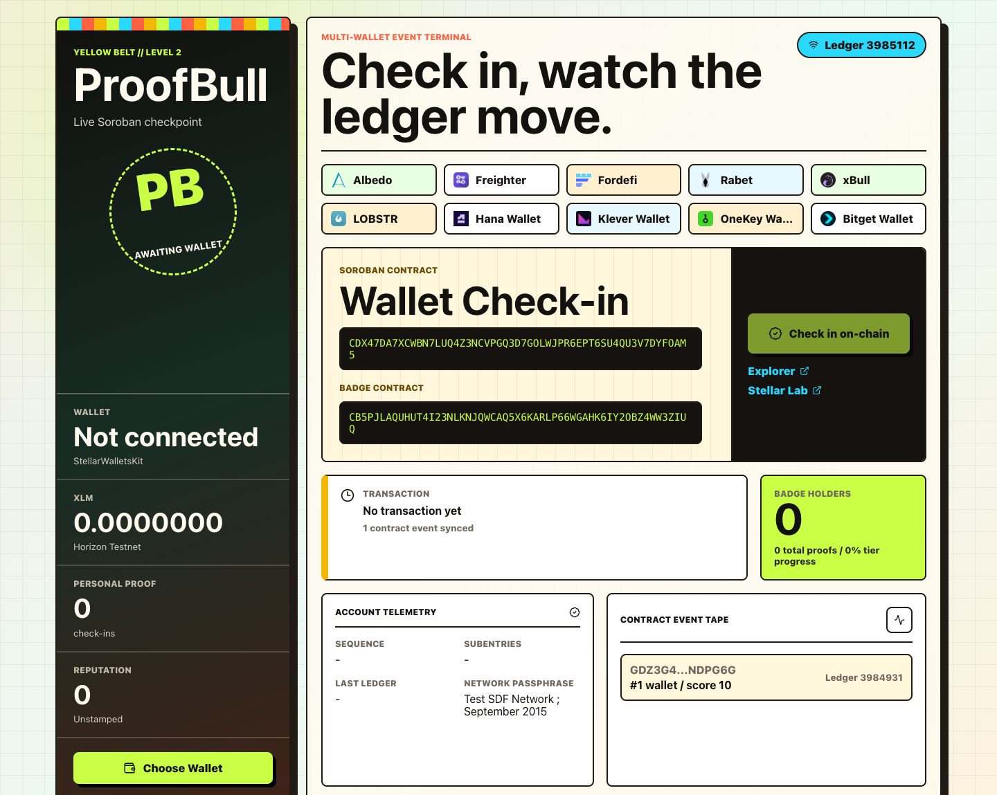
PROOFBULL
Stellar check-ins for verifiable builder activity
Blue Belt pitch deck // User growth, product iteration, and demo readiness
PB
Notes:
Sources: Local product screenshot from frontend/public/wallet-options-screenshot.png.

Slide 2
PROBLEM
Early dApps struggle to prove real usage.
Reviewers need proof they can inspect.
Wallet activity is scattered
Builders often share screenshots, but reviewers need verifiable Testnet interactions.
Onboarding drops at signing
New users get lost between wallet selection, Testnet funding, and transaction confirmation.
Feedback is disconnected
Product iteration slows when wallet proof and user feedback live in separate places.
ProofBull // Level 5 Blue Belt
02
Notes:
Sources: Project requirements provided in the Level 5 prompt; ProofBull local README.

Slide 3
SOLUTION
ProofBull turns a wallet action into a review-ready proof trail.
1
2
3
4
Connect
Check in
Earn
Submit feedback
Pick a Stellar Testnet wallet.
Record the action with Soroban.
Turn activity into a badge score.
The product captures what to improve next.
One flow combines onboarding, proof, analytics, and feedback.
ProofBull // Level 5 Blue Belt
03
Notes:
Sources: ProofBull frontend and contract workflow in the local repository.

Slide 4
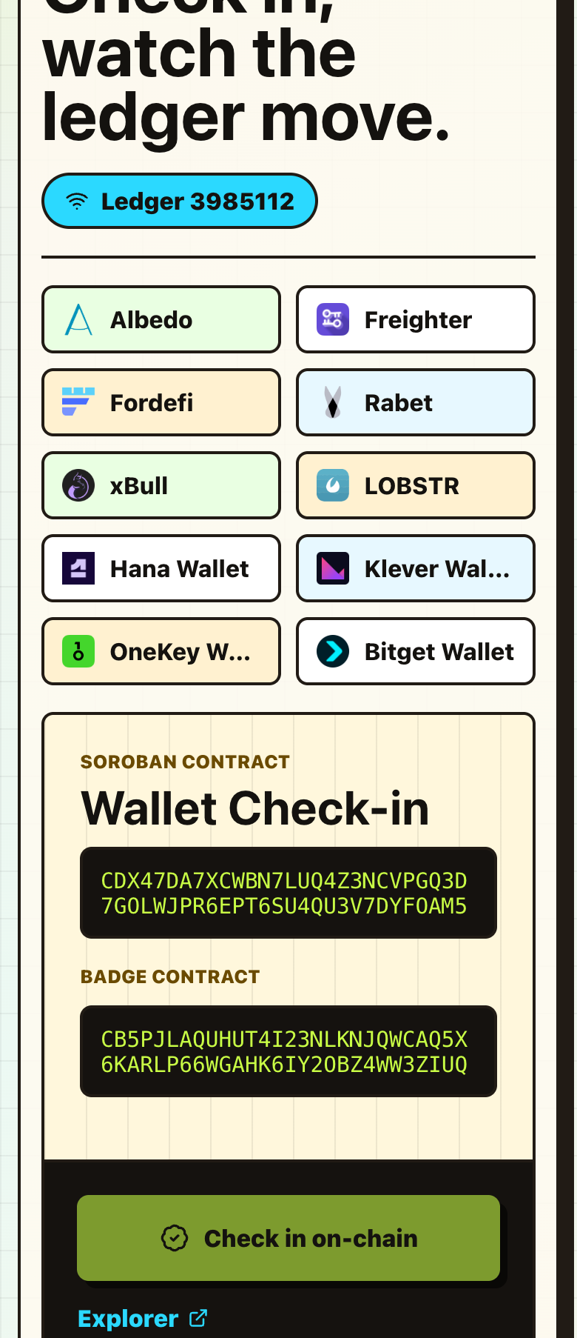
PRODUCT WALKTHROUGH
Live, responsive, built for the signing moment.
Mobile proof
ProofBull // Level 5 Blue Belt
04
Notes:
Sources: Local product screenshots from frontend/public.

Slide 5
ARCHITECTURE
ProofBull separates wallet UX, proof APIs, and Soroban logic.
React frontend
Wallet selector, transaction states, monitoring, feedback
Two contracts
check-in + badge
Express API
Horizon lookup, analytics, feedback, proof summaries
Soroban contracts
Check-in contract and reputation badge contract
Stellar Testnet
Transaction hashes, ledger events, explorer verification
ProofBull // Level 5 Blue Belt
05
Notes:
Sources: Local README architecture section and backend/frontend source files.

Slide 6
VALIDATION SYSTEM
Proof is auditable across users, transactions, and feedback.
50+
50+
1
1
real Testnet users
transaction wallets
Google Form export
feedback roadmap
The backend tracks active transaction wallets, while the evidence pack links Form responses, Excel analysis, screenshots, and explorer URLs.
ProofBull // Level 5 Blue Belt
06
Notes:
Sources: Level 5 requirements in the prompt and local Level 5 evidence files.

Slide 7
MARKET OPPORTUNITY
The first beachhead is teams that need lightweight proof-of-participation.
Hackathons and workshops
Participants need a fast way to show wallet setup and contract usage.
Start with review proof. Grow into reputation.
Builder communities
Organizers need verifiable activation without building custom dashboards.
Early ecosystem programs
Reviewers need usage proof, feedback summaries, and demo-ready artifacts.
ProofBull // Level 5 Blue Belt
07
Notes:
Sources: Product positioning derived from the ProofBull repository and Level 5 requirements.

Slide 8
GROWTH STRATEGY
Growth starts with guided cohorts, then turns proof into retention.
Acquire
Activate
Retain
Invite Stellar workshop users and hackathon peers to complete a guided Testnet check-in.
Use wallet guidance, transaction status, and explorer links to reduce signing uncertainty.
Turn repeat check-ins into badge progress, cohort history, and community proof.
ProofBull // Level 5 Blue Belt
08
Notes:
Sources: Growth strategy created from Level 5 requirements and current product capabilities.

Slide 9
ROADMAP
Next phase: convert proof collection into a repeatable onboarding engine.
Blue Belt ask
Approve after 50 real wallet rows, Form export, and demo links are attached.
Now
Ship Level 5 growth proof, feedback workbook, and pitch deck.
Next
Use real responses to improve funding guidance and transaction copy.
Later
Add retention metrics, cohort pages, and stronger badge utility.
ProofBull // Stellar Testnet MVP
Notes:
Sources: Local Level 5 evidence plan and roadmap workbook.

