Slide 1


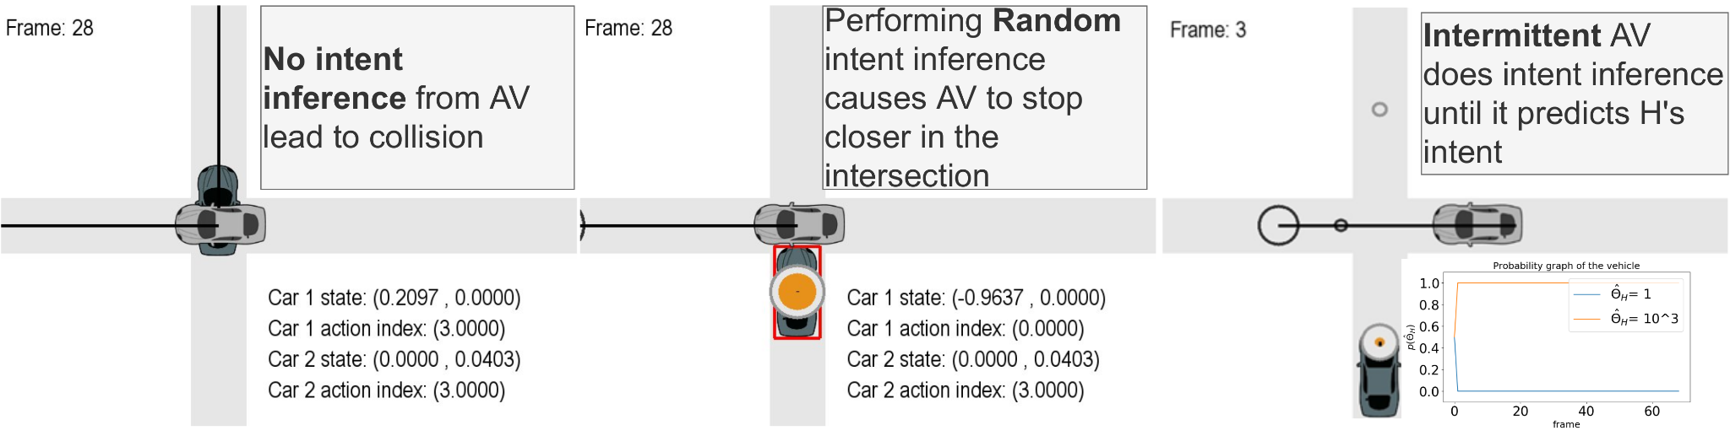
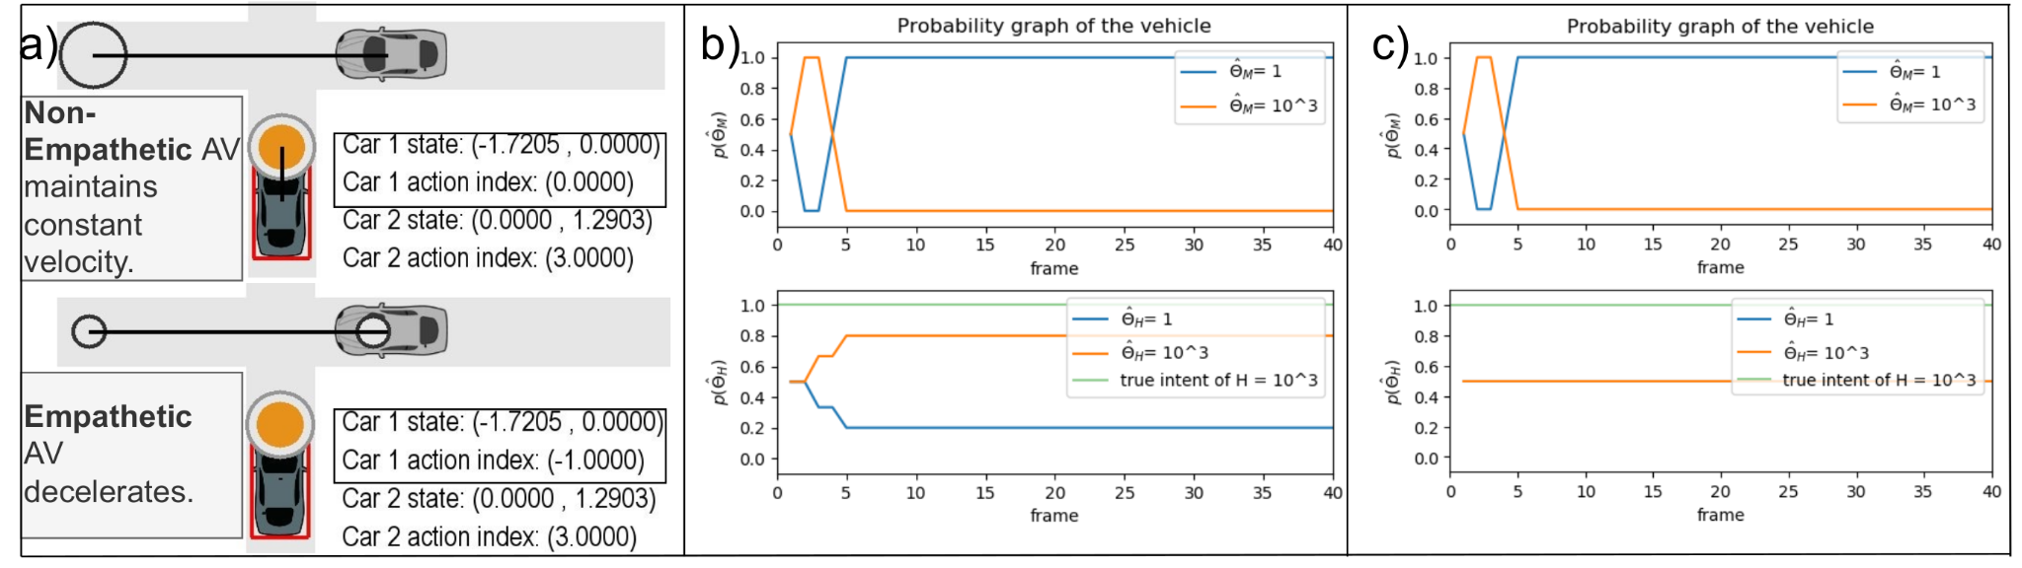
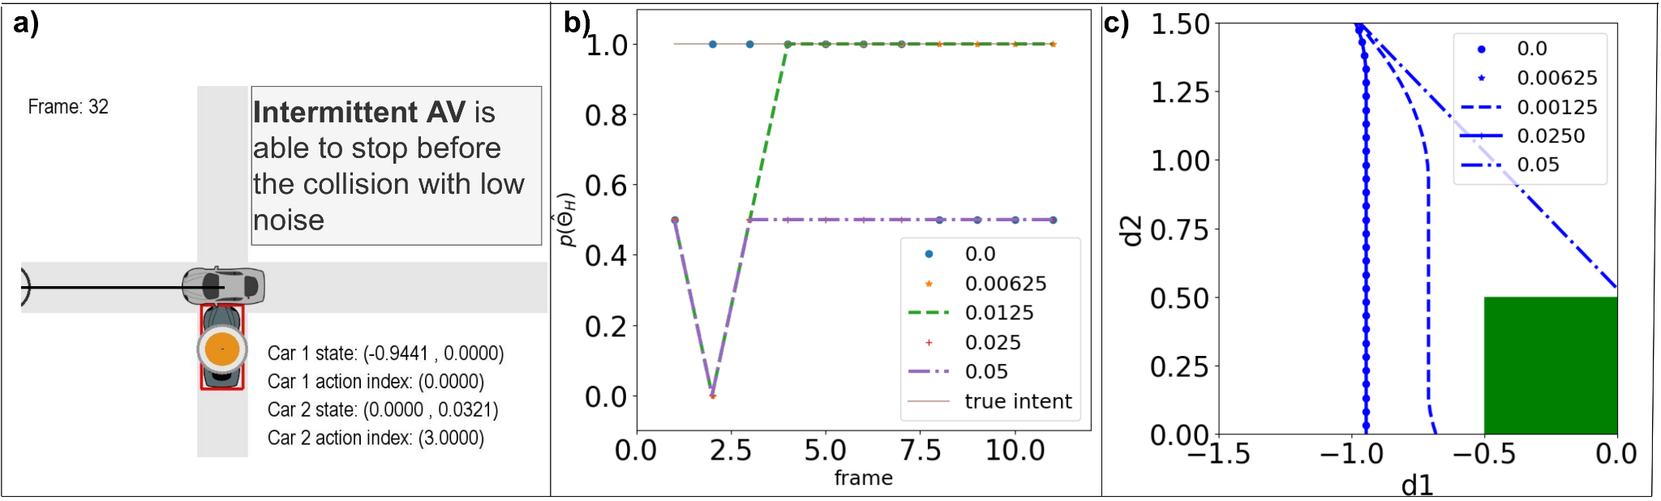
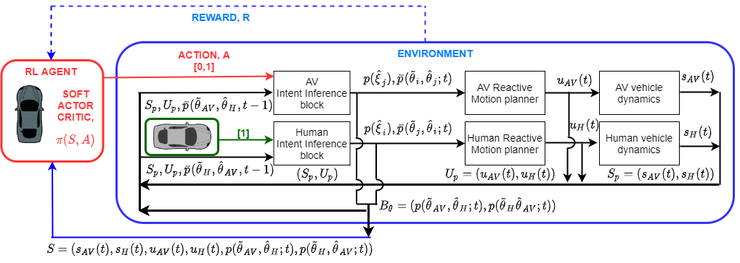
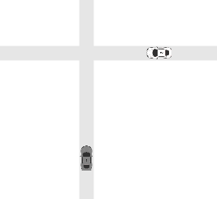



When Shall I Estimate Your Intent?
Costs and Benefits of Intent Inference in Multi-Agent Interactions
Sunny Amatya ¹, Mukesh Ghimire¹, Yi Ren¹, Zhe Xu¹, Wenlong Zhang ¹
¹ Ira A. Fulton Schools of Engineering, Arizona State University
Introduction
Motivation
Case Study
In multi-agent interactions, estimating other’s intent is imperative for successful interaction.[1]
Such game can be modeled as dynamic game with incomplete information.[2]
Computing perfect Bayesian equilibrium (PBE) in real time is computationally expensive. [3]
Do we need to run the intent inference at the same frequency as decision making / control?
What is a good choice of trigger for intent inference?
Will empathy show more advantages in an event-triggered intent inference paradigm for multi-agent interactions?
Case study 1: Performance Comparison of Intermittent Empathetic Intent Inference with Baseline Algorithms.
Case study 2: Intermittent Intent Inference with Measurement Noise in the perceived state of the H vehicle.
Parameters | Empathetic | Non-Empathetic | Intermittent
Memory (KB) | 3.11±0.28 | 2.95±0.95 | 1.27±0.34
Time (s) | 291.47±46.79 | 155.20±14.62 | 170.32±14.18
Value | -1.14e5 ±6.58e3 | -1.32e5 ±6.37e3 | -1.09e5 ±4.17e3
Distance | 1.43±0.05 | 1.33±0.07 | 1.42±0.15
Noise Variance | Collision Ratio | Inference Ratio
0.0 | 0.100 | 1.0±0.0
0.00625 | 0.129 | 0.847±0.035
0.0125 | 0.133 | 0.155±0.089
0.025 | 0.145 | 0.562±0.064
0.05 | 0.140 | 0.810±0.051
Fig. 1: Lack of intent inference causes vehicle collision, randomly performing intent inference to save computation load may cause the AV to perform socially inept maneuver, Intermittent intent inference can cause AV to perform intent inference until the intent is known.
Fig. 3: a) Empathetic AV is able to predict H as aggressive and break while non-empathetic AV maintains a constant velocity. b) Empathetic AV with reduced update frequency takes significant time to predict H. (c) Non-empathetic AV is unable to predict the true intent of the H.
Background
Methodology
Intent is hidden goal directed parameters. [1]
Game-theoretic approach for multi-agent interaction requires ego agent to build a theory of mind for the other agent.
Previous studies have shown that empathy allows agent to produce socially adept results. [2]
Human motor controls are event-triggered intermittent control activated via noise or input threshold. [4]
Reinforcement Learning agent takes in the physical and belief states and outputs if the agent should do intent inference or not.
RL agent is empathetic and follows reactive motion planner.
Fig. 5: a) Intermittent AV is able to stop before collision in presence of noise. b) Different estimated intent by the AV in presence of noise. c) Trajectories in different belief update.
Intermittent Intent Inference performs similar navigations as compared to the continuous inference algorithm while saving significant memory and time.
In safety critical cases, intermittent intent inference shows inverse relationship between inference ratio and rate of collision.
Robot: “I’m non-aggressive, therefore you are aggressive”
Robot: “The best explanation is you believed I’m aggressive, and I believed you are non-aggressive.”
?
Future Work
?
?
?
Deployment in other traffic interaction scenario.
The proposed algorithm can be extended to include belief over H’s trajectories. This can aid in generating trajectories from intermittent agents resembling empathetic agents.
Fig. 2: Empathetic agent counts in the possibility of misunderstanding
Fig. 4: Block diagram of the RL-based intermittent empathetic intent inference.
[1] Nikolaidis, S., Hsu, D. and Srinivasa, S., 2017. Human-robot mutual adaptation in collaborative tasks: Models and experiments. The International Journal of Robotics Research, 36(5-7), pp.618-634.
[2] Ren, Y., Elliott, S., Wang, Y., Yang, Y. and Zhang, W., 2019, May. How shall I drive? Interaction modeling and motion planning towards empathetic and socially-graceful driving. In 2019 International Conference on Robotics and Automation (ICRA) (pp. 4325-4331). IEEE.
[3]Chen, Y., Zhang, L., Merry, T., Amatya, S., Zhang, W., Ren, Y., “When shall I be empathetic? The utility of empathetic parameter estimation in multi-agent interactions”, accepted, 2021.
[4]Gawthrop, P., Loram, I. Lakie, M. Gollee,H. “Intermittent control:a computational theory of human control,” Biological cybernetics, vol.104, no. 1, pp. 31–51, 2011.

