Slide 1
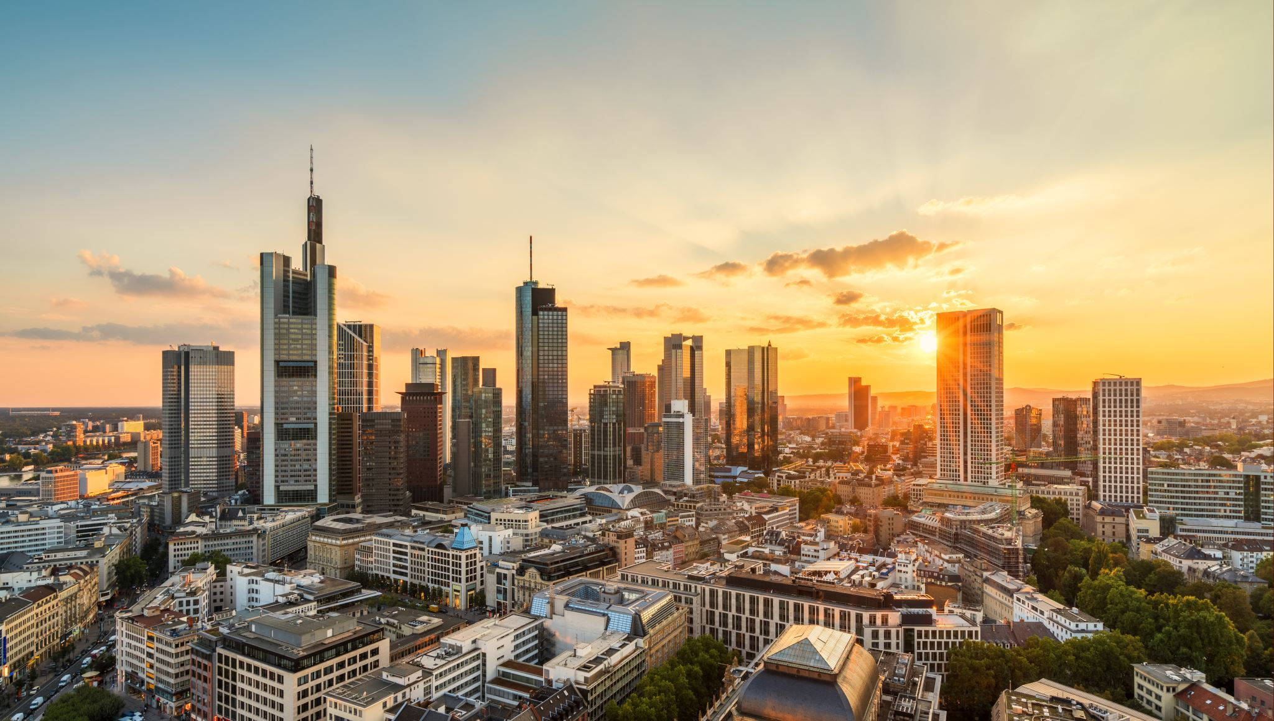
Greatest increase in housing prices in London boroughs

Slide 2
GOAL
DETERMINING WHICH BOROUGHS OF LONDON HAVE SEEN THE GREATEST INCREASE IN HOUSING PRICES, ON AVERAGE, OVER THE LAST TWO DECADES AND FINDING THE MOST DESIRABLE AREA TO LIVE IN

Slide 3
PROJECT MODULES:
1. Sourcing and loading
2. Cleaning, transforming, and visualizing
3. Modeling
4. Evaluating and concluding

Slide 4
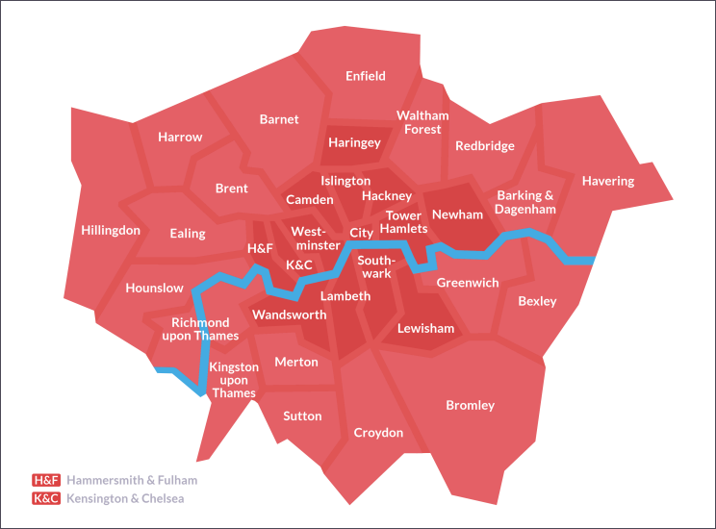
DATA RESOURSE
Data comes from the [London Datastore] https://data.london.gov.uk/download/uk-house-price-index/70ac0766-8902-4eb5-aab5-01951aaed773/UK%20House%20price%20index.xls , A free, open-source data-sharing portal for London-oriented datasets.
There are total 32 London Boroughs and the City of London which is not a borough.

Slide 5
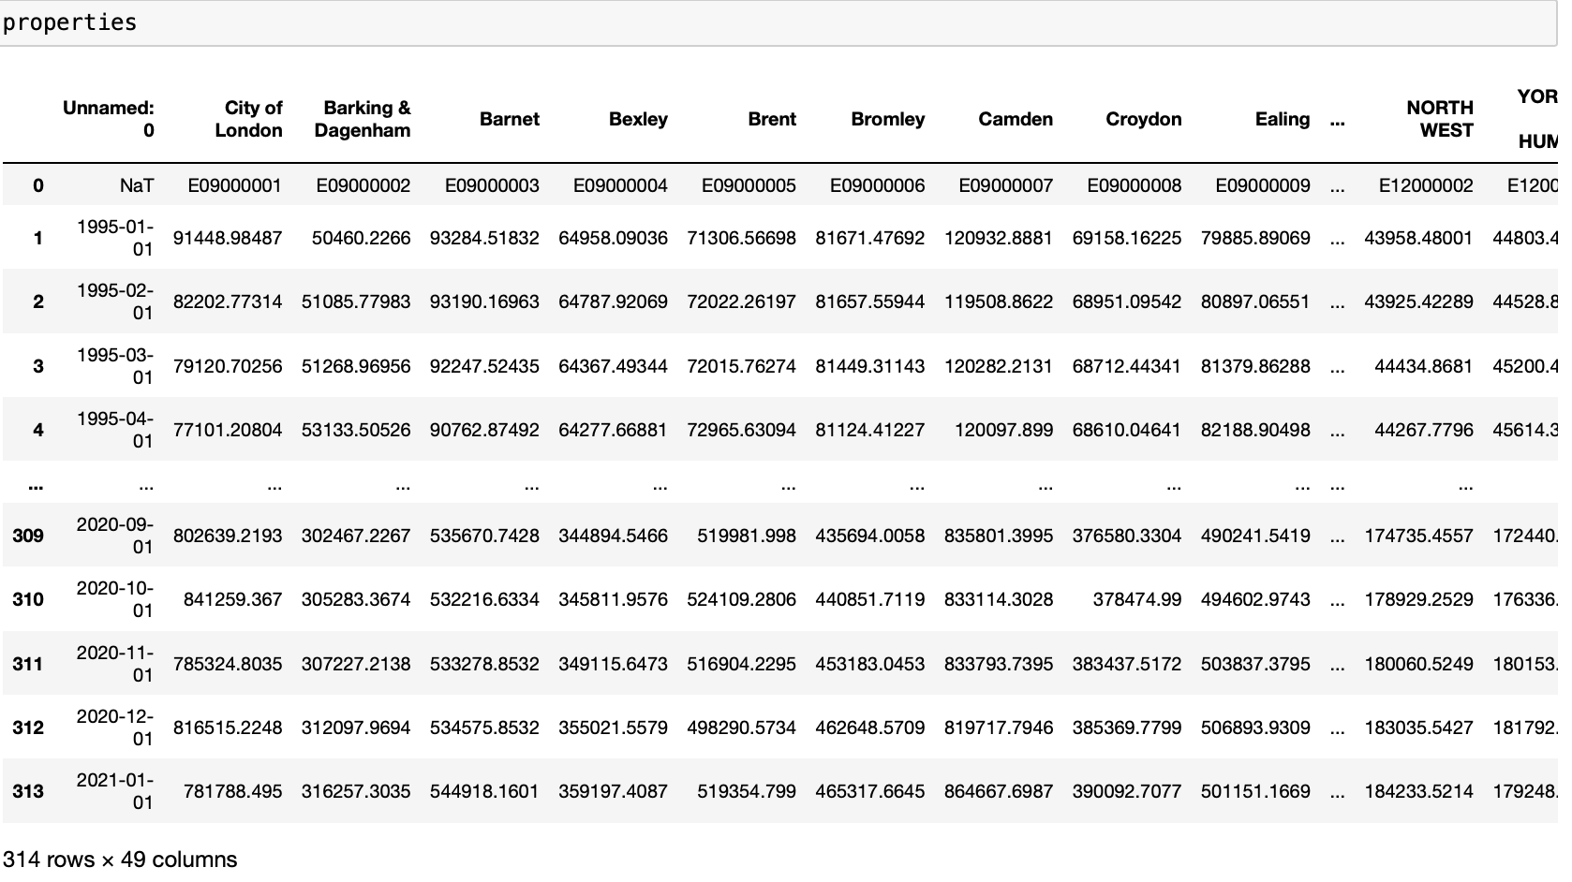
Dataset overview:

Slide 6
challenges
Non-London Boroughs and the missing Values were present in the dataset. Thus, removed all the null values and Non-London Boroughs to filter the dataset for getting relevant information.
Also, Instead of taking the average price of houses for every single month of the year from 2000 to 2018 we calculated the Average Price of houses every year to limit the number of data points.

Slide 7
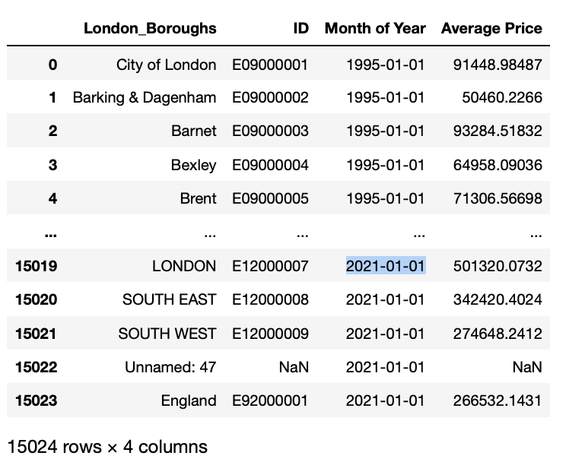
Transforming the data
Melting the DataFrame

Slide 8
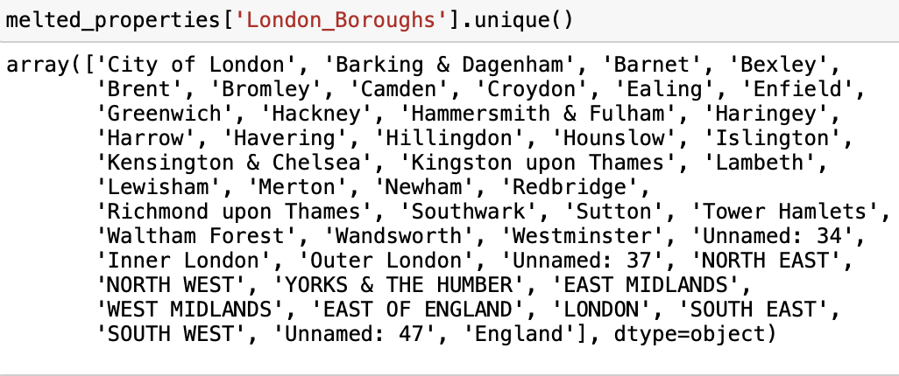
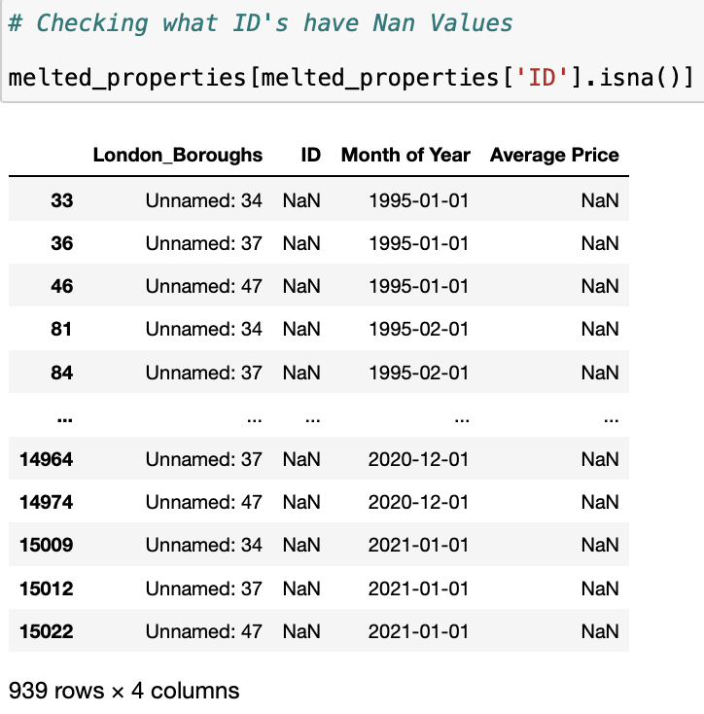
CLEANING THE DATA
Here we have records which are not a London Borough.
Also, we have null values in the dataset.

Slide 9
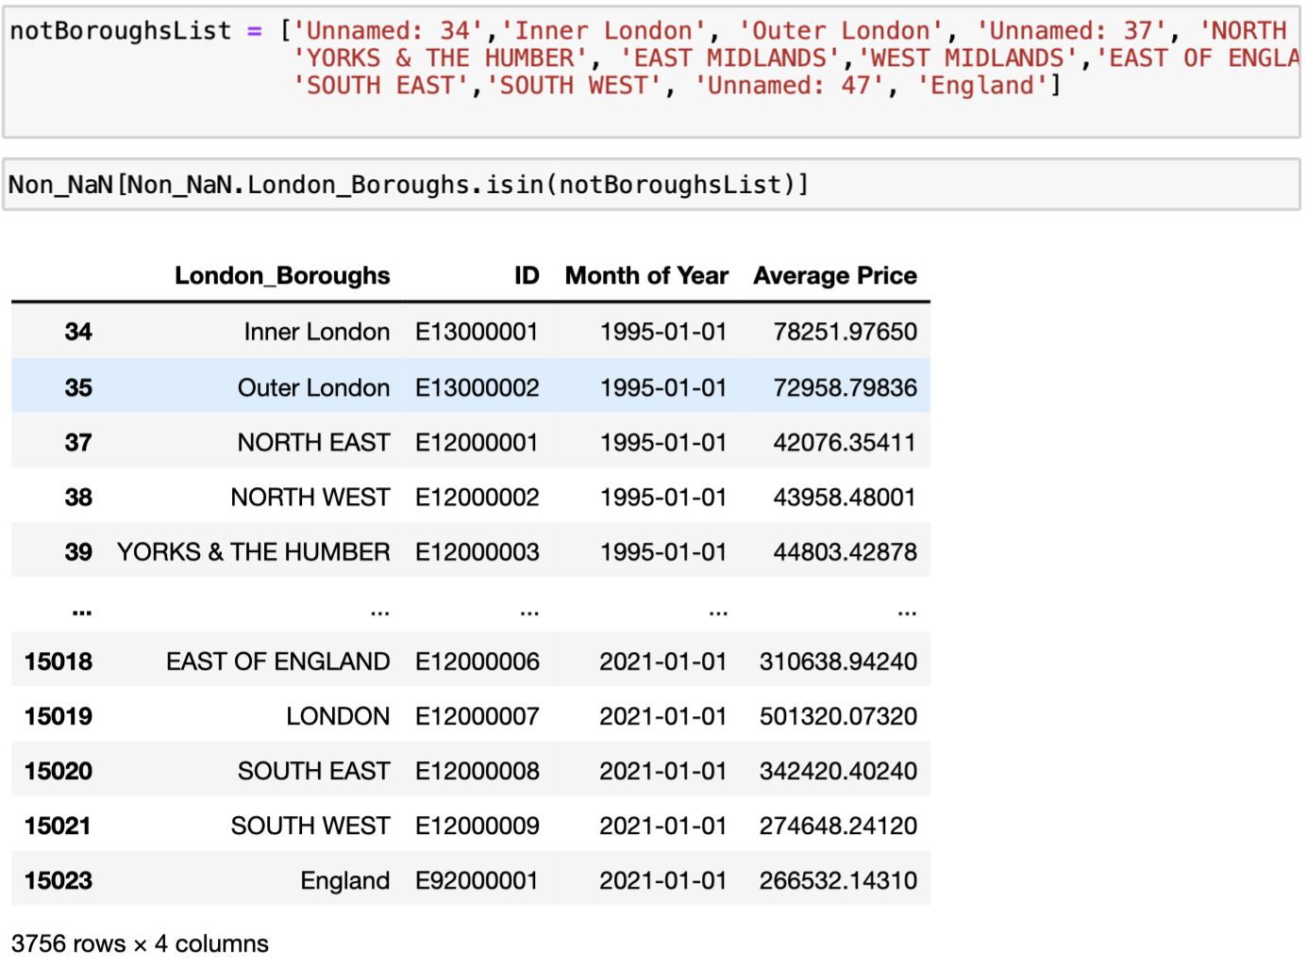
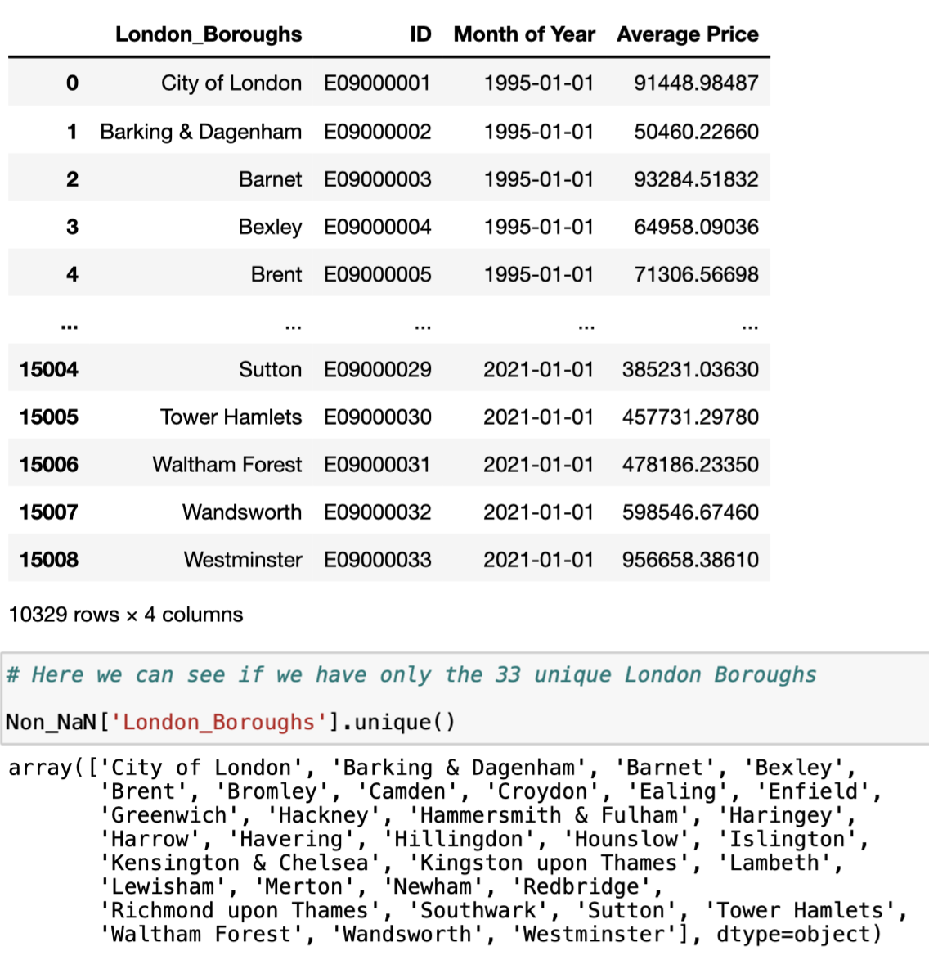
Comparison

Slide 10
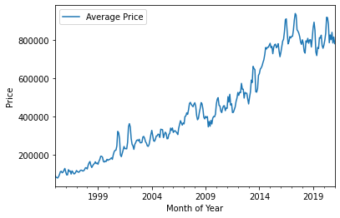
PRICE INCREASE IN CITY OF LONDON
During the Analysis, we compared the price of houses in 1998 to the price in 2018 and found that house prices in London have increased equally almost across all London boroughs but the prices increased rapidly from year 2014-2018

Slide 11
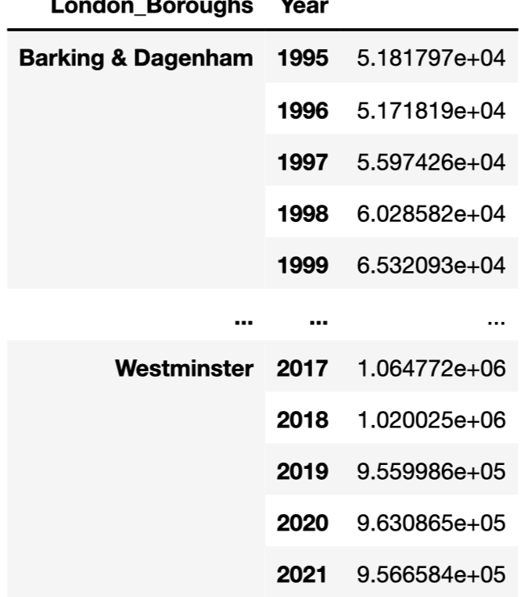
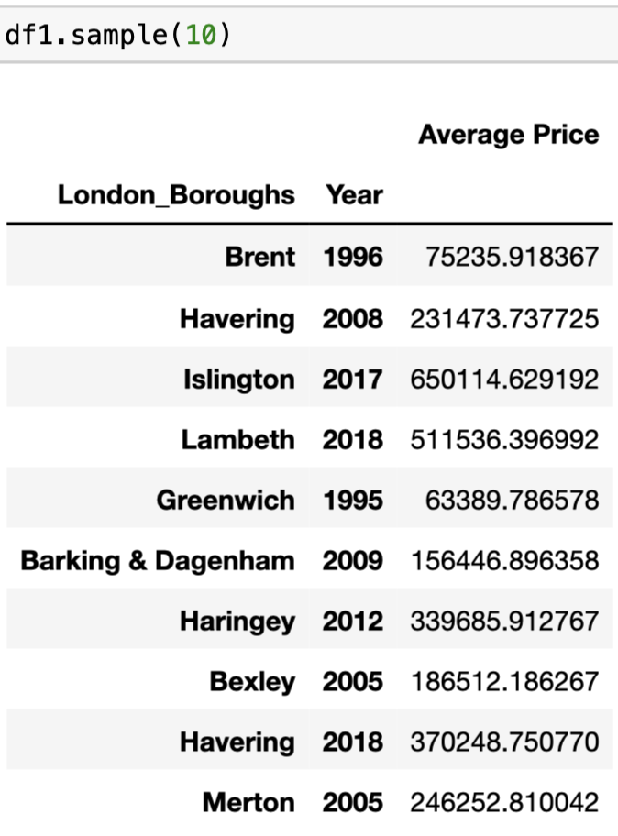
AVERAGE PRICE INCREASE FOR EACH BOROUGH DURING LAST TWO DECADES

Slide 12
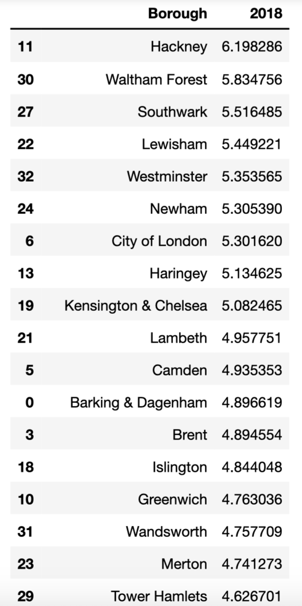
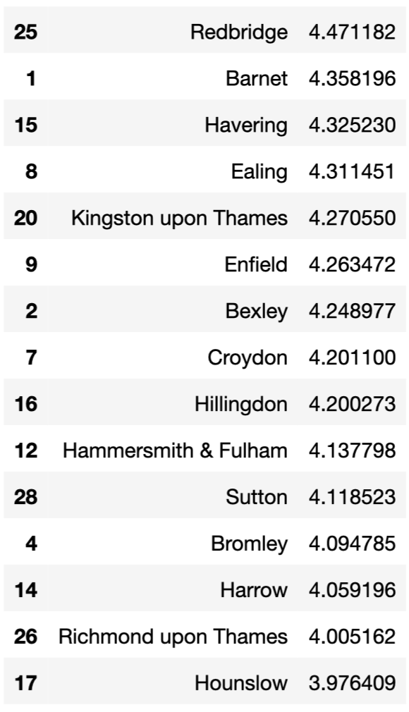

Slide 13
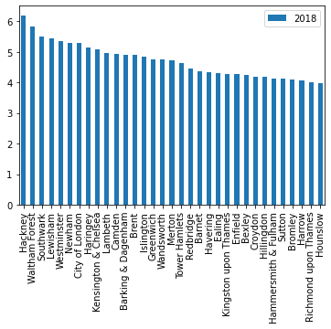
MOST EXPENSIVE BOROUGHS

Slide 14
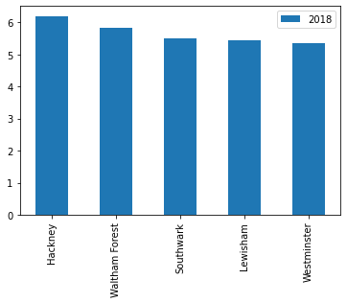
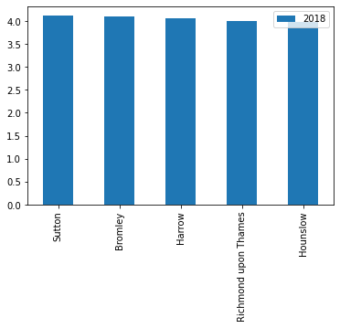
MOST EXPENSIVE PLACES TO LIVE
MOST AFFORDABLE PLACES TO LIVE

Slide 15
conclusion
After analyzing the all 33 London Boroughs we came to a conclusion that over the last 2 decades from 1998 to 2018 the greatest increase in the housing prices, on average were in the boroughs: 'Hackney’, 'Waltham Forest’, 'Southwark’, 'Lewisham’.
The boroughs where there was least increase in housing prices, on average, were: 'Hounslow', 'Richmond upon Thames', ‘Harrow’ ,'Bromley'. Thus these 5 boroughs are best areas to live in due to rising rent prices.

