Slide 1
GRAPH TRAVERSAL

Slide 2
QUESTION - 1

Slide 3
Inconsistent Subset
There are N variables x₁,x₂,...,x_{N} and M relations of the form x_{i} < x_{j} where i != j. A subset S of relations is called inconsistent if there does not exist any assignment of variables that satisfies all the relations in S. e.g, {x₁ < x₂, x₂ < x₃ , x₃ < x₁ } is inconsistent. You need to find if there is an inconsistent subset of M.

Slide 4
Inconsistent Subset (Contd..)
Hint 1
Think of creating a directed graph

Slide 5
Inconsistent Subset (Contd..)
Hint 1
Think of creating a directed graph
V = x₁,x₂,...,x_{N}
E = {(x_{i}, x_{j}) iff (x_{i} < x_{j}) in S}

Slide 6
Inconsistent Subset (Contd..)
Hint 2
How can you detect inconsistency in the graph?

Slide 7
Inconsistent Subset (Contd..)
Hint 2
How can you detect inconsistency in the graph?
Detect cycle in the graph

Slide 8
Inconsistent Subset (Contd..)
Solution
Use DFS to detect cycle
if we encounter a vertex which is already on the stack, we found a loop
all vertices are unvisited
create a stack S
push v onto S
while S is non-empty
peek at the top u of S
if u has neighbour which in S
there is a cycle
else if u has a unvisited neighbour w
push w onto S
else mark u as finished and pop S

Slide 9
QUESTION -2

Slide 10
Two Coloring
Suppose we have an undirected graph and we want to color all the vertices with two colors red and blue such that no two neighbors have the same color. Design an O(V+ E) time algorithm which finds such a coloring if possible or determines that there is no such coloring.

Slide 11
Two Coloring (Contd..)
Hint 1
Can you use BFS or DFS?

Slide 12
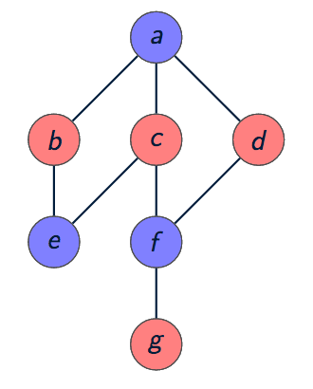
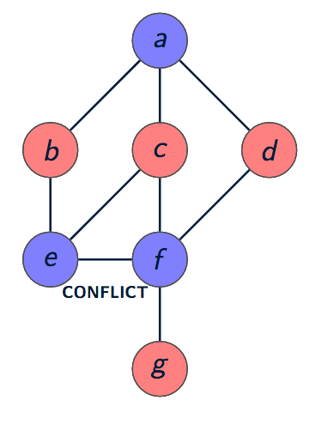
Two Coloring (Contd..)
Solution
Let’s use BFS

Slide 13
Two Coloring (Contd..)
Solution
Start with an arbitrary vertex v, color it, and run BFS from there.
v <- remove(queue)
for each neighbor w of v
if w is uncolored
give it color opposite(color(v)) and put w into queue
else if w is colored
compare to color of v
if different
then move on to next w.
if same
halt with failure.

Slide 14
QUESTION -3

Slide 15
Universal Sink
When an adjacency-matrix representation is used, most graph algorithms require time Ω(V ²), but there are some exceptions.
Given an adjacency matrix for a directed graph G, determine whether G contains a universal sink (a vertex with in-degree |V | − 1 and out-degree 0) in time O(V ).

Slide 16
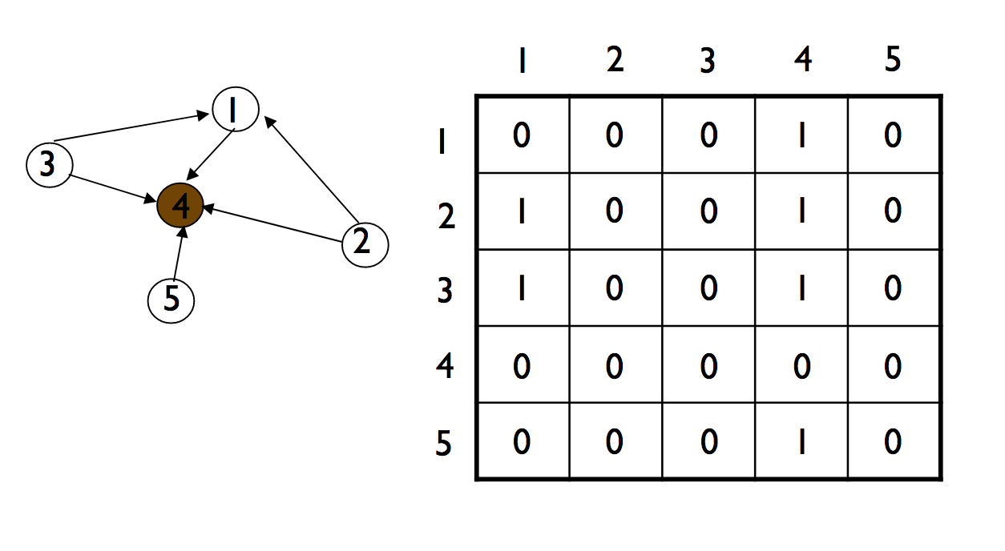
Universal Sink (Contd..)

Slide 17
Universal Sink (Contd..)
Hint 1
How can we determine whether a given vertex u is a universal sink?

Slide 18
Universal Sink (Contd..)
Hint 1
How can we determine whether a given vertex u is a universal sink?
The u-row must contain 0’s only
The u-column must contain 1’s only
A[u][u]=0

Slide 19
Universal Sink (Contd..)
Hint 1
Is-Sink(A, k)
1 let A be |V|×|V|
2 for j = 1 to |V|
3 if a_{kj} == 1
4 return FALSE
5 for i = 1 to |V|
6 if a_{ik} == 1 and i ≠ k
7 return FALSE
8 return TRUE

Slide 20
Universal Sink (Contd..)
Hint 1
Is-Sink(A, k)
1 let A be |V|×|V|
2 for j = 1 to |V|
3 if a_{kj} == 1
4 return FALSE
5 for i = 1 to |V|
6 if a_{ik} == 1 and i ≠ k
7 return FALSE
8 return TRUE
How long would it take to determine whether a given graph contains a universal sink if you were to check every single vertex in the graph?

Slide 21
Universal Sink (Contd..)
Hint 1
Is-Sink(A, k)
1 let A be |V|×|V|
2 for j = 1 to |V|
3 if a_{kj} == 1
4 return FALSE
5 for i = 1 to |V|
6 if a_{ik} == 1 and i ≠ k
7 return FALSE
8 return TRUE
How long would it take to determine whether a given graph contains a universal sink if you were to check every single vertex in the graph?
O(V²)

Slide 22
Universal Sink (Contd..)
Hint 1
Is-Sink(A, k)
1 let A be |V|×|V|
2 for j = 1 to |V|
3 if a_{kj} == 1
4 return FALSE
5 for i = 1 to |V|
6 if a_{ik} == 1 and i ≠ k
7 return FALSE
8 return TRUE
How long would it take to determine whether a given graph contains a universal sink if you were to check every single vertex in the graph?
O(V²)
Can you suggest an algorithm in O(V) ?

Slide 23
Universal Sink (Contd..)
Hint 2
If A[u][v]=1, then u cannot be a universal sink
If A[u][v]=0, then v cannot be a universal sink

Slide 24
Universal Sink (Contd..)

Slide 25
Universal Sink (Contd..)
Solution
Universal-Sink(A)
1 let A be |V|×|V|
2 i = j = 1
3 while i≤|V| and j≤|V|
4 if a_{ij} == 1
5 i = i + 1
6 else
7 j = j + 1
8 if i > |V|
9 return “no universal sink”
10 elsif Is-Sink(A,i) == FALSE
11 return “no universal sink”
12 else
13 return i “is a universal sink”

Slide 26
QUESTION - 4

Slide 27
Articulation Point
Let G = (V, E) be an undirected graph. A vertex v ∈ V is called a cut vertex or an articulation point if the removal of v (and all edges incident upon v) increases the number of connected components in G.
Find all cut vertices in G in O(V+E)

Slide 28
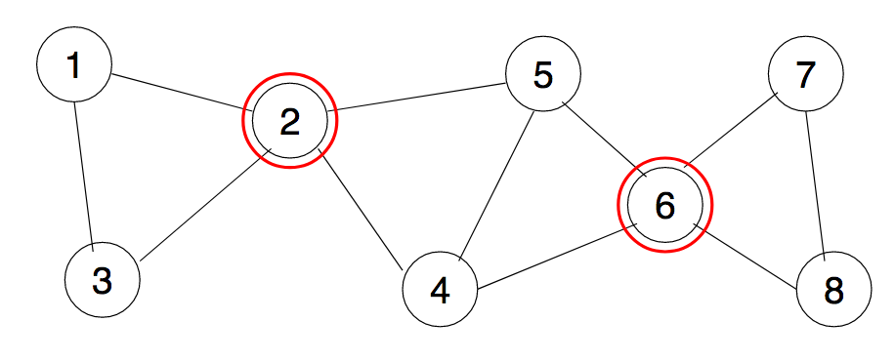
Articulation Point (Contd..)

Slide 29
Articulation Point (Contd..)
Hint 1
Use DFS tree and back edge

Slide 30
Articulation Point (Contd..)
Hint 2
The root of the DFS tree is an articulation point if and only if it has at least two children (subtree)
A non-root vertex v of a DFS-tree is an articulation point of G if and only if has a child s such that there is no back edge from s or any descendant of s to a proper ancestor of v
Leaves of a DFS-tree are never articulation points

Slide 31
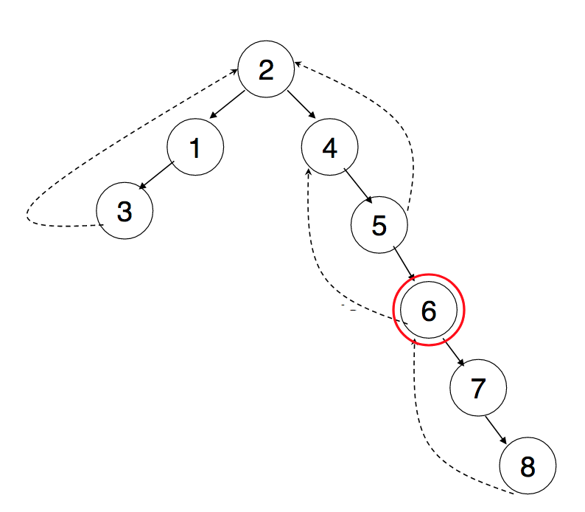
Articulation Point (Contd..)

Slide 32
Articulation Point (Contd..)
How do you know a subtree has a back edge climbing to an upper part of the tree?
low[v] = min { discover[v]; discover[w] : (u,w) is a back edge for some descendant u of v }
u is articulation point if it has a descendant v with
low(v)>=discover [u]
Notes:
For every node v, we need to find out the earliest visited vertex (the vertex with minimum discovery time) that can be reached from subtree rooted with v
If there is a subtree rooted at a children of v which does not have a back edge connecting to a SMALLER discovery time than discover[v], then v is an articulation point.

Slide 33
Articulation Point (Contd..)
Solution
GetArticulationPoints(i, d)
visited[i] = true
discover[i] = d
low[i] = d
childCount = 0
isArticulation = false
for each ni in adj[i]
if not visited[ni]
parent[ni] = i
GetArticulationPoints(ni, d + 1)
childCount = childCount + 1
if low[ni] >= discover[i]
isArticulation = true
low[i] = Min(low[i], low[ni])
else if ni != parent[i]
low[i] = Min(low[i], discover[ni])
if (parent[i] != null and isArticulation) or (parent[i] == null and childCount > 1)
Output i as articulation point

Slide 34
QUESTION - 5

Slide 35
Longest Path
You are given an undirected acyclic graph G(V,E). You need to find a pair of vertices (i,j) such that the length of the path between i and j is maximum among all such pairs. The length of a path is the number of edges on the path.

Slide 36
Longest Path (Contd..)
Hint 1
There is a trivial O(V.(V + E)) algorithm to solve this

Slide 37
Longest Path (Contd..)
Hint 1 sol
Run BFS V times starting from each vertex
Find max
O(V(V+E))

Slide 38
Longest Path (Contd..)
Hint 1 sol
Run BFS V times starting from each vertex.
Find max
O(V(V+E))
Q. Can you give an O(V + E) algorithm?

Slide 39
Longest Path (Contd..)
Hint 2
Need to do BFS twice. How?

Slide 40
Longest Path (Contd..)
Hint 2 sol
Start BFS from any node x and find a node with the longest distance from x
Run another BFS from this endpoint to find the actual longest path.

Slide 41
Longest Path (Contd..)
Q. Prove that the end point found after the first BFS must be an end point of the longest path.

Slide 42
END

