Slide 1
CS 31007 Autumn 2021 COMPUTER ORGANIZATION AND ARCHITECTURE
Instructors
Rajat Subhra Chakraborty (RSC)
Bhargab B. Bhattacharya (BBB)
Lecture #16, #17: Computer Arithmetic
07 September 2021
Indian Institute of Technology Kharagpur
Computer Science and Engineering
Notes:
Good Morning!
The title of today’s talk is “On some Planar Partitioning Problems”.

Slide 2
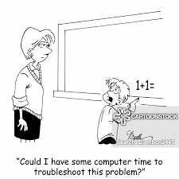
Computer Arithmetic
operation
a
32
ALU
result
32
b
32
?

Slide 3
So far covered …
Evolution and history of computer design
Basic components of a computer
Instruction Set Architecture (ISA)
CPU Performance
MIPS Instruction Set, Programming
Acknowledgement: Patterson and Hennessy

Slide 4
Observed so far …
RISC’s underlying principles lead to efficient hardware design
Simplicity favors regularity
Make the common case fast
Smaller is faster
Good design demands good compromises
Acknowledgement: Patterson and Hennessy

Slide 5
What is inside?
Processor
Devices
Control
Memory
for storing
instructions and data
Keyboard
Input
ALU
Mouse
Output
Datapath
Monitor
Printer
Notes:
1. The input devices bring the object code and input data from the outside world into the computer.

Slide 6
Arithmetic for Computers
§3.1 Introduction
Operations on integers
Addition and subtraction
Multiplication and division
Dealing with overflow
Hardware implementation of ALU
Floating-point real numbers
Representation and operations
Overflow and underflow
Hardware implementation of FP-operations

Slide 7
What determines the execution time of a machine/assembly-level program P when it is run on a machine M?
P consists of a number of machine-level instructions (IC: instruction count);
Each machine instruction requires several clock cycles to complete (CPI: average number of clock cycles per instruction);
Each clock cycle has certain time period (CCT: clock cycle time)
Thus, CPU-time = IC × CPI × CCT
(CPU Performance Equation)

Slide 8
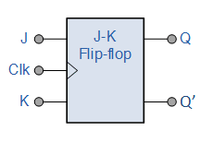

Clock Timing
Does it mean that CCT is exclusively determined by the critical delay? Once the hardware is designed, is it fixed for a given technology?
.. Oh no, there is a catch!
You can redesign hardware so that delay becomes smaller: (i) using low-depth logic (increases cost!), or (ii) use retiming, i.e., insert additional state elements (FFs) on long logic paths (increases #clock cycles to perform the same task, thus impacting CPI, though CCT is reduced!)
Clock period should be large enough to accommodate delays along critical paths in the circuit (longest ones); but not too large – system slows down unnecessarily

Slide 9
Execution Cycle
Obtain instruction from memory
Instruction
Fetch
Instruction
Decode
Determine required actions and instruction size
Operand
Fetch
Locate and obtain operand data from memory/register
Execute
Compute result value or status
Result
Store
Deposit results in register/memory for later use
operand-address computation
Next
Instruction
Determine successor instruction
computer arithmetic, ALU design

Slide 10
MIPS Example
C code:
f = (g + h) - (i + j);
f, …, j in $s0, …, $s4
Compiled MIPS code:
add $t0, $s1, $s2 add $t1, $s3, $s4 sub $s0, $t0, $t1
Adders must be very efficient: cost, speed
Amdahl
Make common operations faster …

Slide 11
2’s Complement Integer Arithmetic: Dilemma of Final Carry and Overflow
Decimal
2’s Complement
Decimal
2’s Complement
-1
1111
0
0000
-2
1110
universe:
4-bit 2’s complement arithmetic
1
0001
-3
1101
2
0010
-4
1100
3
0011
-5
1011
4
0100
-6
1010
5
0101
-7
1001
6
0110
-8
1000
7
0111
0 1 0 0
(+4)
1 1 0 0
(-4)
1 0 0 0
(-8)
0 1 0 0
(+4)
+
1 0 1 1
(-5)
+
0 1 1 0
(+6)
+
1 0 0 0
(-8)
+
0 1 0 0
(+4)
1 1 1 1
(-1)
1 0 0 1 0
(+2)
1 0 0 0 0
(0)
1 0 0 0
(-8)
no final carry;
no overflow;
result correct
final carry discarded;
result still correct;
no overflow
final carry √;
overflow √;
result invalid
no final carry;
overflow √;
result invalid

Slide 12
Overflow Detection Logic: Hardware Solution
sign-bit
A: a_{n-1}, a_{n-2}, ……, a₁, a₀
B: b_{n-1}, b_{n-2}, ……, b₁, b₀
+
S: s_{n-1}, s_{n-2}, ……, s₁, s₀
Overflow = a_{n-1}b_{n-1}s_{n-1} + a_{n-1}b_{n-1} s_{n-1}
overflow → adding two positives yields a negative
or, adding two negatives gives a positive
In MIPS, on detecting overflow, interrupt (exception) is invoked;
add, addi (overflow considered); addu, addiu (overflow ignored)

Slide 13
Overflow Detection Logic: Another Solution
Carry into MSB ° Carry out of MSB
For a N-bit ALU: Overflow = CarryIn[N - 1] XOR CarryOut[N - 1]
CarryIn0
A0
1-bit
ALU
Result0
X
Y
X XOR Y
B0
CarryOut0
0
0
0
CarryIn1
A1
0
1
1
1-bit
ALU
Result1
1
0
1
B1
CarryOut1
1
1
0
CarryIn2
A2
1-bit
ALU
Result2
B2
CarryIn3
A3
Overflow
1-bit
ALU
Result3
B3
CarryOut3 (final carry)
Show that these two solutions are logically equivalent

Slide 14
Hazards of Finite-Precision Arithmetic
Compute: X = A + B – C; A, B, C are +ve integers;
X = (A + B) – C
Or,
X = A + (B – C) ?
The first choice might cause
overflow – invalid result
The second option is safer
Binary search
(x₁ + x₂)/2
x₁ x₂
x₁ + (x₂ – x₁)/2 → better write this way: safer!

Slide 15
Saturating Adders
Saturating arithmetic:
When a result is out of range, provide the most positive or the most negative value that is representable
Required in many DSP applications
Adder
0
1
Overflow
Saturation
logic
Courtesy: Behrooz Parhami, UCSB

Slide 16
Why Adders?
Addition: a fundamental operation
Basic block of most arithmetic operations
Address calculation
Faster and faster
How?
Architectural-level optimization
Gate-level optimization
Speed/area trade-off

Slide 17
Review: 1-bit adder
One-bit Half Adder:
One-bit Full Adder:
A B Sum C_{out}
0 0 0 0
0 1 1 0
1 0 1 0
1 1 0 1
A
B
Sum = A ⊕ B
C_{out} = A.B
HA
C_{out}
Sum
C_{in} A B Sum C_{out}
0 0 0 0 0
0 0 1 1 0
0 1 0 1 0
0 1 1 0 1
1 0 0 1 0
1 0 1 0 1
1 1 0 0 1
1 1 1 1 1
A
B
Sum = A ⊕ B ⊕ C_{in}
C_{out} = A.B + B.C_{in} + A.C_{in}
FA
C_{out}
C_{in}
Sum
Notes:
Can we use HA to add two n-bit numbers? No! Carry propagation.

Slide 18
n-bit Ripple-Carry Adder (RCA)
To add two n-bit numbers
A: a_{n-1}, a_{n-2}, ……, a₁, a₀
B: b_{n-1}, b_{n-2}, ……, b₁, b₀
a_{n-1}
b_{n-1}
a₂
b₂
a₁
b₁
a₀
b₀
Flat Combinational Logic
Inputs: a_{n-1}, a_{n-2}, ……, a₁, a₀ ,b_{n-1}, b_{n-2}, ……, b₁, b₀
Outputs: s_{n-1}, s_{n-2}, ……, s₁, s₀, c_{n}
FA
. . .
FA
FA
FA
C_{n}
C₀
s_{n-1}
s₂
s₁
s₀
A
B
N-bit RCA delay = n * δ
δ = (delay of 1-bit FA)
C_{out}
FA
C_{in}
Sum
Critical path in an n-bit ripple-carry adder
→ CCT needs to accommodate long delay
Cost = O(n); delay = O(n)
Notes:
What is C0? C_n?
This architecture is called Ripple-carry adder: the simplest!
Carry delay is important

Slide 19
4-bit Ripple-Carry Addition: Example
A=0011
0
0
0
1
1
0
1
1
B=0101
A₃
B₃
A₂
B₂
A₁
B₁
A₀
B₀
C₄
FA
C₃
FA
C₂
FA
C₁
FA
C₀
0
S₃
S₂
S₁
S₀
T=0
0
0
0
0
0
0
0
0
S=0000
T=1
0
0
0
1
0
1
1
0
S=0110
T=2
0
0
0
1
1
0
1
0
S=0100
T=3
0
0
1
0
1
0
1
0
S=0000
T=4
0
1
1
0
1
0
1
0
S=1000
delay = 4 units; also, overflow has occurred
Notes:
The time unit is the delay for one full adder to compute its S and Cout signals
What is the meaning of the intermediate (T=1..3) values of S?
How long should the clock period be?
What effect does the carry chain delay have on the clock frequency?

Slide 20
Subtraction using 2’s complement

Slide 21
Multi-bit Adder
MSB LSB

Slide 22
Ripple-Carry Adder
Chain 1-bit adders together
Carry ripples through the entire chain
Disadvantage: slow

Slide 23
Possible solutions to mitigate
carry-propagation delay
1. Detect the end of carry propagation rather than wait for
the worst-case time
2. Speed-up propagation using techniques such as
lookahead
carry-select
logarithmic adder
3. Limit carry propagation to within a small number of bits
4. Trade-off: speed (or inversely, delay) versus logic cost

Slide 24
CS 31007 Autumn 2021 COMPUTER ORGANIZATION AND ARCHITECTURE
Instructors
Rajat Subhra Chakraborty (RSC)
Bhargab B. Bhattacharya (BBB)
Lecture #18: Computer Arithmetic
13 September 2021
Indian Institute of Technology Kharagpur
Computer Science and Engineering
Notes:
Good Morning!
The title of today’s talk is “On some Planar Partitioning Problems”.

Slide 25
How to speed up computer arithmetic?
Notes:
Good Morning!
The title of today’s tComputer alk is “On some Planar Partitioning Problems”.

Slide 26
Carry-Lookahead Adder
RCA
A₃
B₃
A₂
B₂
A₁
B₁
A₀
B₀
C₄
FA
C₃
FA
C₂
FA
C₁
FA
C₀
S₃
S₂
S₁
S₀
CLA
A₃
B₃
A₂
B₂
A₁
B₁
A₀
B₀
C₃
C₂
C₁
C₄
FA
FA
FA
FA
C₀
S₃
S₂
S₁
S₀
Instead of RCA, use n independent 1-bit FA-modules working in parallel;
no signal propagation through stages; directly generate all
carry-bits from inputs
Notes:
In the example,
By looking at (A4,B4), we can say for sure that C5=0, no matter what C4 is.
By looking at (A2,B2), we can say for sure that C3=1.
C3, “generated” by (A2,B2) (or by A0,B0 if you wish), “propagated” as far as C4, and then got “killed” by (A4,B4)
The idea is, can we look at A(3..0) and B(3..0) and determine the value of C4 in one shot?

Slide 27
Carry-Lookahead Adder
Generate all carry bits directly from inputs, instead of rippling through FA-blocks sequentially
Few notation:
Generate (g_{i}) and propagate (p_{i}) signals for each bit:
A column will generate a carry out if a_{i} AND b_{i} are both 1.
g_{i} = a_{i} b_{i}
A column will propagate a carry in to the carry out if A_{i} OR B_{i} is 1.
p_{i} = a_{i} + b_{i}
The carry out of a column (C_{i}) is:
c_{i+1} = a_{i} b_{i} + (a_{i} + b_{i} )c_{i} = g_{i} + p_{i} c_{i}

Slide 28
Carry Lookahead Adder (CLA): Basic Idea
ith-bit
A: a_{n-1}, a_{n-2}, .., a_{i}…, a₁, a₀
B: b_{n-1}, b_{n-2}, .., b_{i} ,…,b₁, b₀
+
S: s_{n-1}, s_{n-2}, ……, s₁, s₀
carry-bit c_{i}
At the ith stage, carry will be generated for propagation to the next stage if and only if
a_{i} = b_{i} = 1; => g_{i} = a_{i} b_{i} ==> carry-generate function
or either a_{i} or b_{i} = 1, and previous carry c_{i -1} arrives here;
=> p_{i} = a_{i} + b_{i} => carry-propagate function

Slide 29
Carry-Lookahead Adder
Generate all carry bits directly from inputs, instead of rippling through FA-blocks sequentially
Few notation:
Generate (g_{i}) and propagate (p_{i}) signals for each bit:
A column will generate a carry out if a_{i} AND b_{i} are both 1.
g_{i} = a_{i} b_{i}
A column will propagate a carry in to the carry out if A_{i} OR B_{i} is 1.
p_{i} = a_{i} + b_{i}
The carry out of a column (C_{i}) is:
c_{i+1} = a_{i} b_{i} + (a_{i} + b_{i} )c_{i} = g_{i} + p_{i} c_{i}

Slide 30
Carry-Lookahead Adder
We can visualize carry “generate” and “propagate” functions from another perspective:
C_{i+1} = a.b + b. c_{in} + a. c_{in}
= a.b + c_{in}. (a+b)
A column will generate a carry out if a_{i} AND b_{i} are both 1, i,e., g_{i} = a_{i} b_{i}
A column will propagate a carry if A_{i} or B_{i} is 1, i.e.,
p_{i} = a_{i} + b_{i}
The carry out of a column (C_{i}) is:
c_{i+1} = a_{i} b_{i} + (a_{i} + b_{i} )c_{i} = g_{i} + p_{i} c_{i}

Slide 31
Carry-Lookahead Adder
Idea:
Produce c_{i} ahead of time instead of passing through (i-1) stages
Carry propagation in RCA
Bit position
Carry
A
B
Sum
7 6 5 4 3 2 1 0
1 0 0 1 1 1 1
0 1 0 0 1 1 0 1 +
0 1 0 0 0 1 1 1
1 0 0 1 0 1 0 0
FA
FA
FA
FA
FA
Instead of RCA, use independent 1-bit FA-modules
no signal propagation through stages

Slide 32
Carry-Lookahead Adder
RCA
A₃
B₃
A₂
B₂
A₁
B₁
A₀
B₀
C₄
FA
C₃
FA
C₂
FA
C₁
FA
C₀
S₃
S₂
S₁
S₀
CLA
A₃
B₃
A₂
B₂
A₁
B₁
A₀
B₀
C₃
C₂
C₁
C₄
FA
FA
FA
FA
C₀
S₃
S₂
S₁
S₀
Instead of RCA, use n independent 1-bit FA-modules working in parallel;
no signal propagation through stages; directly generate all
carry-bits from inputs
Notes:
In the example,
By looking at (A4,B4), we can say for sure that C5=0, no matter what C4 is.
By looking at (A2,B2), we can say for sure that C3=1.
C3, “generated” by (A2,B2) (or by A0,B0 if you wish), “propagated” as far as C4, and then got “killed” by (A4,B4)
The idea is, can we look at A(3..0) and B(3..0) and determine the value of C4 in one shot?

Slide 33
Basic Signals
Generate signal: g_{i} = a_{i}b_{i}
Propagate signal: p_{i} = a_{i} + b_{i}
Carry recurrence
c_{i+1} = g_{i} + c_{i}p_{i}

Slide 34
Average Carry Propagation Length
Generate signal: g_{i} = a_{i}b_{i}
Propagate signal: p_{i} = a_{i} + b_{i}
Given binary numbers with random bits, for each position i we have
Probability of carry generation = ¼ (both 1)
Probability of carry annihilation = ¼ (both 0)
Probability of carry propagation = ½ (different)
Average length of the longest carry chain for n-bit addition: O(log₂n)

Slide 35
Unrolling Carry Recurrence
c_{i} = g_{i-1} + c_{i-1}p_{i-1} =
= g_{i-1} + (g_{i-2} + c_{i-2}p_{i-2})p_{i-1} = g_{i-1} + g_{i-2} p_{i-1} + c_{i-2}p_{i-2}p_{i-1} =
= g_{i-1} + g_{i-2} p_{i-1} + (g_{i-3} + c_{i-3}p_{i-3})p_{i-2}p_{i-1} =
= g_{i-1} + g_{i-2} p_{i-1} + g_{i-3} p_{i-2}p_{i-1} + c_{i-3}p_{i-3}p_{i-2}p_{i-1} =
= ….. =
= g_{i-1} + g_{i-2} p_{i-1} + g_{i-3} p_{i-2}p_{i-1} + g_{i-4}p_{i-3}p_{i-2}p_{i-1} + ….. +
+ g₀p₁p₂…p_{i-2}p_{i-1} + c₀p₀p₁p₂…p_{i-2}p_{i-1} =
= g_{i-1} + ∑ g_{k} ∏ p_{j} + c₀ ∏ p_{j}
i-2
i-1
i-1
k=0
j=k+1
j=0

Slide 36
4-bit Carry-Lookahead Adder
c₄ = g₃ + g₂ p₃ + g₁ p₂p₃ + g₀p₁p₂p₃ + c₀p₀p₁p₂p₃
c₃ = g₂ + g₁ p₂ + g₀ p₁p₂ + c₀p₀p₁p₂
g_{i} = a_{i}b_{i}
p_{i} = a_{i} + b_{i}
c₂ = g₁ + g₀ p₁ + c₀p₀p₁
c₁ = g₀ + c₀ p₀
c_{i+1} = g_{i} + c_{i}p_{i}
s₀ = x₀ ⊕ y₀ ⊕ c₀ = p₀ ⊕ c₀
s₁ = p₁ ⊕ c₁
s₂ = p₂ ⊕ c₂
s₃ = p₃ ⊕ c₃

Slide 37
Carry Lookahead Adder
one AND-gate and
one OR-gate
C₁ = a₀b₀ + (a₀+b₀)c₀ = g₀ + p₀c₀
C₂ = a₁b₁ + (a₁+b₁)c₁ = g₁ + p₁c₁ ₌ g₁ + p₁g₀ ₊ p₁p₀c₀
C₃ = a₂b₂ + (a₂+b₂)c₂ = g₂ + p₂c₂ ₌ g₂ + p₂g₁ ₊ p₂p₁g₀ ₊ p₂p₁p₀c₀
C₄ = a₃b₃ + (a₃+b₃)c₃ = g₃ + p₃c₃ ₌ g₃ + p₃g₂ ₊ p₃p₂g₁ ₊ p₃p₂p₁g₀ ₊ p₃p₂p₁p₀c₀
g_{i} = a_{i}b_{i} p_{i} = a_{i} + b_{i}
inputs
a₃ b₃
a₂ b₂
a₁ b₁
a₀ b₀
g₃
p₃
g₂
p₂
g₁
p₁
g₀
p₀
CLA logic
c₀
c₄
c₃
c₂
c₁
carry-bits

Slide 38
Carry Generation Logic

Slide 39
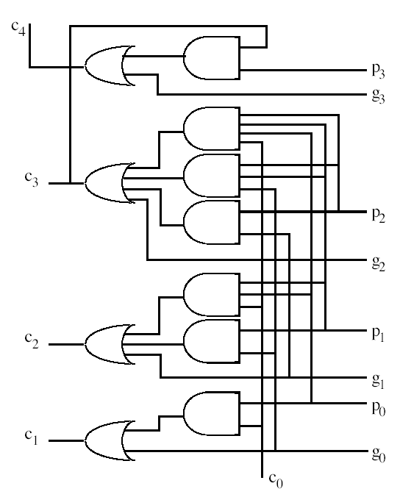
4-bit CLA Logic
A: a₃ a₂ a₁ a₀
B: b₃ b₂ b₁ b₀
g_{i} = a_{i}b_{i}
p_{i} = a_{i} + b_{i}
all carry-bits are generated directly from inputs;
one can thus use independent FA-modules, to produce the sum-bits in parallel!

Slide 40
n-bit CLA Adder
Much faster than RCA
Critical path delay in an n-bit CLA?
Cost = O(?); delay O(?)

Slide 41
Carry Lookahead Adder: Analysis
one AND-gate and
one OR-gate
C₁ = a₀b₀ + (a₀+b₀)c₀ = g₀ + p₀c₀
C₂ = a₁b₁ + (a₁+b₁)c₁ = g₁ + p₁c₁ ₌ g₁ + p₁g₀ ₊ p₁p₀c₀
C₃ = a₂b₂ + (a₂+b₂)c₂ = g₂ + p₂c₂ ₌ g₂ + p₂g₁ ₊ p₂p₁g₀ ₊ p₂p₁p₀c₀
C₄ = a₃b₃ + (a₃+b₃)c₃ = g₃ + p₃c₃ ₌ g₃ + p₃g₂ ₊ p₃p₂g₁ ₊ p₃p₂p₁g₀ ₊ p₃p₂p₁p₀c₀
g_{i} = a_{i}b_{i} p_{i} = a_{i} + b_{i}
Cost = O(?); delay = O(?)
inputs
a₃ b₃
a₂ b₂
a₁ b₁
a₀ b₀
g₃
p₃
g₂
p₂
g₁
p₁
g₀
p₀
CLA logic
c₀
cost = O(n³);
delay = O(1)
2-level AND-OR logic
c₄
c₃
carry-bits
c₂
c₁
Independent FA blocks
sum outputs

Slide 42
Full Carry Lookahead
a₃
b₃
a₂
b₂
a₁
b₁
a₀
b₀
c_{in}
. . .
s₃
s₂
s₁
s₀
Theoretically, it is possible to derive each sum digit directly from the inputs that affect it
Full carry-lookahead adder is impractical for large n

Slide 43
Solution 1: n-bit Hybrid CLA Adder
Implementation of lookahead for the complete adder is impractical because of cost
Divide n stages into smaller groups
Full carry lookahead within each group
Ripple carry among groups
Compromise between cost and delay

Slide 44
12-Bit Hybrid Adder (CLA + RCA)
A=
1101
1001
1010
B=
0111
0110
1101
A₁₁
A₁₀
A₉
A₈
A₇
A₆
A₅
A₄
A₃
A₂
A₁
A₀
B₁₁
B₁₀
B₉
B₈
B₇
B₆
B₅
B₄
B₃
B₂
B₁
B₀
p,g
p,g
p,g
p,g
p,g
p,g
p,g
p,g
p,g
p,g
p,g
p,g
0
C₀
Carry Generator
Carry Generator
Carry Generator
C₁₂
C₈
C₄
S₁₁
S₁₀
S₉
S₈
S₇
S₆
S₅
S₄
S₃
S₂
S₁
S₀
RCA
CLA
Trade-off: cost versus delay
Another solution: 12-Bit Hybrid (RCA + CLA)??
Cost = O(?); delay = O(?)
Notes:
The timing is not realistic. I have assumed:
p_i and g_i computations take 1 cycle
Carry generation block take 1 cycle to generate the last carry
Hence, the second row shows T=2 (p,g calc + carry gen), while other rows show 1 cycle (only carry generation)

Slide 45
CLA principle can be used recursively to build bigger adders => Carry-Lookahead Tree (CLT)
Example: A 16-bit adder - Use four 4-bit adders
It takes block g and p terms and c_{in} to generate block-carry-bits
Use the CLA principle again to design lower level adders
CLA
CLA
CLA
We have seen (i) CLA + RCA; (ii) RCA + CLA
Solution – 2
(CLA + CLA + …)
CLA
CLA

Slide 46
16-bit 2-level Carry-Lookahead Tree (CLT)
c₁₅
c₁₄
c₁₃
c₁₁
c₁₀
c₉
c₇
c₆
c₅
c₃
c₂
c₁
g₁₄p₁₄
g₁₂p₁₂
g₁₀p₁₀
g₈p₈
g₆p₆
g₄p₄
g₂p₂
g₀p₀
g₁₃p₁₃
g₁₁p₁₁
g₉p₉
g₇p₇
g₅p₅
g₃p₃
g₁p₁
g₁₅p₁₅
c₁₂
c₈
c₄
c₀
CLA
CLA
CLA
CLA
g_{[12,15]}
P_{[12,15]}
g_{[8,11]}
p_{[8,11]}
g_{[4,7]}
p_{[4,7]}
g_{[0,3]}
p_{[0,3]}
CLA
g_{[0,15]}
p_{[0,15]}
(Carry-lookahead tree - CLT)
Cost = O(?); delay O(?)

Slide 47
64-bit 3-level Carry-Lookahead Tree (CLT)
c₃₁ c₃₀ c₂₉
c₂₇ c₂₆ c₂₅
c₂₃ c₂₂ c₂₁
c₁₉ c₁₈ c₁₇
c₄₈
c₃₂
c₂₈
c₂₄
c₂₀
c₁₆
c₀
CLA GEN
CLA GEN
CLA GEN
CLA GEN
g_{[28,31]}
g_{[24,27]}
g_{[20,23]}
g_{[16,19]}
p_{[28,31]}
p_{[24,27]}
p_{[20,23]}
p_{[16,19]}
CLA GEN
g_{[48,63]}
g_{[32,47]}
g_{[16,31]}
g_{[0,15]}
p_{[48,63]}
p_{[32,47]}
p_{[16,31]}
p_{[0,15]}
CLA GEN
g_{[0,63]}
p_{[0,63]}

Slide 48
Solution – 3: Carry-Select Adders (CSA)
Idea:
Compute sum-bits in parallel for two possible carry-bits;
When the previous carry actually arrives, just select the pre-computed “sum”
CLA: Looking ahead in time (pre-compute carry-bits)
CSA: Looking ahead in space (pre-compute sum-bits)

Slide 49
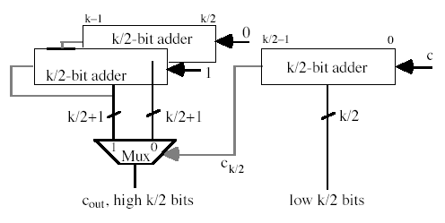

k-bit Carry-Select Adder
carry-out
sum-bits
Units: cost and delay of a single 2-to-1 multiplexer

Slide 50
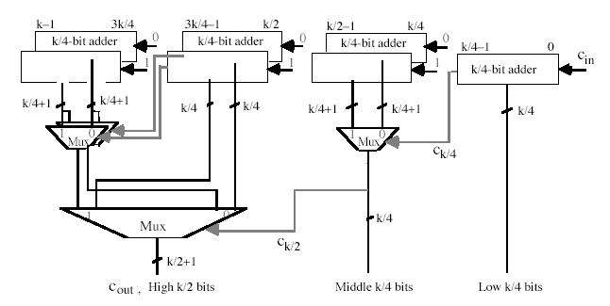
Multi-level k-bit Carry-Select Adder
cost = ?
delay = ?
Other adder designs:
Carry-skip addition

Slide 51
Pitfalls of CLA Adder
Implementation of lookahead for the complete adder is impractical because of cost
Analyze the implementation complexity of CLA

Slide 52
CS 31007 Autumn 2021 COMPUTER ORGANIZATION AND ARCHITECTURE
Instructors
Rajat Subhra Chakraborty (RSC)
Bhargab B. Bhattacharya (BBB)
Lecture #19, #20: Computer Arithmetic
14 September 2021
Indian Institute of Technology Kharagpur
Computer Science and Engineering
Notes:
Good Morning!
The title of today’s talk is “On some Planar Partitioning Problems”.

Slide 53
Solution – 4: Tree-Based Adder
Recall: 4-bit CLA
In CLA, carry-logic cost grows @ O(n³) for n-input adders
c₄ = g₃ + g₂ p₃ + g₁ p₂p₃ + g₀ p₁p₂p₃ + c₀ p₀p₁p₂p₃
inputs
c₃ = g₂ + g₁ p₂ + g₀ p₁p₂ + c₀ p₀p₁p₂
g_{i} = a_{i}b_{i}
p_{i} = a_{i} + b_{i}
c₂ = g₁ + g₀ p₁ + c₀ p₀p₁
c₁ = g₀ + c₀ p₀
c_{n} => last term would be p₀p₁p_{2……..}p_{n-1}
c_{i+1} = g_{i} + c_{i}p_{i}
In general, the problem boils down to =>
How to compute efficiently in reasonable cost and time:
x₀ , x₀x₁, x₀ x₁x₂, x₀x₁x₂ x₃, …., x₀x₁x₂x₃ …x_{n-1}
(Prefix-sum/product problem)

Slide 54
4-bit Carry-Lookahead Adder
c₄ = g₃ + g₂ p₃ + g₁ p₂p₃ + g₀ p₁p₂p₃ + c₀ p₀p₁p₂p₃
inputs
c₃ = g₂ + g₁ p₂ + g₀ p₁p₂ + c₀ p₀p₁p₂
g_{i} = a_{i}b_{i}
p_{i} = a_{i} + b_{i}
c₂ = g₁ + g₀ p₁ + c₀ p₀p₁
c₁ = g₀ + c₀ p₀
c_{n} => last term would be p₀p₁p_{2……..}p_{n-1}
In general, the problem boils down to =>
How to compute efficiently in reasonable cost and time:
x₀ , x₀x₁, x₀ x₁x₂, x₀x₁x₂ x₃, …., x₀x₁ x₂x₃ …x_{n-1}
(Prefix-sum/product problem)

Slide 55
Why so fuss about prefix computation?
Use a serial chain …. … done!
input
x
x
x
x
x
x
x
x
7
6
5
4
3
2
1
0
*
2-input AND-gate
*
fanout
*
*
delay = O(n);
fanout: O(1);
output
*
*
cost = O(n)
x₀x₁x_{2 ….}x₇
x₀x₁x₂ x₃ x₀ x₁x₂ x₀x₁ x₀
However, its delay is again O(n), so the whole purpose of CLA design is defeated. Can we reduce delay, compromising cost and fanout?
Notes:
- One disadvantage of this adder is the high fanout of the output of C7. Other adder structures like the Kogg-Stone tree are designed to reduce the fanout.

Slide 56
Prefix tree: Basic idea
input
x
x
x
x
x
x
x
x
7
6
5
4
3
2
1
0
*
2-input AND-gate
*
*
*
*
fanout
*
*
*
*
delay = O(log n);
fanout: O(n);
*
*
*
output
*
x₀x₁x_{2 ….}x₇
cost = O(nlog n)
x₀x₁x₂ x₃ x₀ x₁x₂ x₀x₁ x₀
Large fanout slows down 0 → 1 or 1 → 0 transitions at logic nodes and thus may increase consumed power and signal delay indirectly
Notes:
- One disadvantage of this adder is the high fanout of the output of C7. Other adder structures like the Kogg-Stone tree are designed to reduce the fanout.

Slide 57
Prefix Tree: Logarithmic-Delay
x
x
x
x
x
x
x
x
x
x
x
x
x
x
x
x
15
14
13
12
11
10
9
8
7
6
5
4
3
2
1
0
Level
1
*
AND-gate
2
fanout
3
delay = O(log n);
fanout: O(log n);
4
adder cost = O(n²log n)?
5
6
s
s
s
s
s
s
s
s
s
s
s
s
s
s
s
s
15
14
13
12
11
10
9
8
7
6
5
4
3
2
1
0
x₀x₁x₂ x₃ x₀ x₁x₂ x₀x₁ x₀
Notes:
- One disadvantage of this adder is the high fanout of the output of C7. Other adder structures like the Kogg-Stone tree are designed to reduce the fanout.

Slide 58
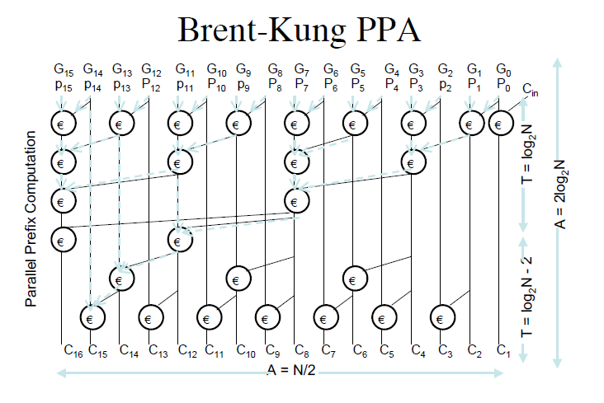
Brent-Kung Parallel-Prefix Adder (log-delay)
delay = O(log n);
cost = O(nlog n);
fanout: O(logn);
cost can further be improved
c_{i+1} = g_{i} + c_{i}p_{i}
cost = O(n²log n)?

Slide 59
Brent-Kung: Carry-Generation Tree for 8-Bit Adder
C
0
(g
,p
)
C
2
C
0
0
C
4
(g
,p
)
1
1
1
(g
,p
)
C
3
C
2
2
5
(g
3
,p
3
)
(g
4
,p
4
)
C
6
(g
5
,p
5
)
(g
6
,p
6
)
C
7
(g
7
,p
7
)
cost ~ O(nlog n)
delay ~ O(log n)
t
∼
log
n
add
2
Notes:
The tree generating C7 is called “forward tree”, and the rest is called “backward tree”
What do the inputs to module generating C5 mean?
[Par00] p. 101 shows a 16-bit Brent-Kung tree structure.

Slide 60
Other Tree-Based Prefix Adders
Kogge-Stone Adder (16-Bit)
fanout: constant
delay = O(log n);
cost = O(nlog n);
- high wiring complexity
Notes:
The tree generating C7 is called “forward tree”, and the rest is called “backward tree”
What do the inputs to module generating C5 mean?
[Par00] p. 101 shows a 16-bit Brent-Kung tree structure.

Slide 61
Adder Design
Design considerations
Timing (delay)
Power/energy, heat dissipation
-- fan-in, fan-out, logic switching
Area (cost)
-- logic, wiring
logic depth
Timing
# fan-in
fan-out
# wire tracks
Power
Area
Notes:
The tree generating C7 is called “forward tree”, and the rest is called “backward tree”
What do the inputs to module generating C5 mean?
[Par00] p. 101 shows a 16-bit Brent-Kung tree structure.

Slide 62
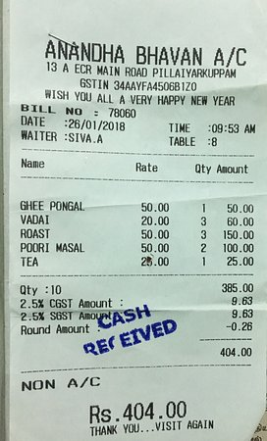

Adding multiple numbers
can we do better?
Notes:
The tree generating C7 is called “forward tree”, and the rest is called “backward tree”
What do the inputs to module generating C5 mean?
[Par00] p. 101 shows a 16-bit Brent-Kung tree structure.

Slide 63
Carry-Save Addition: Adding multiple operands
Consider adding six numbers (4 bits each)
1001, 0110, 1111, 0111, 1010, 0110 (all unsigned +ve)
One way is to add them pair wise, getting three results, and then adding them again
1001 1111 1010 01111 100101
0110 0111 0110 10110 10000
01111 10110 10000 100101 110101
Other method is add them three at a time by saving carry
1001 0111 00000 010101 001101
0110 1010 11110 010100 101000
1111 0110 01011 001100 110101
00000 01011 010101 001101 SUM
11110 01100 010100 101000 CARRY
final sum

Slide 64
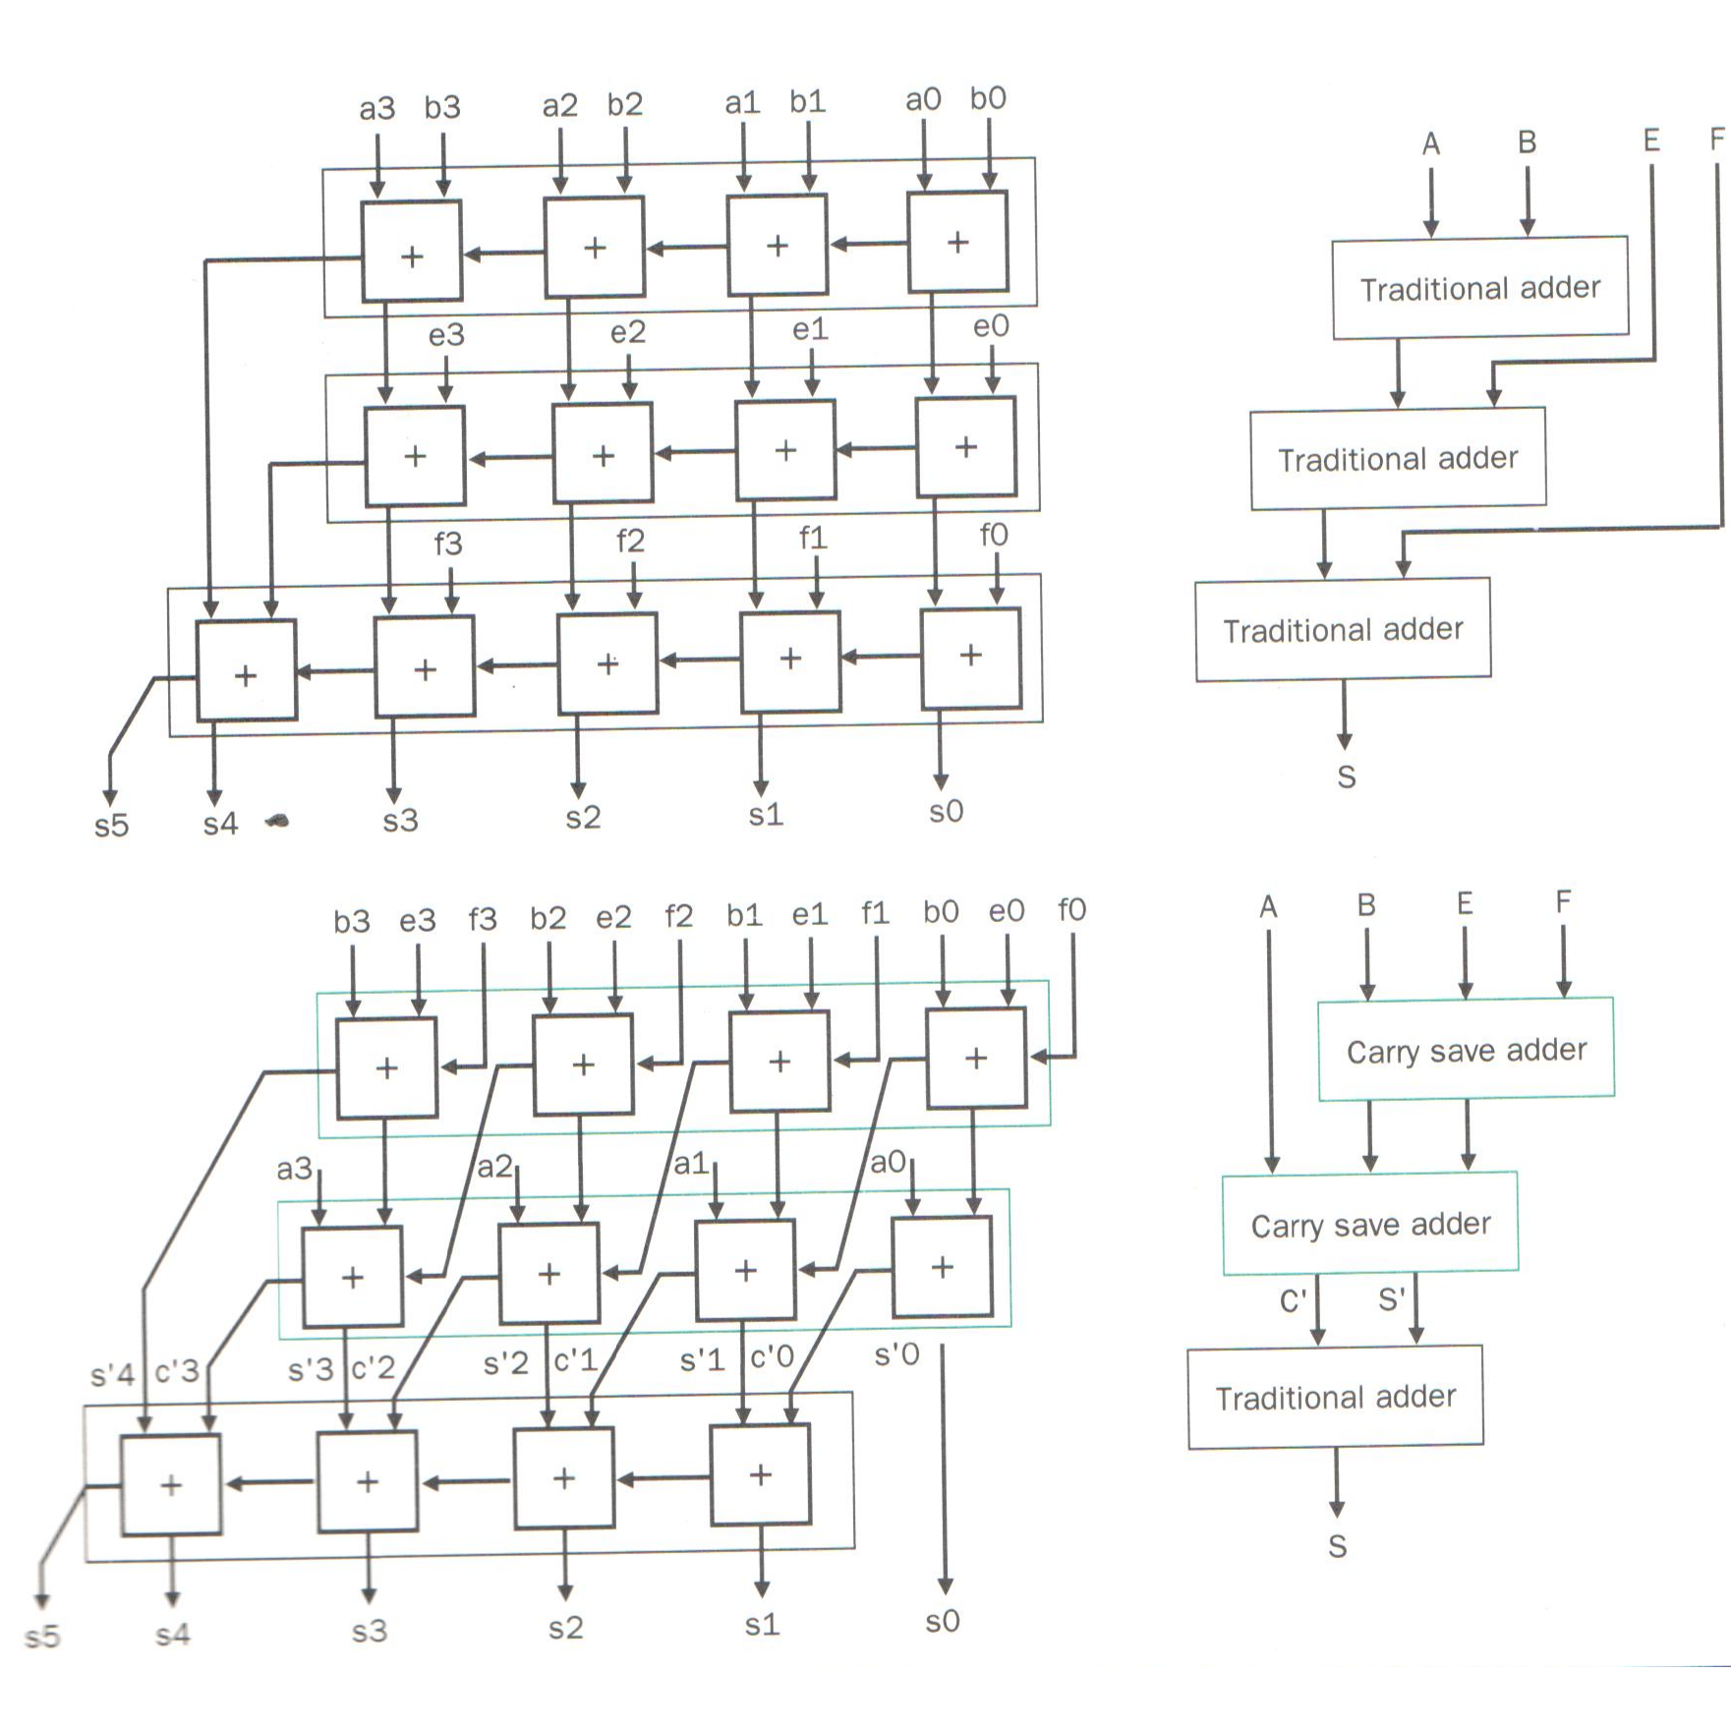
CARRY-SAVE ADDER (addition of multiple operands)
Add four 4-bit integers, A, B, E, F
can be made CLA
Cost = O(?); delay O(?)

Slide 65
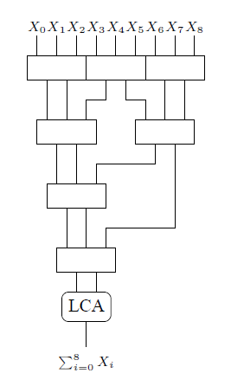
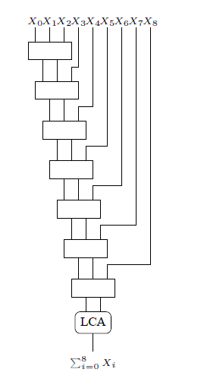
Adding m, n-bit numbers with CSA and log-adder
m
m
n
n
depth = log_{3/2}m
LCA: Lookahead carry adder with log-delay (~CLT)
Wallace tree;
Delay = O(logm + lg (n + logm))
Linear chain;
Delay = O(m + lg (n + m))

Slide 66
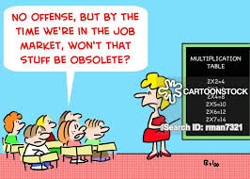
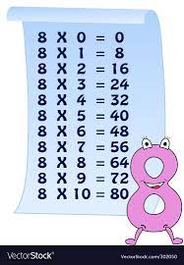
Integer Multiplication
Multiplication Table

Slide 67
Multiplication
 |  |  |  | 1 | 0 | 0 | 0
 |  |  | × | 0 | 1 | 0 | 1
 |  |  |  | 1 | 0 | 0 | 0
 |  |  | 0 | 0 | 0 | 0
 |  | 1 | 0 | 0 | 0
 | 0 | 0 | 0 | 0
 | 0 | 1 | 0 | 1 | 0 | 0 | 0
- 8
+ 8
2’s compl.
+5
+ 5
Multiplicand
Multiplier
Partial products
Final sum
Base 10: 8 × 5 = 40
=> 32 + 0 + 8 = 40
How wide is the result?
=> log(n × m) = log n + log m
=> 32-bit × 32-bit = 64-bit result
unsigned
Can you notice the need for Carry-Save Addition? We need to add multiple numbers!

Slide 68
CARRY-SAVE ADDER (addition of multiple operands)
Add four 4-bit integers, A, B, E, F

Slide 69
CS 31007 Autumn 2021 COMPUTER ORGANIZATION AND ARCHITECTURE
Instructors
Rajat Subhra Chakraborty (RSC)
Bhargab B. Bhattacharya (BBB)
Lecture #21: Computer Arithmetic
16 September 2021
Indian Institute of Technology Kharagpur
Computer Science and Engineering
Notes:
Good Morning!
The title of today’s talk is “On some Planar Partitioning Problems”.

Slide 70
Unsigned Multiplication
A_{i} and B_{i} are all 0 or 1

Slide 72
4-Bit Array Multiplier Using Carry-Save Adders
Carry-Save Adder

Slide 73
Array Multiplier Using Carry-Save Adders
CLT

Slide 74
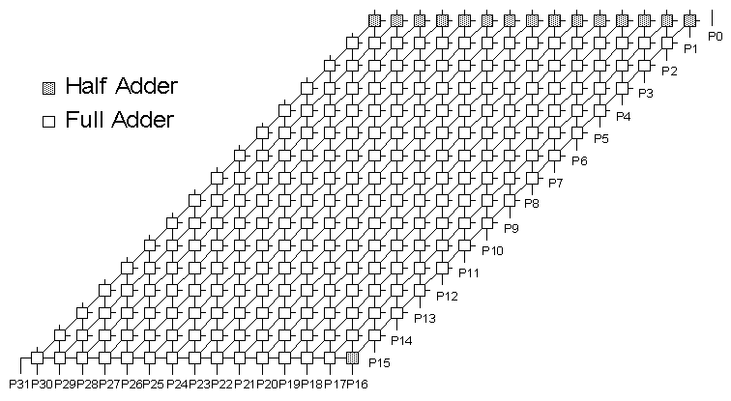
16-bit Array Multiplier using Carry Sav-Adder
[Courtesy: J. Hayes, Univ. of Michigan]
Conceptually straightforward
Fairly expensive hardware

Slide 75
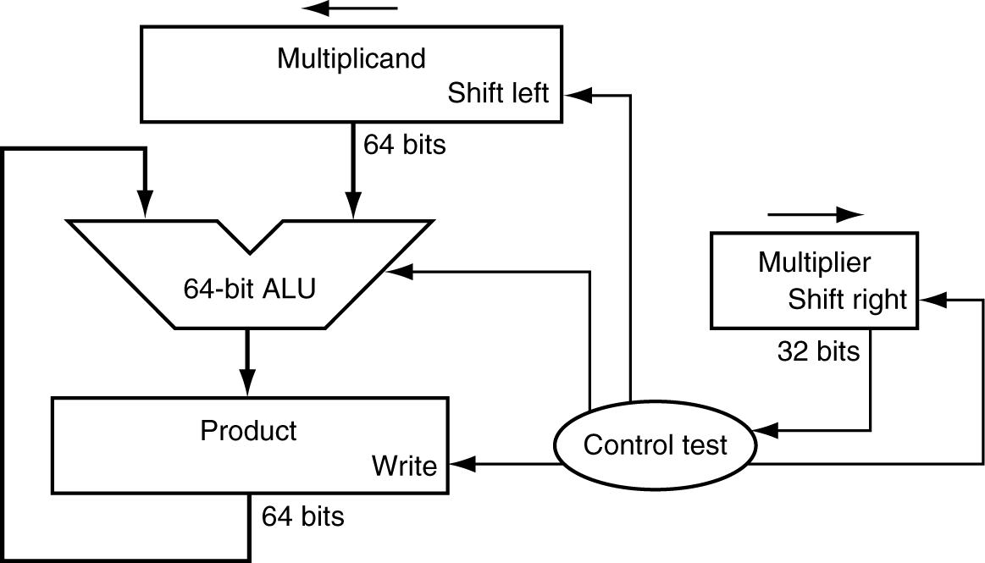
Multiplication (Shift and Repeated Additions)
§3.3 Multiplication
Mimic the multiplication process in hardware
multiplicand
1000
× 1001
1000
0000
0000
1000
1001000
multiplier
product
Length of product is the sum of operand lengths

Slide 76
Explanations
Multiplicand register is kept 64-bit wide because 32-bit multiplicand will be shifted 32 times to the left
Requires a 64-bit ALU
Product register must be 64-bit wide to accommodate the result
Contents of multiplier register is shifted 32 times to the right so that each bit successively appears as the least significant bit (LSB) to be checked by the controller

Slide 77
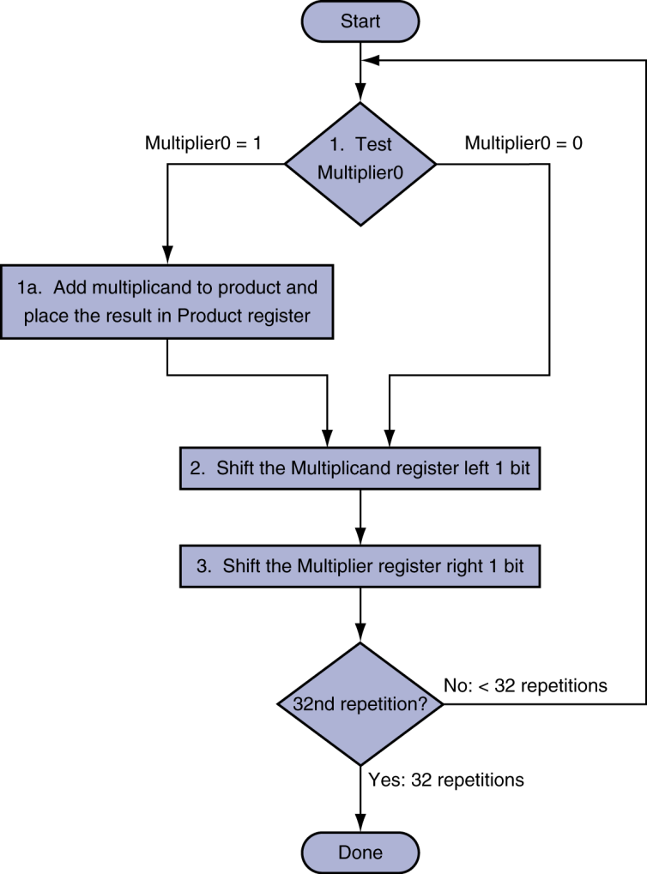
Multiplication Hardware
multiplicand
1000
× 1001
1000
0000
0000
1000
1001000
multiplier
product
Initially 0

Slide 78
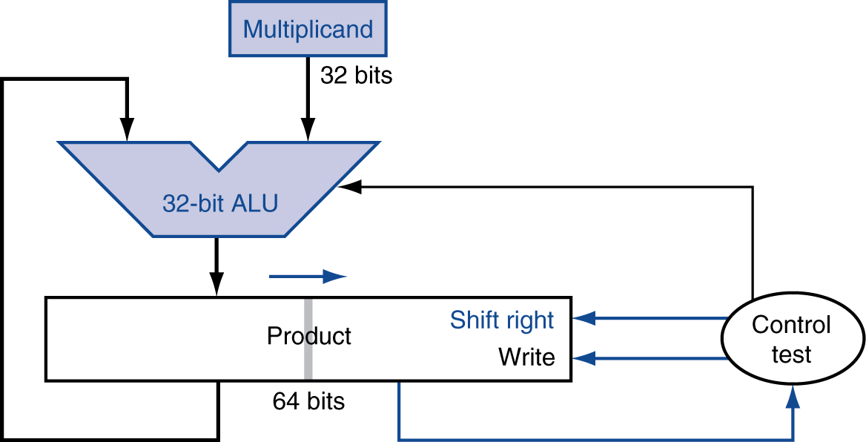
An Optimized Version of Multiplier
Perform steps in parallel: add/shift
Multiplier
(32-bits)
One cycle per partial-product addition

Slide 79
Optimized Multiplication: Implementation

Slide 80
Multiplication Example
0010 × 0110 = ? 0010 (+ 2, multiplicand); 0110 (+ 6, multiplier)
logical shift
+12

Slide 81
Signed Multiplication
Recall
For p = a × b, if either a < 0 or b < 0, then p < 0
If (a < 0 and b < 0) or (a > 0 and b > 0) then p > 0
Hence sign(p) = sign(a) ⊕ sign(b)
Hence
Convert multiplier and multiplicand to positive number each
Multiply two positive numbers
Compute sign, convert product accordingly

Slide 82
Multiplication: A Fundamental Question
What is the complexity of multiplying two n-bit integers?
A_{i} and B_{i} are all 0 or 1

Slide 83
Integer Multiplication
Multiplication
Given two n-bit integers a and b, compute a × b
1
1
0
1
0
1
0
1
School method
Θ(n²) bit operations
×
0
1
1
1
1
1
0
1
1
1
0
1
0
1
0
1
0
0
0
0
0
0
0
0
1
1
0
1
0
1
0
1
1
1
0
1
0
1
0
1
Ref: Jon Kleinberg and Éva Tardos, Algorithm Design
Slides by Kevin Wayn Copyright © 2005 Pearson-Addison Wesley
1
1
0
1
0
1
0
1
1
1
0
1
0
1
0
1
1
1
0
1
0
1
0
1
0
0
0
0
0
0
0
0
0
1
1
0
1
0
0
0
0
0
0
0
0
0
0
1
Q. Is school multiplication algorithm optimal?

Slide 84
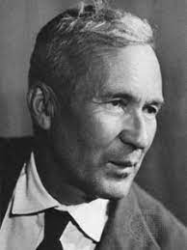
Integer Multiplication
School method
Θ(n²) bit operations
Multiplication
Given two n-bit integers a and b, compute a × b
1
1
0
1
0
1
0
1
×
0
1
1
1
1
1
0
1
1
1
0
1
0
1
0
1
0
0
0
0
0
0
0
0
1
1
0
1
0
1
0
1
Andrey Nikolaevich Kolmogorov (1903 – 1987)
1
1
0
1
0
1
0
1
1
1
0
1
0
1
0
1
1952: Kolmogorov conjectured that any multiplication algorithm will take Ω(n²) bit operations, i.e., it is asymptotically optimal
1
1
0
1
0
1
0
1
1
1
0
1
0
1
0
1
0
0
0
0
0
0
0
0
1960: Kolmogorov announced in a seminar at Moscow State University that it is indeed Ω(n²)
0
1
1
0
1
0
0
0
0
0
0
0
0
0
0
1
Q. Is grade-school multiplication algorithm optimal?

Slide 85
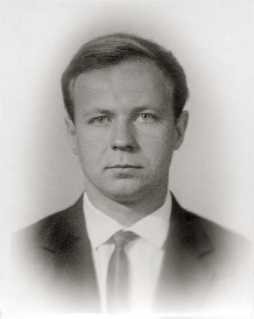
Integer Multiplication
School method
Θ(n²) bit operations
Multiplication
Given two n-bit integers a and b, compute a × b
1
1
0
1
0
1
0
1
1960: Kolmogorov announced in a seminar at Moscow State University that multiplication is indeed Ω(n²)
×
0
1
1
1
1
1
0
1
1
1
0
1
0
1
0
1
0
0
0
0
0
0
0
0
Kolmogorov
1
1
0
1
0
1
0
1
1
1
0
1
0
1
0
1
1
1
0
1
0
1
0
1
Anatoly Alexeyevich
Karatsuba (1937 – 2008)
1
1
0
1
0
1
0
1
1
1
0
1
0
1
0
1
1960: Within one week, Karatsuba disproved the claim, showing that multiplication can be done in O(n^{1.585}) time!
0
0
0
0
0
0
0
0
0
1
1
0
1
0
0
0
0
0
0
0
0
0
0
1

Slide 86
Karatsuba multiplication algorithm for two n-bit integers a, b
⎣n/2⎦
⎡n/2⎤
a
a₁
a₀
b
b₁
b₀
1
2
1
3
3
To multiply two n-bit integers a and b:
Add two ½n bit integers.
Multiply three ½n-bit integers, recursively
Add, subtract, and shift to obtain result
a₁b₀ + a₀b₁
=
(a₁+ a₀) (b₁+ b₀) ̶ a₁b₁ ̶ a₀b₀
Theorem: [Karatsuba-Ofman 1962] One can multiply two n-bit integers in O(n^{1.585}) bit operations
Ref: Jon Kleinberg and Éva Tardos, Algorithm Design
Slides by Kevin Wayn Copyright © 2005 Pearson-Addison Wesley
Notes:
Karatsuba: also works for multiplying two degree N univariate polynomials

Slide 87
Multiplication of two n-bit integers a, b
Theorem: [Schönhage and Strassen] It is possible to multiply two n-bit integers in O(nlogn log logn) bit operations
Ref: D. E. Knuth, The Art of Computer Programming,
Vol. 2: Seminumerical Algorithms, Addison Wesley
Notes:
Karatsuba: also works for multiplying two degree N univariate polynomials

