Slide 1
CS 31007 Autumn 2021 COMPUTER ORGANIZATION AND ARCHITECTURE
Instructors
Rajat Subhra Chakraborty (RSC)
Bhargab B. Bhattacharya (BBB)
Lecture # 7
CPU Performance Equation, Amdahl’s Law, Die Yield
19 August 2021
Indian Institute of Technology Kharagpur
Computer Science and Engineering
Notes:
Good Morning!
The title of today’s talk is “On some Planar Partitioning Problems”.

Slide 2
What determines the execution time of a machine/assembly-level program P when it is run on a machine M?
P consists of a number of machine-level instructions (IC: instruction count);
Each machine instruction requires several clock cycles to complete (CPI: average number of clock cycles per instruction);
Each clock cycle has certain time period (CCT: clock cycle time)
Thus, CPU-time = IC × CPI × CCT
(CPU Performance Equation);
Performance ∝ 1/CPU-time

Slide 3
CPU Clocking
CPUs are driven by constant-rate system clocks:
100 MHz clock frequency (f) means the system clock ticks 100 million times every second:
Clock period
CCT
Clock (cycles)
Data transfer and computation
Update state
One Clock Cycle Time (“Tick”), i.e., CCT
= 1/100,000,000 sec
=1/100 microsec = 10 nanosec
CCT = 1/f

Slide 4





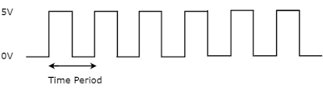
What determines the clock frequency for a processor?
460
245
200
72
30
# heart-beats per minute → clock period
clock frequency (f) = 1/CCT
= clock cycle time (CCT)
original image
Time period of pulsating heart (contraction and relaxation) should be just large enough so that blood reaches to the farthest extremities in one pumping cycle

Slide 5
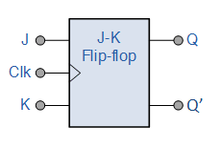

Clock Timing
CCT > signal delay along the longest sensitizable logic path (critical path) among those from PI/outputs(FFs) → PO/inputs(FFs)
critical path
Clock period should be large enough to accommodate delays along critical paths in the circuit (longest ones);
but should not be too large – system slows down unnecessarily
original image

Slide 6
clock

Slide 7
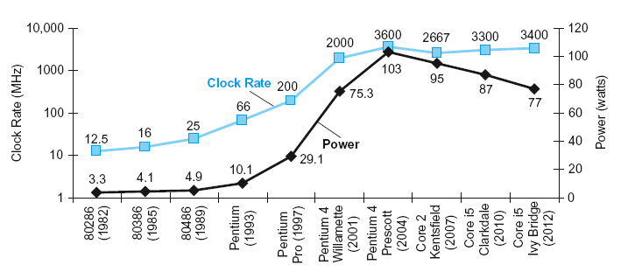
Power Issues and CCT
§1.7 The Power Wall
In CMOS IC technology
~×40
5V → 1V
×1000

Slide 8
Mem

Slide 9
CPU Time
Performance improved by
Reducing number of clock cycles
Increasing clock rate (a.k.a. frequency)
Hardware designer must often trade off clock rate against cycle count

Slide 10
CPU Time Example
Computer A: 2GHz clock, 10s CPU time
Designing Computer B
Aim for 6s CPU time
Can do faster clock, but causes 1.2 × clock cycles
How fast must Computer B clock be?

Slide 11
Instruction Count and CPI
Instruction Count for a program
Determined by program, ISA and compiler
Average cycles per instruction
Determined by CPU hardware
If different instructions have different CPI
Average CPI affected by instruction mix

Slide 12
CPI Example
Computer A: Cycle Time = 250ps, CPI = 2.0
Computer B: Cycle Time = 500ps, CPI = 1.2
Same ISA
Which is faster, and by how much?
A is faster…
…by this much

Slide 13
CPI in More Detail
If different instruction classes take different numbers of cycles
Weighted average CPI
Relative frequency

Slide 14
CPI Example: Who is better?
Two compiled codes for the same problem, using instructions in classes A, B, C
Class | A | B | C
CPI for class | 1 | 2 | 3
IC for Programmer 1 | 2 | 1 | 2
IC for Programmer 2 | 4 | 1 | 1
Sequence 1: IC = 5
Clock Cycles = 2×1 + 1×2 + 2×3 = 10
Avg. CPI = 10/5 = 2.0
Sequence 2: IC = 6
Clock Cycles = 4×1 + 1×2 + 1×3 = 9
Avg. CPI = 9/6 = 1.5

Slide 18
Performance Summary
The BIG Picture: CPU Performance Equation
CPU-time = IC × CPI × CCT
Performance depends on
Algorithm: affects IC, possibly CPI
Programming language: affects IC, CPI
Compiler: affects IC, CPI
Instruction set architecture: affects IC, CPI, CCT
CPI is also affected by memory hierarchy, pipelining; CCT is affected by logic design, technology

Slide 19
Reducing Power
Suppose a new CPU has
85% of capacitive load of old CPU
15% voltage and 15% frequency reduction
The power wall
We can’t reduce voltage further
We can’t remove more heat
How else can we improve performance?

Slide 20
How to improve the performance of a machine by “Enhancement” of one or more components?
→ Amdahl’s Law
How to improve the performance of a computing system by adding more processors (cores)?
→ Gustavson-Barsis Law

Slide 21
Example: Improving performance in steps
New machine M_{new} (improved a.k.a. (enhanced)
Old machine M_{old}
responsible for 1/3 of CPU-time
C_{old}
C_{new}
Speed-up for component C
= 2×
Question: What is the overall speed-up of M_{new} w.r.t. M_{old}?

Slide 22
Gradual enhancement of resources for speed-up
Let C be a component (e.g., adder) of an old machine, which is improved to C’ in a new machine
A job submitted to the old machine takes 60 secs to finish

Slide 23
Gradual enhancement of resources for speed-up
2

Slide 24

The general result concerning the overall speed-up, when a component of the old machine is enhanced is captured in “Amdahl’s Law”
Gene Amdahl
(1922-2015)

Slide 25

Amdahl's Law
Speed-up due to enhancement E:
CPU-time w/o E Performance w/E
Speed-up(E) = ------------- = ------------------
CPU-time w/E Performance w/o E
Suppose that enhancement E accelerates a fraction F of the task by a factor S, and the remainder of the task is unaffected
F

Slide 26
Amdahl’s Law
CPU-time_{new} = CPU-time_{old} × (1 - Frac_{enhanced}) + Frac_{enhanced}
Speed-up_{enhanced}
CPU-time_{old}
CPU-time_{new}
1
Speed-up_{overall} =
=
(1 - Frac_{enhanced}) + Frac_{enhanced}
Speed-up_{enhanced}
Law of diminishing return: unaffected fraction will determine the limiting case!
Improvement of larger fraction will yield higher overall speed-up → Make the common case faster

Slide 27
Example: Amdahl’s Law
Floating-point (FP) instructions are improved to run 2X in a new machine
10% of actual instructions are FP

Slide 28
Example: Amdahl’s Law
Floating-point (FP) instructions are improved to run 2× in a new machine
10% of actual instructions are FP
CPU-time_{new} = CPU-time_{old} × (0.9 + 0.1/2) = 0.95 × CPU-time_{old}
1
Speed-up_{overall}
=
=
1.053
0.95
For FP Speed-up 100X, Speed-up_{overall}
=
1.109

Slide 29
Pitfall: Amdahl’s Law
Improving an aspect of a computer and expecting a proportional improvement in overall performance
§1.10 Fallacies and Pitfalls
Example: multiply accounts for 80s/100s
How much improvement in multiply performance to get 5× overall?
Can’t be done!
Corollary: Make the common case fast

Slide 30
Multiprocessors
Multicore microprocessors
More than one processor per chip
Clock frequency limited
Requires explicitly parallel programming
Compare with instruction level parallelism
Hardware executes multiple instructions at once
Hidden from the programmer
Hard to do
Programming for performance
Load balancing
Optimizing communication and synchronization

Slide 31
Parallelism: Adding multiple processors
Pessimistic view
1. X:= A + B
2. Y:= X * C
3. D:= B + C
4. E:= X – C
Statement 1 & 2 cannot be executed in parallel (serial);
1 and 3 can be executed in parallel; 2 & 4 can be done in parallel
Single processor
Multi-processor
What kind of speed-up is expected?
s: time needed by a single processor on serial parts of P;
p: time needed by a single processor on the parts of P that can be parallelized; s + p = 1
By Amdahl’s Law, the speed-up in the multi-core processor
= 1/(s +p/N) If s = 10%, the maximum speed-up is 10X

Slide 32
Parallelism: Adding multiple processors Amdahl’s Law versus Gustavson-Barsis Law
By Amdahl’s Law, the speed-up in the multi-core processor
= 1/(s +p/N), i.e., it is limited by s, increasing N does not help.
In Amdahl’s Law, the size of the job is assumed to be constant;
however, multi-cores can solve a large job in the same time.
This leads to Gustavson-Barsis Law:
Let s and p represent serial and parallel time on N-core system; The single core processor would take s + (p × N) time to perform the same job P.
Hence, Speed-up = (s + (p × N))/(s + p) = (s + (p × N)
Thus, by Gustavson-Barsis Law, speed-up grows with N
Optimistic view

Slide 33
Metrics of Performance
Application
Throughput per month
Operations per second
Programming
Language
Compiler
(Millions) of Instructions per second: MIPS
(Millions) of (FP) operations per second: MFLOP/s
ISA
Datapath
Control
Megabytes per second
Function Units
Transistors
Wires
Pins
Cycles per second (clock rate)

Slide 34
ISA: RISC versus CISC
RISC (Reduced Instruction Set Computing)
Keep the instruction set small and simple
Fixed instruction lengths, easy encoding
Load-store instruction sets; register-indirect addressing with offset; ALU operations involve only registers
lw $t1 - 40($t2); add $t0,$s1,$s2
Limited addressing modes
Limited operations
IC high, CPI low
Advantage: enables hardware simple and fast; decoding simple; pipelining easy, die-area small
Performance is optimized focused on software

Slide 35
RISC Example: MIPS, Sun SPARC, HP PA-RISC, IBM PowerPC, Alpha, RISC-V, ARM
CISC - Complex Instruction Set Computer
- complex instructions, encoding non-uniform
- different lengths
- can handle multiple operands
- complex functionalities
- IC low, CPI high
pipelining becomes harder; hardware cost increases; compiler design becomes more involved;
Examples of CISC processors are Intel CPUs, System/360, VAX, AMD
Notes:
As opposed to CISC – Complicated Instruction Set Architecture (ala the x86)

Slide 36







Eight Great Ideas
Amdahl’s law
Design for Moore’s Law
Use abstraction to simplify design
Make the common case fast
Performance via parallelism
Performance via pipelining
Performance via branch prediction
Hierarchy of memories
Dependability via redundancy
§1.2 Eight Great Ideas in Computer Architecture
Gustavson-Barsis law

Slide 37
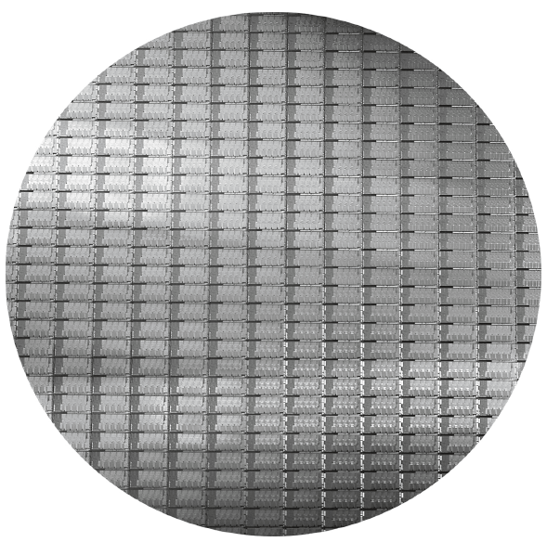
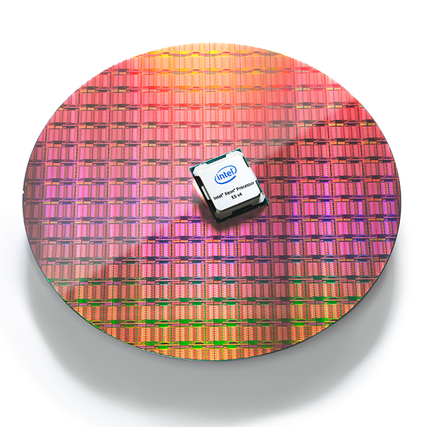
Intel Core i7 Wafer
Estimation of Die Yield
Intel Xeon E5-2600 v4 chips with 22 processors, 14nm process technology (2016)
die
300mm wafer, 280 dies, 32nm technology, 4-8 cores per die
Each die is 20.7 x 10.5 mm
wafer
chip

Slide 38
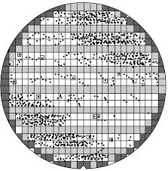
Defects in IC’s and Yield
defects on chips make them unusable;
peripheral chips are incompletely fabricated, and hence unusable (square-peg in round-hole problem);
yield: fraction of good chips produced;
chip-cost depends on yield;

Slide 39
Integrated Circuit Cost
chip-cost ~ (die-area)⁴
[1 + {(Defects per unit area of chip × chip area)/α}]^{α}
This is an empirical estimation of yield; α is a parameter that roughly captures the complexity of the manufacturing process
Nonlinear relation to area and defect rate
Wafer cost and area are fixed
Defect rate determined by manufacturing process
Die area determined by architecture and circuit design

Slide 40


Slide 45
Concluding Remarks
Cost/performance is improving
Due to underlying technology development
Hierarchical layers of abstraction
In both hardware and software
Instruction set architecture
The hardware/software interface
Execution time: the best performance measure
Power is a limiting factor
Use enhancement and parallelism to improve performance
§1.9 Concluding Remarks

Slide 46
Next Class
Introducing MIPS Assembly Language
Notes:
Good Morning!
The title of today’s talk is “On some Planar Partitioning Problems”.

Slide 47
CS 31007 Autumn 2021 COMPUTER ORGANIZATION AND ARCHITECTURE
Announcement for Test-01
Monday, 06 September 2021, 12 noon – 2 pm
Exam will be conducted via CSE Moodle
Coverage: Processor Design Basics, von Neumann Architecture,
ISA, RISC/CISC, CPU-Performance, Die Yield,
MIPS Assembly Language Programming
(Material covered till 02 September 2021)
Indian Institute of Technology Kharagpur
Computer Science and Engineering
Notes:
Good Morning!
The title of today’s talk is “On some Planar Partitioning Problems”.

