Slide 1
DA421: Fairness in AI Models Assignment 01 – Situation testing using kNN
Name: Kaki Hephzi Sunanda
Roll Number: 210150018
Notes:
ID=d924773e-9a16-4d6d-9803-8cb819e99682 Recipe=text_billboard Type=TextOnly Variant=0 FamilyID=AccentBoxWalbaum_Zero

Slide 2
Objective
Detect and correct bias in the adult dataset, particularly focusing on sensitive attributes like race and marital status.
Implement situation testing using k-NN.
Apply DiscoverN() and PreventionN() algorithms for bias detection and correction.
Evaluate multiple classifiers (Naive Bayes, Logistic Regression, Decision Trees) before and after t-correction.

Slide 3
Methodology
Dataset : Adult (Census Income) dataset.
The dataset was sampled to 50%, ensuring that the proportions of the demographic attributes were maintained.
Nominal attributes were encoded into numerical representations.
Situation testing using kNN :
k-NN algorithm was used to calculate the bias for each tuple based on sensitive attribute.
Different values of k (e.g., k = 8, 16, 32) were tested to determine bias.

Slide 4
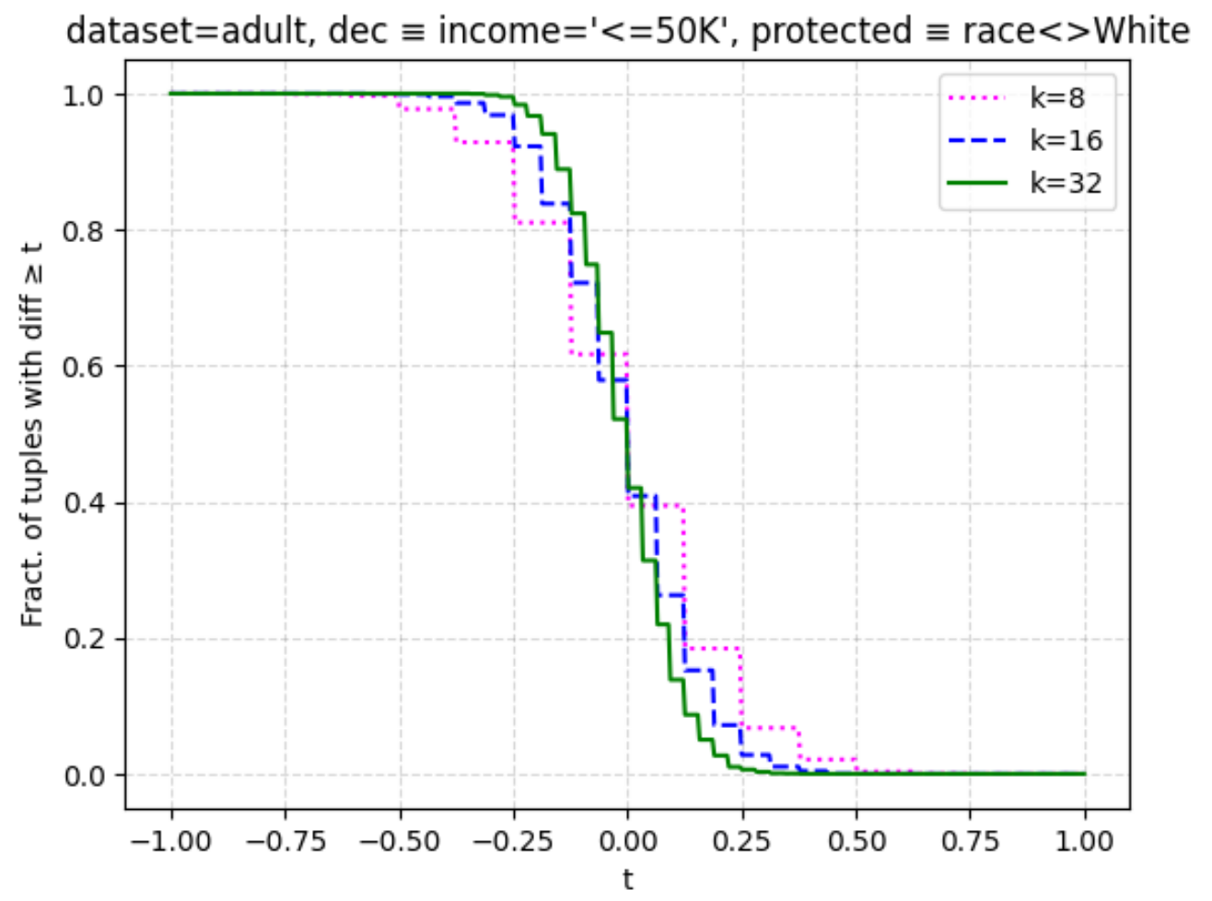
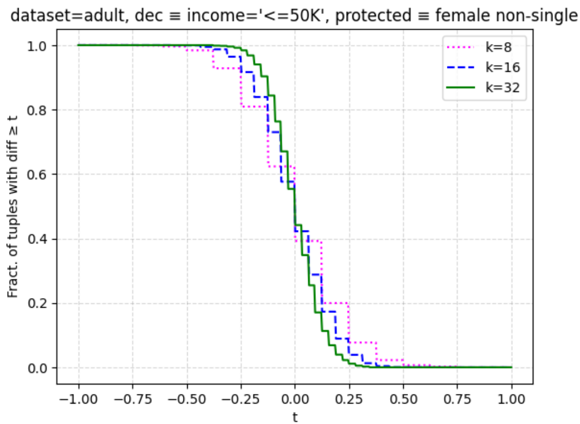
Bias distribution for Experiment 1:
Bias distribution for Experiment 2:

Slide 5
Methodology
Application of DiscoverN and PreventionN Algorithms
DiscoverN: To label the dataset (t-labeled) for discrimination.
PreventionN: To correct the bias (t-corrected) by modifying certain decisions.
Classification:
Naive Bayes, Logistic Regression, and Decision Tree (C4.5) were implemented on both the t-labeled and t-corrected datasets.
Evaluation metrics: Accuracy and 0.10-discrimination were calculated to compare results.

Slide 6
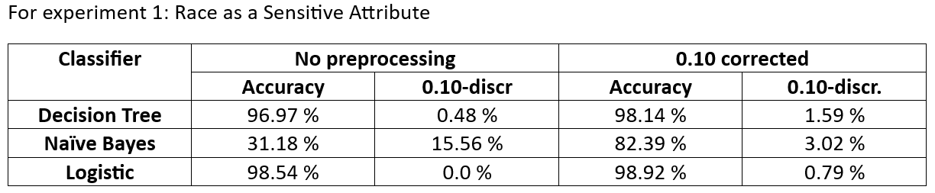
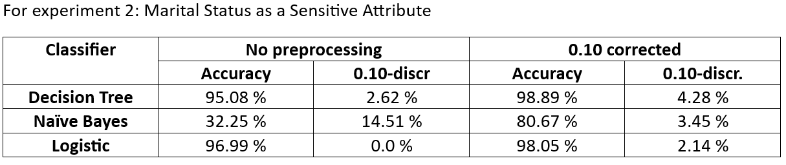
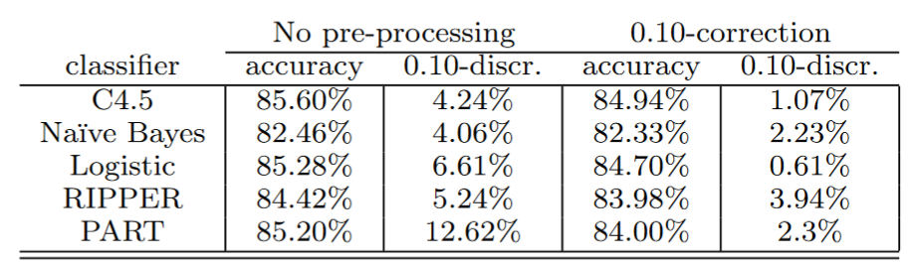

Slide 7
Results & Observations
Naive Bayes shows a significant reduction in 0.10-discrimination after applying the correction in both experiments.
Despite improvements in accuracy, both Decision Tree and Logistic Regression show an increase in 0.10-discrimination after correction.
Overfitting in Decision Tree and Logistic Regression models likely caused low discrimination before correction, which increased after correction.
The structure of the dataset itself after t-correction could introduce complexity, leading to bias.

Slide 8
Thank You

