Slide 1


MaternaCare
Empowering mothers with real-time health monitoring for a safer pregnancy journey

Slide 2

Problem
Deaths One in five pregnancies worldwide faces complications, leading to potential risks for both mothers and babies.
Fetal Distress Detection of fetal distress through abnormal
or reduced fetal movements, enabling timely medical intervention.
Healthcare Inaccessibility lack of timely access to medical
services, often due to factors like geographic location
Delayed Interventions postponement or lack of timely medical
treatment or action in response to a health issue
Missed Pregnancy refers to the failure to detect early symptoms or
warning signs of potential complications during pregnancy

Slide 3




Solution
A wearable pregnancy belt that provides real-time
monitoring for both the mother and fetus
ability to identify potential health risks or abnormalities in
both the mother and fetus at an early stage
Healthcare Access in Remote Areas enables timely
medical support in underserved locations.
Convenience and Comfort ensure easy use and
a pleasant experience, prioritizing user well-being.

Slide 4
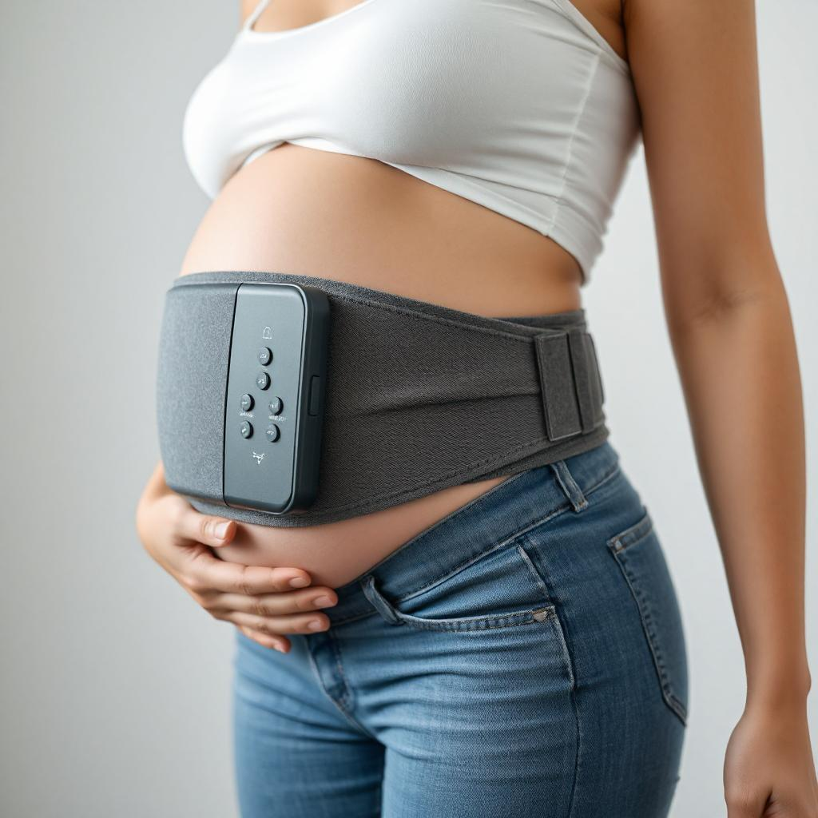
Our product

Slide 5
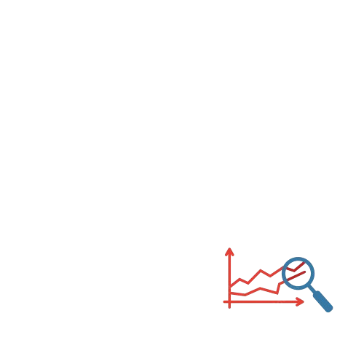







Core Capabilities
Maternal and Fetal Health Tracking
Heart rate of
Both fetus and mother
Blood pressure
Body and environment
temperature
Stress
Levels
Contraction
Monitoring
AI Innovations
Personalized
Wellness
Multilingual &
Voice-Assistance
Fetal Movement
Detection
Predictive Analytics

Slide 6


Market Adoption
RURAL
Essential healthcare solution for underserved regions, where access to prenatal care is limited.
Key Demographic: Pregnant women in remote areas, rural healthcare organizations, and government health initiatives.
Urban
Tech-savvy and premium segment, looking for advanced prenatal care
solutions that integrate AI and real-time health monitoring.
Key Demographic: Expecting mothers, healthcare providers, and hospitals in metropolitan cities.

Slide 7





Competitive Advantages
Fetal Movement Detection
Dual Monitoring System
Body water content
monitoring
Smart Alerts & Emergency
System
Biodegradable

Slide 8
Presented by
Sai Keerthana
6304665742
Chandrakantha Patil English medium school
Kalaburagi

