Slide 1
Directives

Slide 2
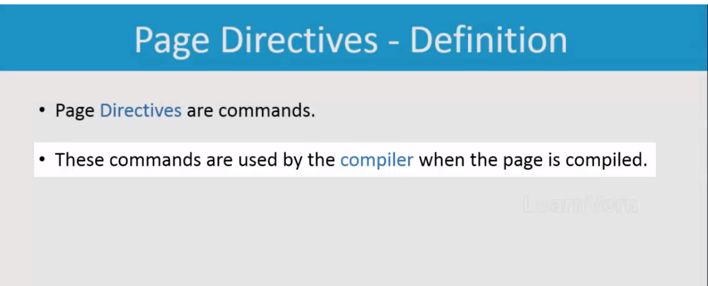

Slide 3
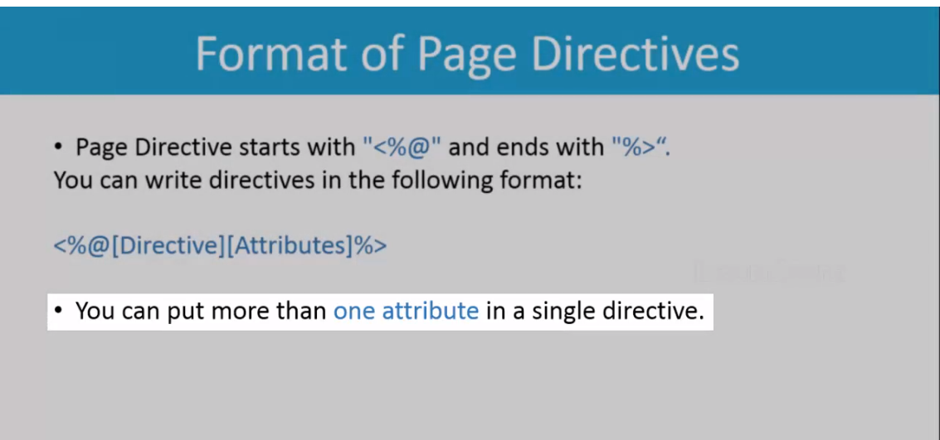
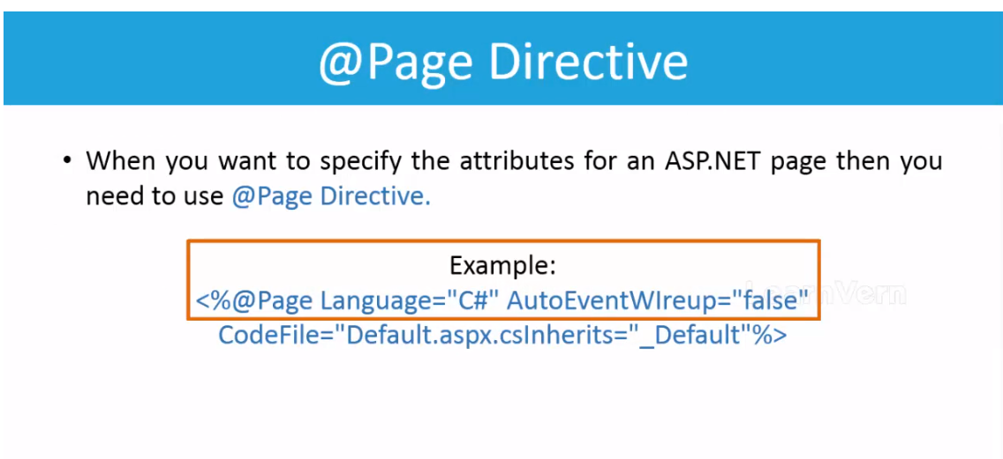

Slide 4
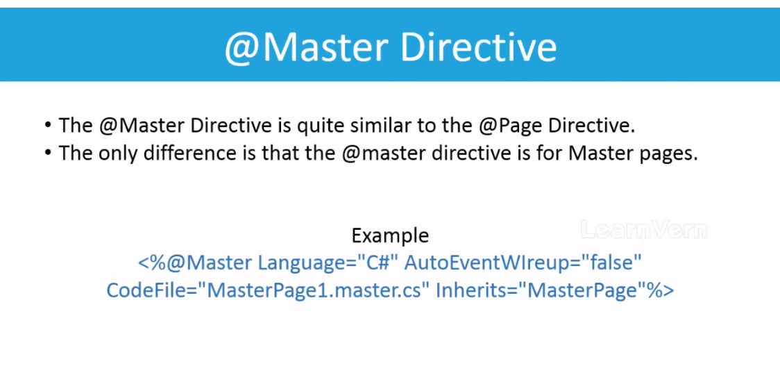

Slide 5
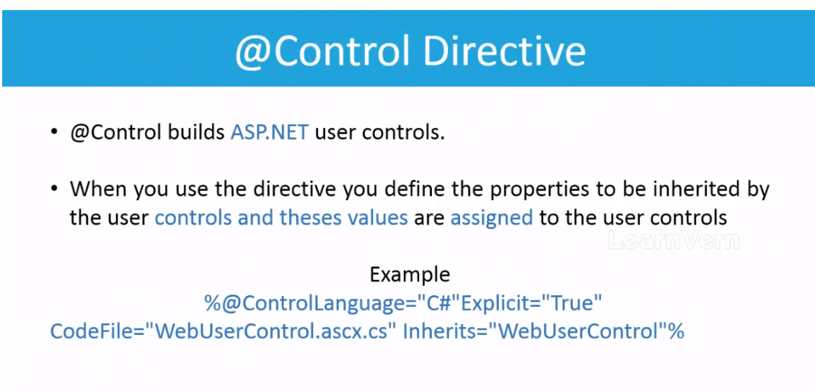

Slide 6
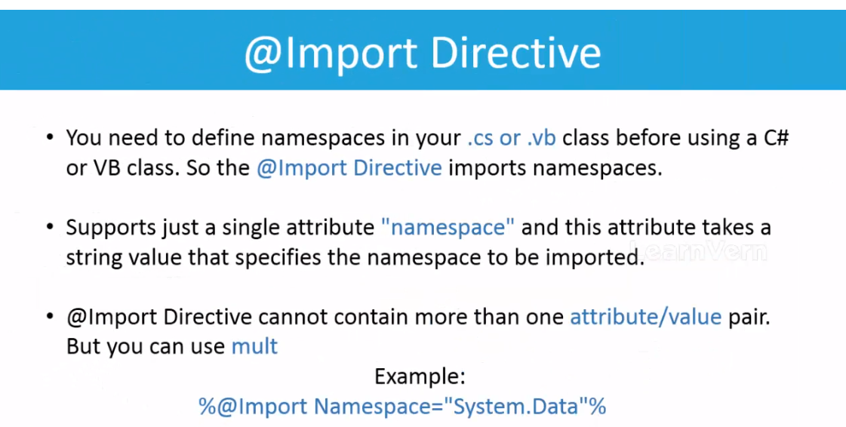

Slide 7
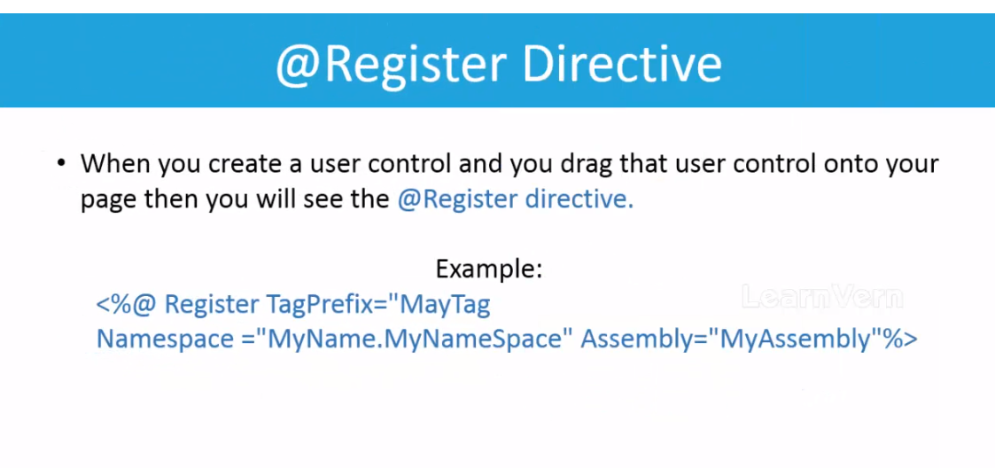

Slide 8
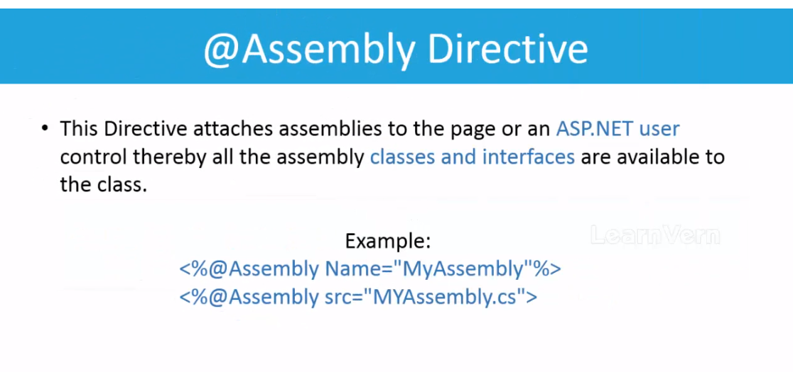

Slide 9
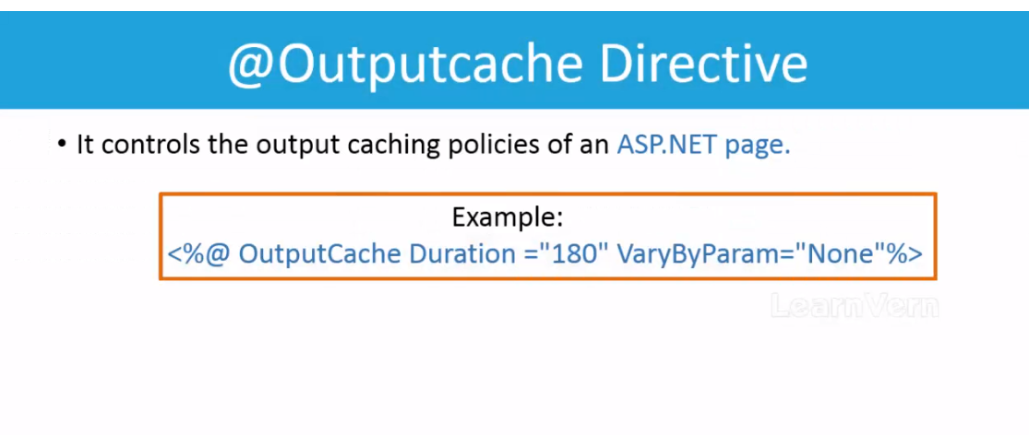
Assume, user requests for some data from the database, the requests first goes through the Asp.net server,
The data when comes from the database, it first gets stored into the Asp.net server’s cache. Then the duration taken to retrieve data from the cache can be long, in order to set that duration, OutputCache directive is used.

