Slide 1
ECMA Ajax

Slide 2
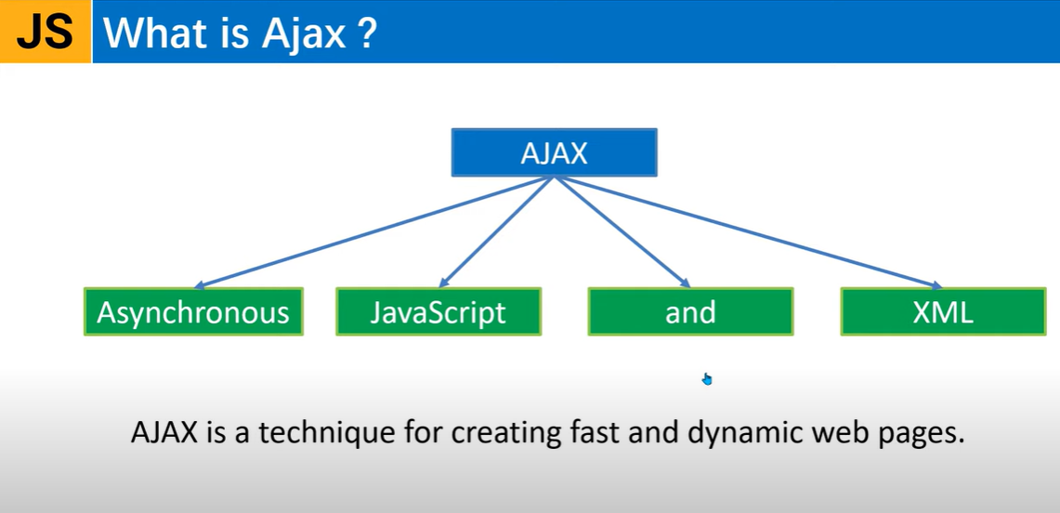

Slide 3
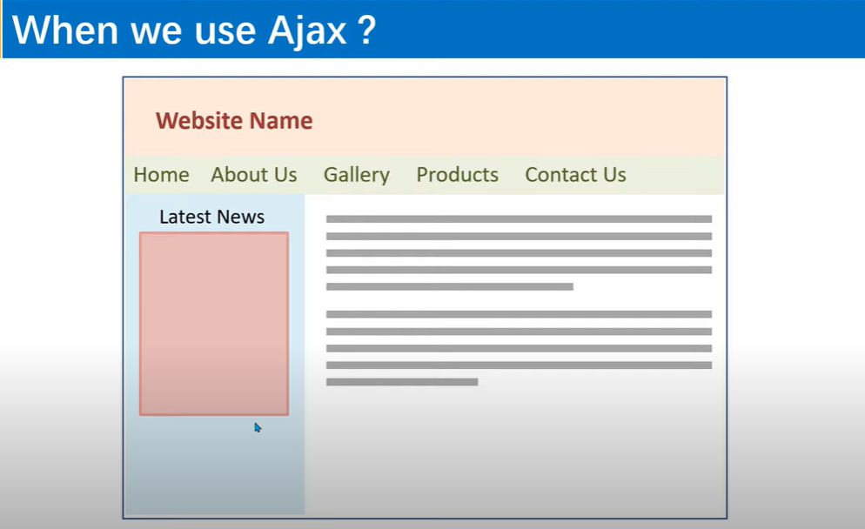

Slide 4
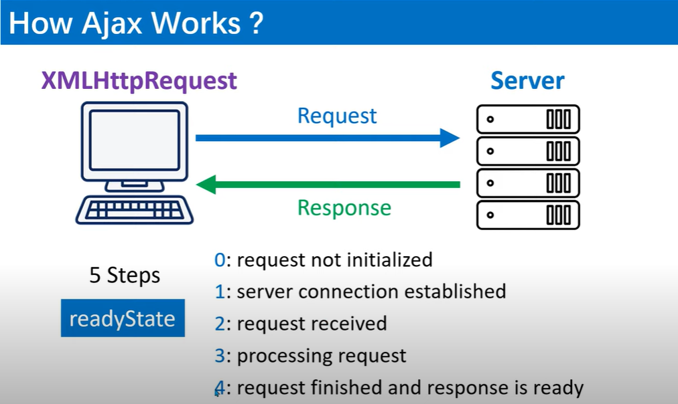

Slide 5
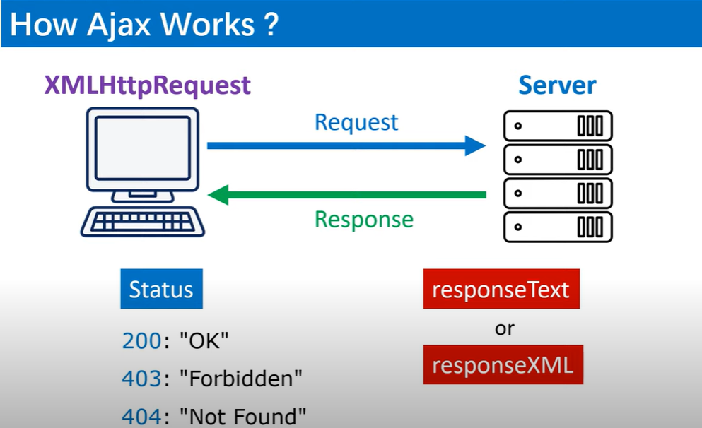

Slide 6
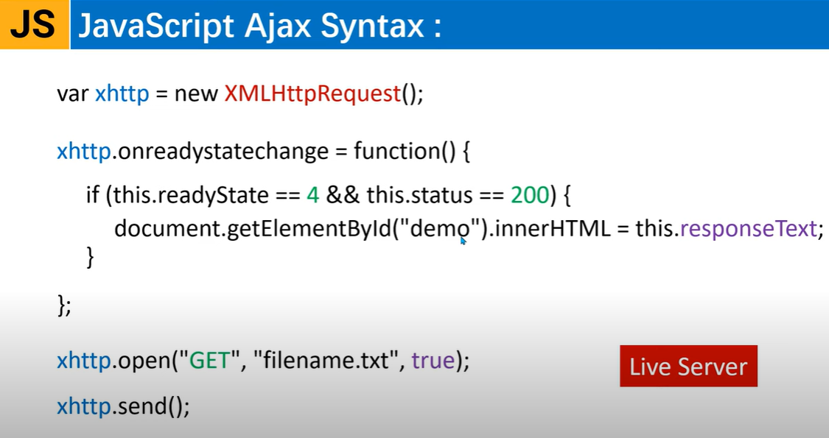
file name
Method name
Async mode

Slide 7
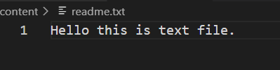
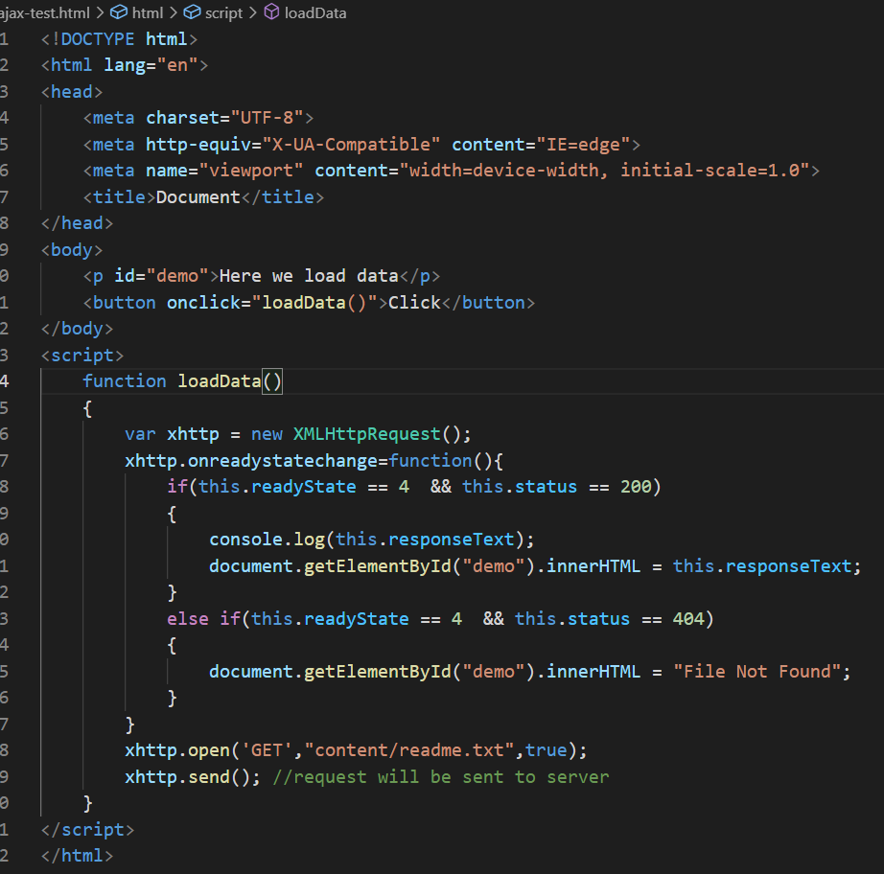
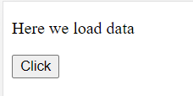
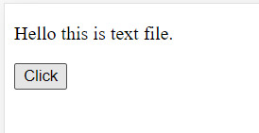
Example
Using this method of XMLHttpRequest is older version of JS, but now most developers prefer using ajax with jQuery.
There is also a new method included now in ES6 version. i.e. fetch() method.

Slide 8
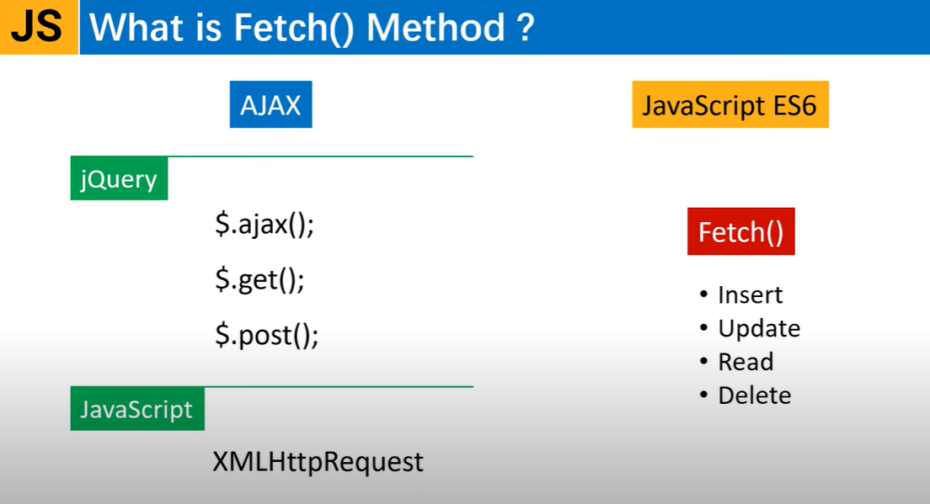

Slide 9
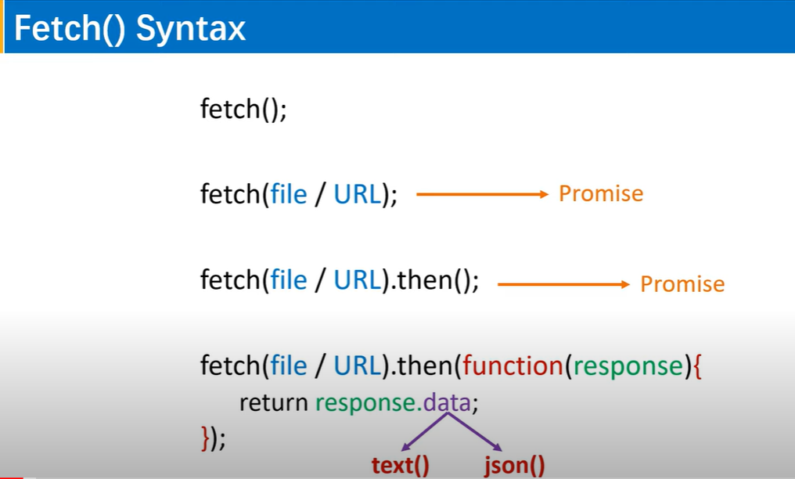
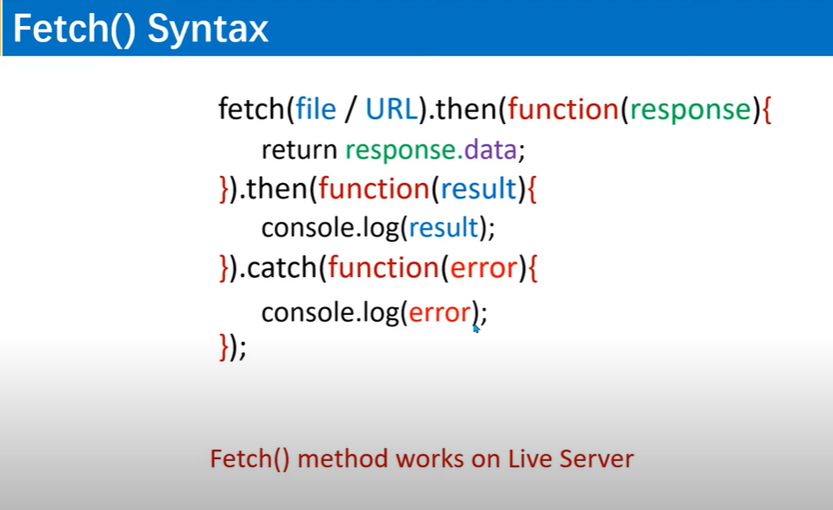

Slide 10
Example – To get data from server
<script>
fetch("content/readme.txt").then((response)=>{
//console.log(response.text()); //here it returns a promise
return response.text();
}).then((data)=>{
//console.log(data);
//or
document.write(data);
})
</script>
<script>
fetch("https://jsonplaceholder.typicode.com/users").then((response)=>{
//here it returns a promise
return response.json();
}).then((data)=>{
console.log(data);
//or
//document.write(data);
})
</script>

Slide 11
Example
<script>
fetch("https://jsonplaceholder.typicode.com/users").then((response)=>{
//console.log(response.text()); //here it returns a promise
return response.json();
}).then((data)=>{
//console.log(data1);
//or
//document.write(data);
for (x in data)
{
document.write(x);
//to access the inner objects
document.write(`${data[x].name} - ${data[x].email} , ${data[x].address.city}<br/>`);
}
}).catch((error)=>{
//console.log(error);
document.write("Cannot fetch data");
});
</script>
<script>
fetch("json/student-data.json").then((response)=>{
return response.json();
}).then((data)=>{
console.log(data);
//or
//document.write(data);
for (x in data)
{
document.write(x);
//to access the inner objects
document.write(`${data[x].name} - ${data[x].age} , ${data[x].city}<br/>`);
}
}).catch((error)=>{
//console.log(error);
document.write("Cannot fetch data");
});
</script>

Slide 12
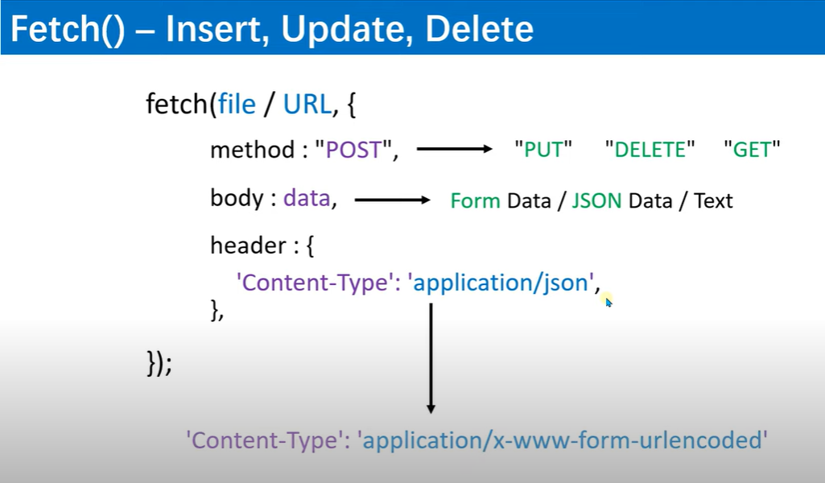

Slide 13
Example – to store data on server
<script>
//to send data to web server
fetch('https://jsonplaceholder.typicode.com/posts', {
method: 'POST',
body: JSON.stringify({
title: 'foo',
body: 'bar',
userId: 1,
}),
headers: {
'Content-type': 'application/json; charset=UTF-8',
},
})
.then((response) => response.json())
.then((json) => console.log(json));
</script>

Slide 14
Example – To store data entered in form input fields
<body>
<form id="myform">
Title: <input type="text" id="title"/><br/><br/>
Body: <input type="text" id="body"/><br/><br/>
UserId: <input type="text" id="userid"/><br/><br/>
<input type="submit" id="saveform" value="Save"/>
</form>
<script>
document.getElementById('saveform').addEventListener("click",function(e){
e.preventDefault(); //the functionality of button to refresh the page will be prevented.
var obj={
title:document.getElementById('title').value,
body:document.getElementById('body').value,
userId:document.getElementById('userid').value
};
//to update data on web server
fetch('https://jsonplaceholder.typicode.com/posts', {
method: 'POST',
body: JSON.stringify(obj),
headers: {
'Content-type': 'application/json; charset=UTF-8',
},
})
.then((response) => response.json())
.then((json) => console.log(json));
});
</script>

Slide 15
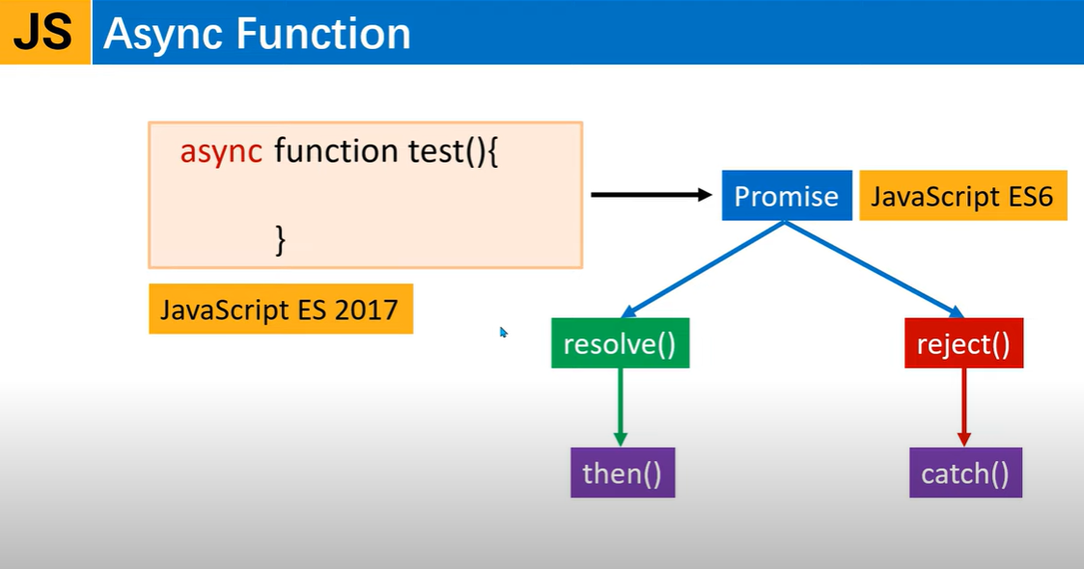
In ES6, Promise function was internally calling every time resolve() & reject() methods, upon which it calls then() & catch() methods, which is tedious task.
To overcome from this issue in Promise function, ES7 included async function.

Slide 16
Example
<script>
//Now to make it async function, use async keyword
//This function will work in asynchronous mode i.e. in background
async function test() {
return "Hello test";
}
console.log(test());
</script>
<script>
//This is second method to create async function.
let test = async function() {
return "Hello test";
}
test().then((response)=>{
console.log(response);
});
</script>
This returns a Promise
<script>
//This is one method to create async function.
async function test() {
return "Hello test";
}
test().then((response)=>{
console.log(response);
});
</script>
<script>
//This is third method to create async function.
let test = async() =>{
return "Hello test";
}
test().then((response)=>{
console.log(response);
});
</script>

Slide 17
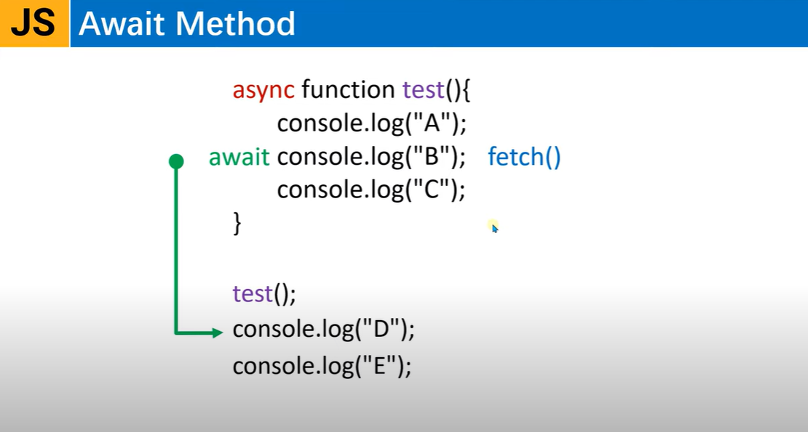
1
4
2
3

Slide 18
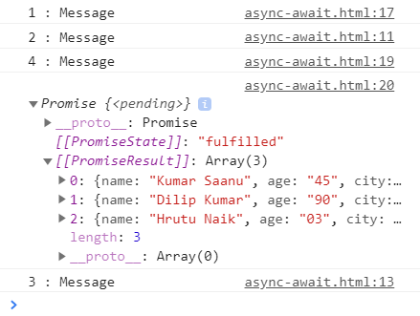
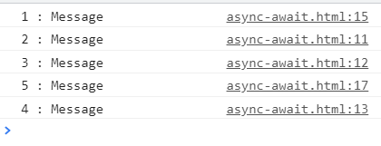
Example
<script>
async function test()
{
console.log("2 : Message");
const response = await fetch("json/student-data.json");
console.log("3 : Message");
const students = await response.json();
return students;
}
console.log("1 : Message");
let t = test();
console.log("4 : Message");
console.log(t);
</script>
<script>
async function test()
{
console.log("2 : Message");
await console.log("3 : Message");
console.log("4 : Message");
}
console.log("1 : Message");
test();
console.log("5 : Message");
</script>
output
output

Slide 19
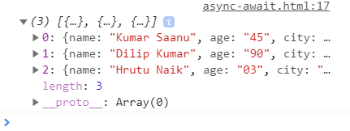
Example
<script>
async function test()
{
const response = await fetch("json/student-data.json");
const students = await response.json();
return students;
}
test().then((res)=>{
console.log(res);
}).catch((err)=>{
console.log(err);
});
</script>
output
output
<script>
//To handle exception if async function called multiple times
async function test()
{
try{
const response = await fetch("json/student-data.json");
const students = await response.json();
return students;
}
catch(error){
console.log(error);
}
}
test().then((res)=>{
console.log(res);
});
</script>
<script>
//Alternative way to shorten this code
async function test()
{
return (await fetch("json/student-data.json")).json();
}
test().then((res)=>{
console.log(res);
}).catch((err)=>{
console.log(err);
});
</script>

