Slide 1
ES6 DE structuring

Slide 2
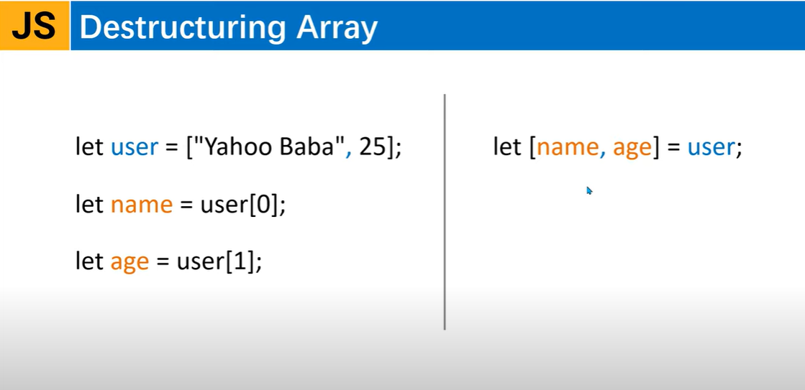

Slide 3
Example
<script>
let user=["Hrutu",,"Goa"]; //array created
// let name=user[0];
// let age=user[1]; //so on
//Thus ES6 has newer version of assigning each array values to a variable
//i.e. called destructuring of array
let [name,age=20,city]=user; //this is destructuring of array user
console.log(name);
console.log(age);
console.log(city);
//Now if an item is removed from the user array then at line 14 we get undefined
//We can provide default value at 14 & provide empty item at 9.
</script>
<script>
let user=["Hrutu",,"Goa",["Female",65000]]; //array with an array created
let [name,age=20,city,[gender,salary]]=user; //this is destructuring of array user
console.log(name);
console.log(age);
console.log(city);
console.log(gender);
console.log(salary);
</script>

Slide 4
Destructuring Array with Rest Operator
<script>
let user=["Hrutu",3,"Goa"];
//Now using rest operator
let [name,...args]=user; //this is destructuring of array user
console.log(name);
console.log(args);
</script>

Slide 5
Destructuring array using function
<script>
//Destructuring array using function with return
function user()
{
return ["Hrutu",4,"Goa"];
}
let [name,age,city]=user();
console.log(name);
console.log(age);
console.log(city);
</script>
<script>
//Destructuring array using function
function user([name,age,city])
{
console.log(name);
console.log(age);
console.log(city);
}
user(["Hrutu",4,"Panaji"]);
</script>

Slide 6
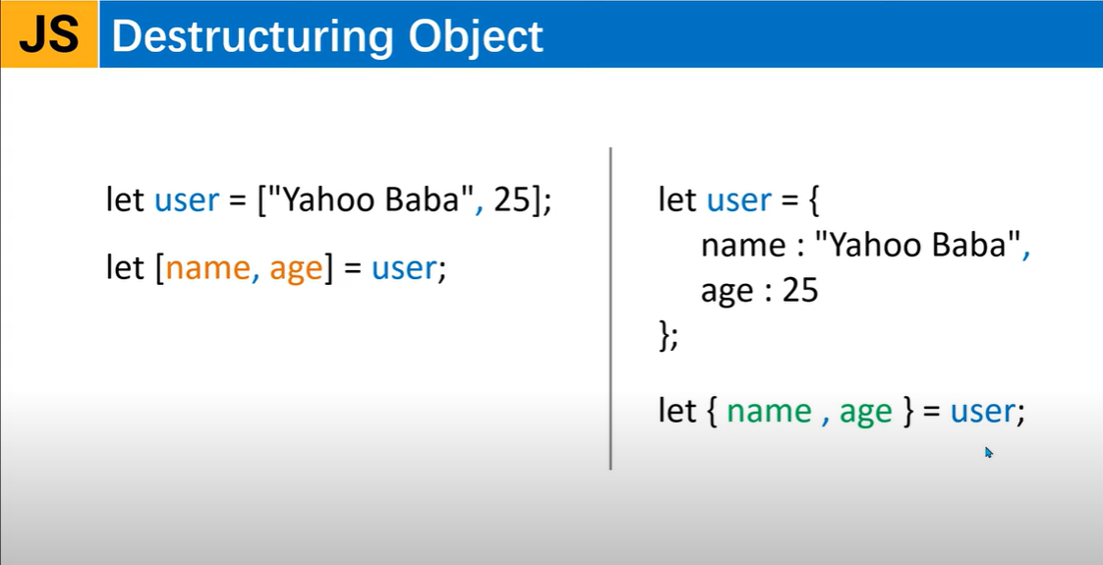

Slide 7
Example
<script>
let user={
name :"Hrutu",
age:21,
city:"Goa"
};
let {name,age,city}= user;
console.log(name);
console.log(age);
console.log(city);
</script>
<script>
let user={
name :"Hrutu",
age:21,
city:"Goa"
};
let {name:n,age:a,city:c}= user;
console.log(n);
console.log(a);
console.log(c);
</script>
OR

