Slide 1
ECMA Script 6

Slide 2
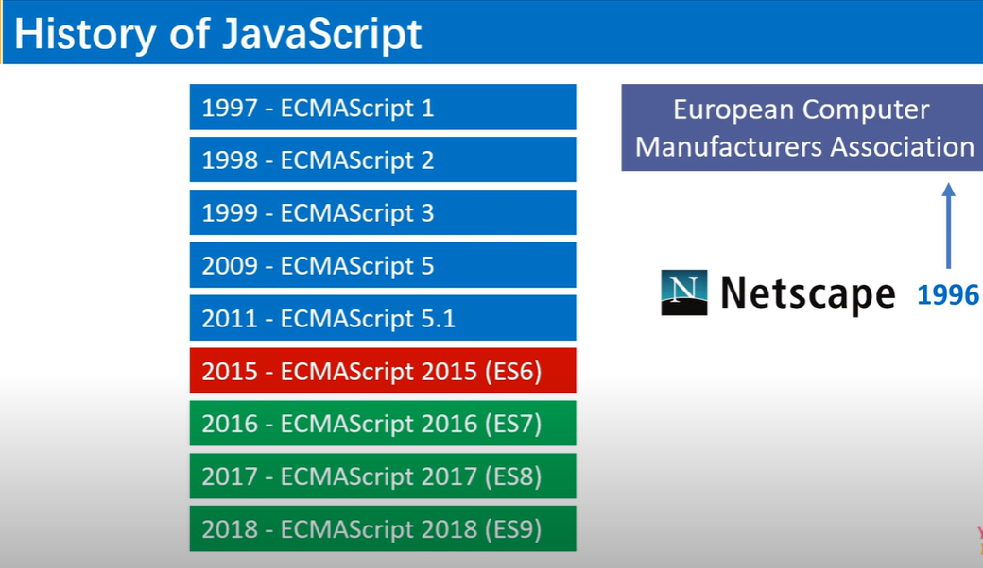

Slide 3
What is ECMA Script?
European Computer Manufacturers Association (ECMA) Script.
Provide Standard to JavaScript for different browsers.
Also Used with Node.js
This is not framework nor library.
We use ‘var’ for variables
>>var a=10;
Now we can use ‘let’ also
>>let a =10;

Slide 4
History & Version Script
First appeared in 1997, 23 years ago.
First Edition in June 1997.
ES6(6th Edition) in 2015 also called ECMA Script 2015.
ES11(11th edition) in June 2020.

Slide 5
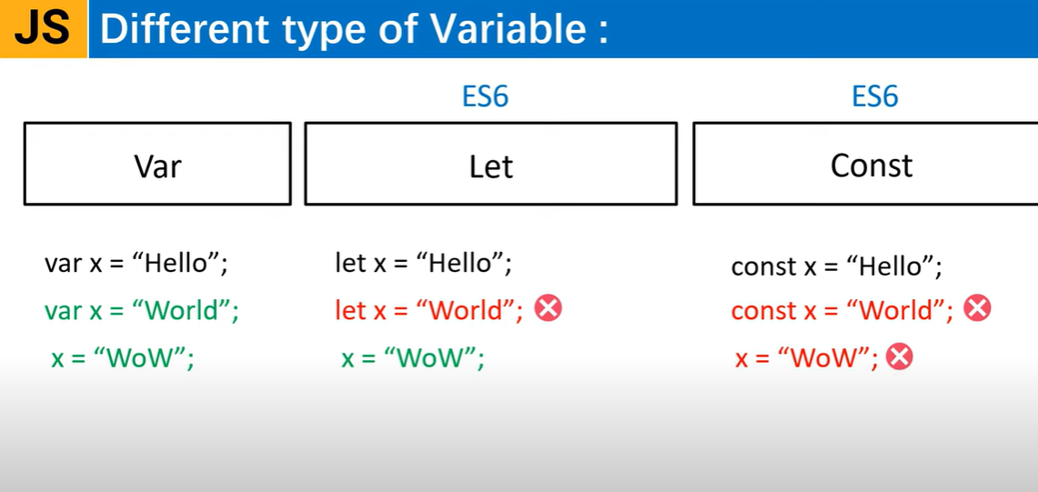

Slide 6
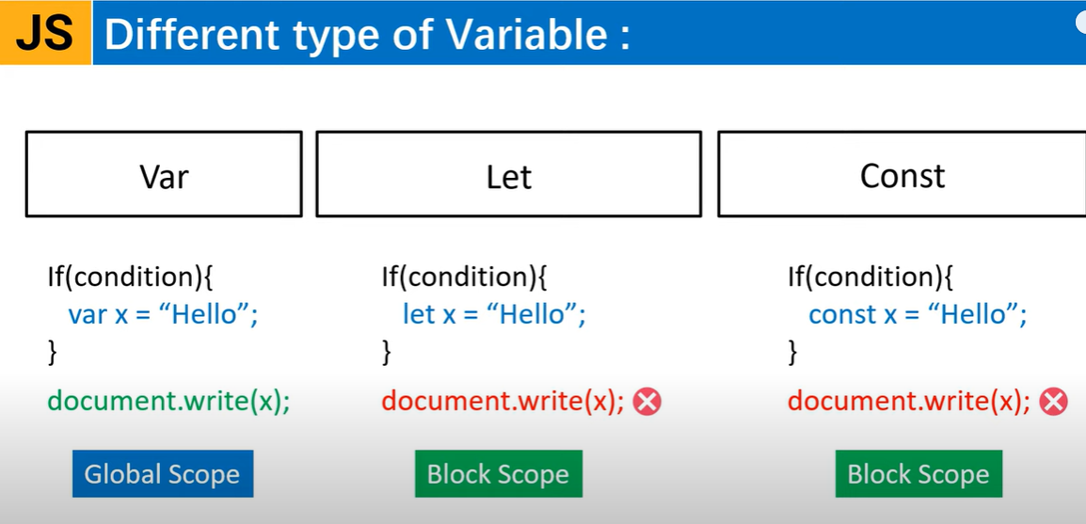

Slide 7
Let keyword (let Vs var)
What is let? – Is data storage keyword. It is block level.
What is var? – It is global scope.
<script>
var a=10;
let b=20;
if(true)
{
var a=30;
let b=40;
console.warn(a);//30
console.log(b);//40
}
console.warn(a); //30
console.log(b);//20
</script>
<script>
var a=10;
var a=20; //error for let if redeclared but not for var
</script>

Slide 8
Hoisting with let & var
<script>
let a;
console.warn(a); //undefined->this is called hoisting
console.warn(d);
let d;//error: Cannot access 'd' before initialization
var b;
console.warn(b);//undefined
//if declared later
console.warn(c);
var c; //undefined
</script>

Slide 9
Looping with let & var
<script>
for(var i=0;i<10;i++)
{
setTimeout(function(){console.warn(i);},1000); //print value 10 for 10 times.
}
for(let j=0;j<10;j++)
{
setTimeout(function(){console.warn(j);},1000);//prints 0-9.
}
</script>

Slide 10
Example
<script>
for(var i =1; i<=10;i++)
{
document.write(i+"<br/>");
}
console.log(i);
for(let i =1; i<=10;i++)
{
document.write(i+"<br/>");
}
console.log(i);
for(const i =1; i<=10;i++)
{
document.write(i+"<br/>");
}
console.log(i);
</script>

Slide 11
Default Parameters in ES6
<script>
function add(a,b=0) //b is default parameter
{
return a+b;
}
console.warn(add(10,20));
console.warn(add(10));
</script>
<script>
function someVal()
{
return 100;
}
function add(a,b=0,c=someVal()) //c is assigned by a function call
{
return a+b+c; //110
}
//console.warn(add(10,20));
console.warn(add(10));
</script>
<script>
function someVal()
{
//return 100;
return "last";
}
function add(a,b=0,c=someVal()) //c is assigned by a function call
{
return a+b+c; //110
}
//console.warn(add(10,20));
console.warn(add(10));
</script>

Slide 12
Example
If we call same function in its parameter, it will make infinity loop, that’s why it gives maximum call stack error, but we can call other functions rather than main.
<script>
function main(a,b=main()) //Error: maximum call stack size exceeded
{
return a+b;
}
main();
</script>

Slide 13
Example
<script>
function Employee(id)
{
this.id=id;
}
function generateEmpId()
{
return Math.floor(Math.random()*100);
}
function tagEmployee(employee=new Employee(generateEmpId()))
{
employee.dept="Sales";
return employee;
}
const emp = new Employee(generateEmpId());
console.log(tagEmployee(emp));
</script>
<script>
function Employee(id)
{
this.id=id;
}
function generateEmpId()
{
return Math.floor(Math.random()*100);
}
function tagEmployee(employee)
{
employee.dept="Sales";
return employee;
}
console.log(tagEmployee(new Employee(generateEmpId())));
//But this is not better approach
</script>

Slide 14
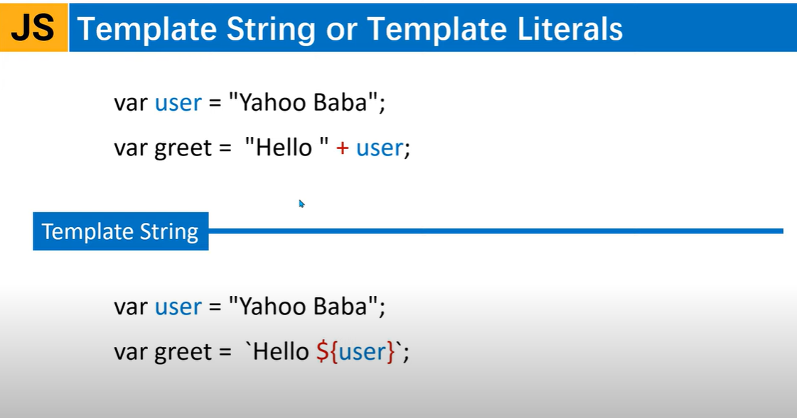

Slide 15
Template Literals
Template literal is also called as String literal. It supports next line.
<script>
let quote="either you run the code or the code will run you!!";
let by="sunanda";
console.warn(quote +"by"+ by);
console.warn(`${quote} by ${by}`);
let user="Hrutika Naik";
document.write("Hello "+user+" Welcome to 2021 !!");
//Using template string
document.write(`Hello ${user} Welcome to 2021.`);
</script>

Slide 16
Example
<script>
document.write(`${stmt}`);//or document.write(stmt);
document.write(`Hi Mr's "${user}"`);
console.log(stmt);
//Using function
let fname="Steve";
let lname="Smith";
function fullname(f,l){
return `${f} ${l}`;
}
let greet=`Hello ${fullname(fname,lname)}`;
document.write(greet);
</script>

