Slide 1
ECMA6 OOP Introduction

Slide 2
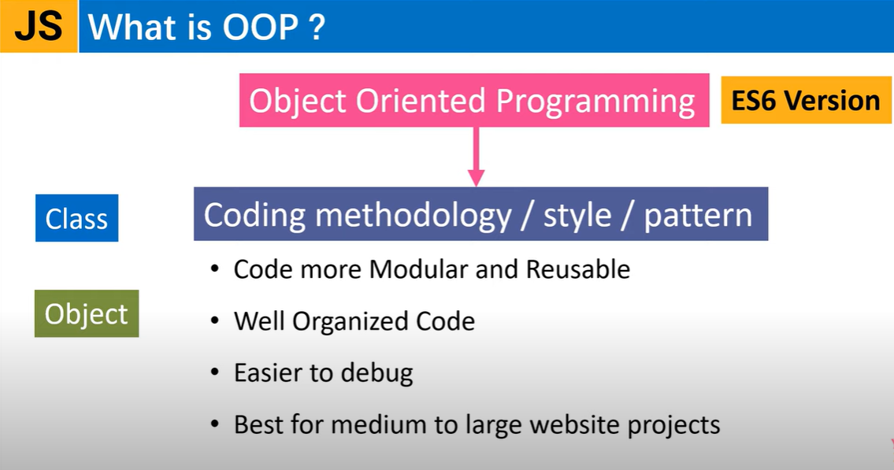

Slide 3
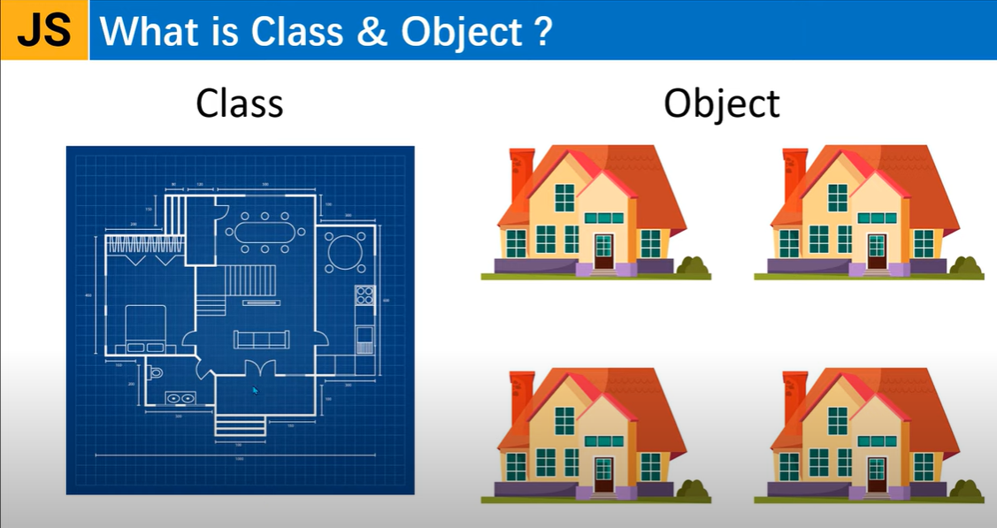

Slide 4
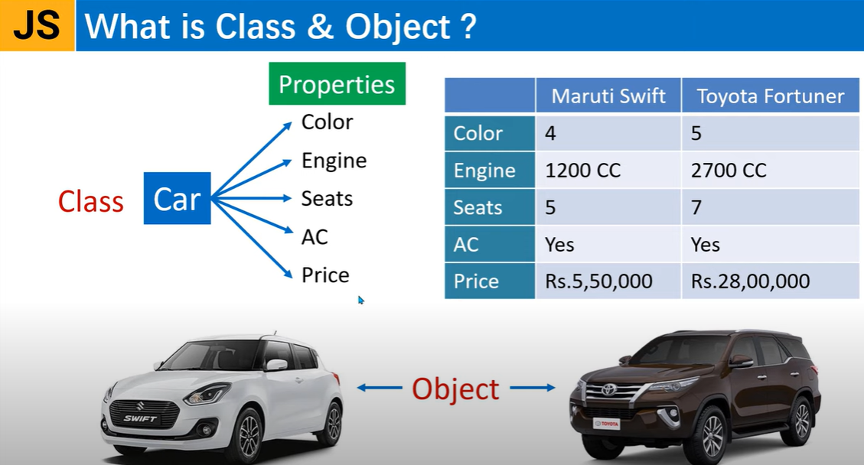

Slide 5
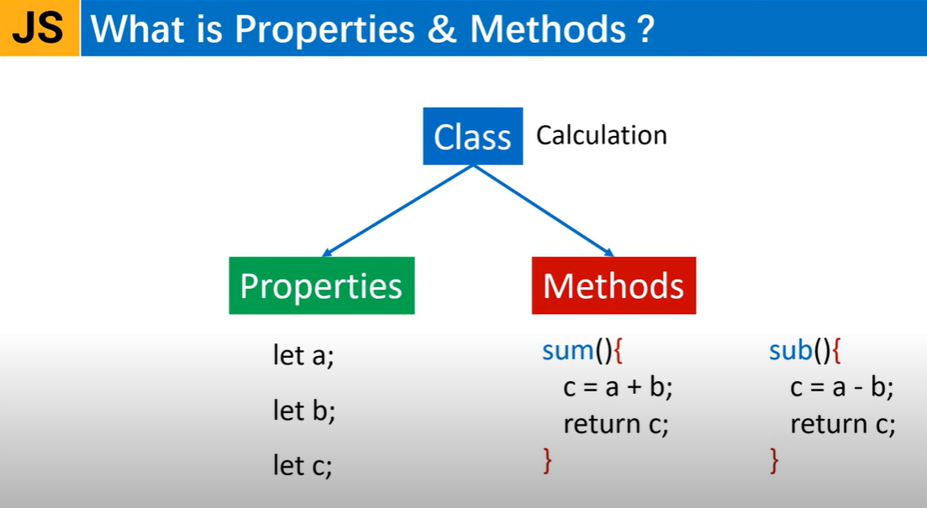

Slide 6
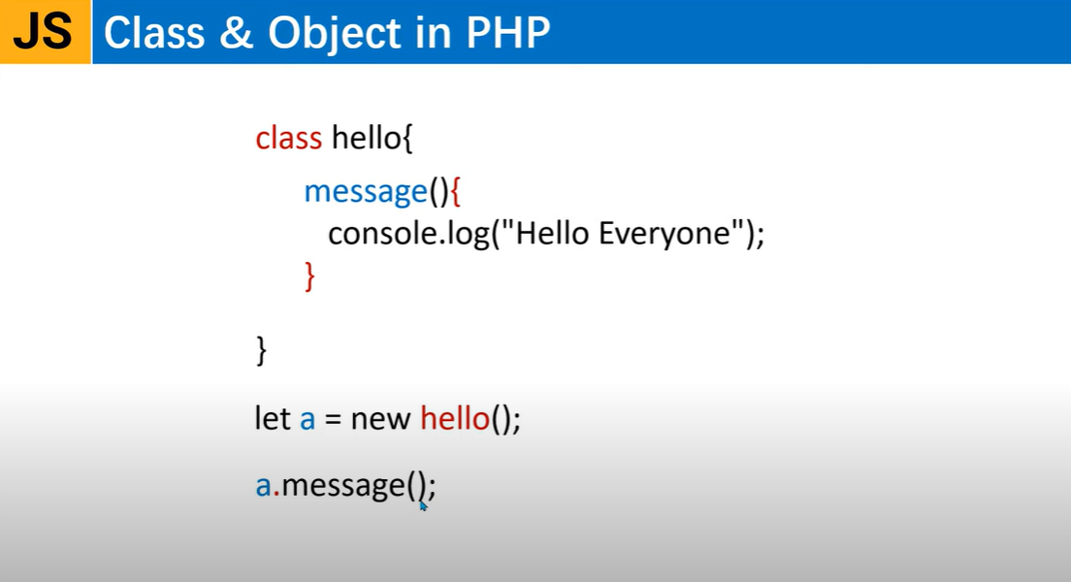

Slide 7
Example
<script>
class Hello
{
message()
{
console.log("Hello Everyone");
}
sorry()
{
console.log("Sorry everyone");
}
}
//create object of class Hello
let h = new Hello();
h.message();//function call
h.sorry();
</script>

Slide 8
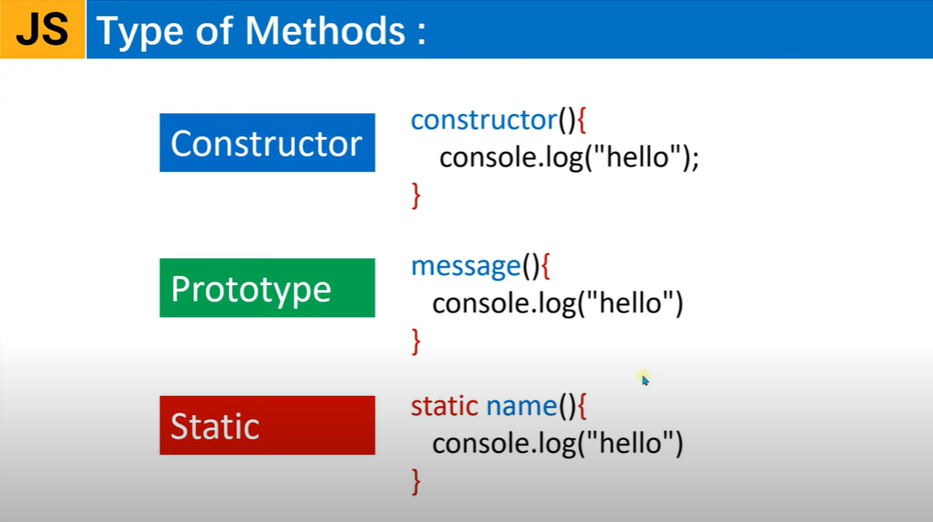

Slide 9
Example
<script>
class Student
{
constructor(n)
{
this.name=n;
console.log("constructor called");
}
hello()
{
console.log("Hello "+this.name);
}
}
//create object of class Hello
let s = new Student("Hrutika");
s.hello();
</script>
<script>
class Student
{
constructor()
{
let name;
console.log("constructor called");
}
hello()
{
console.log("Hello "+this.name);
}
}
//create object of class Hello
let s = new Student(); //automatically calls constructor
s.name="Hrutika";
s.hello();
</script>

Slide 10
Classes in ES6
<script>
class Fruits
{
name="apple";
constructor()
{
console.warn("I am Fruit class constructor",this.name);
}
getFruits()
{
//console.warn("I am function");
//return "orange";
return this.name;
}
showFruit(item)
{
return item;
}
}
let f1=new Fruits(); //or let f1=new Fruits;
//f1.getFruits(); //function call
f1.name="puma"; //reinitializing class data member allowed
console.warn(f1.getFruits());
console.warn(f1.showFruit("Grapes"));
</script>
<script>
class Student
{
constructor(n)
{
this.name=n;
console.log("constructor called");
}
hello()
{
console.log("Hello "+this.name);
}
static demo()
{
console.log("I am static func");
}
}
//create object of class Hello
let s = new Student("Hrutika"); //automatically calls constructor
//s.name="Hrutika";
s.hello();
//static methods are called by classname
Student.demo();
</script>

Slide 11
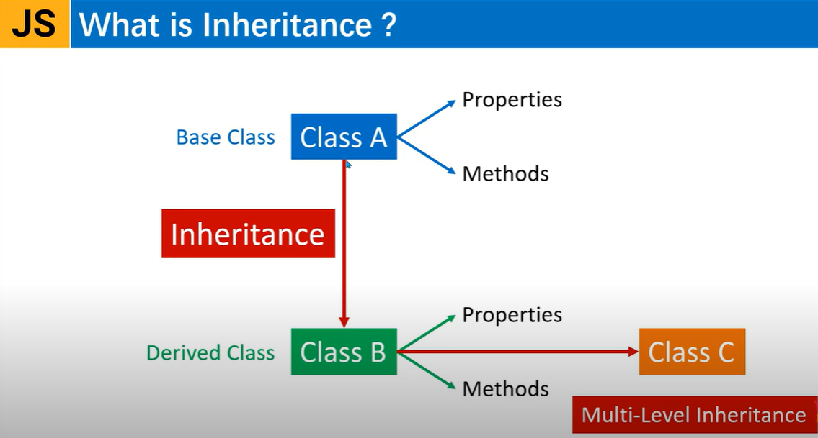

Slide 12
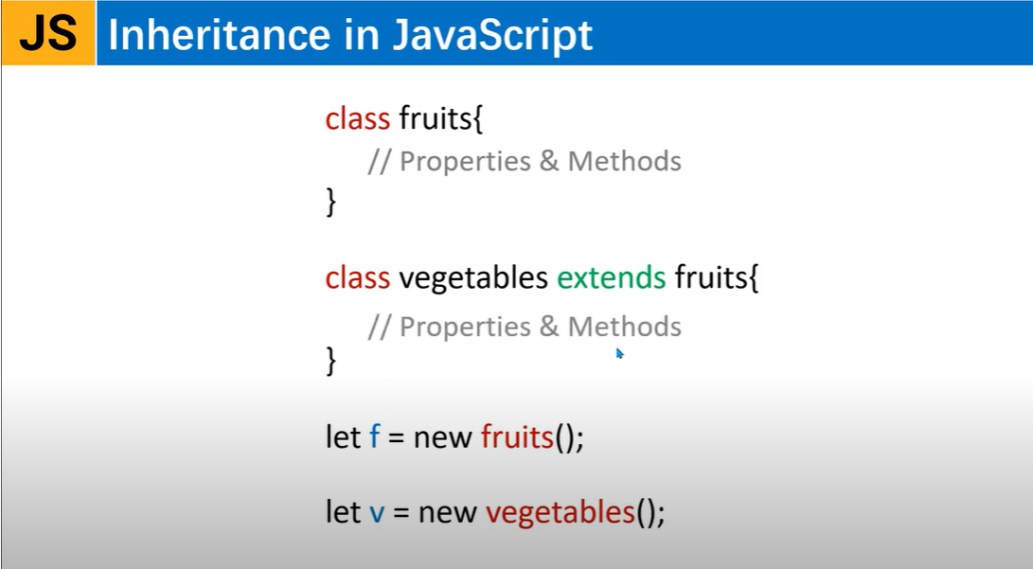

Slide 13
Inheritance in ES6
<script>
class Category
{
dryFruits()
{
return "Almond is dry fruit";
}
pomeFruit()
{
return "Apple is pomefruit";
}
}
class Fruits extends Category
{
constructor()
{
super(); //inherits parent's constructor
console.warn("This is constructor");
}
getFruits()
{
return "apple";
}
}
let f1=new Fruits();
console.warn(f1.getFruits());
console.warn(f1.pomeFruit());
</script>

Slide 14
Example
<script>
class employee
{
constructor(name)
{
this.empname=name;
console.log("Constructor of employee");
}
info()
{
console.log("Employee Name: "+ this.empname);
}
}
class manager extends employee
{
constructor(name)
{
super();
console.log("Constructor of manager "+name);
}
info()
{
super.info();
console.log("Manager Name: "+ this.empname);
}
}
let m = new manager("Yahoo"); </script>
<script>
class employee
{
constructor(name)
{
this.empname=name;
console.log("Constructor of employee");
}
info()
{
console.log("Employee Name: "+ this.empname);
}
}
class manager extends employee
{
info()
{
super.info();
console.log("Manager Name: "+ this.empname);
}
}
let m = new manager("Yahoo");
m.info();
</script>

Slide 15
Example
<script>
class employee
{
constructor(name,age,salary)
{
this.empname=name;
this.empage=age;
this.empsalary=salary;
console.log("Constructor of employee");
}
info()
{
document.write(`<h3>Employee Class</h3>
Name : ${this.empname}<br/>
Age : ${this.empage}<br/>
Salary :${this.empsalary}`);
}
}
class manager extends employee
{
info()
{
let ta=1000;
let pa=300;
let totalSalary=this.empsalary + ta + pa;
document.write(`<h3>Manager Class</h3>
Name : ${this.empname}<br/>
Age : ${this.empage}<br/>
Salary :${this.empsalary}`);
}
}
let m = new manager("Steve",23,569000);
let e = new employee("Jack",56,90000);
m.info();
e.info();
</script>

Slide 16
Example – Multilevel Inheritance
class manager extends employee
{
info()
{
let ta=1000;
let pa=300;
let totalSalary=this.empsalary + ta + pa;
document.write(`<h3>Manager Class</h3>
Name : ${this.empname}<br/>
Age : ${this.empage}<br/>
Salary :${this.empsalary}`);
}
}
class test extends manager{
}
let t = new test("Steve",23,569000);
t.info();
</script>
<script>
class employee
{
constructor(name,age,salary)
{
this.empname=name;
this.empage=age;
this.empsalary=salary;
console.log("Constructor of employee");
}
info()
{
document.write(`<h3>Employee Class</h3>
Name : ${this.empname}<br/>
Age : ${this.empage}<br/>
Salary :${this.empsalary}`);
}
}

Slide 17
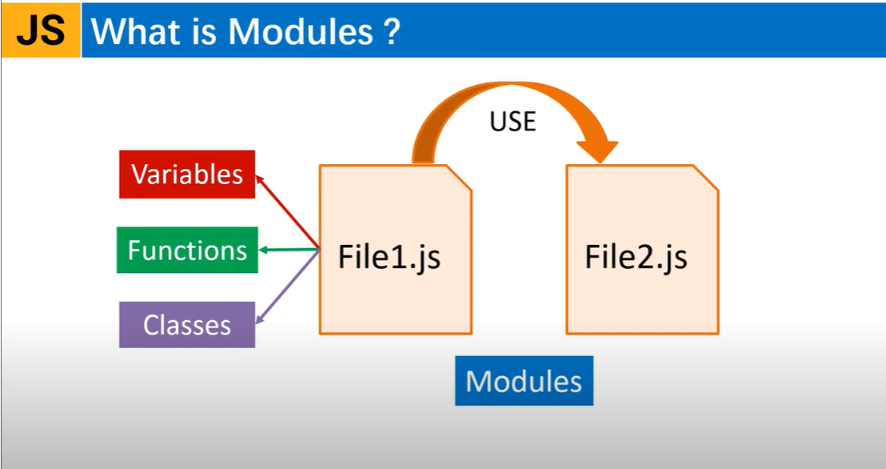

Slide 18
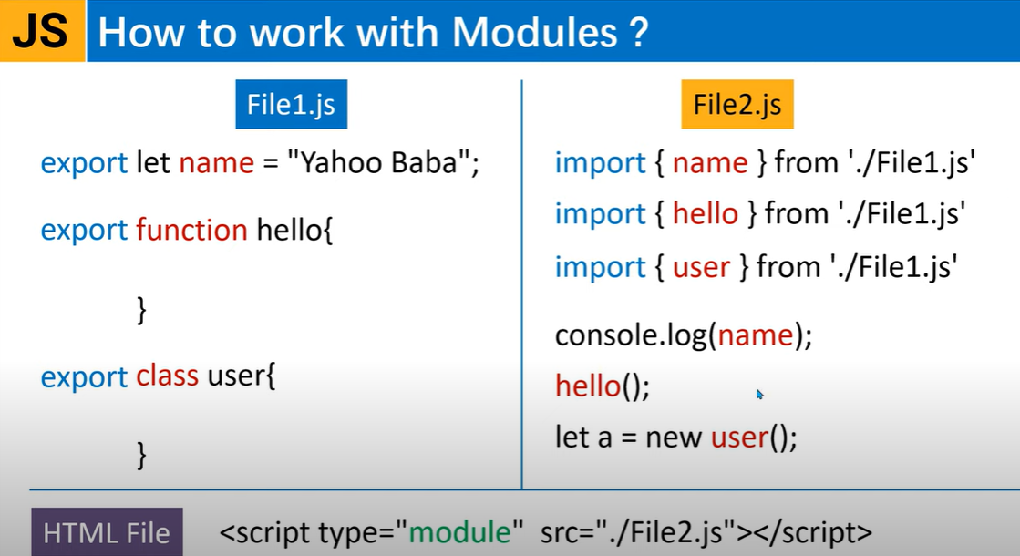

Slide 19
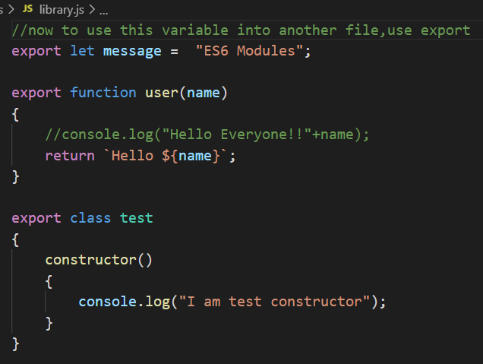
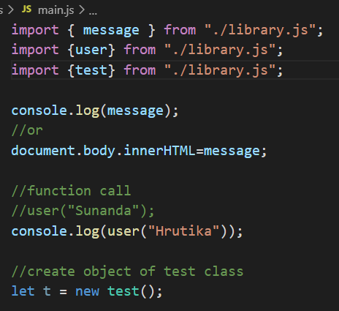
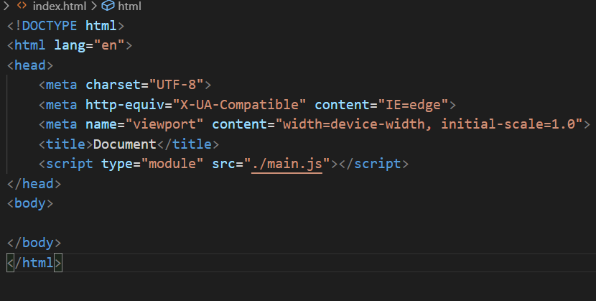
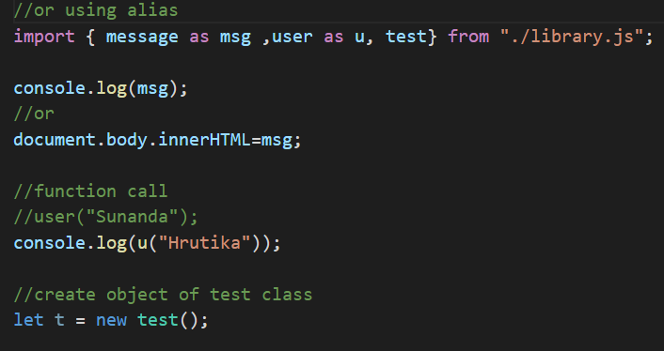
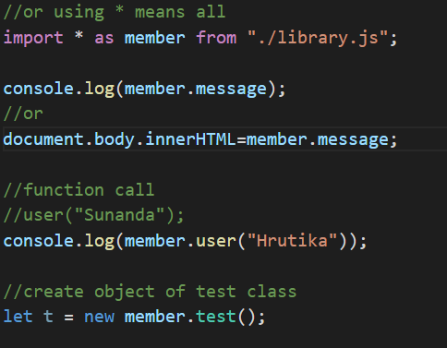
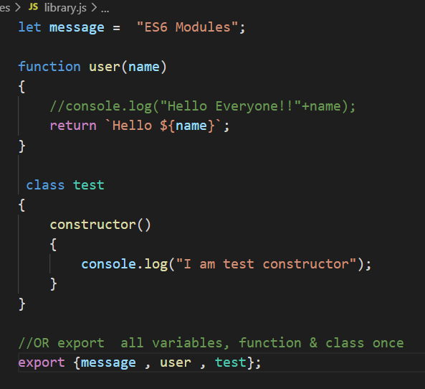
Example
//library.js
//main.js
//index.html
OR

Slide 20
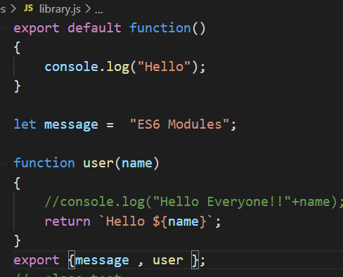
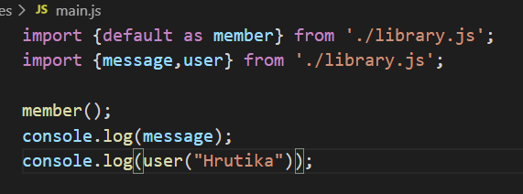
Example – default feature in Module

Slide 21
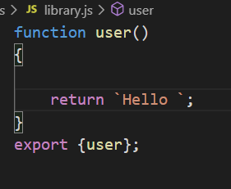
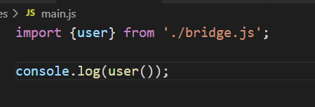

Example – Aggregate Modules

