Slide 1
ES6 Promise

Slide 2
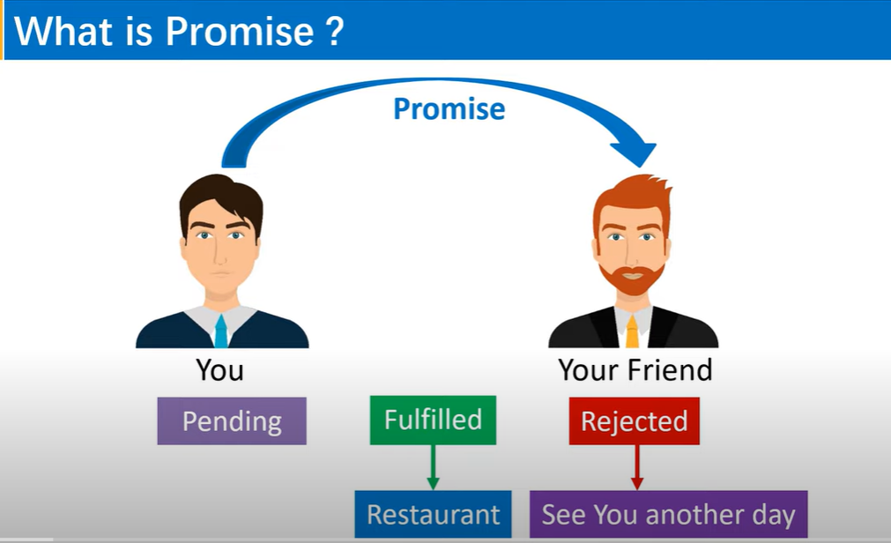

Slide 3
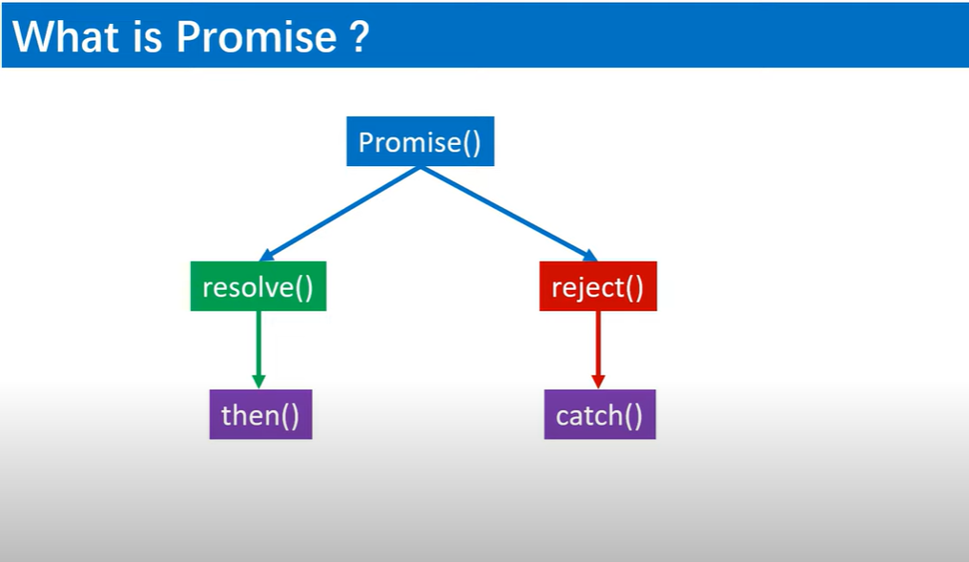

Slide 4
What is Promise?
In JavaScript, Promise is a very important concept.The Promise object represents the eventual completion or failure of an asynchronous operation and its resulting value.
👉🏻 A Promise is a proxy with an unknown value whenever a Promise is generated.
👉🏻 This allows the controller to connect with the final success value or reason for failure of the asynchronous operation.
👉🏻 This allows asynchronous methods to return the same values ​​as synchronous methods.
👉🏻Instead of returning the final value immediately, the asynchronous method returns a promise to provide the value at a particular point in the future.

Slide 5
Basic Syntax
Promise is a constructor function, so we need a new to create a Promise. It takes a function, as it's argument, with two parameters: resolve and reject.
The syntax generally looks like:
const myPromise = new Promise((resolve, reject) => { } ) ;
States of a Promise
A promise has three states:
i) pending: It's the initial state, neither successful nor unsuccessful.
ii) fulfilled: It means that the operation was completed successfully.
iii) rejected: It indicates that the operation has failed.
Resolve Parameter
The resolve parameter is used when we want the promise to succeed.
Reject Parameter
The reject is used when we want to catch the failure.

Slide 6
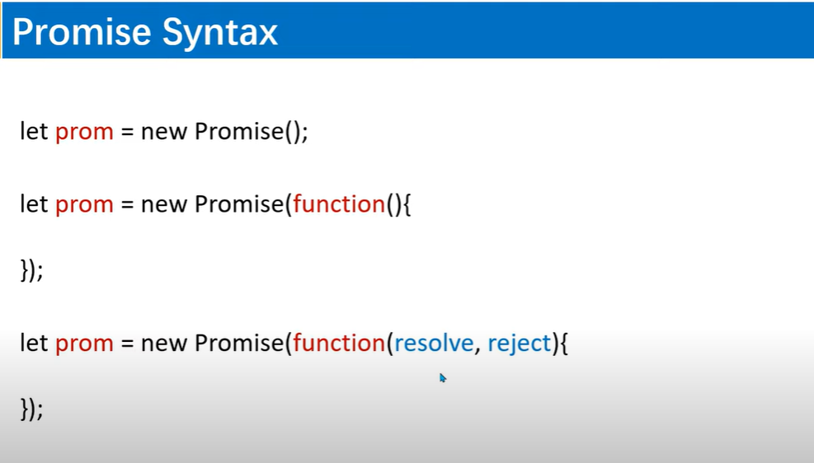

Slide 7
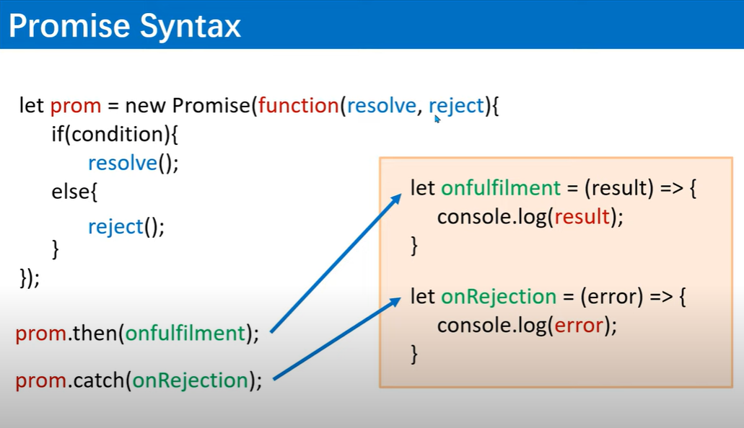

Slide 8
Example
const makeServerRequest = new Promise((resolve, reject) => {
let responseFromServer;
if (responseFromServer) {
resolve("We got the Data");
} else {
reject("Data not Found");
}
});

Slide 9
Example
<script>
let condition=true;
let prom = new Promise(function(resolve,reject){
if(condition)
{
resolve("I am Successfull");
}
else{
reject(" I am Failure");
}
});
console.log(prom);
</script>
<script>
function prom(condition)
{
return new Promise(function(resolve,reject) {
if(condition)
{
resolve("I am Successfull");
}
else{
reject(" I am Failure");
}
});
}
console.log(prom(true));
</script>
OR

Slide 10
Retrieving Data from Promise: then() & catch()
In JavaScript, we often struggle to deal with asynchronous operations . There comes the concept of Promise, with which we can deal with those operations. To understand how to retrieve data from a Promise, the then & catch concept is very important.
First of all, let's create a promise for example.
const addition = (a, b) =>
new Promise((resolve, reject) => {
if (typeof a == "number" && typeof b == "number") {
resolve(a + b);
} else {
reject ("Not a Number")
}
});
addition(10, 5)
.then((response) => {
console.log(response);
})
.catch((err) => {
console.log(err);
});
addition(10, "5")
.then((response) => {
console.log(response);
})
.catch((err) => {
console.log(err);
});
When we execute the Promise that we created in the above example, if it is resolved, the then block is executed and we can get the result from the callback function .
The Promise will be rejected if any of the values of a or b is not a number & will be captured in the catch block.

Slide 11
<script>
function prom(condition)
{
return new Promise(function(resolve,reject){
console.log("Fetching Data, Please wait...")
setTimeout(()=>{
if(condition)
{
resolve("I am Successfull");
}
else{
reject(" I am Failure");
}
},1000)
});
}
let onfulfilment = (response)=>{
console.log(response);
}
let onrejection =(error)=>{
console.log(error);
}
prom(true).then(onfulfilment);
prom(false).catch(onrejection);
//since prom func is getting called twice, thus we do method chaining
//console.log(prom(true));
</script>
<script>
function prom(condition)
{
return new Promise(function(resolve,reject){
console.log("Fetching Data, Please wait...")
setTimeout(()=>{
if(condition)
{
resolve("I am Successfull");
}
else{
reject(" I am Failure");
}
},3000)
});
}
//since prom func is getting called twice, thus we do method chaining
prom(true).then((response)=>{
console.log(response);
}).catch((error)=>{
console.log(error);
});
//console.log(prom(true));
</script>

Slide 12
Example- Calculate Division using Promise
<script>
function prom(a,b)
{
return new Promise(function(resolve,reject){
console.log("Fetching Data, Please wait...")
var c = a/b;
setTimeout(()=>{
if(a,b)
{
resolve(`Your answer is: ${c}`);
}
else{
reject(`Failed to Divide`);
}
},2000)
});
}
//since prom func is getting called twice, thus we do method chaining
prom(5,0).then((response)=>{
console.log(response);
}).catch((error)=>{
console.log(error);
});
</script>

Slide 13
Promise in ES6
Promise is first the code has to be executed then only you will receive the output.
Promise is an object that returns a value which you hope to receive in the future, but not now.
<script>
let a="sun";//undefined is a data type
setTimeout(()=>{
a="hello ECMA";
},3000);
alert(a); //sun output
</script>
Here without executing the settimeout function code, alert(a) is executed.

Slide 14
Now Using Promise:
<script>
let a="sun";//undefined is a data type
let promiseData=new Promise((resolved,reject)=>{
setTimeout(()=>{
a="hello ECMA";
resolved("done");
},3000);
})
promiseData.then(()=>{
alert(a);
})
//alert(a); //sun output
</script>
Producing Code
Consuming Code

Slide 15
Why need Promise?
JavaScript is always synchronous and single-threaded language.
It means JavaScript never wait for code or function result when they take some time.
JavaScript directly executes next code.

Slide 16
Example
<script>
let data =1;
console.warn("Normal data:",data);//1
data = 2;
setTimeout(()=>{
console.warn("timer data:",data);//2
},2000);
data=3;
console.warn("last data:",data);//3
//output order: 1 3 3, which is not expected so promise is used.
</script>
So to resolve this issue, we use Promise.

Slide 17
<script>
let data=new Promise((resolve,reject)=>{
setTimeout(()=>{
resolve("Done !! Code is executed");
});
});
//console.warn(data); //prints Promise
data.then((item)=>{
console.warn(item);
}); </script>
<script>
let data=new Promise((resolve,reject)=>{
setTimeout(()=>{
resolve({name:"Sun",age:33}); //even object can be passed here
});
});
//console.warn(data); //prints Promise
data.then((item)=>{
console.warn(item);
});
</script>

Slide 18
If Promise is rejected,
<script>
let data=new Promise((resolve,reject)=>{
setTimeout(()=>{
//resolve({name:"Sun",age:33}); //even object can be passed here
reject("Some issues");
});
});
//console.warn(data); //prints Promise
data.then((item)=>{
console.warn(item);
}).catch((err)=>{
console.warn("catch block",err);
}); </script>

Slide 19
Promise Chaining
<script>
let data = fetch("https://dummy.restapiexample.com/api/v1/employees"); //to call APi
//console.warn(data);
//Promise Chaining
data.then((item)=>{
return item.json()
}).then((result)=>{
console.warn("2nd output:",result);
}); </script>
<script>
let data=new Promise((resolve,reject)=>{
setTimeout(()=>{
resolve(10);
},2000);
});
data.then((item)=>{
console.warn("1st:",item);
return item *10;
}).then((item)=>{
console.warn("2nd:",item);
return item*10;
}).catch((err)=>{
console.warn("catch block",err);
}); </script>

Slide 20
Finally in Promise
Finally block is executed every time if the code is resolved or if the code is rejected.
<script>
let data=new Promise((resolve,reject)=>{
setTimeout(()=>{
resolve(10);
},2000);
});
data.finally(()=>{
console.warn("final block");
})
data.then((item)=>{
console.warn("1st:",item);
return item *10;
}).then((item)=>{
console.warn("2nd:",item);
return item*10;
}).catch((err)=>{
console.warn("catch block",err);
}); </script>

Slide 21
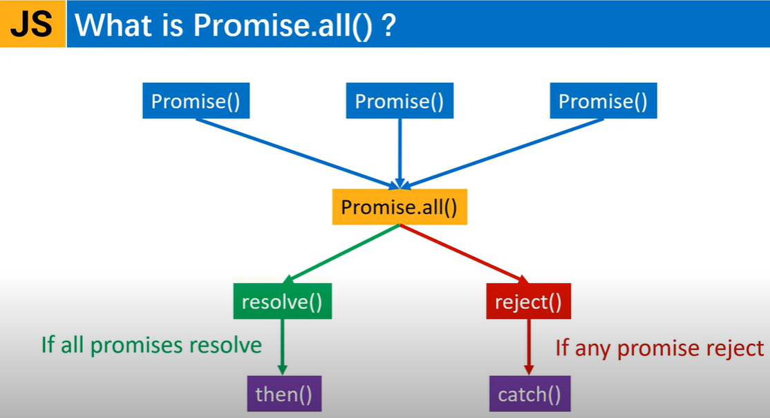

Slide 22
Promise.all() Method
👉 The Promise.all() method accepts an iterable Object, such as an Array of promises as an input and returns a single promise that resolves to a result array of the input promises.
👉 When all input promises have been resolved or the iterable input does not contain a promise, the returned promise will be resolved.
👉 It rejects immediately when an input promise rejects or non-promise throws an error and will reject with that first rejection message / error message.
👉 It is often used when there are many asynchronous tasks involved that the overall code relies on to work successfully - all of the ones we want to do before we continue to execute the code.
👉 This method aggregates the results of multiple promises.

Slide 23
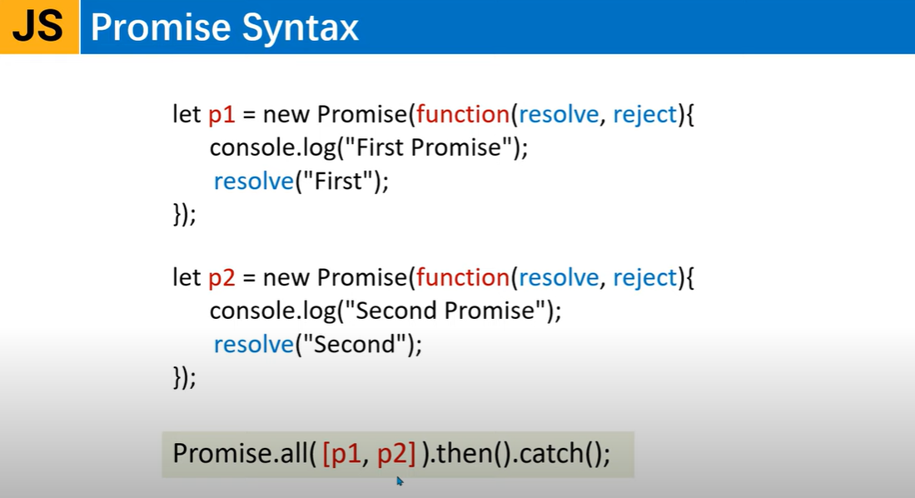

Slide 24
Example
<script>
let p1=new Promise((resolve,reject)=>{
setTimeout(()=>{
console.log("The first promise has resolved!!!")
resolve(10)
},1*1000);
});
let p2=new Promise((resolve,reject)=>{
setTimeout(()=>{
console.log("The second promise has resolved!!!")
resolve(20)
},2*1000);
});
let p3=new Promise((resolve,reject)=>{
setTimeout(()=>{
console.log("The third promise has resolved!!!")
resolve(30)
},3*1000);
});
var total=0;
Promise.all([p1,p2,p3]).then((response)=>{
//to sum all values returned from 3 promises
for(var i in response)
{
total += response[i];
}
console.log(`Results :${response}`);
console.log(`Sum is :${total}`);
}).catch((error)=>{
console.log("Error:"+error);
});
</script>

Slide 25
Example- Alternative Method
<script>
let promiseCall=function(returnValue,message){
return function(resolve,reject){
setTimeout(()=>{
console.log(`The ${message} promise has resolved!!!`)
resolve(returnValue);
},returnValue*100);
}
}
let p1=new Promise(promiseCall(10,"first"));
let p2=new Promise(promiseCall(20,"Second"));
let p3=new Promise(promiseCall(30,"Third"));
var total=0;
Promise.all([p1,p2,p3]).then((response)=>{
//to sum all values returned from 3 promises
for(var i in response)
{
total += response[i];
}
console.log(`Results :${response}`);
console.log(`Sum is :${total}`);
}).catch((error)=>{
console.log("Error:"+error);
});
</script>

Slide 26
Example
const promise1 = new Promise((resolve, reject) => {
setTimeout(resolve, 300, "resolved");
}); //will be resolved after 300ms
const promise2 = 93; //non-promise
const promise3 = new Promise((resolve, reject) => {
setTimeout(resolve, 100, "resolved2");
}); // will be resolved after 100ms
Promise.all([promise1, promise2, promise3])
.then((values) => {
console.log(values);
})
.catch((err) => {
console.log(err);
});
//expected output: [ 'resolved', 93, 'resolved2' ]

Slide 27
Rejection of Promise.all() : Fail-Fast Behavior
Promise.all() shows fail-fast behavior, that is, Promise.all() asynchronously rejects with the value of the promise that rejected, if any of the passed-in elements are rejected.
For example, if we pass in two promises that resolve after a timeout and one promise that rejects immediately, then Promise.all() will reject immediately. It does not depend on if the other promises have resolved. The following example just does the same!
const pro1 = new Promise((resolve, reject) => {
setTimeout(() => resolve("one"), 1000);
});
const pro2 = new Promise((resolve, reject) => {
setTimeout(() => resolve("two"), 2000);
});
const pro3 = new Promise((resolve, reject) => {
setTimeout(() => reject("rejected"), 3000);
});
Promise.all([pro1, pro2, pro3])
.then((values) => {
console.log(values);
})
.catch((error) => {
console.log(error);
});
//expected output: rejected

Slide 28
Promise.any() Method
👉 The Promise.any() takes an iterable Object, such as an Array of promises as an input. Once a promise is fulfilled, a single promise is returned and the promise is resolved using the value of the promise.
👉 If no promises in the iterable fulfill (if all of the given promises are rejected), then the returned promise is rejected with an AggregateError (that groups together individual errors).
Unlike Promise.all(), this method is used to return the first promise that fulfills.
It is short-circuited right after a promise is completed, so as soon as a promise is fulfilled, it will not wait for other promises to complete.
🔹 When a non-empty iterable is passed, and any of the promises fulfill, or are non-promises, then the promise returned by this method is fulfilled asynchronously.
Promise.any() rejects with an AggregateError if no promise fulfils.
🔹 The AggregateError object represents an error when several errors need to be wrapped in a single error. It is thrown when multiple errors need to be reported by an operation.

Slide 29
Example
const SlowlyDone = new Promise((resolve, reject) => {
setTimeout(resolve, 500, "Done slowly");
}); //resolves after 500ms
const QuicklyDone = new Promise((resolve, reject) => {
setTimeout(resolve, 100, "Done quickly");
}); //resolves after 100ms
const Rejection = new Promise((resolve, reject) => {
setTimeout(reject, 100, "Rejected"); //always rejected
});
Promise.any([SlowlyDone, QuicklyDone, Rejection])
.then((value) => {
console.log(value);
// QuicklyDone fulfils first
})
.catch((err) => {
console.log(err);
});
//expected output: Done quickly

Slide 30
Promise.prototype.finally()
👉 The finally() method returns a Promise.
👉 When a Promise is completed, either resolved or rejected,this specified callback function is executed.
👉 This helps to avoid duplicating code in both the promise's then() and catch() handlers.
👉 The finally() method will help if you're going to do any processing or cleanup work once a promise is made, regardless of the outcome.
const addition = (a, b) =>
new Promise((resolve, reject) => {
if (typeof a == "number" && typeof b == "number") {
resolve(a + b);
} else {
reject("Not a Number");
}
});
addition(10, 5)
.then((response) => {
console.log(response);
})
.catch((err) => {
console.log(err);
})
.finally(() => {
console.log("Numbers are added");
});
/* expected output: 15
Numbers are added */

Slide 31
Promise.race() Method
👉 The Promise.race() method returns a Promise that is resolved or rejected, as soon as one of the promises in an iterable, such as an array, fulfills or rejects, with the value or reason from that Promise.
👉 The promise returned will be forever pending, if the iterable passed is empty.
👉 Promise.race() will resolve to the first value found in the iterable, if the iterable contains one or more non-promise value or an already settled promise.
const pro1 = new Promise((resolve, reject) => {
setTimeout(() => resolve("one"), 200);
});
const pro2 = new Promise((resolve, reject) => {
setTimeout(() => resolve("two"), 100);
});
Promise.race([pro1, pro2])
.then((response) => {
console.log(response); //output: two
})
.catch((err) => {
console.log(err);
});
const pro3 = new Promise((resolve, reject) => {
setTimeout(() => reject("rejected"), 300);
});
const pro4 = new Promise((resolve, reject) => {
setTimeout(() => resolve("four"), 400);
});
Promise.race([pro3, pro4])
.then((response) => {
console.log(response);
})
.catch((err) => {
console.log(err);
}); //output: rejected

Slide 32
Example
const pro1 = new Promise((resolve, reject) => {
setTimeout(() => resolve("one"), 200);
});
const pro2 = new Promise((resolve, reject) => {
setTimeout(() => resolve("two"), 100);
});
const pro3 = new Promise((resolve, reject) => {
setTimeout(() => reject("rejected"), 300);
});
const pro4 = new Promise((resolve, reject) => {
setTimeout(() => resolve("four"), 400);
});
Promise.race([pro1, pro2, pro3, pro4])
.then((response) => {
console.log(response);
})
.catch((err) => {
console.log(err);
});
//output: two

