Slide 1
Lexical Scope for ‘this’ in ES6
Lexical means- range of a thing.
But this approach can be optimized using Arrow function.
<script>
let data={
list:'friend',
names:['Bob','Peter','Sam'],
getFriends:function()
{
let that = this.list;
//console.warn(this.names);
this.names.map(function(item){
console.warn("Friend:",item);
//console.warn(this.list); //undefined bcoz this inner func lost its this.
console.warn(that,":",item);
})
}
}
data.getFriends();
</script>
<script>
let data={
list:'friend',
names:['Bob','Peter','Sam'],
getFriends:function()
{
//Using Arrow function
this.names.map((item)=>{
console.warn(this.list,":",item);
})
}
}
data.getFriends();
</script>

Slide 2
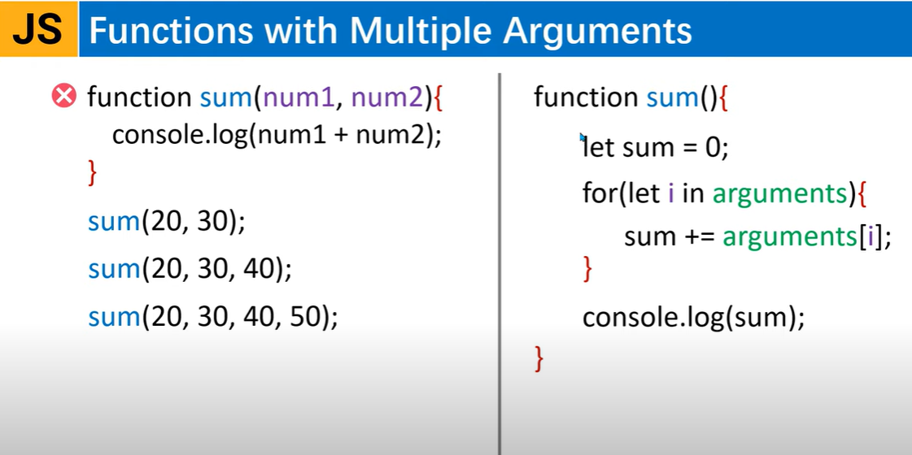

Slide 3
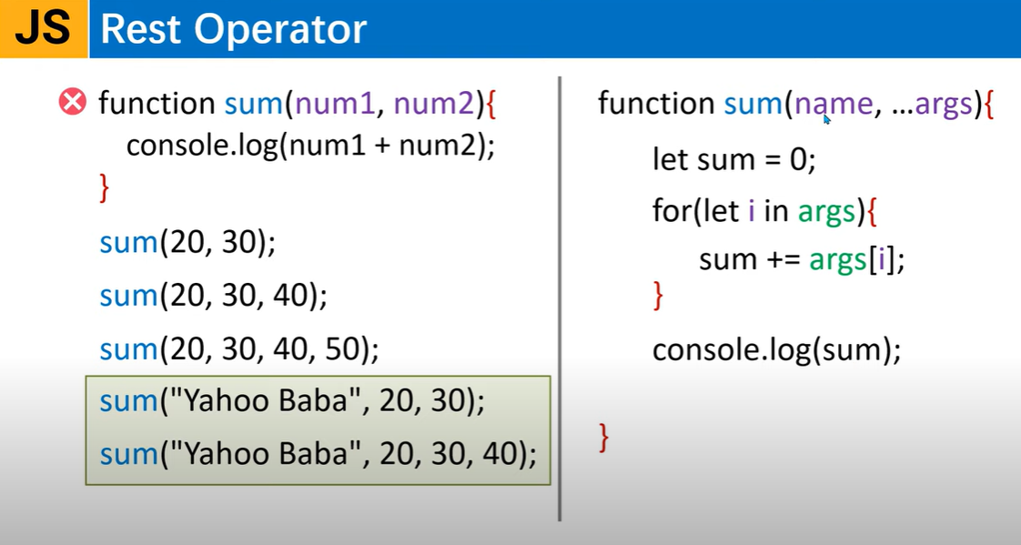

Slide 4
Example
<script>
function sum()
{
let sum=0;
for(let i in arguments)
{
sum +=arguments[i];
}
document.write(sum+"<br/>");
console.log(arguments);
}
sum("Hrutu",20,30,40);//function caller
sum(10,20);
</script>
<script>
function sum(name,...args)
{
console.log(args);
document.write(`Hello ${name}`);
let sum=0;
for(let i in args)
{
sum +=args[i];
}
document.write(sum+"<br/>");
console.log(arguments);
}
sum("Hrutu",20,30,40);//function caller
//sum(10,20);
</script>

Slide 5
Rest Operator in ES6
Rest operator is used when we are unaware of how many number of parameters will be required in a function. Rest parameter must be the last formal parameter.
<script>
function fruits(...f)
{
console.warn("Fruits");
//console.warn(a,",",b);
console.warn(f);
}
fruits('apple','banana','kiwi','orange','grapes');//here we unaware of how many parameters can occur.
</script>
Similar to python’s (*args)
<script>
function fruits(a,b,c,...n)
{
console.warn("Fruits");
//console.warn(a,",",b);
console.warn(n); //'orange','grapes'
}
fruits('apple','banana','kiwi','orange','grapes');//here we unaware of how many parameters can occur.
</script>

Slide 6
Example-function composition with rest operator
<script>
function greet()
{
console.warn("Hello");
}
function fruits(a,b,c,...n)
{
console.warn("Fruits");
//console.warn(a,",",b);
console.warn(n); //'orange','grapes'
greet();
}
fruits('apple','banana','kiwi','orange','grapes',greet);//here we unaware of how many parameters can occur.
</script>

Slide 7
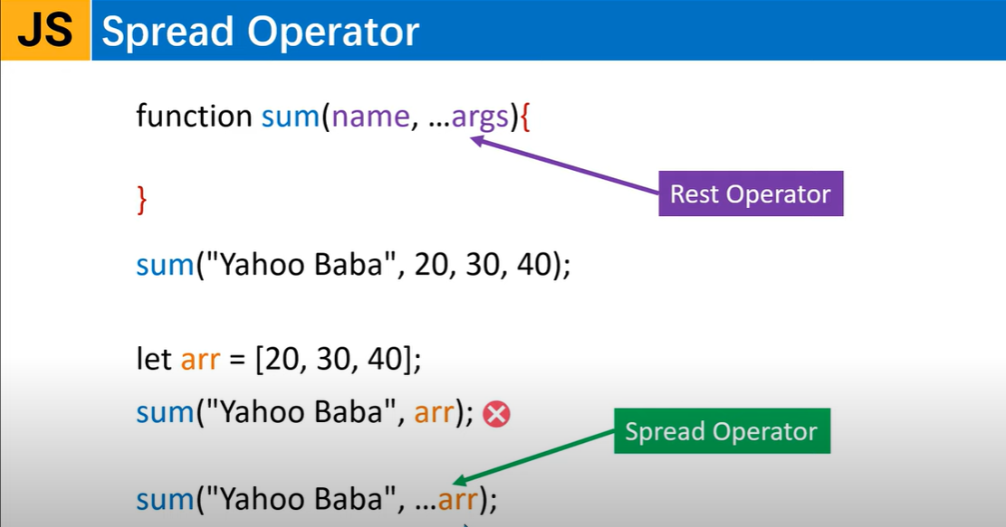

Slide 8
Example
<script>
var arr=[10,20,30,40];
console.log(...arr); //now they display separately not as array
console.log([...arr]);
</script>
<script>
function sum(name,...args)
{
console.log(args);
document.write(`Hello ${name}:`);
let sum=0;
for(let i in args)
{
sum +=args[i];
}
document.write(sum+"<br/>");
console.log(arguments);
}
var arr=[10,20,30];
sum("Hrutu",...arr);//function caller
</script>
<script>
var arr=[10,20,30,40];
console.log(arr); //now they display separately not as array
var arr2=arr;
arr.push(50);
//console.log([...arr]);
//OR
console.log(arr2);
</script>
<script>
var arr1=[10,20,30,40];
var arr2=[50,60];
var arr3= arr1.concat(arr2);
console.log(arr3);
//Now using spread opt
var arr4=[5,...arr1, ...arr2,80]; //without using concat()
console.log(arr4);
</script>

Slide 9
Spread operator with objects
<script>
//using spread opt with objects
var obj1={
name : "Yahoo",
course : "MCA"
};
var obj2={
age : 25
};
//now we merge them
var obj3 = {...obj1, ...obj2};
console.log(obj3);
</script>

Slide 10
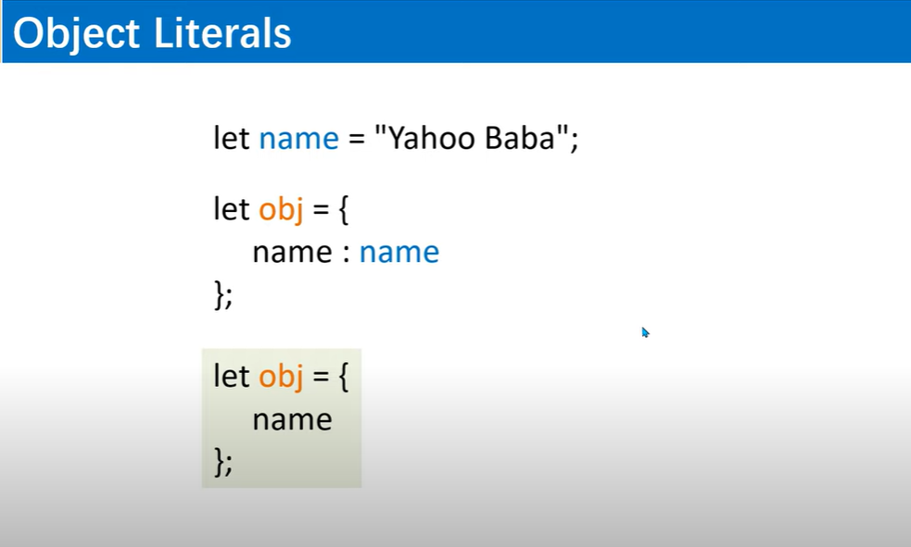
Object Literals

Slide 11
Example
<script>
//This is old JS version object used here
let name="Yahoo";
let course="MCA";
var obj={
name:name,
course:course
};
console.log(obj);
//New JS version(ES6)
var obj2={
name, //here property & value name are same so once written.
course
}
console.log(obj2);
</script>

Slide 12
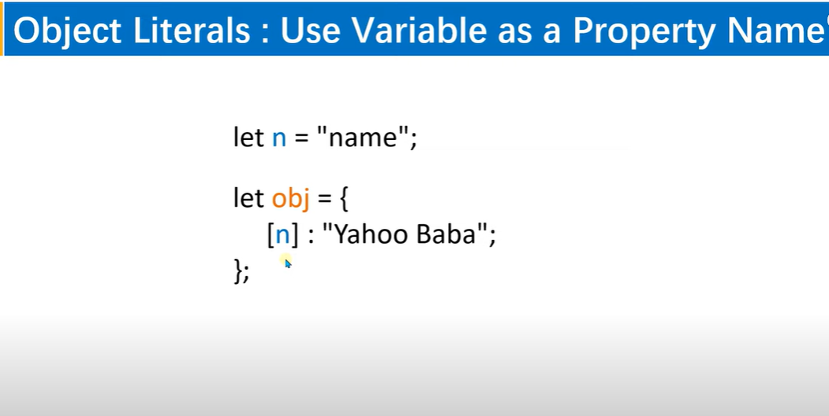
<script>
//Using variable as property name of object
let n="name";
var obj={
[n]:"Yahoo",
course:"MCA"
};
console.log(obj);
//We can also directly access the property name
console.log(obj.name);
</script>
<script>
//Using variable as property name of object
let n="student";
var obj={
[n + "name"]:"Yahoo",
course:"MCA"
};
console.log(obj);
</script>

Slide 13
Defining Function as a Object Value
<script>
//Using variable as property name of object
let n="student";
var obj={
[n + "name"]:"Yahoo",
course:"MCA",
showDetail:function(){
return `${this.studentname} is student of ${this.course}`
}
};
console.log(obj);
console.log(obj.showDetail());
</script>

Slide 14
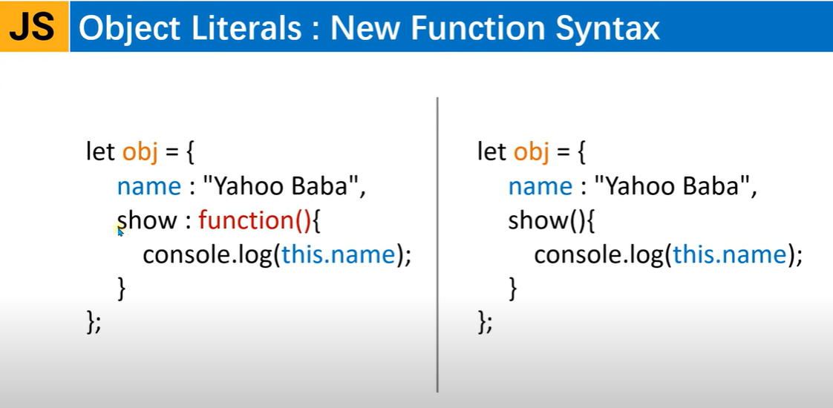

Slide 15
Example
<script>
//Using variable as property name of object
let n="student";
var obj={
[n + "name"]:"Yahoo",
course:"MCA",
showDetail:function(){ //another way
return `${this.studentname} is student of ${this.course}`
},
printDetail(){
return `${this.studentname} is studying ${this.course}`
},
'display detail'(){
return `${this.studentname} is in branch of ${this.course}`
}
};
console.log(obj);
console.log(obj.showDetail());
//or
console.log(obj['printDetail']());
//or
console.log(obj['display detail']());
</script>

Slide 16
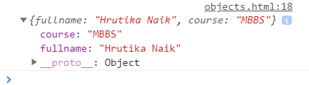

Example- A function returning an object
<script>
let name="Hrutika";
let course="MBBS";
//this function returns object
function student(n,c)
{
return {name,course};
}
console.log(student(name,course));
</script>
<script>
let fname="Hrutika";
let lname="Naik";
let course="MBBS";
//this function returns object
function student(fn,ln,c)
{
let fullname= fn+" "+ln;
return {fname,course};
}
console.log(student(fname,lname,course));
</script>
//Output:
//Output:

Slide 17
Example
<script>
let fname="Hrutika";
let lname="Naik";
let course="MBBS";
//this function returns object
function student(fn,ln,c)
{
let fullname= fn+" "+ln;
return {fullname,course};
}
console.log(student(fname,lname,course));
//or to get individual value of object
let s=student(fname,lname,course);
console.log(s.fullname);
console.log(s.course);
</script>

