Slide 1
ECMA Symbol Data type

Slide 2
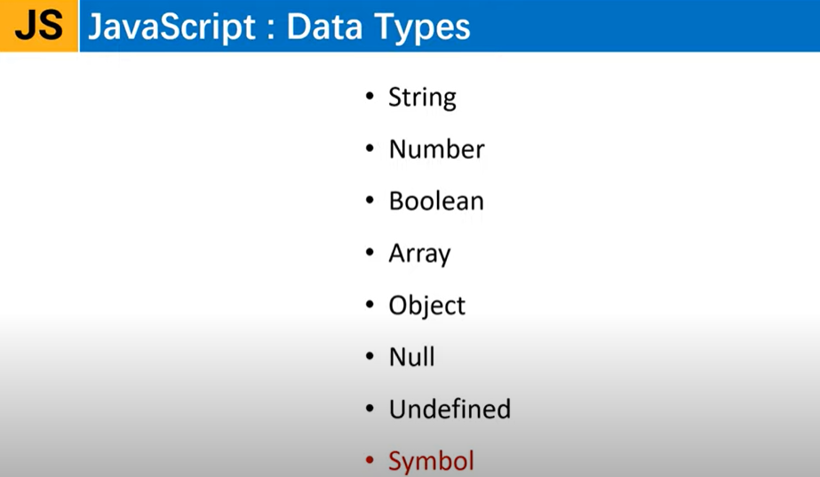

Slide 3
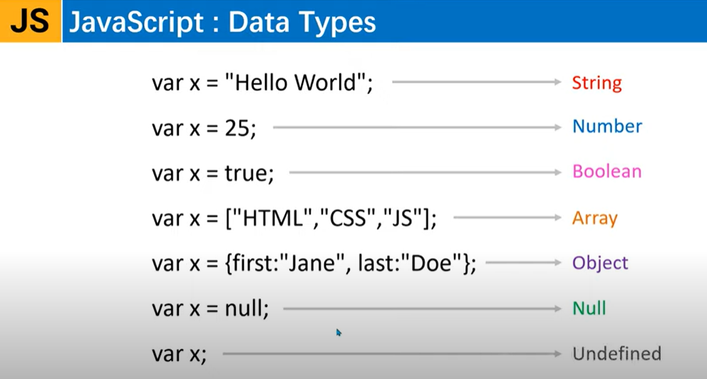

Slide 4
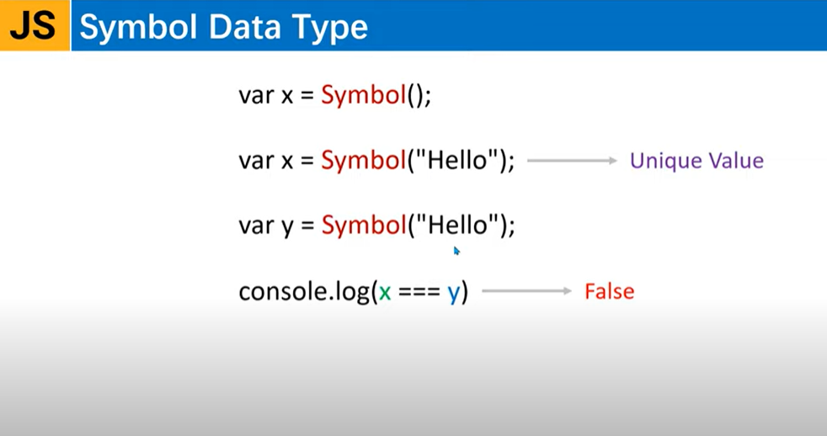
Symbol is basically used for storing unique values.

Slide 5
Example
<script>
let id1 = Symbol("Hello");
let id2 = Symbol("Hello");
// console.log(id);
// console.log(typeof id);
console.log(id1 == id2); //false
let str1="Hello";
let str2="Hello";
console.log(str1 == str2);//true
</script>
These symbol values cannot be used directly in the document.
It throws error : cannot convert symbol value to a string.
<script>
let id1 = Symbol("Hello");
let id2 = Symbol("Hello");
// console.log(id);
// console.log(typeof id);
console.log(id1 == id2); //false
alert(id1.toString());
alert(id1.description); //prints value of symbol
</script>

Slide 6
To use Symbol inside the object
<script>
//how to use symbol in the object
let age = Symbol("Age");
let user = {
name:'Jack',
class:'MCA'
};
user[age] = 25;
console.log(user);
//to show value of object
console.log(user.class);
//Similarly to show symbol value
//console.log(user.age); //error :undefined
console.log(user[age]);//correct
</script>
<script>
//how to use symbol in the object
let age = Symbol("Age");
let user = {
name:'Jack',
class:'MCA',
[age] : 23
};
console.log(user);
</script>
OR

Slide 7
To iterate through object values using loop
In JavaScript, we use object so that we can convert to json and send to web server. And converting from object to json is easy.
<script>
//how to use symbol in the object
let age = Symbol("Age");
let user = {
name:'Jack',
class:'MCA'
};
user[age] = 25;//loop doesn't print symbol.
user["gender"] = "Male";//this prints.
for(let key in user)
{
console.log(key);
}
</script>
<script>
//how to use symbol in the object
let age = Symbol("Age");
let user = {
name:'Jack',
class:'MCA'
};
user[age] = 25;//loop doesnt print symbol.
user["gender"] = "Male";//this prints.
console.log(user);
//to convert object to json and print
console.log(JSON.stringify(user));
//Now to use symbol and convert to json so that we send it to server
//we must use description keyword for symbol and then convert to json
</script>

Slide 8
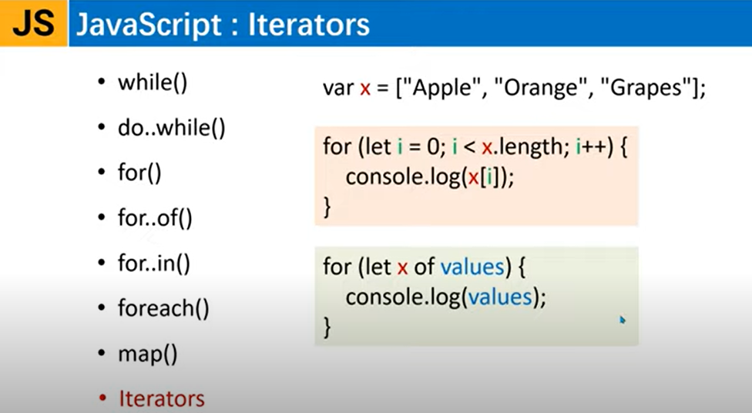

Slide 9
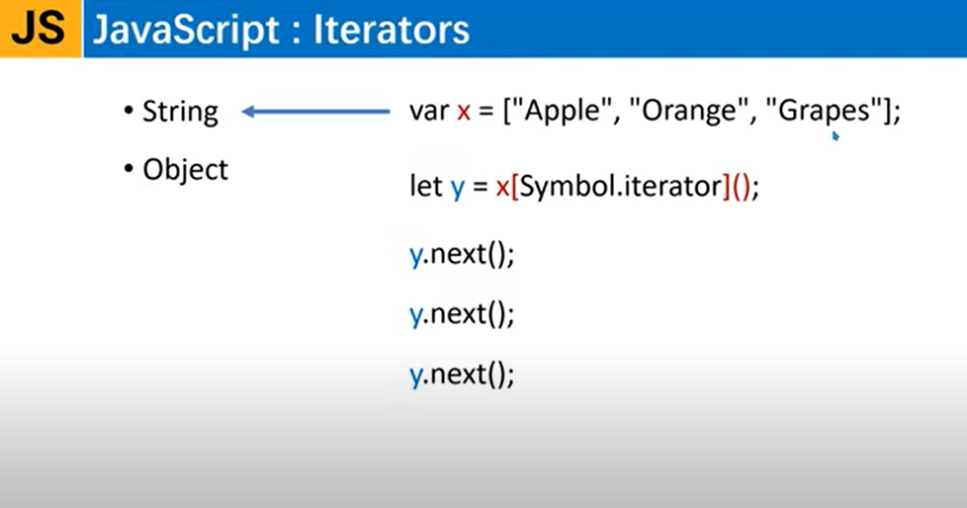

Slide 10
Example
<script>
let numbers =[100,200,300];
console.log(numbers);
console.log(typeof numbers[Symbol.iterator]); //it is a function
//Now using this function we can do array iteration
let iter = numbers[Symbol.iterator]();
console.log(iter.next()); //100
console.log(iter.next());//200
console.log('Hello');
//console.log(iter.next());//300
//or- if you want to see the value using next()
console.log(iter.next().value);
console.log(iter.next().done);//false
//console.log(iter.next()); //undefined
</script>
Iterators are not only used with Array but also can be used with string and object.
<script>
let str ="Hrutika Naik";
let iter = str[Symbol.iterator]();
//Now using loop
let result = iter.next();
while(!result.done)
{
console.log(result.value);
result = iter.next();
}
</script>
//Alternatively using for loop
<script>
let numbers =[100,200,300];
let iter = numbers[Symbol.iterator]();
//Now using loop
let result = iter.next();
while(!result.done)
{
console.log(result.value);
result = iter.next();
}
</script>
<script>
let str ="Hrutika Naik";
//or using for loop
for(let char of str)
{
console.log(char);
}
</script>

Slide 11
Custom Iterator
<script>
function numberiterator(arr){
var nextNum = 0;
return {
next(){
if(nextNum < arr.length){
return{
value:arr[nextNum++],
done : false
}
}
else{
return{
done : true
}
}
}
}
}
let numbers =[10,20,30,40,50];
//Creating custom iterator
let num =numberiterator(numbers);
//function call
console.log(num.next());
console.log(num.next());
console.log(num.next());
console.log(num.next());
console.log(num.next());
console.log(num.next());
</script>

Slide 12
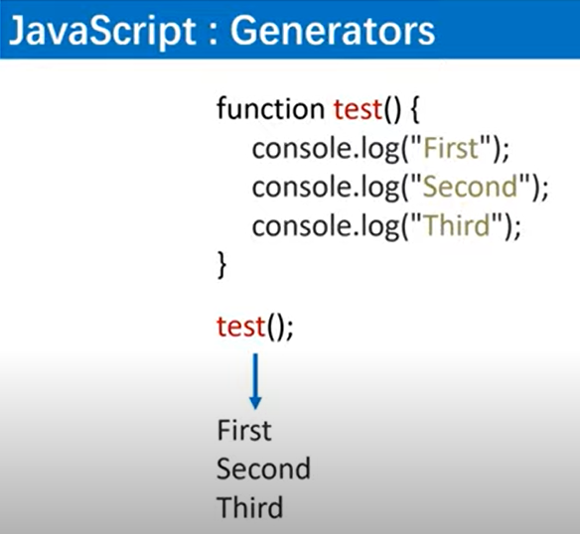
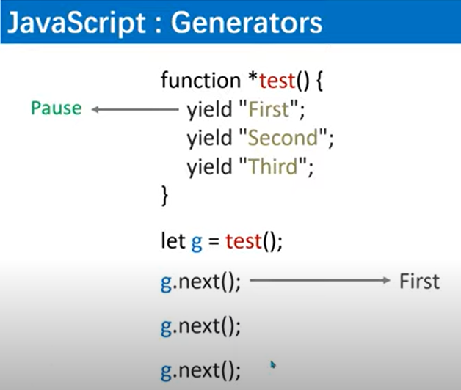

Slide 13
Example
//Using loop to iterate
<script>
//to make generator function add *
function *generateit()
{
console.log('First Message');
yield 'Yield No.1'; //yield means pause
console.log('Second Message');
yield 'Yield No.2';
}
let g = generateit();
console.log(g.next().value);
console.log(g.next().value);
console.log(g.next().value);//undefined
</script>
<script>
//to make generator function add *
function *generateit()
{
console.log('First Message');
yield 'Yield No.1'; //yield means pause
console.log('Second Message');
yield 'Yield No.2';
}
let g = generateit();
for(let value of g)
{
console.log(value);
}
</script>
To create unlimited yields

Slide 14
Example
<script>
//to make generator function add *
function *generateit()
{
let nextNum = 300;
while(true)
{
yield(nextNum++);
}
}
let g = generateit();
console.log(g.next().value);
console.log(g.next().value);
</script>
<script>
//to make generator function add *
function *generateit()
{
let nextNum = 300;
while(true)
{
yield(nextNum++);
}
}
let g = generateit();
for(let value of g)
{
if(value > 310){
break;
}
console.log(value);
}
</script>

Slide 15
<script>
//to make generator function add *
function *generateit()
{
let result =(yield) * 10;
console.log(`Result : ${result}`);
}
let g = generateit();
g.next(); //it will call automatically generator func
g.next(500); //it goes to next yield.
</script>
<script>
//to make generator function add *
function *generateit()
{
let result =[yield,yield,yield];
console.log(`Result : ${result}`);
console.log(`Result : ${result[2]}`); }
//to print multiple yield values use array
let g = generateit();
g.next();
g.next(500);
g.next(600);
g.next(700);
//you can also pass string values
</script>
<script>
//to make generator function add *
//you can also use single value and array together.
function *generateit()
{
yield 55;
yield* ["Nodejs","Angular","Reactjs"]; }
//to print multiple yield values use array
let g = generateit();
console.log(g.next().value);
console.log(g.next().value);
console.log(g.next().value);
console.log(g.next().value);
console.log(g.next().value);
</script>

Slide 16
Example – using spread operator with generator
<script>
//to make generator function add *
//you can also use single value and array together.
function *generateit()
{
yield 'PHP';
yield "Nodejs";
yield "Angular";
yield "Reactjs";
}
//to print multiple yield values use array
let g = generateit();
console.log(g.next().value);
console.log([...g]); //using spread opt
console.log(g.return('End'));
</script>

Slide 17
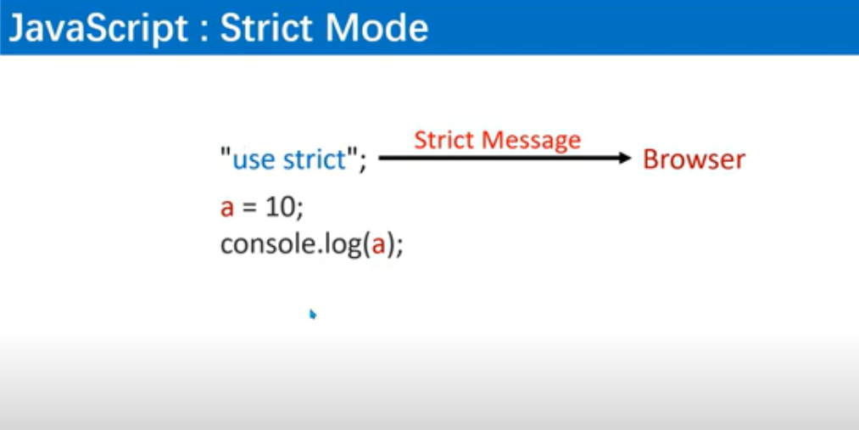
“use strict” command basically tells browser to strictly check the code for any syntax error.

Slide 18
Example
<script>
"use strict"; //using this command it will throw error
a=10;
console.log(a);//it still prints without use strict command.
</script>
<script>
//using this command it will throw error
var a=10;
function test()
{
"use strict";
b=20;
}
test();
</script>
<script>
"use strict";
function test(a,b,b)
{
console.log(a+b+b);
}
test(10,20,30);
</script>

Slide 19
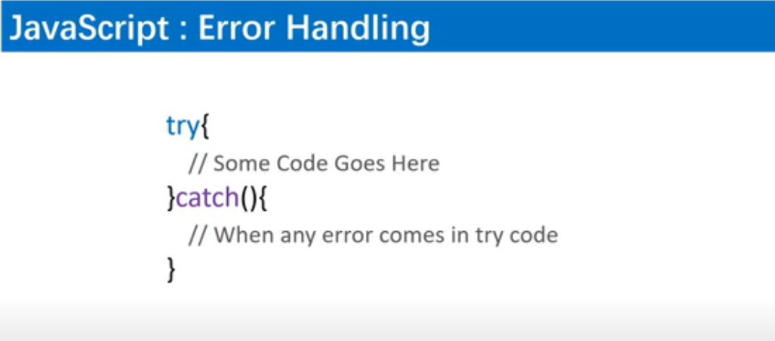

Slide 20
Example
<script>
setTimeout(function () {
try {
blabla;
}
catch (error) {
console.log('Error occured :',error);
}
}, 1000); </script>
<script>
try{
console.log('Start of try');
dssdkcskd;//error occurs
console.log('End of try');
}
catch(error){
console.log(error);
}
</script>
<script>
try{
blabla;
}
catch(error)
{
console.log(error.name);
console.log(error.message);
console.log(error.stack);
}
</script>

Slide 21
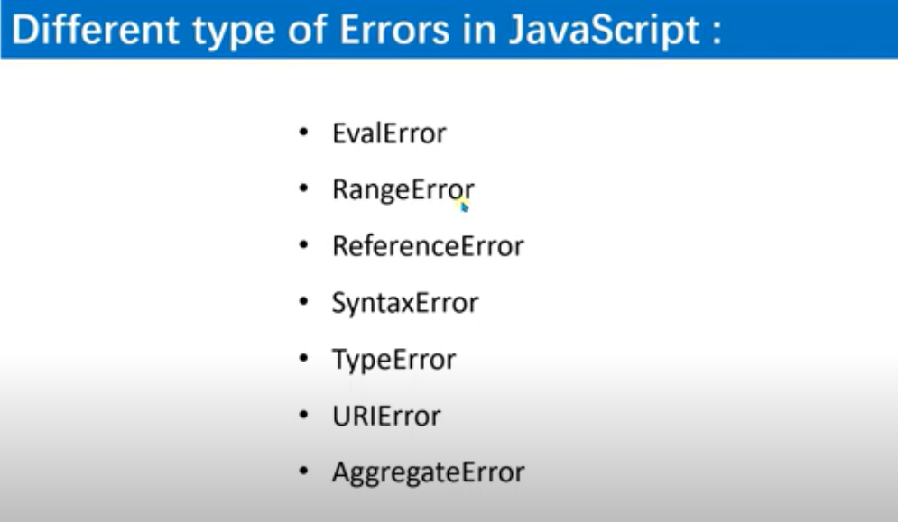

Slide 22
Example
<script>
try{
let json ='{"name":"Yahoo","age":30}';
//now convert JS object into json
let user = JSON.parse(json);
console.log(user.name);
console.log(user.age);
}
catch(error)
{
if(error instanceof ReferenceError)
{
console.log('Reference error',error);
}
else if(error instanceof TypeError)
{
console.log('Type error',error);
}
else{
console.log('Unkown error',error);
}
}
</script>
<script>
try{
blabla;
}
catch(error)
{
if(error instanceof ReferenceError)
{
console.log('Reference error');
}
else if(error instanceof TypeError)
{
console.log('Type error');
}
else{
console.log('Unkown error');
}
}
</script>

Slide 23
Example - Throw keyword & finally block
<script>
try{
let json ='{"age":30}';
//now convert JS object into json
let user = JSON.parse(json);
if(!user.name)
{
throw new Error("Incomplete Data!!: No name")
}
console.log(user.name);
console.log(user.age);
}
catch(error)
{
if(error instanceof ReferenceError)
{
console.log('Reference error',error);
}
else if(error instanceof TypeError)
{
console.log('Type error',error);
}
else{
console.log('Unkown error',error);
}
} finally{
console.log("Thank You. Visit Again !!");
}
</script>

