Slide 1
ES6 Tutorial

Slide 2
Find vs findIndex methods
<script>
let data=[10,20,7,50,1,100];
let result=data.find(function(item){
return item < 50;
});
console.warn(result);
let ans=data.find(function(item){
return (item>20 && item<100);
});
console.warn(ans);
</script>
Find() accepts function as argument and returns the value
<script>
let data=[10,20,7,50,1,100];
function custom(item)
{
return item<50;
}
let result=data.find(custom);
console.warn(result);
</script>

Slide 3
Example
<script>
let data=[
{id:11,name:"Sun"},
{id:8,name:"Hrutu"},
{id:50,name:"pooja"},
{id:1,name:"steve"}
]
function custom(item)
{
return item.id; //by default first object's value
}
let result=data.find(custom);
console.warn(result);
</script>
<script>
let data=[
{id:11,name:"Sun"},
{id:8,name:"Hrutu"},
{id:50,name:"pooja"},
{id:1,name:"steve"}
]
function custom(item)
{
//return item.id; //by default first object's value
return (item.id<10 && item.name ==="Hrutu");
}
let result=data.find(custom);
console.warn(result);
</script>

Slide 4
findIndex() method
<script>
let data=[
{id:11,name:"Sun"},
{id:8,name:"Hrutu"},
{id:50,name:"pooja"},
{id:1,name:"steve"}
]
function custom(item)
{
//return item.id; //by default first object's value
return (item.id<10 && item.name ==="Hrutu");
}
let result=data.findIndex(custom);//returns index of object
console.warn(result);
</script>
findIndex() method returns index/position of the object

Slide 5
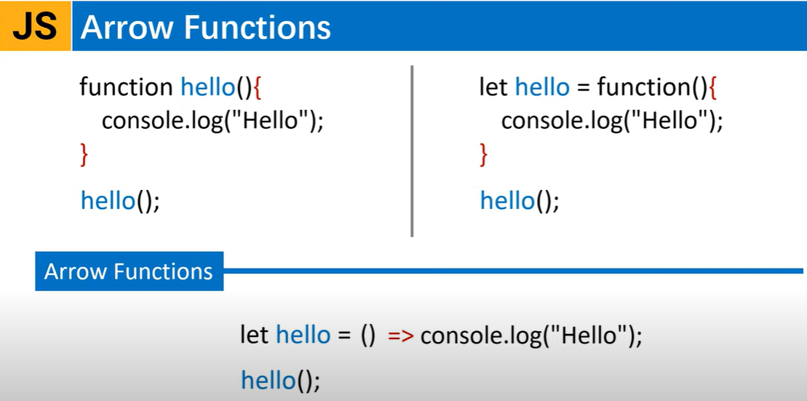

Slide 6
Arrow function
<script>
let data=[10,20,30,40,50];
//Named function
function test()
{
return 1;
}
//Anonymous function
let test2 = function()
{
return 1;
}
//Arrow function-when used with loop no need of return stmt.
let test3 = ()=>{
return 1;
}
console.warn(test2());
console.warn(test3());
</script>
<script>
let welcome = function(name)
{
return `Hello & Welcome ${name}`;
}
console.log(welcome("Sunanda"));
//Using Arrow function and if one line function body then 'return' and '{}' not required.
let welcome2 = (name,age)=>`Hello & Welcome ${name}-${age}`;
console.log(welcome2("Sunanda",33));
console.log(typeof welcome2);
//if arrow function contains only one argument
let welcome3 = name=>`Hello & Welcome ${name}`;
console.log(welcome3("Sunanda"));
</script>

Slide 7
Map function
//map with normal function with return stmt.
//map with arrow function without return stmt.
<script>
let data=[10,20,30,40,50];
//Return an array with the square of all the values in the original array
let newData= data.map(function(item){
return item*2;
});
console.warn(newData); </script>
<script>
let data=[10,20,30,40,50];
let newData=data.map((item)=>
item*2
)
console.warn(newData); </script>
//map with arrow function with return stmt.
Map() returns a new array.
Does not change the size of original array unlike filter.
Uses values from original array when making new one.
<script>
let data=[10,20,30,40,50];
let newData=data.map((item)=>{
return item*2;
})
console.warn(newData); </script>

Slide 8
Example
<script>
let item={
name:"Sunanda",
getName:function(){
console.warn("Normal",this); //Normal function needs to bind with its own 'this'
},
getNameArrow:()=>{
console.warn("Arrow",this);//Arrow function doesn't have its own 'this' so no need to bind
}
}
item.getName();
item.getNameArrow();
</script>

