Slide 1
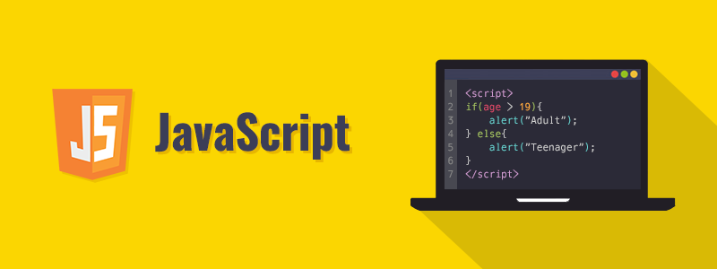
Introduction to JavaScript

Slide 2


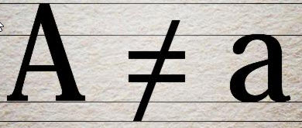
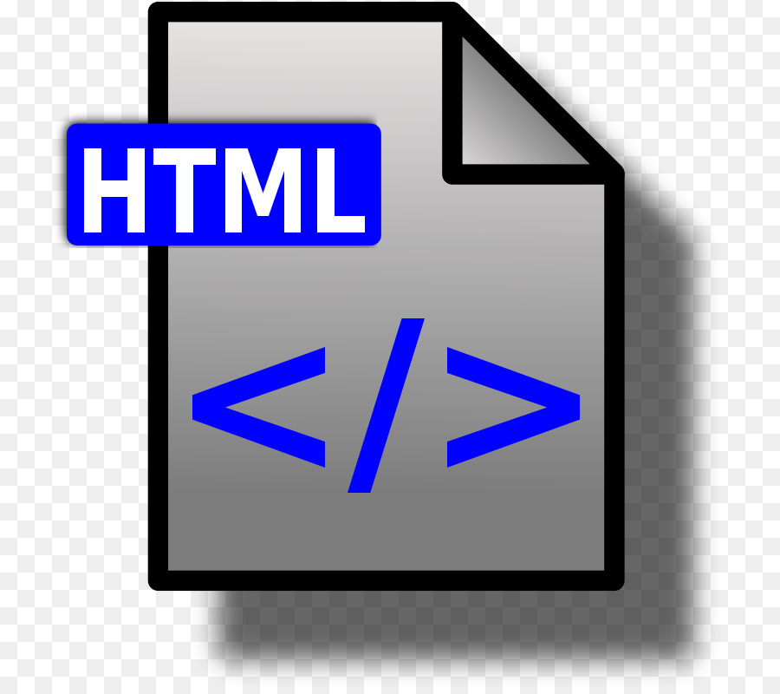

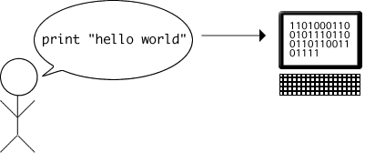
What is JavaScript?
Case- sensitive language
Without any additional libraries JavaScript is also called as “Vanilla JavaScript”.
Programming language which helps in making interactive web pages.
Interpreted and executed on the client machine
Reduces the load on the server as some operations
Used as default scripting language for HTML

Slide 3
What is JavaScript ?
JavaScript is the most popular and widely used client-side scripting language.
Client-side scripting refers to scripts that run within your web browser.
JavaScript is designed to add interactivity and dynamic effects to the web pages by manipulating the content returned from a web server.
JavaScript is an object-oriented language, and it also has some similarities in syntax to Java programming language.
But, JavaScript is not related to Java in any way.
JavaScript is the default scripting language for HTML5.

Slide 4
History of JavaScript
JavaScript was originally developed as Live Script by Netscape in the mid 1990s.
It was later renamed to JavaScript in 1995, and became an ECMA(European Computer Manufacturers Association) standard in 1997.
Now JavaScript is the standard client-side scripting language for web-based applications, and it is supported by virtually all web browsers available today, such as Google Chrome, Mozilla Firefox, Apple Safari, etc.
JavaScript is officially maintained by ECMA (European Computer Manufacturers Association) as ECMAScript.
ECMAScript 6 (or ES6) is the latest major version of the ECMAScript standard.

Slide 5
What You can do with JavaScript?
There are lot more things you can do with JavaScript.
You can modify the content of a web page by adding or removing elements.
You can change the style and position of the elements on a web page.
You can monitor events like mouse click, hover, etc. and react to it.
You can perform and control transitions and animations.
You can create alert pop-ups to display info or warning messages to the user.
You can perform operations based on user inputs and display the results.
You can validate user inputs before submitting it to the server.

Slide 6
Adding JavaScript to Your Web Pages
There are typically three ways to add JavaScript to a web page:
Embedding the JavaScript code between a pair of <script> and </script> tag.
Creating an external JavaScript file with the .js extension and then load it within the page through the src attribute of the <script> tag.
Placing the JavaScript code directly inside an HTML tag using the special tag attributes such as onclick, onmouseover, onkeypress, onload, etc.

Slide 7
Embedding the JavaScript Code
You can embed the JavaScript code directly within your web pages by placing it between the <script> and </script> tags.
The <script> tag indicates the browser that the contained statements are to be interpreted as executable script and not HTML.
<html lang="en">
<head>
<meta charset="UTF-8">
<title>Embedding JavaScript</title>
</head>
<body>
<script>
var greet = "Hello World!"; document.write(greet); // Prints: Hello World!
</script>
</body>
</html>

Slide 8
Calling External JavaScript File
You can also place your JavaScript code into a separate file with a .js extension, and then call that file in your document through the src attribute of the <script> tag, like this:
<script src="js/hello.js"></script>
//index.js
//index.html
<html lang="en">
<head>
<meta charset="UTF-8">
<title>Including External JavaScript File</title>
</head>
<body>
<button type="button" id="myBtn">Click Me</button>
<script src="js/hello.js"></script>
</body>
</html>
// A function to display a message function sayHello()
{
alert("Hello World!");
} // Call function on click of the button document.getElementById("myBtn").onclick = sayHello;

Slide 9
Placing JavaScript Code Inline
You can also place JavaScript code inline by inserting it directly inside the HTML tag using the special tag attributes such as onclick, onmouseover, onkeypress, onload, etc.
//index.html
<html lang="en">
<head>
<meta charset="UTF-8">
<title>Inlining JavaScript</title>
</head>
<body>
<button onclick="alert('Hello World!')">Click Me</button>
</body>
</html>

Slide 10
JavaScript Syntax
The syntax of JavaScript is the set of rules that define a correctly structured JavaScript program.
A JavaScript consists of JavaScript statements that are placed within the <script></script> HTML tags in a web page, or within the external JavaScript file having .js extension.
JavaScript is case-sensitive. This means that variables, language keywords, function names, and other identifiers must always be typed with a consistent capitalization of letters.
A comment is simply a line of text that is completely ignored by the JavaScript interpreter.
JavaScript support single-line as well as multi-line comments.
Single-line comments begin with a double forward slash (//), followed by the comment text.
Whereas, a multi-line comment begins with a slash and an asterisk (/*) and ends with an asterisk and slash (*/).
<html lang="en">
<head>
<meta charset="utf-8">
<title>Example of JavaScript Statements</title>
</head>
<body>
<script>
var x = 5;
var y = 10;
var sum = x + y;
document.write(sum); // Prints variable value
</script>
</body>
</html>

