Slide 1

BLOCK CODING DEVELOPER
Session 1
Input Processing Outputs

Slide 2


Recall…
What we have learnt in last session
What challenges you are facing

Slide 3

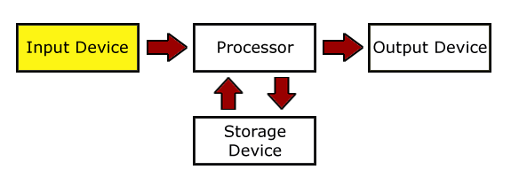
Input Processing Outputs
We will Learn today:
Identifying input
Learning how computer process information
Exploring with inputs from a keyboard
Exploring output on a monitor

Slide 4
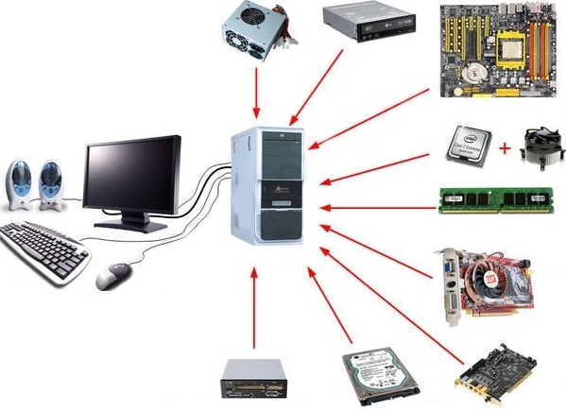
Phases
The activities of a computer can be broken down into four phases :
Input
Process
Output
Storage
Note - The cycle of activities performed by a computer is also known as the Input-Process-Output (IPO) cycle

Slide 5
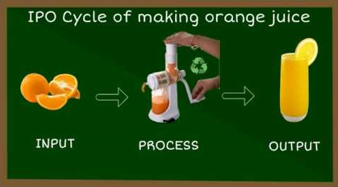
Four Phases of the Information Processing Cycle…
Input:
Computer receives data and instructions
Process:
Computer applies instructions to data to produce information (organized Data)
Storage:
Saving the information for a subsequent use or use in future
Output:
Computer sends information to people in a usable format

Slide 6
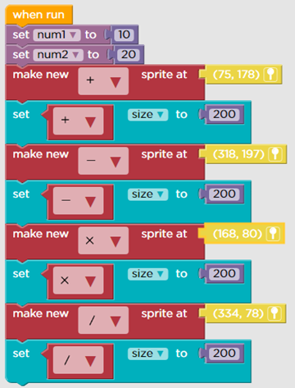
Demonstration…
Identify the Input, Process & Output phases
Calculating the sum of two numbers using a calculator

Slide 7
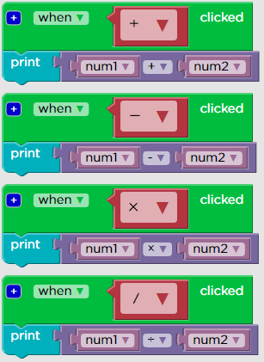
Demonstration…
Identify the Input, Process & Output phases
Calculating the sum of two numbers using a calculator

Slide 8
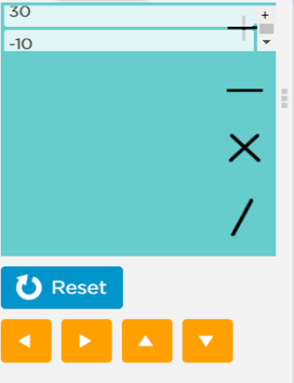
Demonstration…
Calculating the sum of two numbers using a calculator:
Input: First number, + Second number and = operator.
Process: Calculation of the sum
Output: Sum of the two numbers

Slide 9

What is a Computer?
A computer is an electronic machine that processes information
It takes in raw information at one end, stores it until it's ready to work on it
Taking in Information is called Input, Storing information in Memory / Storage, Chewing information is Called Processing, and showing out results is called Output

Slide 10
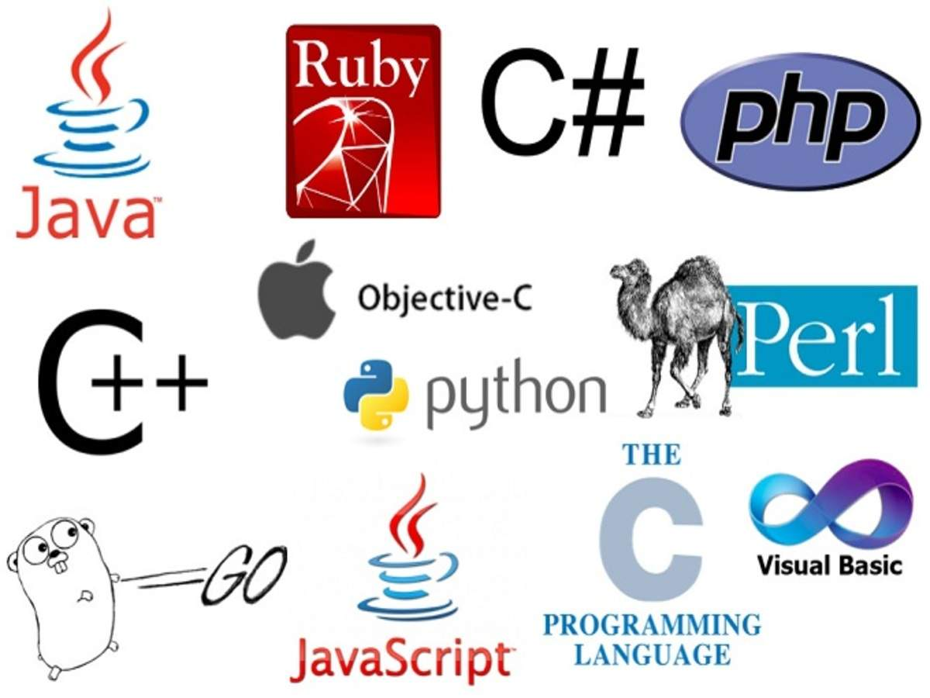
Programs and Programming languages…
Computer uses a step-by-step procedure to perform any task :
Accept input
Process the input
Generate the output

Slide 11
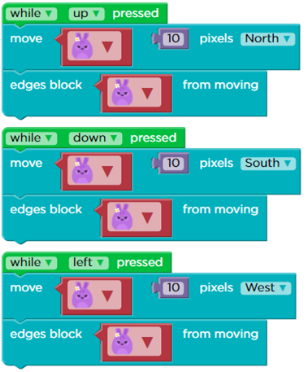
Programs and Programming languages…
You need to provide a set of instructions that specify:
The kind of input that will be provided
The processing that needs to be done
The kind of output expected

Slide 12
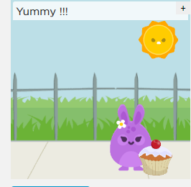
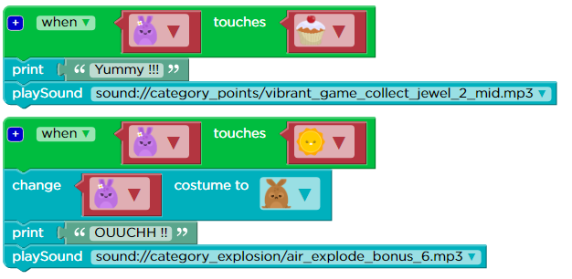
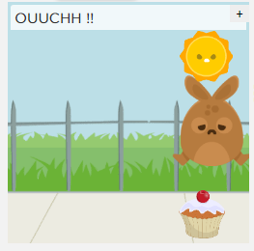
Programs and Programming languages…

Slide 13
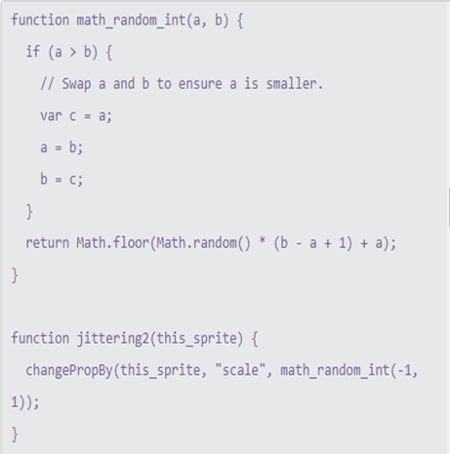
Programming languages…
Machine Language
Binary digits represent data & Instructions
High Level Language
Programmers can easily understand or interpret or compile
C, C++, Python, Java…

Slide 14
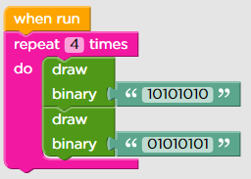

Block Coding…
Coding Instruction Blocks
Drag & Drop Learning Environment

Slide 15

Summary:
Identifying input
Learning how computer process information
Exploring with inputs from a keyboard
Exploring output on a monitor

Slide 16
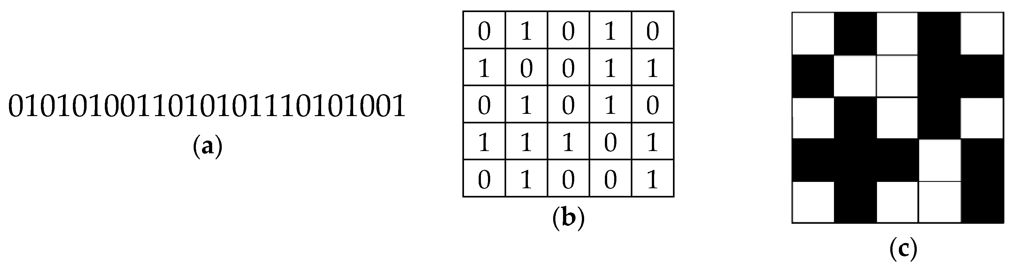
Next Session..
Binary Strings- Session 1
Learn Binary Number Systems
Write Binary Codes
Create bitmap images

