Slide 1

BLOCK CODING DEVELOPER
Session 2
Binary Strings-Session 1

Slide 2

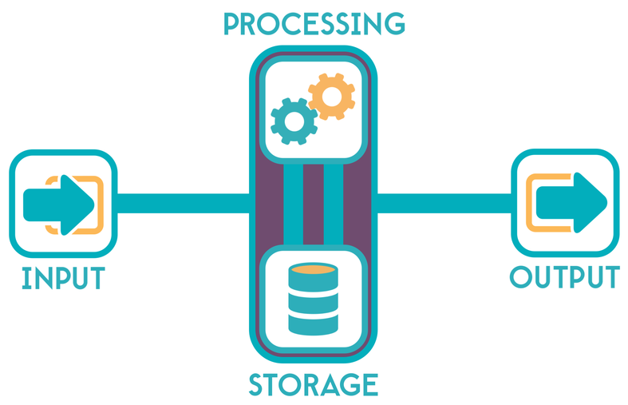
Recall
What we have learnt in last session
What challenges you are facing

Slide 3
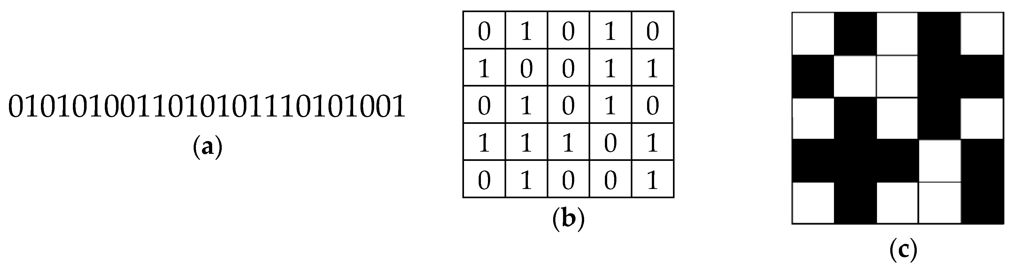
Binary Strings- Session 1
We will Learn Today:
Understanding Binary Number System
Writing Binary Codes
Creating Bitmap images

Slide 4
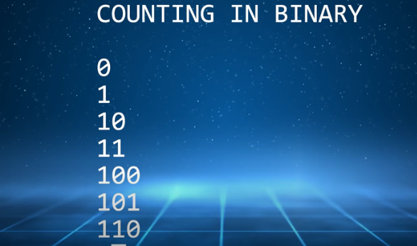
What is Binary ?
Data in computers is stored and transmitted as a series of ones and zeros (also known as Binary).
Binary is extremely important in the world of computers. The majority of computers today store all sorts of information in binary form.

Slide 5
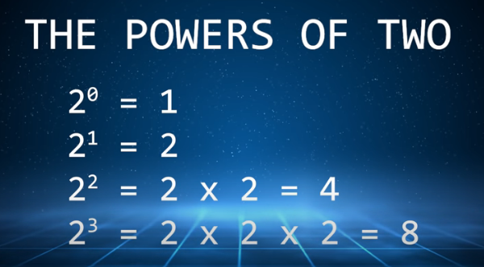
What is meant by a Binary Number System?
Binary number system, in mathematics, positional numeral system employing 2 as the base and so requiring only two different symbols for its digits, 0 and 1, instead of the usual 10 different symbols needed in the decimal system.

Slide 6
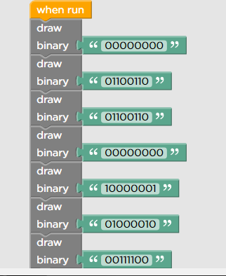
Number System
Number
It is a symbol representing a unit or quantity.
Number System
Defines a set of symbols used to represent quantity.
Radix
The base or radix of number system determines how many numerical digits the number system uses.

Slide 7
Number System
Decimal Number System
Binary Number System
0,1,2,3,4,5,6,7,8,9
0,1 (Binary Digit)
8 bit = 1 byte
1 KB = 1000 byte
1 MB= 10 lakh byte
1 GB = 10⁹ byte
1 TB = 10¹² byte

Slide 8

What is Binary Codes?
In the coding, when numbers, letters or words are represented by a specific group of symbols, it is said that the number, letter or word is being encoded. The group of symbols is called as a code.
The digital data is represented, stored and transmitted as group of binary bits. This group is also called as binary code

Slide 9

Advantages of binary :
Binary codes are suitable for the computer applications
Binary codes are suitable for the digital communications
Binary codes make the analysis and designing of digital circuits
Since only 0 & 1 are being used, implementation becomes easy
0 & 1 binary codes also used to create bitmap images

Slide 10

What is Bitmap?
Bitmap is an array of binary data representing the values of pixels in an image or display
What’s a pixel, you say? A pixel is a little tiny square that is filled with a color
Bitmap images, also known as Raster images, store color information
Basically, it’s a grid where each individual square is a pixel that contains color information

Slide 11
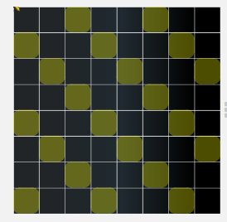
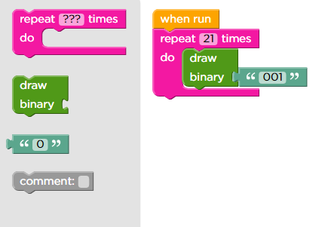
Demonstration : To Create Bitmap images
In Sprite lab, ‘draw binary’ function used
Block code

Slide 12
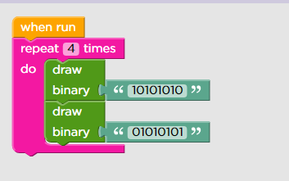
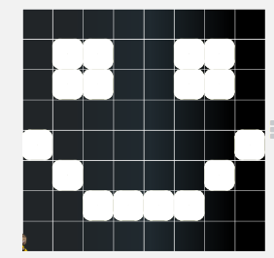
Demonstration
Here, we create a smiley bitmap image
Output

Slide 13
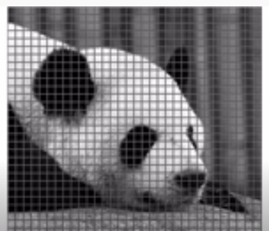
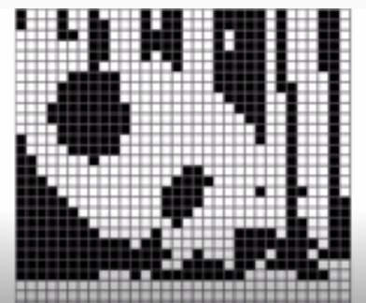
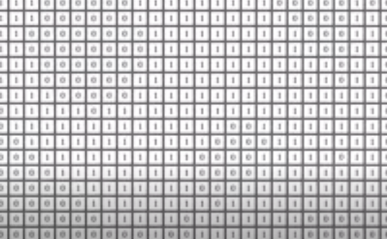
How It’s Created and Stored?
When you break down an image into a grid made of thousands of squares, you get a bitmap.
Each square in that grid holds a little bit of color data and displays (or doesn’t display) a color based on that data.

Slide 14

Summary
Understanding Binary Number System
Writing Binary Codes
Creating Bitmap images

Slide 15
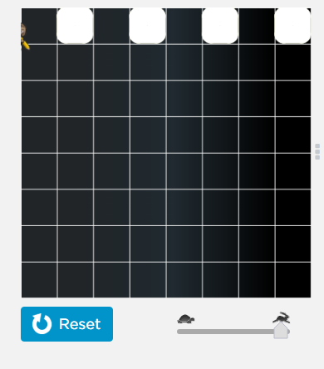
Next Session..
Binary Strings- Session 1
Learn Binary Number Systems
Write Binary Codes
Create bitmap images

