Slide 1

BLOCK CODING DEVELOPER
Session 3
Binary Strings-Session 2

Slide 2

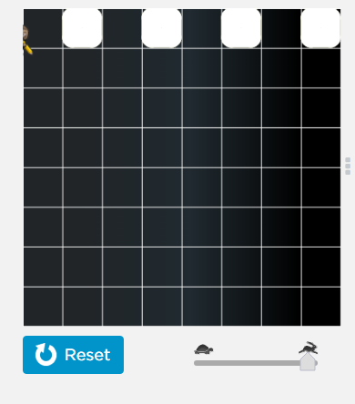
Recall
What we have learnt in last session
What challenges you are facing

Slide 3
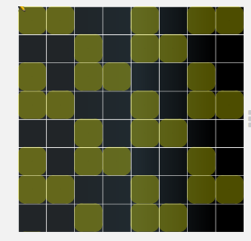
Binary Strings- Session 2
We will Learn Today:
About Binary Number System
Writing Binary Codes
Creating Bitmap images

Slide 4
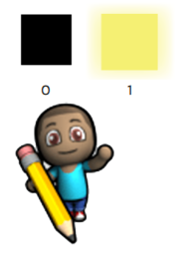
Binary Number System
A Binary Number is made up of only 0s and 1s.
110100
Example of Binary Number:
There is no 2,3,4,5,6,7,8,9 in Binary
Binary Numbers have many uses in Mathematics and beyond

Slide 5
How do we count using Binary?
It is just like counting in decimal except we reach 10 much sooner.
Well how do we count in Decimal ?
0 start at 0
…Count 0,1,2,3,4,5,6,7,8,9 and then…
9 is the last digit in decimal
10 So we start back at 0 again, but add 1 on the left.
Binary
0 |  | We start at 0
1 |  | Then 1
?? |  | But then there is no symbol for 2…what do we do?

Slide 6
The same thing is done in Binary…
What happens in Decimal?
99 When we run out of digits , we…
100.. Start back at 0 again, but add 1 on the left.
 | Binary
 | 0 |  | Start at 0
 | 1 |  | Then 1
 | 10 |  | Now start back at 0 again, but add 1 on the left
 | 11 |  | 1 more
 | ??? |  | But Now what..?

Slide 7
And that is what we do in Binary:
 | Binary
 | 0 |  | Start at 0
 | 1 |  | Then 1
 | 10 |  | Start back at 0 again, but add 1 on the left
 | 11
 | 100 |  | start back at 0 again, and add one to the number on the left... ... but that number is already at 1 so it also goes back to 0 ... ... and 1 is added to the next position on the left
 | 101
 | 110 |  | And so on..

Slide 8
Decimal Vs. Binary
Here are some equivalent values:
Decimal | 0 | 1 | 2 | 3 | 4 | 5 | 6 | 7 | 8 | 9 | 10 | 11 | 12 | 13 | 14 | 15
Binary | 0 | 1 | 10 | 11 | 100 | 101 | 110 | 111 | 1000 | 1001 | 1010 | 1011 | 1100 | 1101 | 1110 | 1111

Slide 9

Bases
The Base represents as the total number of digit used in the number system
Bases we will use
Binary : Base 2
Decimal : Base 10
Octal : Base 8
Hexadecimal : Base 16

Slide 10
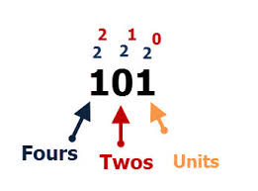
Binary Numbers
Binary Numbers are just “Base 2” instead of “Base 10”.
So you start counting at 0, then 1, then you run out of digits ... so you start back at 0 again, but increase the number on the left by 1.

Slide 11
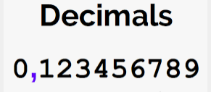
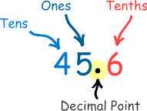
Decimal Numbers
A number containing a decimal point
Example:
6.4
Whole Part
Decimal Part
6.4 = 6 + .4

Slide 12
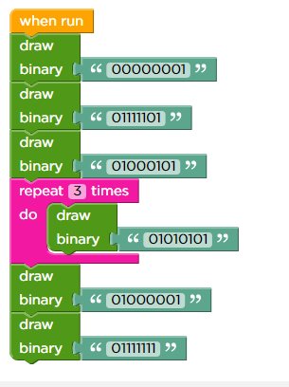
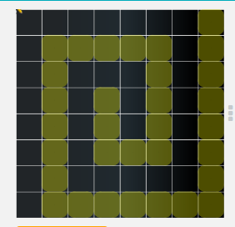
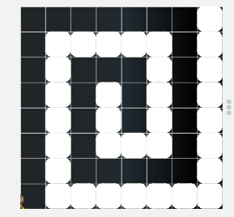
Demonstration
Here, Binary pattern created using binary strings
Output

Slide 13
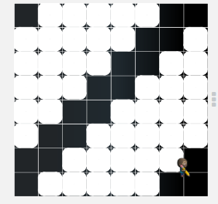
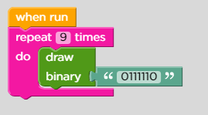
Demonstration
Here, using repeat loop bitmap pattern created
Output

Slide 14

Summary
Learnt Bases/Radix
Writing Binary Codes
Creating Bitmap Images

Slide 15
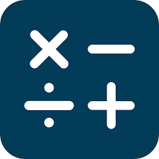
Next Session
Binary Math - Session 1:
Learn Binary mathematics.
Convert 2-bits Binary number into Decimal Number.
Creating Bitmap images.

