Slide 1

BLOCK CODING DEVELOPER
Session 4
Binary Math-Session 1

Slide 2

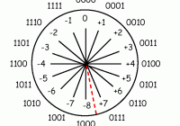
Recall
What we have learnt in last session
What challenges you are facing

Slide 3
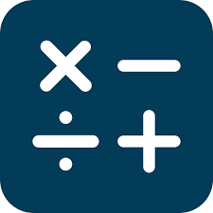
Binary Math –Session 1
We will learn Today:
Binary Mathematics
Convert 2-bits binary number into Decimal number
Read Binary Number to Decimal Number
Write Decimal Number to Binary Number
Creating Bitmap images

Slide 4
Converting 2-bit Binary to Decimal number
Binary Number: 11
1
1
(1*2^1)
(1*2^0)
3 (Decimal Equivalent)

Slide 5
Conversion- Binary to Power of 2 Base
• Split the number in a group beginning from the right by the factor of power «n» (2^{n})
• Then convert the binary group directly to the power of 2 base
Example
• (100110010)₂ = (……)₁₀
• (1100110)₂ = (……)₁₀
• (10110010)₂ = (……)₁₀
• (1100110)₂ = (……)₁₀

Slide 6
Read Binary Number to Decimal
01000010 = 64+2 =66
128 | 64 | 32 | 16 | 8 | 4 | 2 | 1
0 | 1 | 0 | 0 | 0 | 0 | 1 | 0
Index value
Binary value
Select those numbers with binary digit “1” associated to the index value.

Slide 7
Write Decimal Number to Binary
Example: 19 = 10011₂
1 2 4 9 19
1 0 0 1 1
Stop here, Put “0” when “Even” and Put “1” when “Odd”.

Slide 8
• Example 1:
Convert 0.375 to its binary equivalent
0.375₁₀ is equivalent to 0.011₂
Multiplication | Product | Integral Part
0.375x2 | 0.75 | 0
0.75x2 | 1.5 | 1
0.5x2 | 1.0 | 1

Slide 9

Practice…
Convert 99 to Binary ?
Convert decimal 12.75 to binary representation
Convert binary number 1010.0011 into decimal representation

Slide 10


Bitmap File Formats
BMP
GIF
JPEG
EXIF
PNG
TIFF.
Note: All of them except BMP files can be compressed and transferred via the web.

Slide 11

Bitmap File Formats…..
You can determine a file’s format by where it came from or how the image will be used.
Windows exclusively uses BMPs
GIFs and JPEGs are designed for web transfer.
EXIF files come from digital cameras and carry photo-specific information and camera settings.
BMPs are large, full files that can’t be compressed.

Slide 12
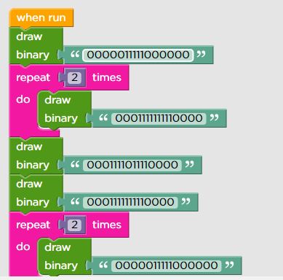
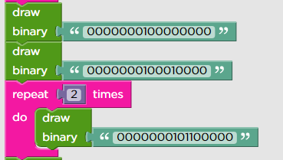
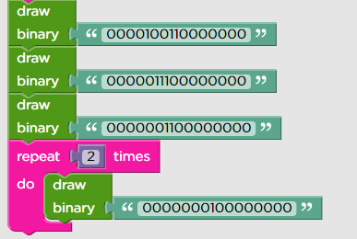
Demonstration…
Create bitmap image

Slide 13
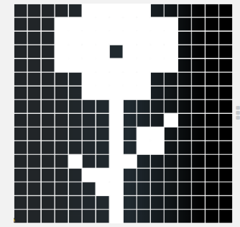
Output….
Bitmap Flower image

Slide 14
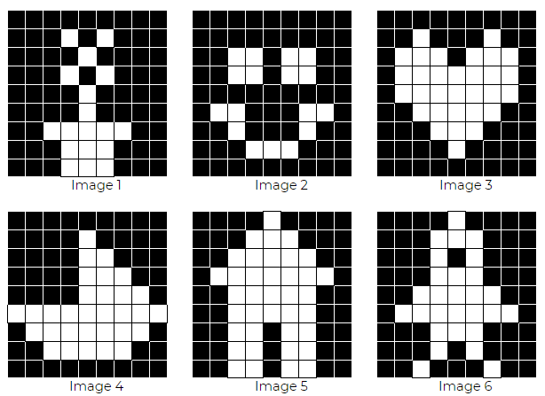
Practice…..
Bitmap Images

Slide 15
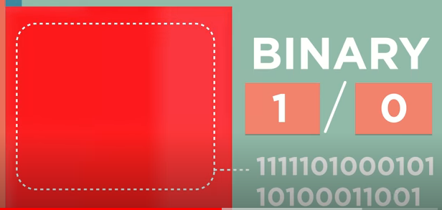

When to use Bitmaps In Your Designs?
Bitmaps are perfect for creating detailed images (like photographs) because of the amount of data each pixel can store.
The greater the amount of data, the broader the range of colors it can display.
It is much easier to create a colorful image with realistic, transitioning color tones when you have access to a full range of colors.

Slide 16

Summary
Learnt Basic Binary Mathematics
Convert 2-bits binary number into Decimal number
Demonstrated bitmap images

Slide 17
Next Session
Binary Math - Session 2:
Learn Basic Binary mathematics
Convert 4-bits Binary number into Decimal Number
Creating Bitmap images

