Slide 1

BLOCK CODING DEVELOPER
Session 5
Binary Math-Session 2

Slide 2

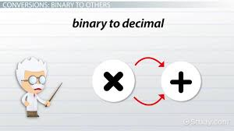
Recall
What we have learnt in last session
What challenges you are facing

Slide 3
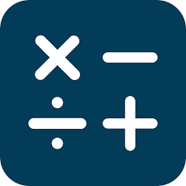
Binary Math Session -2
We Will Learn Today:
Binary Number- Addition Rule
Binary Number- Subtraction Rule
Converting 4-bit Binary to Decimal number
Demo- To create bitmap images.

Slide 4
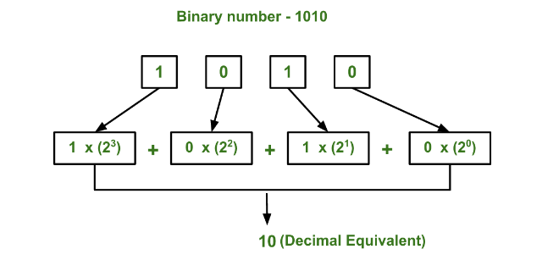
Converting 4-bit Binary to Decimal number

Slide 5
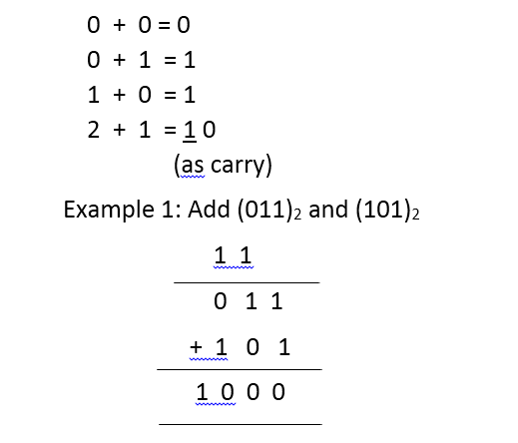
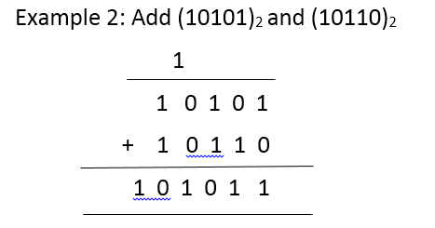
Binary Number – Addition Rule

Slide 6
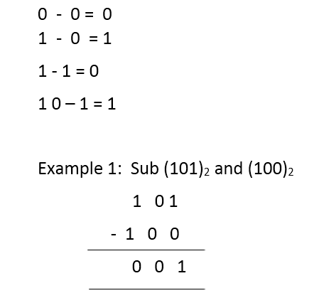
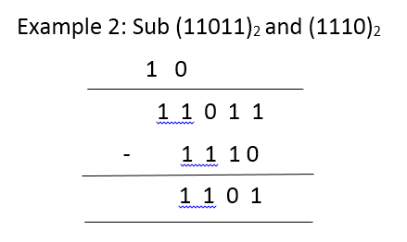
Binary Number – Subtraction Rule

Slide 7
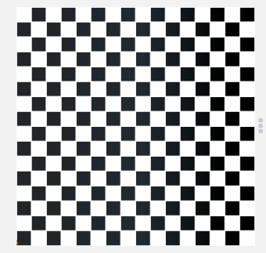
Demonstration
Creating a Chessboard bitmap image

Slide 8
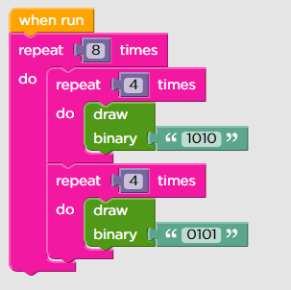
Chessboard Coding

Slide 9
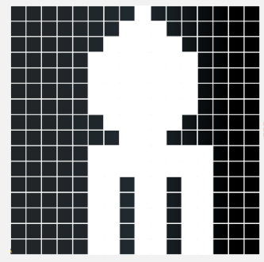
Demonstration
Creating Spaceship bitmap image

Slide 10
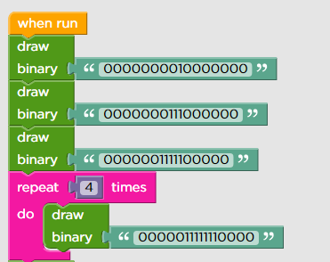
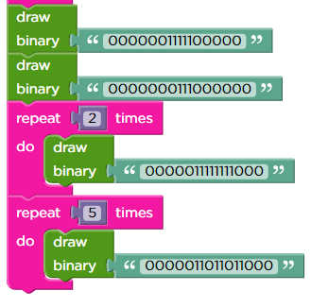
Spaceship Coding

Slide 11

Summary
In this session, we learnt :
Addition and Subtraction of Binary Numbers
Converting 4-bit Binary to Decimal number
Creating bitmap images

Slide 12
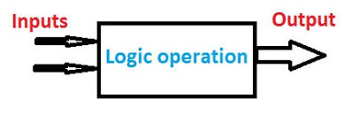
Next Session
Logic Gates Session-1
Learn logical AND & OR of Conditional Statements
Use Logical Operations
Build Logical thinking

