Slide 1

BLOCK CODING DEVELOPER
Session 6
Logic Gates-Session 1

Slide 2


Recall
What we have learnt in last session
What challenges you are facing

Slide 3
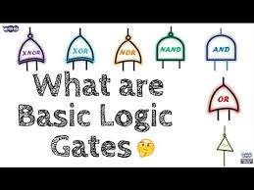
Logic Gates – Session 1
To study and understand the AND & OR gates
Implement the basic gates
Understanding Truth Table
Use logical operations to implement decision logic

Slide 4
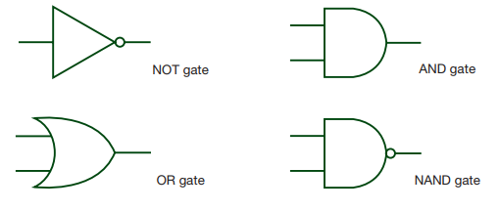
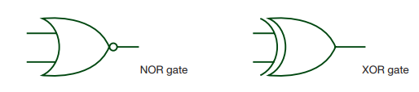
Logic Gates
A large number of electronic circuits (in computers, control units, and so on) are made up of logic gates.
These process signals which represent true or false. Signals can be represented as ON or OFF, 1 or 0 as well.
The most common symbols used to represent logic gates are shown below.
AND
NOT
OR
NAND
NOR
XOR

Slide 5
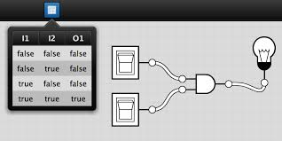
Truth Tables
Truth tables are used to show logic gate functions
The NOT gate has only one input, but all the others have two inputs
When constructing a truth table, the binary values 1 and 0 are used
Every possible combination, depending on number of inputs, is produced
Basically, the number of possible combinations of 1s and 0s is 2n, where n = number of inputs

Slide 6
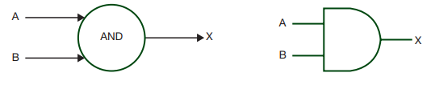
AND gate
The output (X) is true (i.e. 1 or ON) if:
INPUT A AND INPUT B are BOTH TRUE (i.e. 1 or ON)
Truth table for: X = A AND B
This gate gives high output (1) if all the inputs are 1’s.
otherwise the output will be low (0).
Its Boolean algebra representation is: X=A.B
A dot(.) is used to show the AND operation i.e. A.B
INPUT A | INPUT B | OUTPUT X
0 | 0 | 0
0 | 1 | 0
1 | 0 | 0
1 | 1 | 1

Slide 7
OR gate
A
The output (X) is true (i.e. 1 or ON) if:
INPUT A OR INPUT B is TRUE (i.e. 1 or ON)
Truth table for: X = A OR B
This circuit will give high output (1) if any input is high (1).
Its Boolean algebra representation is: X=A+B
A plus (+) is used to show the OR operation.
OR
A
X
X
B
B
INPUT A | INPUT B | OUTPUT X
0 | 0 | 0
0 | 1 | 1
1 | 0 | 1
1 | 1 | 1

Slide 8
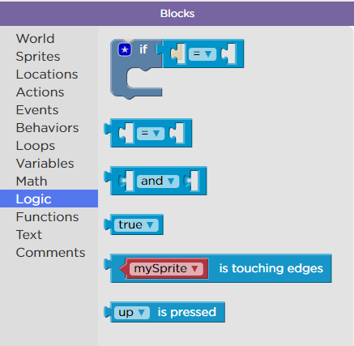
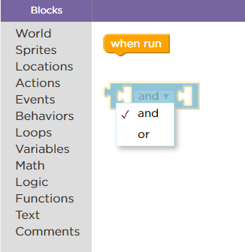
In Sprite Lab, Operators Code : and, or logic gates

Slide 9
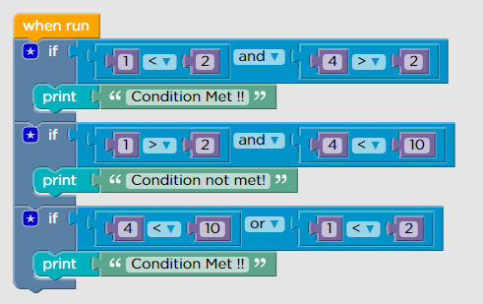
Demonstration
Use logical operations using conditional evaluation to implement decision logic

Slide 10

Summary
In this session, we learnt :
AND & OR Logic gates.
Understanding Truth table.
Implemented Decision logic using logical operations

Slide 11
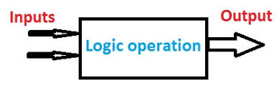
Next Session
Logic Gates Session-2
Understanding the NOT, NAND and NOR gates
Implementing the basic gates
Using logical operations using conditional evaluation to implement decision logic

