Slide 1

BLOCK CODING DEVELOPER
Session 7
Logic Gates-Session 2

Slide 2

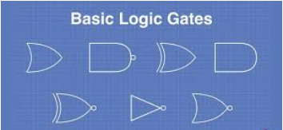
Recall
What we have learnt in last session
What challenges you are facing

Slide 3
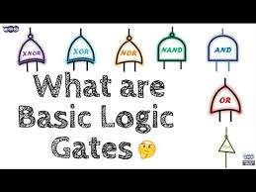
Logic Gates – Session 2
We Will Learn Today:
To study and understand the NOT, NAND & NOR gates
Implement the basic gates
Use logical operations to implement decision logic

Slide 4
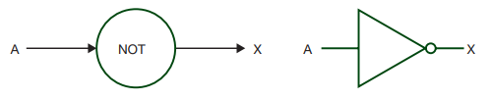
Description of the Three Logic gates:
NOT gate
The output (X) is true (i.e. 1 or ON) if:
INPUT A is NOT TRUE (i.e. 0 or OFF)
Truth table for: X = NOT A
Note: This is the simplest gate it just inverts the input, if the input is high the output will be low and conversely. So B=A’ .
The NOT gate is an electronic circuit that produces an inverted version of the input at its output. It is also known as an inverter. If the input variable is A, the inverted output is known as NOT A. This is also shown as A', or A with a bar over the top
INPUT A | INPUT B
0 | 1
1 | 0

Slide 5

NAND gate
The output (X) is true (i.e. 1 or ON) if:
INPUT A AND INPUT B are NOT BOTH TRUE (i.e. 1 or ON)
Truth table for: X = NOT A AND B.
This is a NOT-AND gate which is equal to an AND gate
followed by a NOT gate.
The NAND gate works opposite to the AND gate.
Its Boolean algebra representation is: C=(A.B)’
The outputs of all NAND gates are high if any of the inputs are low. The symbol is an AND gate with a small circle on the output.
INPUT A | INPUT B | OUTPUT X
0 | 0 | 1
0 | 1 | 1
1 | 0 | 1
1 | 1 | 0

Slide 6
NOR gate
The output (X) is true (i.e. 1 or ON) if:
INPUT A OR INPUT B are NOT BOTH TRUE (i.e. 1 or ON)
Truth table for: X = NOT A OR B
This is a NOT-OR gate which is equal to an OR gate
followed by a NOT gate. The outputs of all NOR gates are
low if any of the inputs are high.
The symbol is an OR gate with a small circle on the output.
The NOR gate works opposite to the OR gate.
Its Boolean algebra representation is: C=(A+B)’
A
A
NOR
X
X
B
B
INPUT A | INPUT B | OUTPUT X
0 | 0 | 1
0 | 1 | 0
1 | 0 | 0
1 | 1 | 0

Slide 7
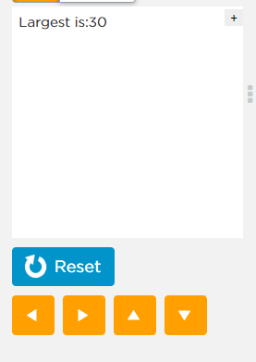
Demonstration
Here, Logical operators used to check the largest number

Slide 8
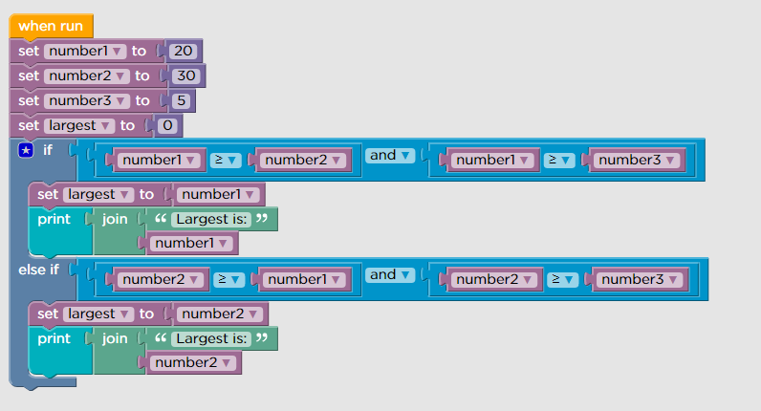
To Check the Largest Number Coding

Slide 9

Summary
In this session, we learnt:
NOT, NAND and NOR Logic gates.
Implemented Decision logic.

Slide 10
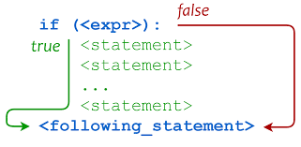
Next Session If Conditionals
Using If Conditionals
Understand Comparison Operations
Implement decision logic

