Slide 1

BLOCK CODING DEVELOPER
Session 8
If Conditionals

Slide 2

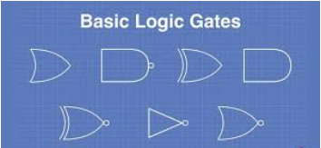
Recall
What we have learnt in last session
What challenges you are facing

Slide 3
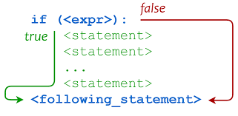
If Conditionals- Session 1
We Will learn Today:
Understanding If Conditionals.
Using if conditional statements.
Use Conditional statements & its evaluation based on different input values.
Build condition evaluation using comparison operations.

Slide 4
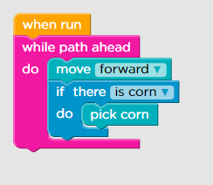
Conditional statements
• Within a method, we can alter the flow of control (the order in which statements are executed) using either conditionals or loops
• The conditional statements if, if-else, and switch allow us to choose which statement will be executed next
• Each choice or decision is based on the value of a Boolean expression (also called the condition)

Slide 5
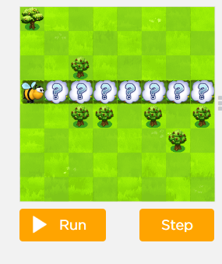
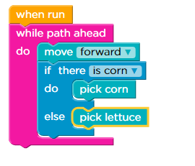
In Programming ,
Conditional statements are possible with the help of the following two constructs:
If statement
If-else statement
It is also called as branching as a program decides which statement to execute based on the result of the evaluated condition.

Slide 6
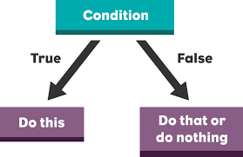
The if Statement
• The statement in the if statement can be any Programming statement such as C, C++, Java, Python, Android, C#, etc.
• A simple statement
• A compound statement, such as an if statement
• A block statement, a group of statements enclosed in braces {}
if (zip_code == 15213)
{
city = “Pittsburgh”; state = “PA”;
}

Slide 7
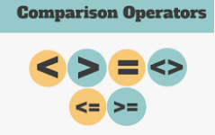
Relational/Comparison Operators:
>Greater than
< Less than
>= Greater than or Equal to
<= Less than or Equal to
== Equal to
!= Not Equal to

Slide 8
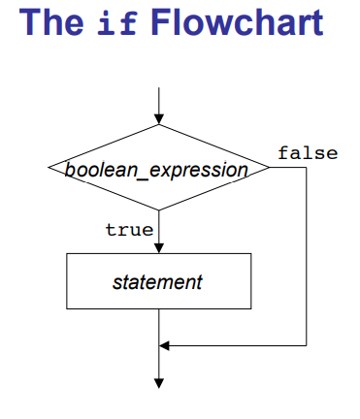

Slide 9
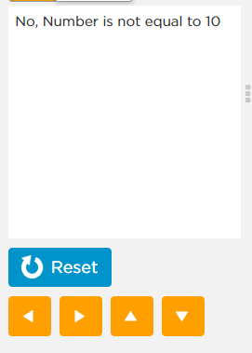
Demonstration
Here, If statement used to check whether number is equal to 15 or not.

Slide 10
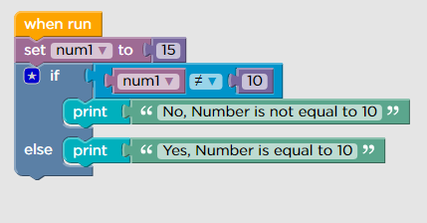
To check whether number is equal to 15 or not Coding

Slide 11
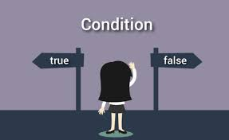
How Does the if statement work?
First the condition is evaluated.
If the result of the condition is “true”, the block of instructions is performed.
If the result of the condition is “false”, the block of the instructions is skipped(ignored).
Conclusion: the block of instructions associated to the “if” is performed only when the result of the condition is true.

Slide 12
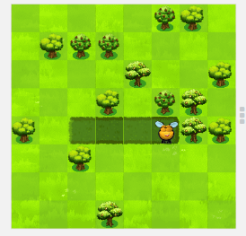
Demonstration-To Build condition evaluation using comparison operations
Here we make the sprite not to go through a object:
Here, we use “if” statement to get nectar if hidden underneath the cloud.

Slide 13
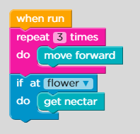
To get nectar if hidden underneath the cloud Coding

Slide 14
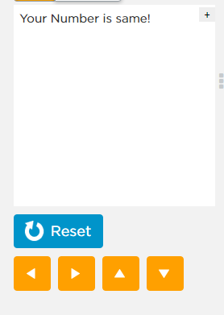
Demonstration
To Check Whether a given number is greater than or smaller than or equal to.

Slide 15
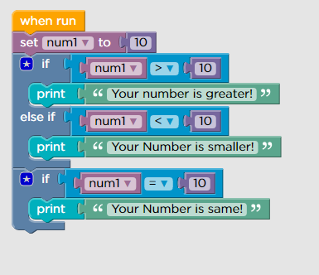
Checking Greater, Smaller or Equal Coding

Slide 16
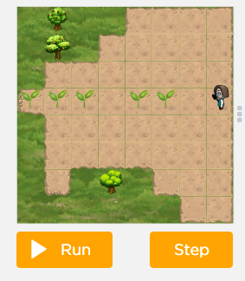
Demonstration
Each plant will have either one piece of corn, one head of lettuce, or one pumpkin.

Slide 17
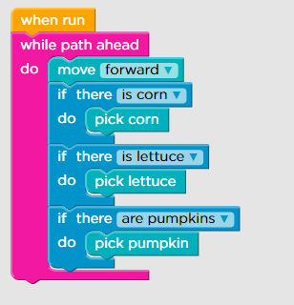
To Pick Corn or Lettuce or Pumpkin if available Coding

Slide 18

Summary
Understanding If Conditionals.
Using if conditional statements.
Use Conditional statements & its evaluation based on different input values.
Demonstration to Build condition evaluation using comparison operations.

Slide 19
Next Session
If-Else Conditionals
Using If –else Conditionals
Understand Comparison Operations
Implement decision logics

