Slide 1

BLOCK CODING DEVELOPER
Session 9
If – Else Conditionals

Slide 2

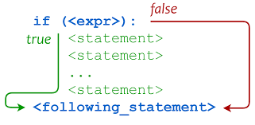
Recall
What we have learnt in last session
What challenges you are facing

Slide 3
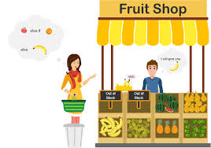
If – Else Conditionals
We Will Learn Today:
If-else Conditionals.
Using if-else conditional statements.
Use Conditional statements & its evaluation based on different input values.
Build condition evaluation using comparison operations.

Slide 4

The if-else Statement
If we want to choose between two alternative, we use the if-else statement:
if (Boolean_expression)
statement 1
else
statement 2
If the Boolean_expression evaluates to “true”, then statement1 is executed.
If the Boolean_expression evaluates to “false”, then statement2 is executed.

Slide 5
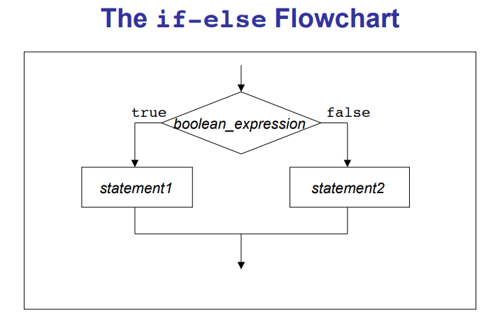

Slide 6
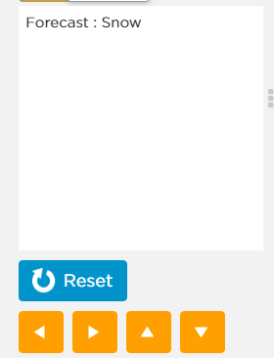
Demonstration
If-else Statement used to find the forecast

Slide 7
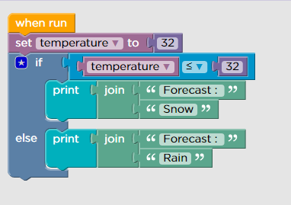
Demonstration
If-else Coding

Slide 8
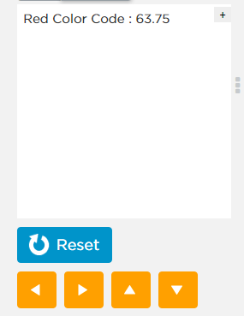
Demonstration
If-else Statement used to check whether red color code is 255 or not

Slide 9
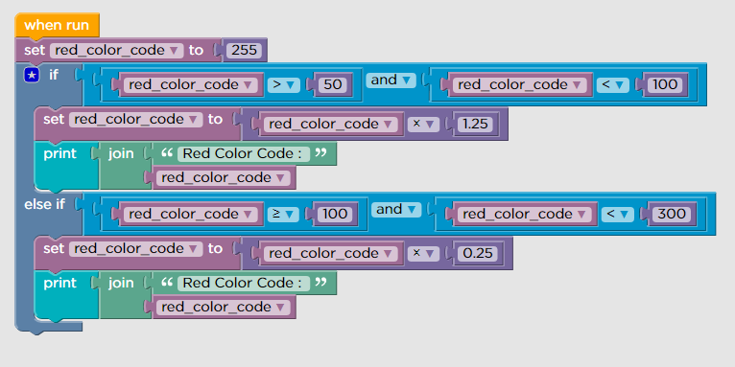
To check whether red color code is 255 or not Coding

Slide 10
Common Error 1
• When you want to test if the value of a variable is in a range.
if (0 < temperature < 100)
{
state = “LIQUID”;
} WRONG!!
if (0 < temperature && temperature < 100)
{
state = “LIQUID”;
} Correct !!

Slide 11
The Dangling else Problem
When an if statement is nested inside the then clause of another if statement, the else clause is paired with the closest if statement without an else clause.
if (x > 0)
if (y > 0)
color = “red”;
else
color = “blue”;
Misleading Indentation

Slide 12
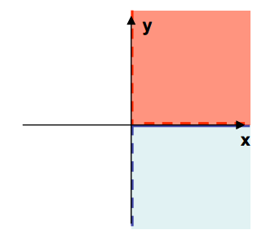
The Dangling else Problem
In reality it is:
if (x > 0)
if (y > 0)
color = “red”;
else
color = “blue”;

Slide 13
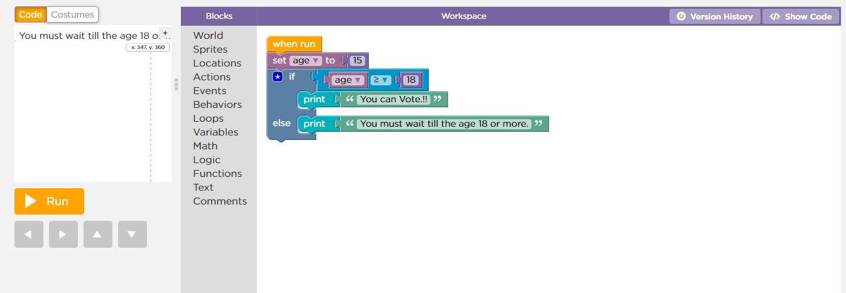
Demonstration- Build condition evaluation using comparison operations

Slide 14
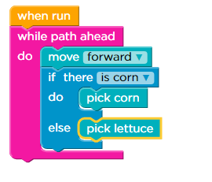
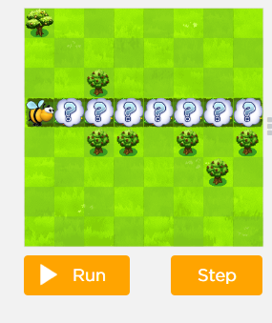
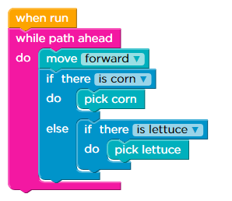
Demonstration
Each plant will have either one corn or one lettuce.
Output
Output

Slide 15
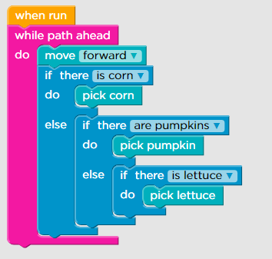
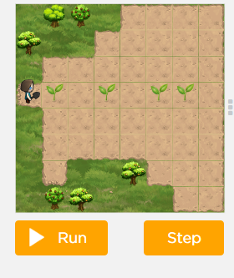
Demonstration
Each plant will have either one piece of corn, one head of lettuce, or one pumpkin.

Slide 16

Summary
Using if-else conditional statements.
Use Conditional statements & its evaluation based on different input values.
Build condition evaluation using comparison operations.

Slide 17

Next Session
Generic Custom Behaviors
Generic Custom behaviors.
Learn to apply generic custom behaviors across sprite.
Activity- Apply generic custom behaviors across sprite.
Code custom behaviors across sprites.

