Slide 1

BLOCK CODING DEVELOPER
Session 10
Generic Custom Behaviors

Slide 2

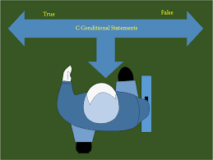
Recall
What we have learnt in last session
What challenges you are facing

Slide 3

Generic Custom Behaviors
We will learn Today:
Understanding Generic Custom behaviors
Apply generic custom behaviors across sprite
Code custom behaviors across sprites

Slide 4
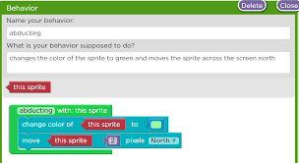
Generic Custom Behaviors
Behaviors can be created for any kind of object, and you can create custom actions and conditions associated to your new behavior.
Behaviors, as well as extensions, can be shared between projects. You can export and import them in a few clicks.

Slide 5
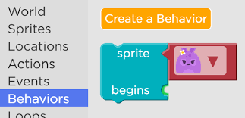
If your behavior is generic and reusable in multiple games, you can even submit it to be integrated in the growing list of custom behaviors shared by the community.
Create your game by assembling behaviors - perfect for fast prototyping
Progressively create custom behaviors for objects in your game - ideal for large games and keeping simple events.

Slide 6
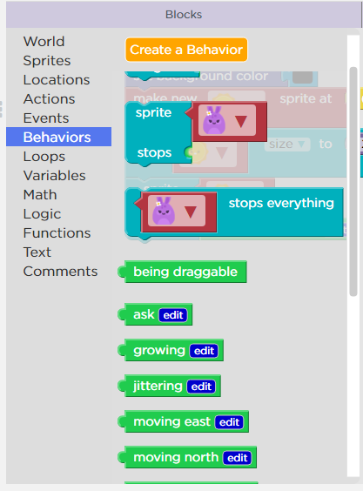
Demonstration –To Create Custom Behavior
In Sprite Lab, We Can Create Custom behavior

Slide 7
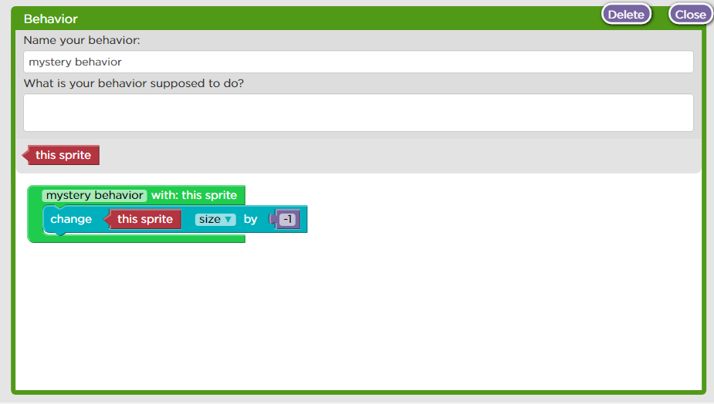
On Click of “ Create Behavior” Button, we can create our own behavior.

Slide 8
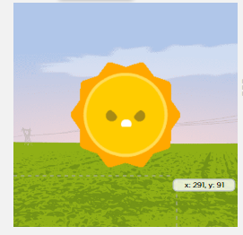
We Create Behavior of the Sun, so that it shrinks to -1

Slide 9
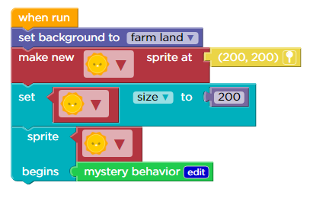
Shrinking Behavior Coding

Slide 10

Demonstration
Here, Custom Behavior for the rocket is created “flying”

Slide 11
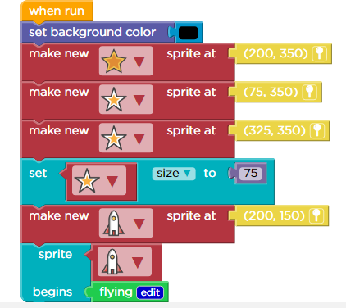
Flying Behavior Coding

Slide 12
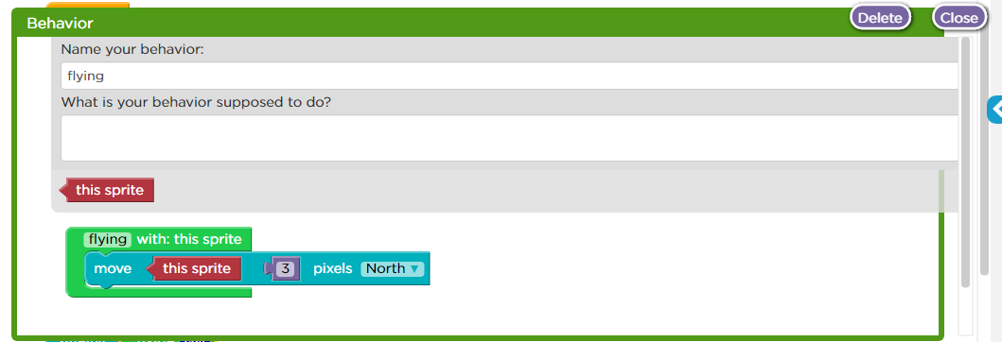
Custom Behavior –Flying Created

Slide 13
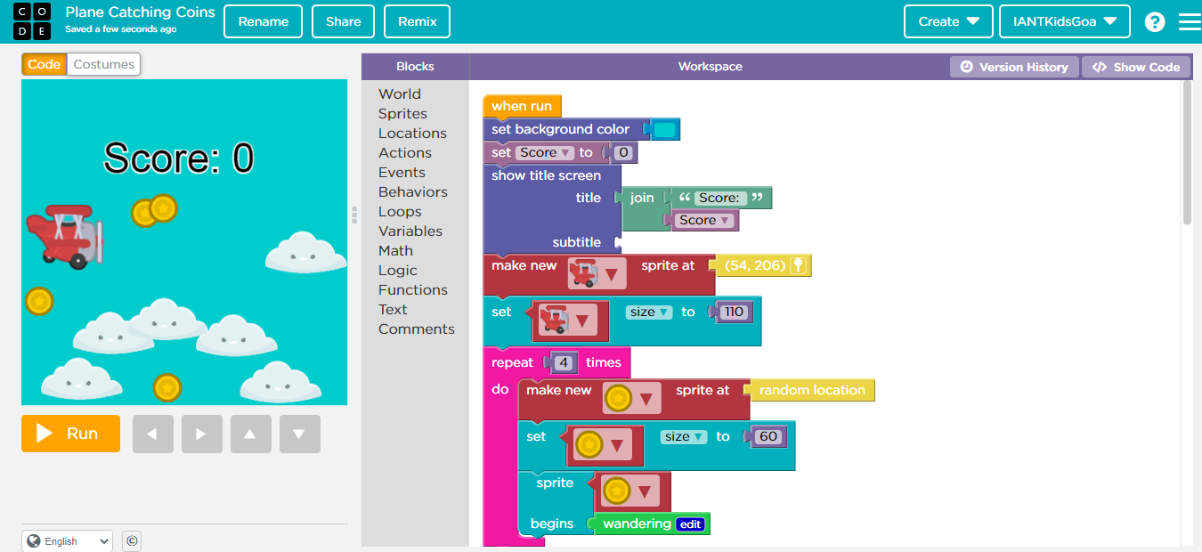
Demonstration: Air Plane Catching Gold Coins

Slide 14
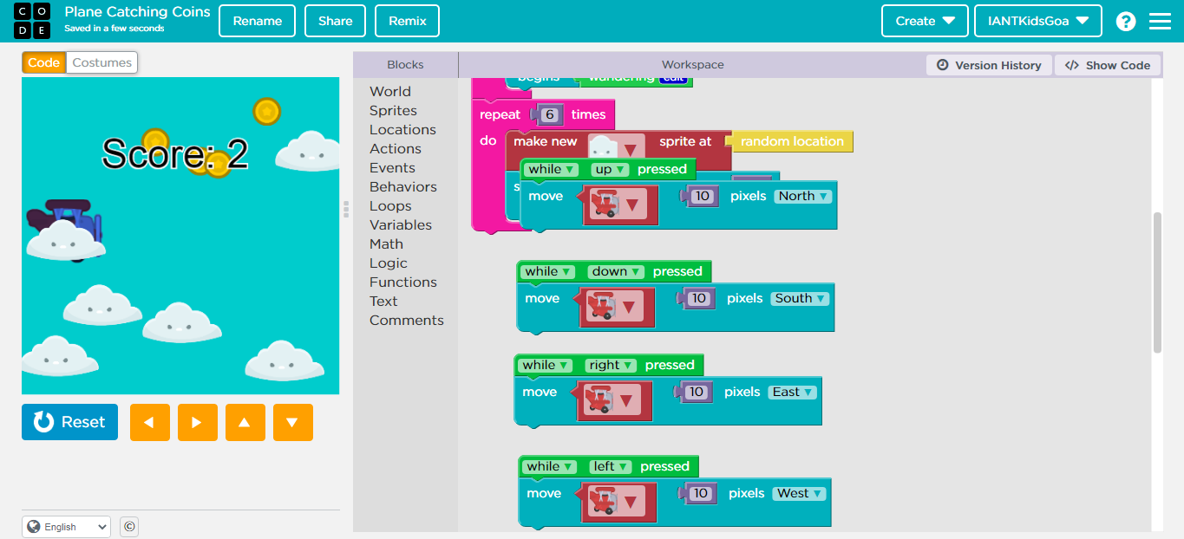

Slide 15
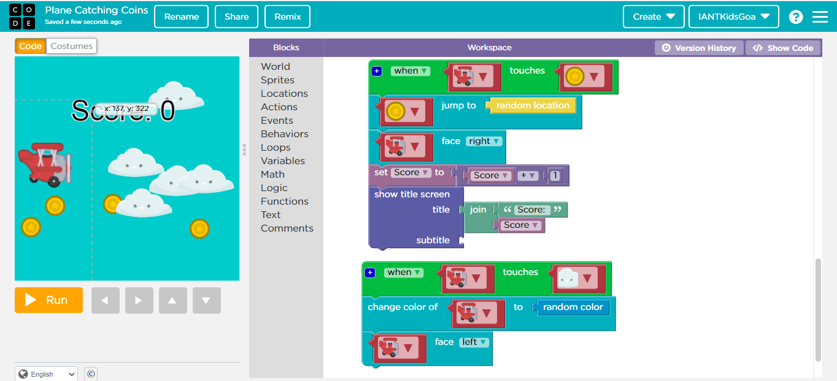

Slide 16
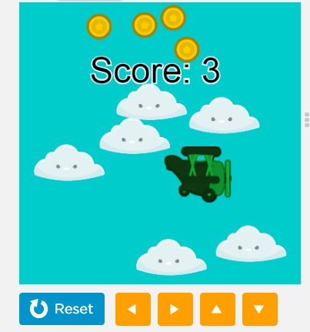
Output Screen 1:

Slide 17
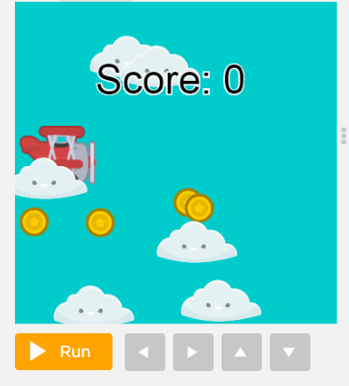
Output Screen 2:

Slide 18
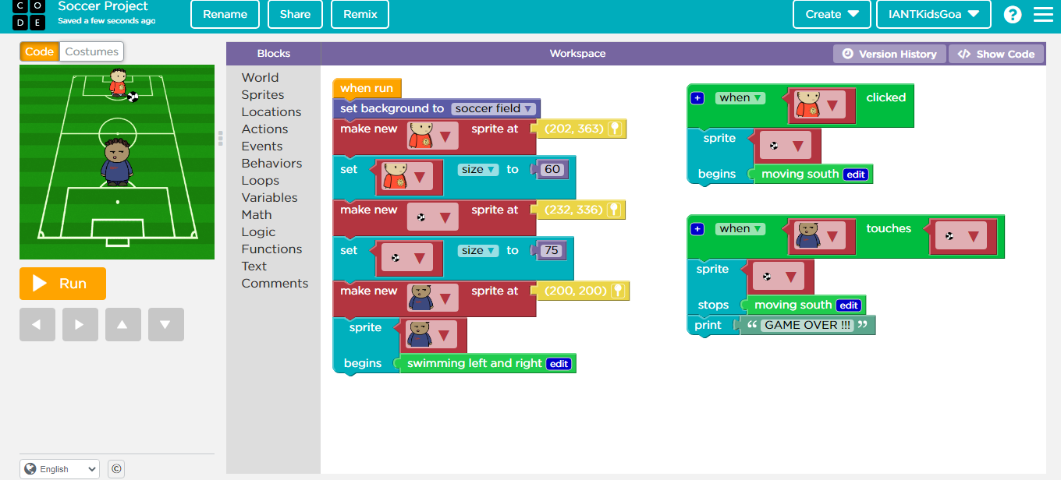
Demonstration: Soccer Player Game

Slide 19
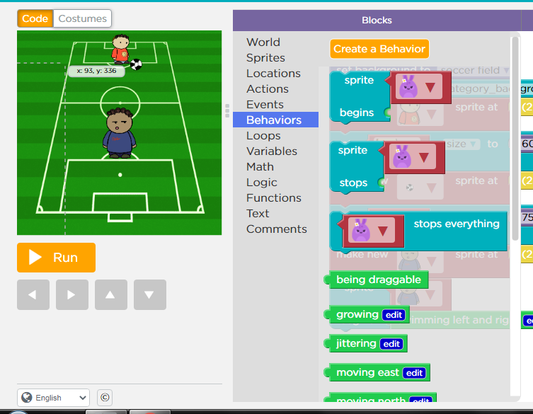
Blocks->Behaviors code used:

Slide 20
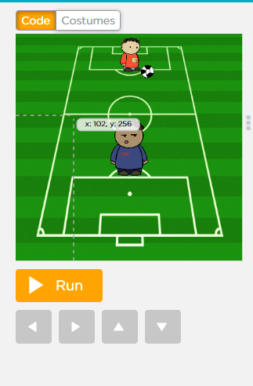
Output Screen:

Slide 21

Summary
Apply generic custom behaviors across sprite.
Code custom behaviors across sprites.

Slide 22

Thank You Happy Coding!!

