Slide 1

SCRATCH CODING LEARNER
Session 21
Decision making with codes -1

Slide 2

Recall
Understanding Generic Custom behaviors
Apply generic custom behaviors across sprite
Code custom behaviors across sprites

Slide 3
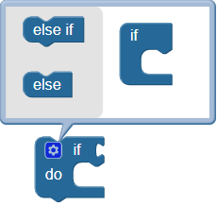
Decision making with codes – 1…
We will Learn today:
Use if statement to change
directions
Learn conditional coding

Slide 4
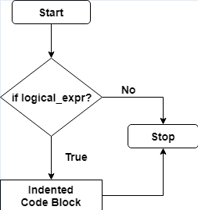
Decision making with codes – 1…
If Statement
If you are 12, raise your hand
If you like baseball, stand up

Slide 5
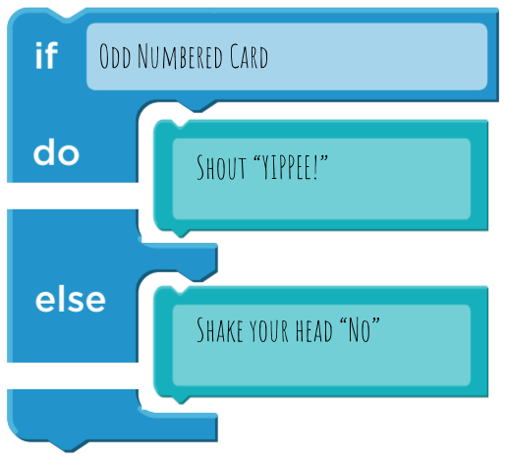
If Statement Programming View…
If ( you are 12)
{
raise your hand
}
If ( you like baseball)
{
stand up
}

Slide 6
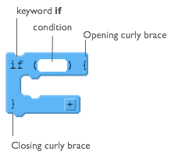
If Statement Scratch View
The If Statement
Located in the Control Menu

Slide 7
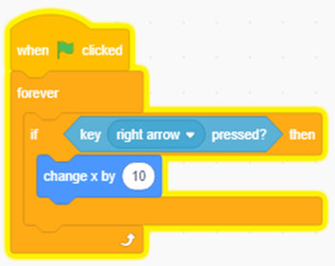
Demonstration…
Let’s create
An If Statement
Loop forever
Create an If Statement
If Key (right arrow) pressed ?
Change x by 10

Slide 8
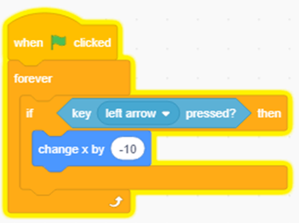
If Statement Practice…
Let’s create
An If Statement
Loop forever
Create an If Statement
If Key (left arrow) pressed ?
Change x by -10

Slide 9
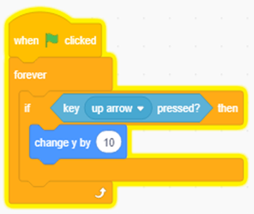
If Statement Practice…
Let’s create
An If Statement
Loop forever
Create an If Statement
If Key (UP arrow) pressed ?
Change x by -10

Slide 10
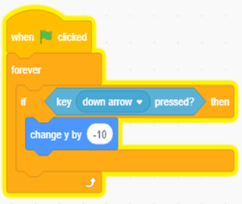
Demonstration…
Let’s create
An If Statement
Loop forever
Create an If Statement
If Key (Down arrow) pressed ?
Change x by -10

Slide 11
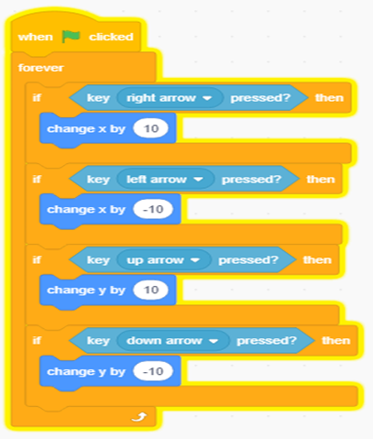
If Statement Practice…
Use blocks to create a IF program

Slide 12
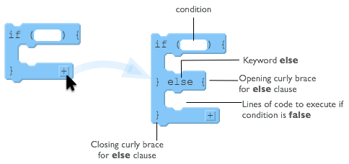
If Else Statement
If ( you are 11 )
{
raise your hand
}
Else
{
stand up
}

Slide 13
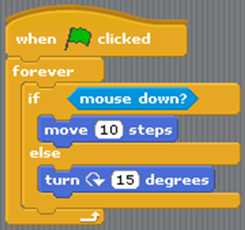
If Else Statement Practice
Loop forever
If the mouse is clicked
Move 10 steps
Else
Turn 15 degrees

Slide 14
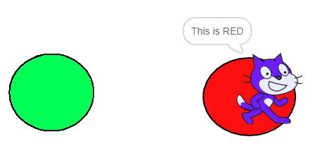
Now It’s your turn?....
Create an animation using if-else block
Use size or color, or shape

Slide 15
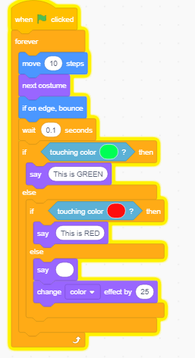
Now It’s your turn?....
Sample Animation with block programming

Slide 16

Summary…
Use if statement to change
directions
Learn conditional coding

Slide 17
Next Session…
Decision making with codes - 2
Conditional coding in apps to create to evaluate outcomes, decision making capabilities.
Use if-else statement to evaluate outcomes.
Make never ending game

